Slide 1
Dijkstra’s Algorithm
Dayne Guy
Nhi Nguyen
Thy Tran
Joao Luiz Dal Cortivo

Slide 2
What is Dijkstra's algorithm?
Dijkstra's algorithm is a fundamental algorithm in computer science, named after Dutch computer scientist Edsger W. Dijkstra.
It is used to find the shortest path between two vertices in a weighted graph.
Widely applied in various fields, such as network routing protocols, transportation systems, and robotics.
Essential for solving problems where finding the optimal path is crucial, minimizing costs or time.
Examples of real-world applications include GPS navigation systems, network routing protocols (like OSPF), and logistics planning in transportation.

Slide 3
How does Dijkstra’s Algorithm works?
Dijkstra's Algorithm starts from a source vertex and explores the neighboring vertices in a greedy manner.
It maintains a priority queue to keep track of the vertices with the shortest distance from the source.
At each step, it selects the vertex with the minimum distance and adds it to the set of visited vertices.
The algorithm continuously updates the distances of the remaining vertices based on the selected vertex.
This process repeats until all vertices are visited or the destination vertex is reached.

Slide 4
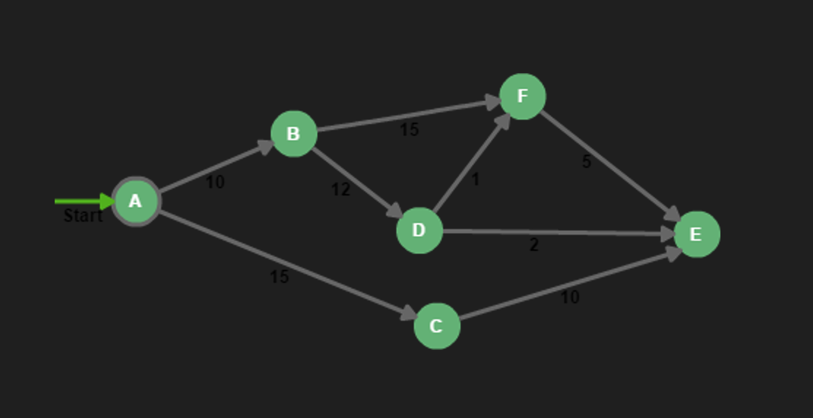
Steps
1. Initialization:
Set the distance of the starting vertex to 0 and the distances of all other vertices to infinity.
Mark all nodes as unvisited.
Create an empty priority queue to keep track of vertices based on their tentative distances.
2. Iterative Process: Repeat the following steps until all vertices are visited or the destination vertex is reached.
3. Select the Current Node:
Choose the unvisited vertex with the smallest tentative distance as the current vertex.
Initially, the starting vertex is selected with a distance of 0.

Slide 5
Steps
4. Update Neighbors: For each neighbor of the current vertex that is still unvisited:
Calculate the tentative distance from the starting vertex to this neighbor through the current vertex.
If the calculated distance is smaller than the recorded distance for this neighbor, update the recorded distance.
5. Mark Current Vertex as Visited:
Once all neighbors are examined, mark the current vertex as visited.
This means its tentative distance is finalized.
6. Repeat: Repeat steps 3-5 until the destination vertex is visited or until all vertices are visited.
7. Result:
The algorithm terminates when all vertices are visited, or the destination vertex is reached.
The recorded distances represent the shortest paths from the starting vertex to all other vertices in the graph.

Slide 6
Code

Slide 7
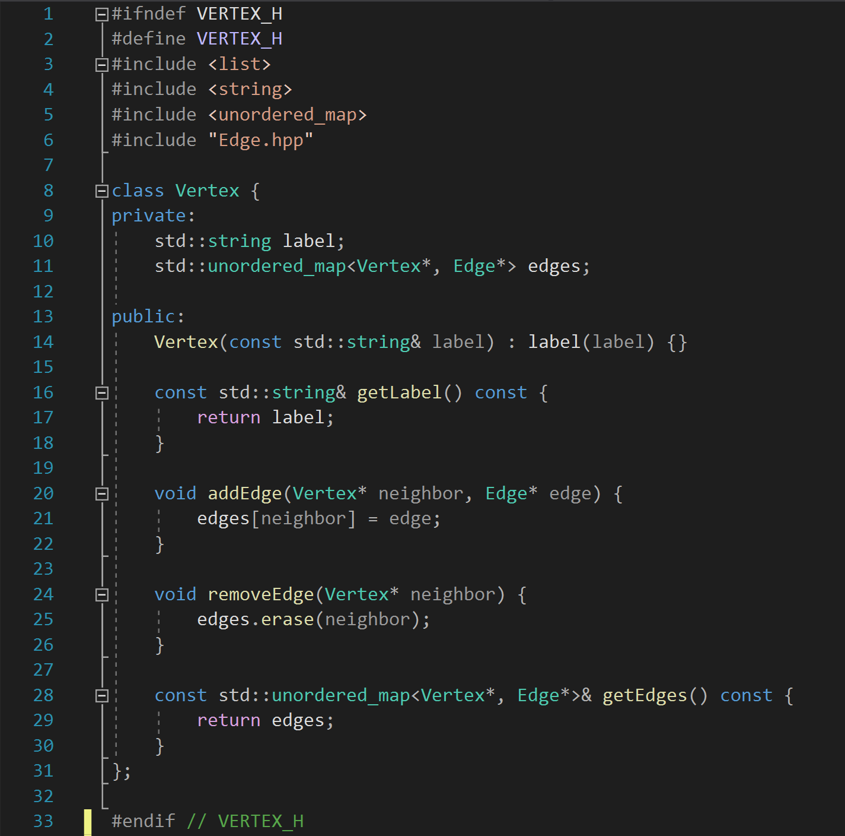
Vertex.hpp

Slide 8
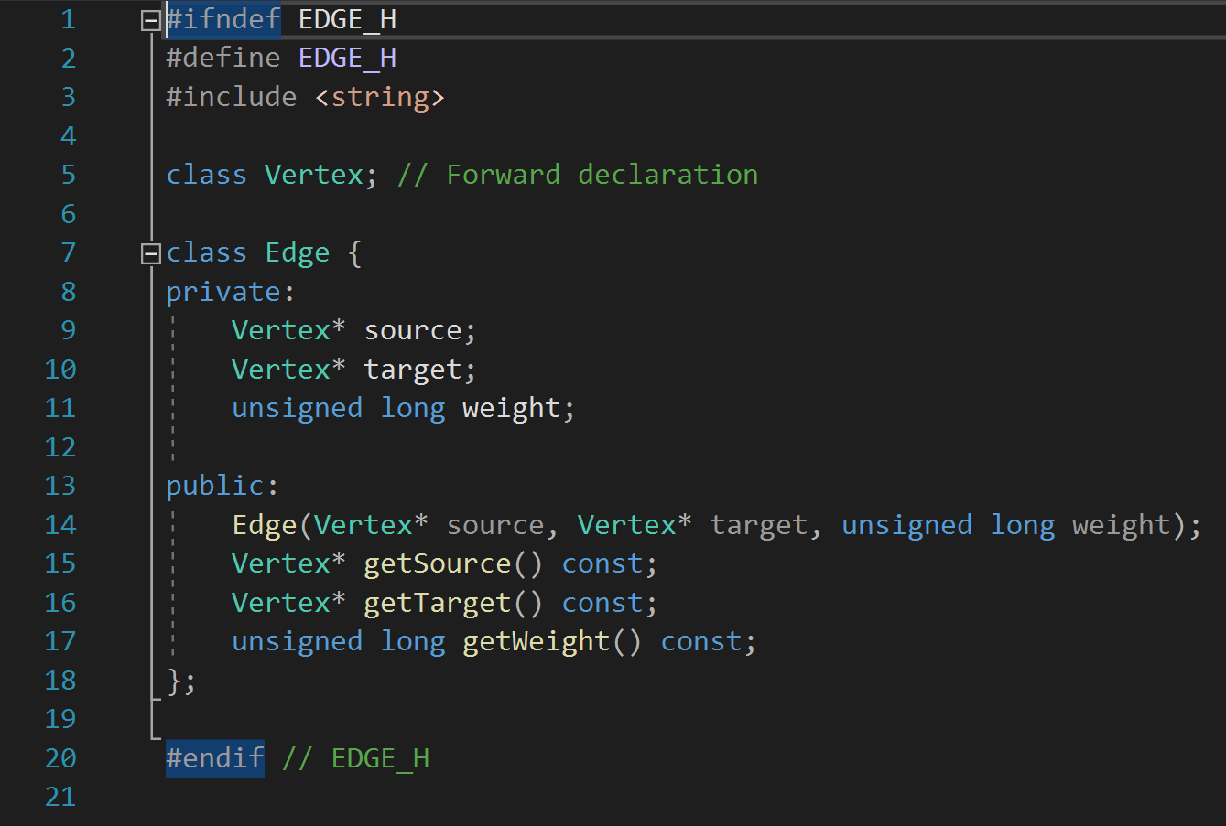
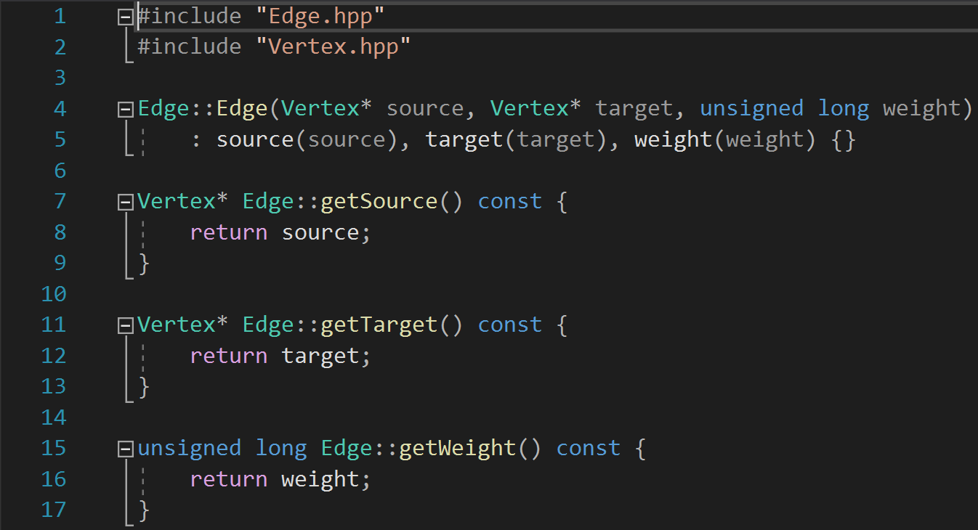
Edge.hpp
Edge.cpp

Slide 9
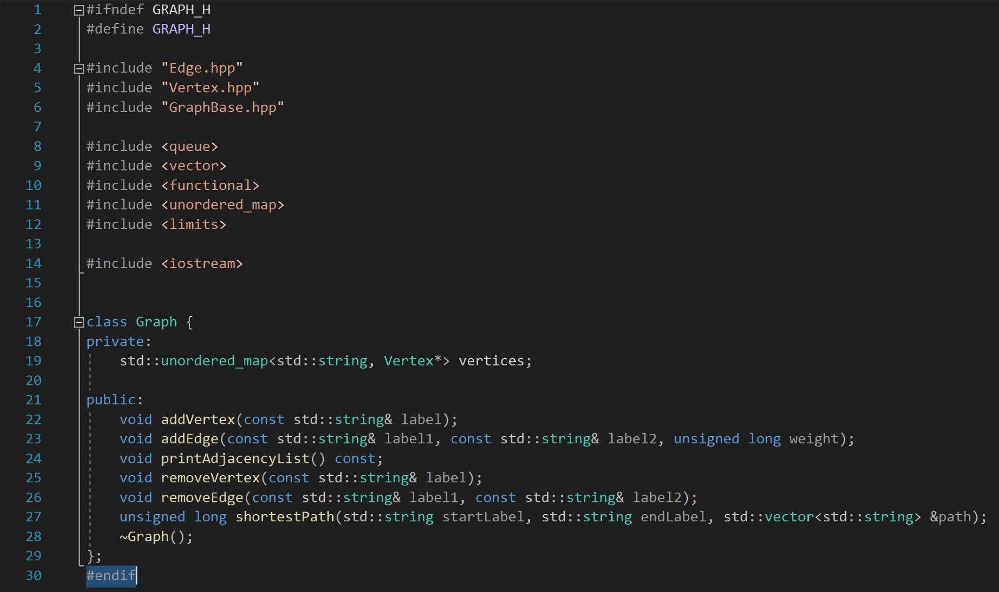
Graph.hpp

Slide 10
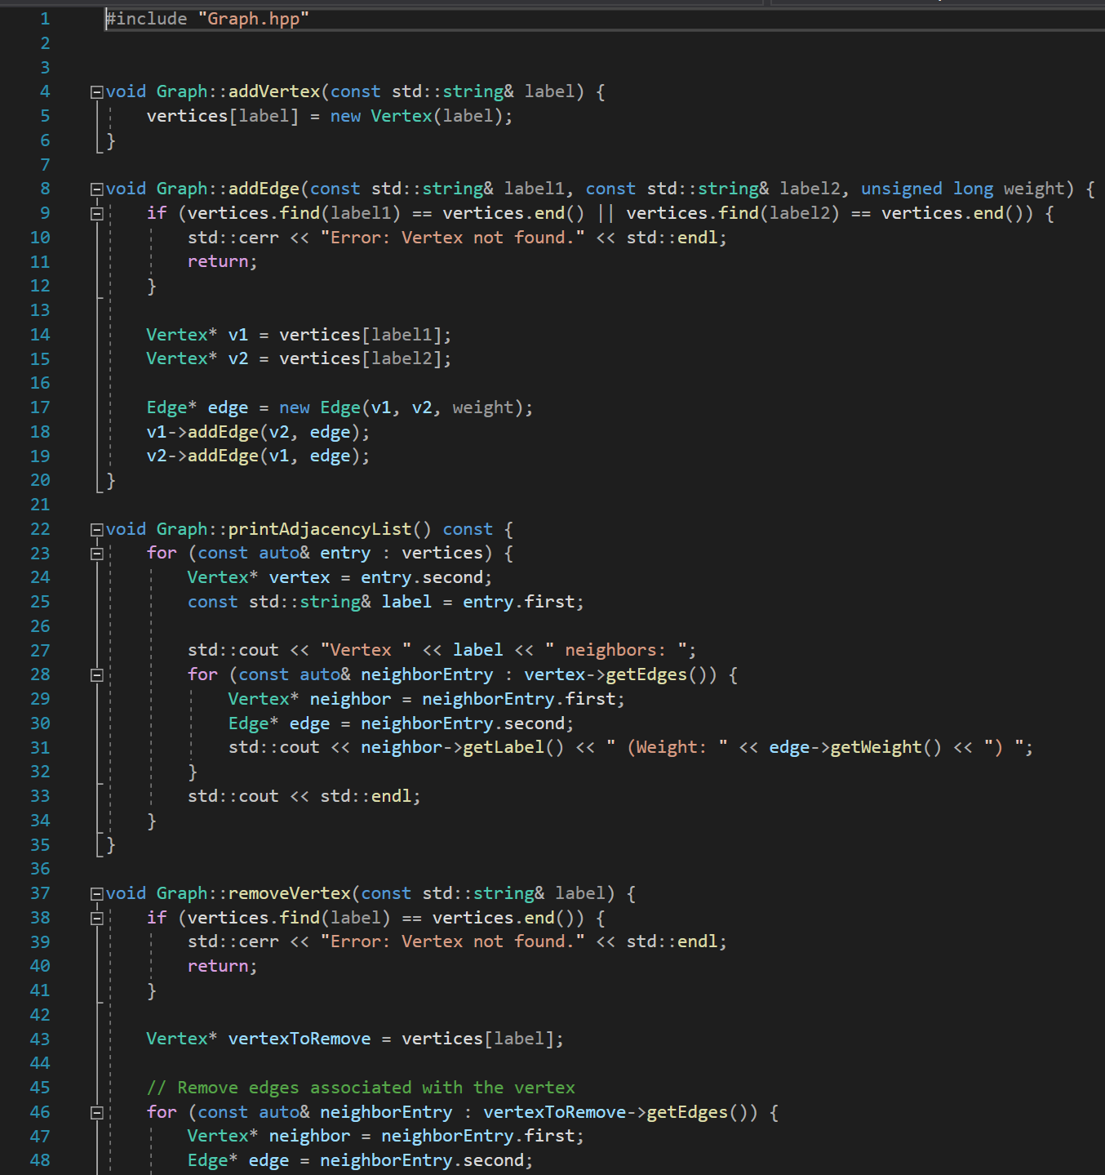
Graph.cpp

Slide 11
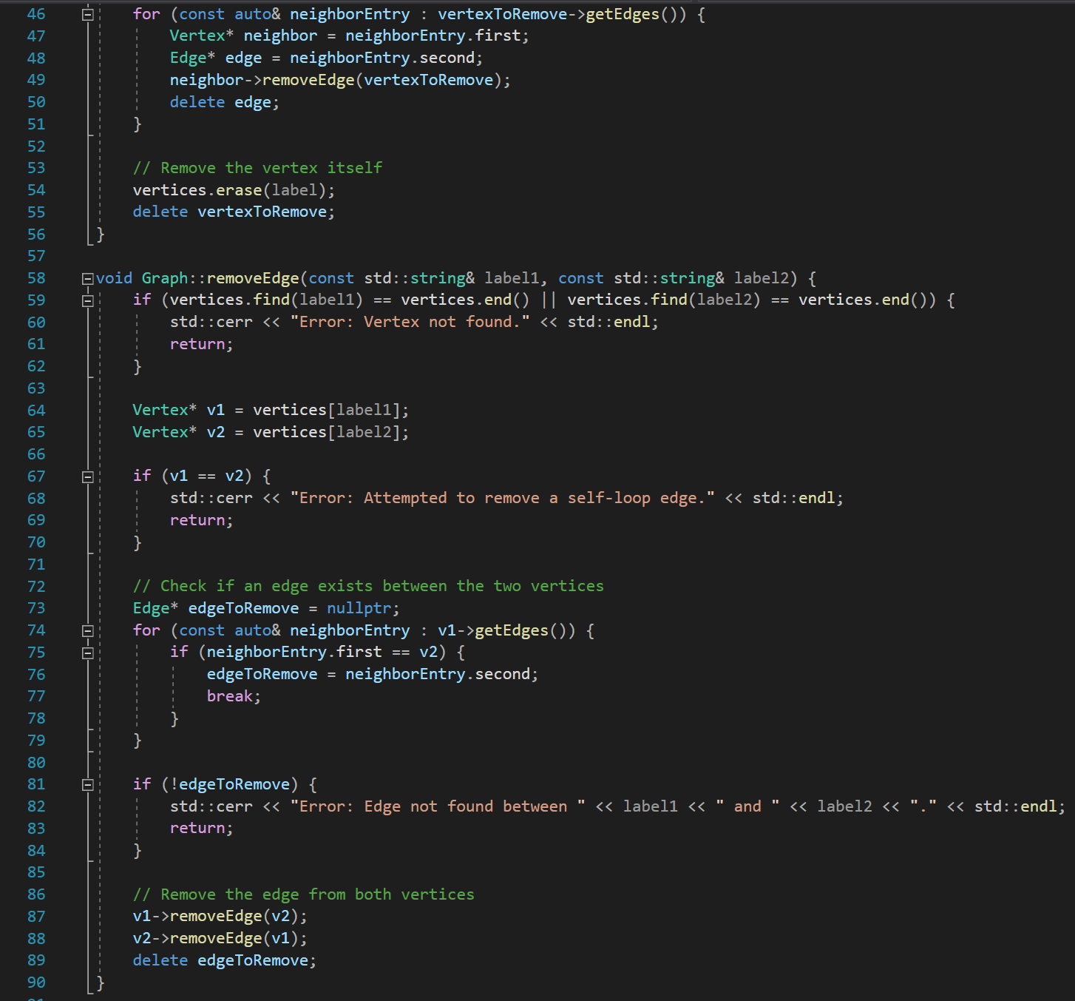
Graph.cpp

Slide 12
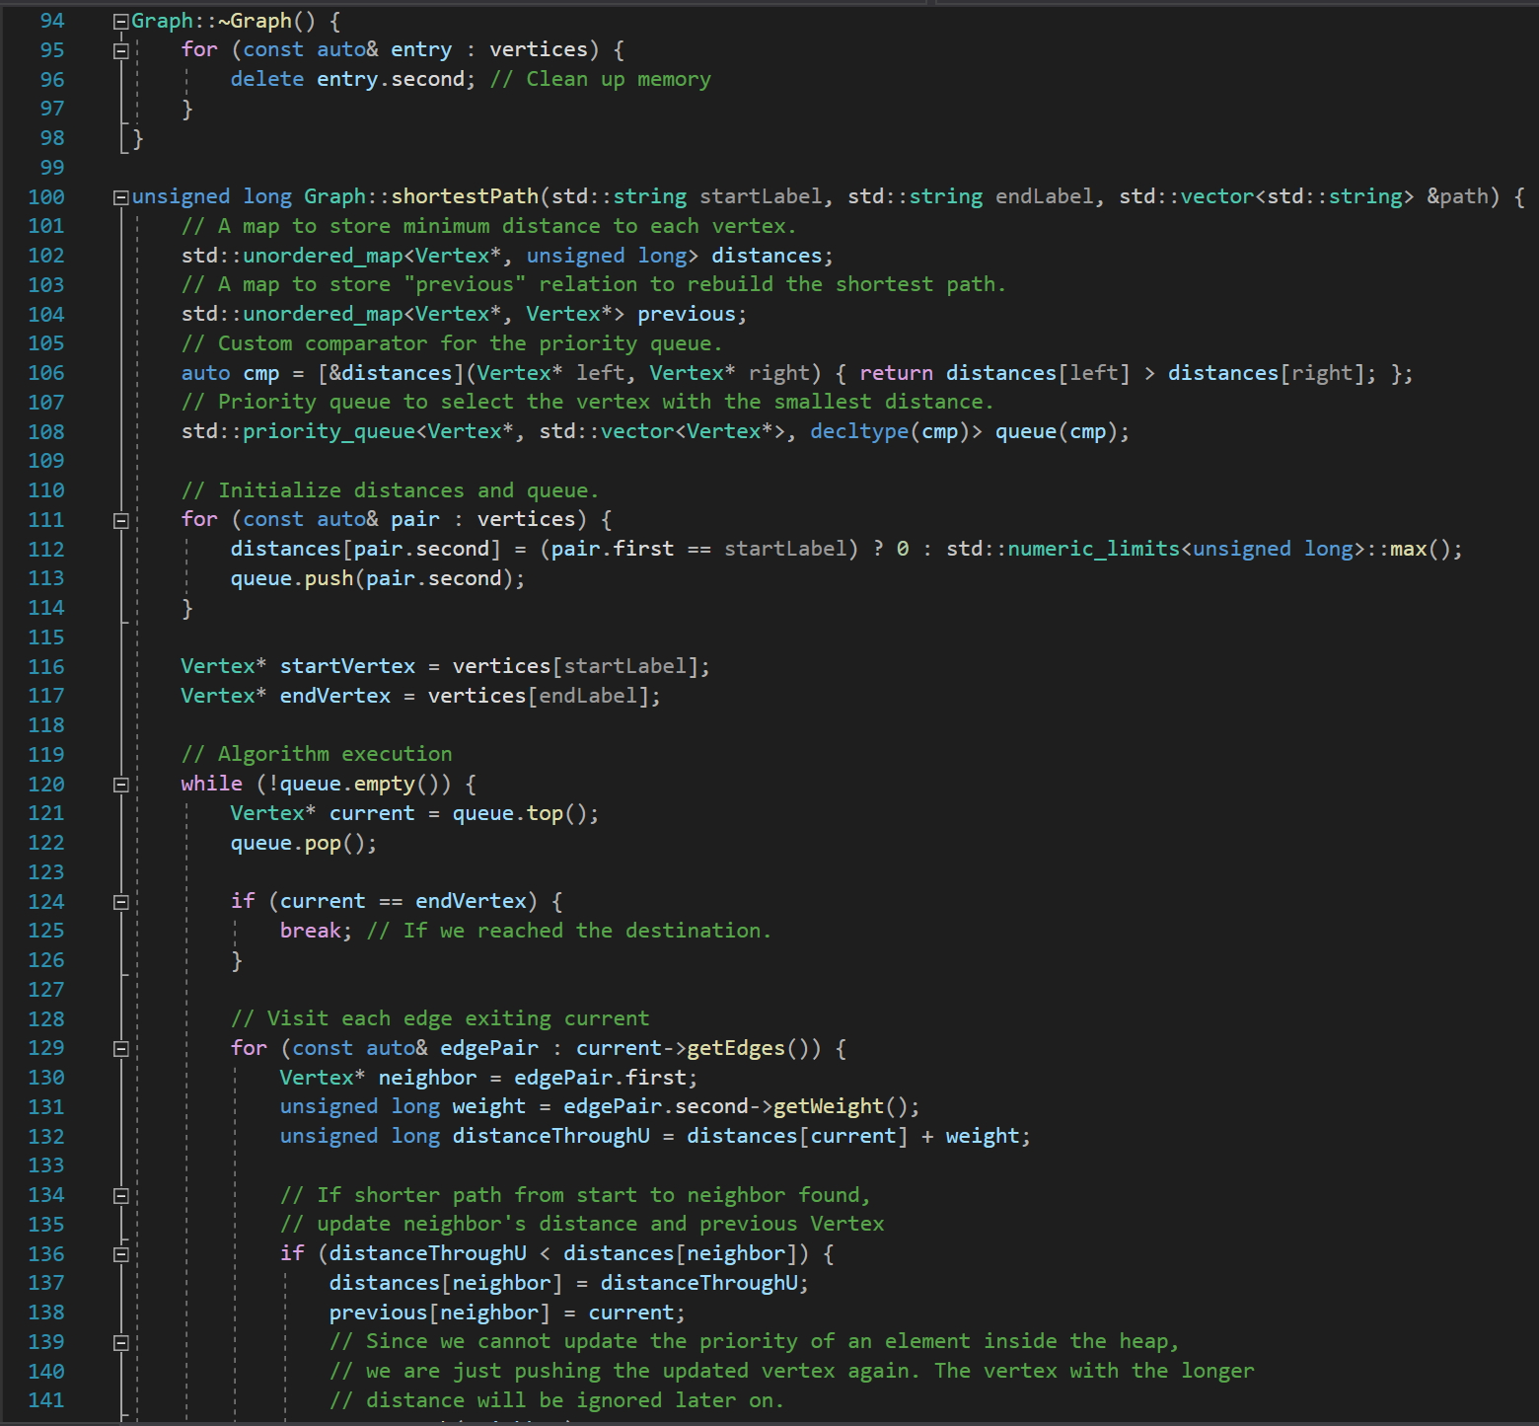
Graph.cpp

Slide 13
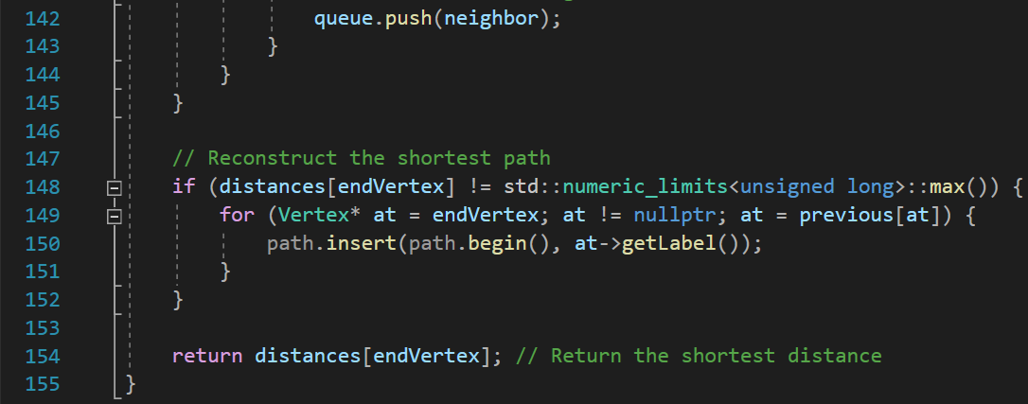
Graph.cpp

Slide 14
Advantages and Limitations
Advantages of Dijkstra's Algorithm:
It guarantees the shortest path if the graph has non-negative edge weights.
It is efficient for finding the shortest path from a single source to all other vertices.
It can handle graphs with millions of vertices and edges efficiently.
Limitations of Dijkstra's Algorithm:
It does not work for graphs with negative edge weights.
It does not handle graphs with cycles or disconnected components.
It may not find the most optimal path if the graph has negative edge weights.

Slide 15
Conclusion
Dijkstra's Algorithm is a powerful tool for finding the shortest path in a graph.
Understanding its principles and limitations is essential for solving various optimization problems.
By applying Dijkstra's Algorithm, we can efficiently solve routing problems, network optimization, and more.

Slide 16
Thank you for your time and attention 🙂

