Slide 1
TruckBeez SDLC Documentation
Web + Mobile · 12 documents from charter to operations
Kitchnow LLC · Prepared by Dayo Sodimu · v0.1 Draft · November 2026
Notes:
TruckBeez is a truck-safe, hazmat-aware navigation app with a fleet web dashboard, built by Kitchnow LLC. This deck summarises the 12 SDLC documents; the full detail is in the Word file.

Slide 2
Twelve documents cover every SDLC phase
≡
Initiation
Requirements
Design
Testing
Deployment
Maintenance
01 Charter
02 BRD
03 SRS
04 Architecture
05 UI/UX
06 API
07 Database
08 Strategy & plan
09 Test cases
10 RTM
11 Deployment & release
12 Operations
Requirement IDs (BR → FR/NFR → screen/API/table → test case) link every document; the RTM keeps them in sync.

Slide 3
Core stack is decided; four choices still need sign-off
★
Decided
Expo (React Native) app, iOS + Android
Express + Socket.IO API (not NestJS)
Phase 1: owner-operators + hazmat carriers
B2B fleet subscription for tracking & reports
Battery budget ≤ 7% per hour navigating
Docker: unit, staging, pre-prod, production
Appium mobile E2E · Asana + Jira + GitHub
HubSpot marketing, goal = app installs
Assumed — confirm before baseline
Next.js web dashboard
PostgreSQL + PostGIS, Redis
AWS ECS Fargate hosting
Stripe billing; $15 / $25 per driver plans
Open decision
Routing provider: HERE vs Trimble PC*MILER (spike, due Dec 2026)

Slide 4
Project Charter: public launch targeted for May 2027
01
50k
150
≤7%/h
0
installs in 12 months
paying fleet accounts
battery while navigating
confirmed unsafe routes
M1 | M2 | M3 | M4 | M5 | M6 | M7
Reqs baselined | Routing provider chosen | Design baselined | MVP complete | Closed beta | Public launch v1.0 | B2B GA
Nov 2026 | Dec 2026 | Dec 2026 | Mar 2027 | Apr 2027 | May 2027 | Jun 2027
Top risks: routing licence cost, restriction-data errors, battery drain, background-location store review. Targets marked as assumptions in the charter.

Slide 5
BRD: free driver app, paid fleet subscriptions
02
Driver
Free
Navigation, hazmat routing, hazard reports
Fleet Starter
$15 / driver / mo
Live map, 90-day history, CSV reports, ≤ 25 drivers
Fleet Pro
$25 / driver / mo
Starter + compliance alerts, geofences, API, 1-year history
Enterprise
Custom
SSO, SLA, dedicated support, unlimited history
12 business requirements (10 Must) and 5 business rules, including:
Truck-legal and hazmat-legal routing for every driver (BR-01, BR-02)
Fleet tracking only with driver consent and only while on duty (BR-06, BRULE-02)
Unpaid fleets get 14 days' grace, then tracking pauses; drivers keep free navigation (BRULE-04)

Slide 6
SRS: 29 functional and 13 non-functional requirements
03
15
9
5
13
mobile requirements (FR-M)
web requirements (FR-W)
API / platform (FR-A)
non-functional (NFR)
NFR | Target
Route calculation | p95 ≤ 3 s; reroute ≤ 5 s
Scale | 20,000 concurrent drivers at launch, 100,000 in 12 months
Availability / reliability | API 99.9% uptime; crash-free sessions ≥ 99.5%
Security / privacy | OWASP ASVS L2 + MASVS L1; CCPA/CPRA; consent before tracking
Safety / accessibility | Typing locked while driving; WCAG 2.1 AA web

Slide 7
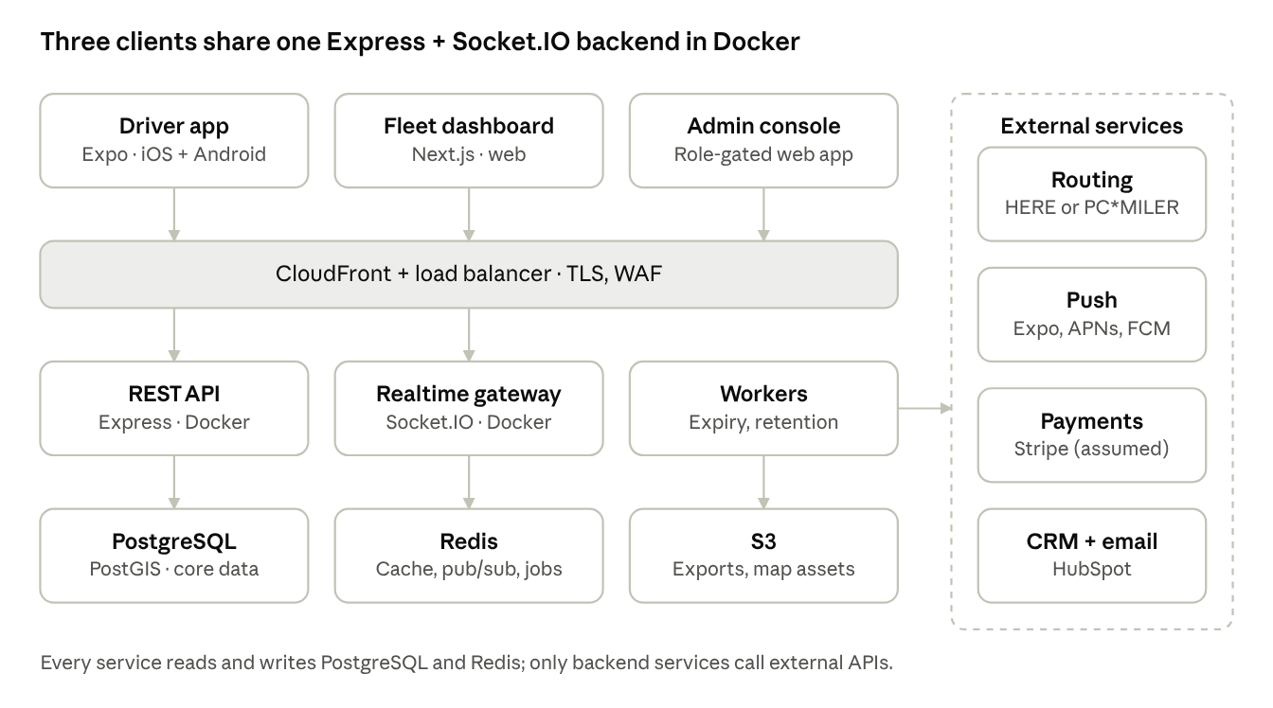
Architecture: one Docker backend serves three clients
04
Routing hidden behind a RoutingProvider interface — HERE or PC*MILER swaps without app changes
Live location every 5 s on duty, fanned out through Socket.IO + Redis
JWT + RBAC, TLS, WAF, secrets in AWS Secrets Manager
Adaptive GPS sampling to hold the 7%/h battery budget

Slide 8
UI/UX: built for a glance at highway speed
05
Glanceable
Next turn, distance and ETA readable in under 2 s
Hands-light
Hazard report in ≤ 2 taps or voice; no typing > 5 mph
Truck-first
Truck profile and hazmat class always on the route summary
Accessible
WCAG 2.1 AA; 64 pt targets in driving mode
Consistent
One design system across mobile and web
12
7
Each screen ID maps to one Figma frame and to the requirements it satisfies, so design, dev and QA share the same references.
mobile screens (M-S01 – M-S12)
web screens (W-S01 – W-S07)

Slide 9
API: versioned REST plus Socket.IO, one JWT
06
Area | Key endpoints
Auth | POST /auth/otp/request · /otp/verify · /oauth/{provider} · /refresh
Routing | POST /routes · /routes/{id}/reroute · GET /places/search
Hazards | GET /hazards?bbox= · POST /hazards · /hazards/{id}/votes
Fleets | POST /fleets · /fleets/{id}/invites · GET /drivers/live · POST /reports
Billing / admin | POST /billing/checkout · /webhooks/stripe · /admin/*
Realtime events
location:update · hazard:report
hazard:new · hazard:expired
fleet:position · fleet:alert
Conventions
Cursor pagination · idempotency keys
120 req/min, 20 routes/min per user
OpenAPI 3.1 is the contract of record

Slide 10
Database: PostgreSQL + PostGIS is the system of record
07
Identity
users · auth_identities · refresh_tokens
Data | Retention
Free-driver locations | 30 days
Fleet locations | 90 days Starter · 1 yr Pro
Hazards | 30 days after expiry
Audit log | 2 years
Deleted accounts | Purged within 30 days
Trucks & trips
trucks · hazmat_profiles · trips · routes · location_points (monthly partitions)
Community
hazards · hazard_votes
Fleet & billing
fleets · fleet_members · invites · duty_sessions · geofences · alerts · subscriptions · audit_log

Slide 11
Test strategy: quality is gated in CI at every level
08
Level | Tool | Runs
Unit + integration | Jest, Supertest, Testcontainers | Every PR
API contract | OpenAPI contract tests + Postman/Newman | Every PR
Web E2E | Playwright (TypeScript), 3 browsers | PR smoke, nightly full
Mobile E2E | Appium 2 + WebdriverIO, real-device cloud | Nightly + RC
Performance | k6 — 20k concurrent drivers | Before each release
Accessibility / security | axe-core, VoiceOver/TalkBack, ZAP, MobSF | Nightly / weekly
Battery + field | 60-min drive sim; beta drivers | Each RC / beta
Routing safety set
50+ origin–destination pairs with known low bridges, weight limits and hazmat tunnels.
Every release must avoid all of them for the given truck and hazmat class. Any failure blocks the release.

Slide 12
A release ships only when every exit criterion is met
08
≥ 98%
0
100%
P1 test cases passed (100% executed)
open Sev-1 / Sev-2 defects
routing safety set passed
≤ 3 s
≤ 7%/h
≥ 99.5%
route p95 at target load
battery on reference devices
crash-free beta sessions, 7 days
Sign-off by QA lead and product owner is recorded in Jira. Sev-1 (e.g. a hazmat route through a restricted tunnel) is hotfixed within 24 h.

Slide 13
Test cases: 31 baseline cases, most automated
09
18
9
4
3
mobile cases (Appium)
web cases (Playwright)
API + load cases
manual-only cases
ID | Critical case | Expected result
TC-M-005 | Route avoids a known low bridge | No option uses the bridge
TC-M-006 | Hazmat class 3 avoids a category D tunnel | Route detours; hazmat chip shown
TC-M-009 | Reroute after leaving the route | New route ≤ 5 s
TC-M-014 | No tracking while off duty | No location updates sent
TC-W-007 | Unpaid fleet auto-pause | Tracking paused after 14 days

Slide 14
Traceability: 24 of 29 functional requirements covered
10
5 gaps to close before the M5 beta
FR-M-10 — truck stops and parking along the route
FR-M-13 — 30-day trip history
FR-M-14 — push notifications
FR-W-05 — compliance alerts (Pro plan)
FR-W-06 — geofences (Could; or defer with sign-off)
Plus: retention purge and HubSpot event tests for the 3 partial items

Slide 15
Deployment: one image promoted through four environments
11
Unit / CI
Every PR
Staging
Merge to main
Pre-production
RC tag · QA approval
Production
Blue/green · QA + product
Mobile release (Expo EAS)
EAS Build → TestFlight / Play internal → EAS Submit
Staged rollout 1% → 10% → 50% → 100% over 7 days
OTA hotfixes for JavaScript-only fixes
Force-update for Sev-1 safety bugs
Rollback
API / realtime: blue/green switch-back < 5 min
Web: previous image < 10 min
Mobile JS: previous EAS Update < 15 min
Database: forward-fix; point-in-time restore for data loss

Slide 16
Operations: 99.9% uptime; unsafe routes are always Sev-1
12
99.9%
≤ 5 s
15 min
5 days
monthly API uptime
live map freshness
Sev-1 incident lead
to blameless postmortem
Severity | Example | Response
Sev-1 | API down; unsafe hazmat route; data breach | Page on-call now; updates every 30 min
Sev-2 | Live map stale; reroute failing on one platform | Within 1 h; updates every 2 h
Sev-3 | Report export slow | Next business day
Runbooks cover routing outage, unsafe-route reports, Socket.IO storms, DB load, bad mobile releases and failed deploys.

Slide 17
Next steps
1. Confirm assumptions: Next.js, PostgreSQL/PostGIS, AWS, Stripe, plan pricing
2. Close the routing spike: HERE vs Trimble PC*MILER (M2, Dec 2026)
3. Write test cases for the 5 RTM gaps before the beta
4. Approve documents 01–03 to baseline requirements (M1)

