Slide 1
Agent 365: pilot the control plane first
Bottom line: use Agent 365 as the control plane for one accountable pilot; verify ownership, access, action traces, licenses, and preview limits before scaling.
DECISION Pilot one accountable agent before scaling governance.
agent-365-2026-03-am-michael-kokoro-onnx
1 / 6
Notes:
Agent 365: pilot the control plane first
Bottom line: use Agent 365 as the control plane for one accountable pilot; verify ownership, access, action traces, licenses, and preview limits before scaling.
Bottom line: use Agent 365 as the control plane for one accountable pilot; verify ownership, access, action traces, licenses, and preview limits before scaling.
Agent 365 is the control plane for AI agents. Ask who owns each one, where it runs, what it can reach, who it affects, and what risk needs action.
Observe with a registry, activity, and health first. Add telemetry so each request, model step, tool call, and error has a trace for operators, not guesswork.
Govern and secure access as one path. Pair lifecycle review, Entra controls, Purview data checks, and Defender signals for every agent before wider rollout.
Keep the current agent and add only needed SDK pieces. Pilot one owned use case, verify licenses and preview limits, then scale only from evidence and review.
Evidence: Agent 365 is a centralized control plane for observing, governing, and securing AI agents. [ev-01] Microsoft Agent 365 - Service Descriptions
Evidence: Observation should pair agent inventory with audited traces for interactions, inference events, and tool usage. [ev-03] Microsoft Agent 365 overview
Evidence: Governance and security connect lifecycle controls, Entra permissions, Purview protection, and Defender detection. [ev-05] Microsoft Agent 365 overview
Evidence: SDK integration extends existing agents with enterprise capabilities without creating or hosting the agent. [ev-07] Microsoft Agent 365 SDK and CLI
Evidence: A pilot must verify prerequisites, licenses, preview limits, and telemetry before scaling. [ev-09] Quickstart: Connect an Existing Agent to Agent 365
Citations
[ev-01] Microsoft Agent 365 - Service Descriptions
[ev-02] Microsoft Agent 365 overview
[ev-03] Microsoft Agent 365 overview
[ev-04] Microsoft Agent 365 SDK and CLI
[ev-05] Microsoft Agent 365 overview
[ev-06] Microsoft Agent 365 overview
[ev-07] Microsoft Agent 365 SDK and CLI
[ev-08] Microsoft Agent 365 SDK and CLI
[ev-09] Quickstart: Connect an Existing Agent to Agent 365
[ev-10] Quickstart: Connect an Existing Agent to Agent 365
[ev-11] Quickstart: Connect an Existing Agent to Agent 365
[ev-12] Microsoft Agent 365 - Service Descriptions

Slide 2
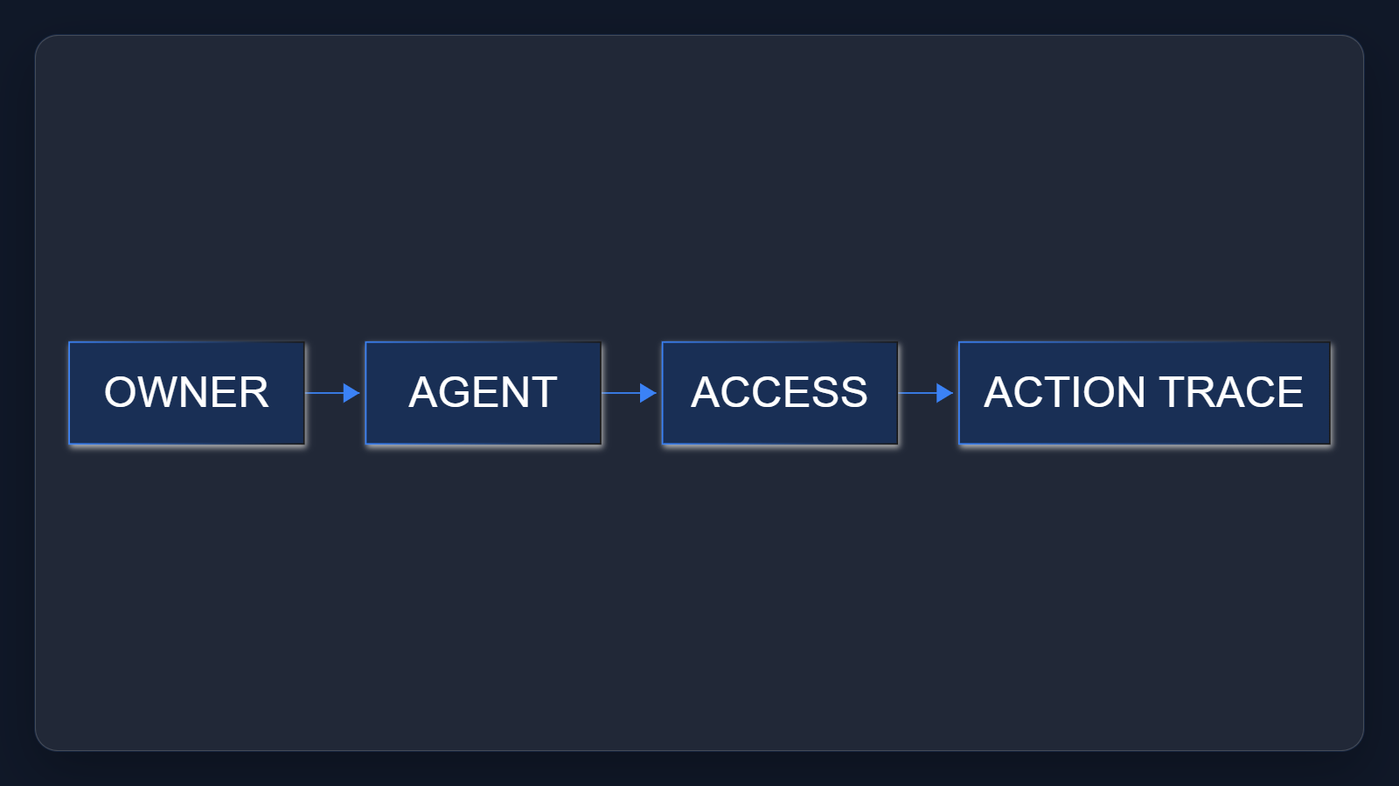
1. Name the control plane
Agent 365 is the control plane for AI agents. Ask who owns each one, where it runs, what it can reach, who it affects, and what risk needs action.
Sources: Microsoft Agent 365 - Service Descriptions · Microsoft Agent 365 overview · Quickstart: Connect an Existing Agent to Agent 365
2 / 6
Notes:
1. Name the control plane
Agent 365 is the control plane for AI agents. Ask who owns each one, where it runs, what it can reach, who it affects, and what risk needs action.
Evidence: service description calls Agent 365 a centralized control plane; overview states observe, govern, and secure. Interpretation: ownership and access questions make the pilot accountable.
Evidence: Agent 365 is a centralized control plane for observing, governing, and securing AI agents. [ev-01] Microsoft Agent 365 - Service Descriptions
Evidence: A pilot must verify prerequisites, licenses, preview limits, and telemetry before scaling. [ev-09] Quickstart: Connect an Existing Agent to Agent 365
Citations
[ev-01] Microsoft Agent 365 - Service Descriptions: https://learn.microsoft.com/en-us/office365/servicedescriptions/microsoft-agent-365/microsoft-agent-365
[ev-02] Microsoft Agent 365 overview: https://learn.microsoft.com/en-us/microsoft-agent-365/overview
[ev-09] Quickstart: Connect an Existing Agent to Agent 365: https://learn.microsoft.com/en-us/microsoft-agent-365/developer/get-started
[ev-10] Quickstart: Connect an Existing Agent to Agent 365: https://learn.microsoft.com/en-us/microsoft-agent-365/developer/get-started
[ev-11] Quickstart: Connect an Existing Agent to Agent 365: https://learn.microsoft.com/en-us/microsoft-agent-365/developer/get-started
[ev-12] Microsoft Agent 365 - Service Descriptions: https://learn.microsoft.com/en-us/office365/servicedescriptions/microsoft-agent-365/microsoft-agent-365

Slide 3
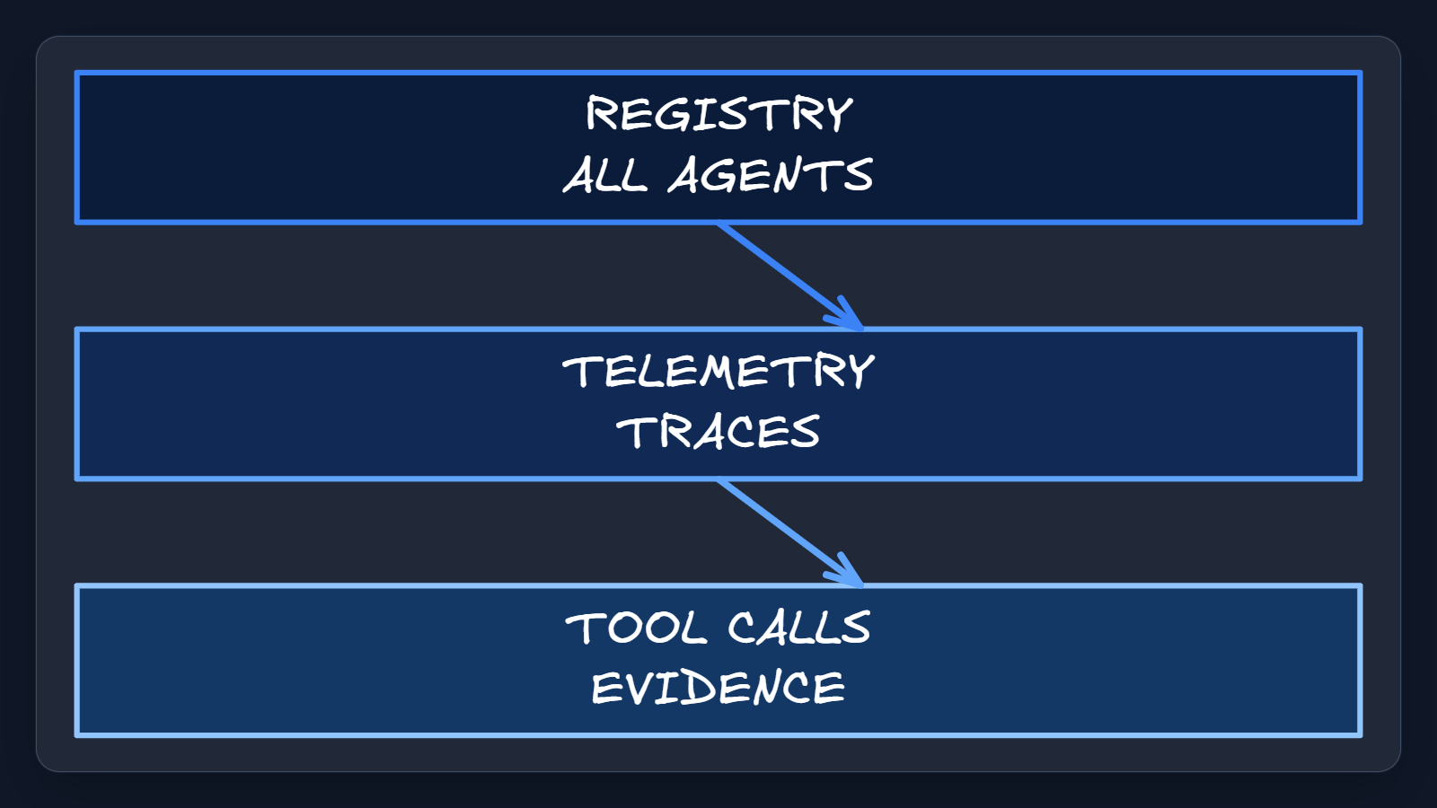
2. Observe traced work
Observe with a registry, activity, and health first. Add telemetry so each request, model step, tool call, and error has a trace for operators, not guesswork.
Sources: Microsoft Agent 365 overview · Microsoft Agent 365 SDK and CLI
3 / 6
Notes:
2. Observe traced work
Observe with a registry, activity, and health first. Add telemetry so each request, model step, tool call, and error has a trace for operators, not guesswork.
Evidence: overview describes real-time visibility into the agentic environment; SDK guidance describes audited, traceable interactions, inference events, and tool usage.
Evidence: Observation should pair agent inventory with audited traces for interactions, inference events, and tool usage. [ev-03] Microsoft Agent 365 overview
Citations
[ev-03] Microsoft Agent 365 overview: https://learn.microsoft.com/en-us/microsoft-agent-365/overview
[ev-04] Microsoft Agent 365 SDK and CLI: https://learn.microsoft.com/en-us/microsoft-agent-365/developer/

Slide 4
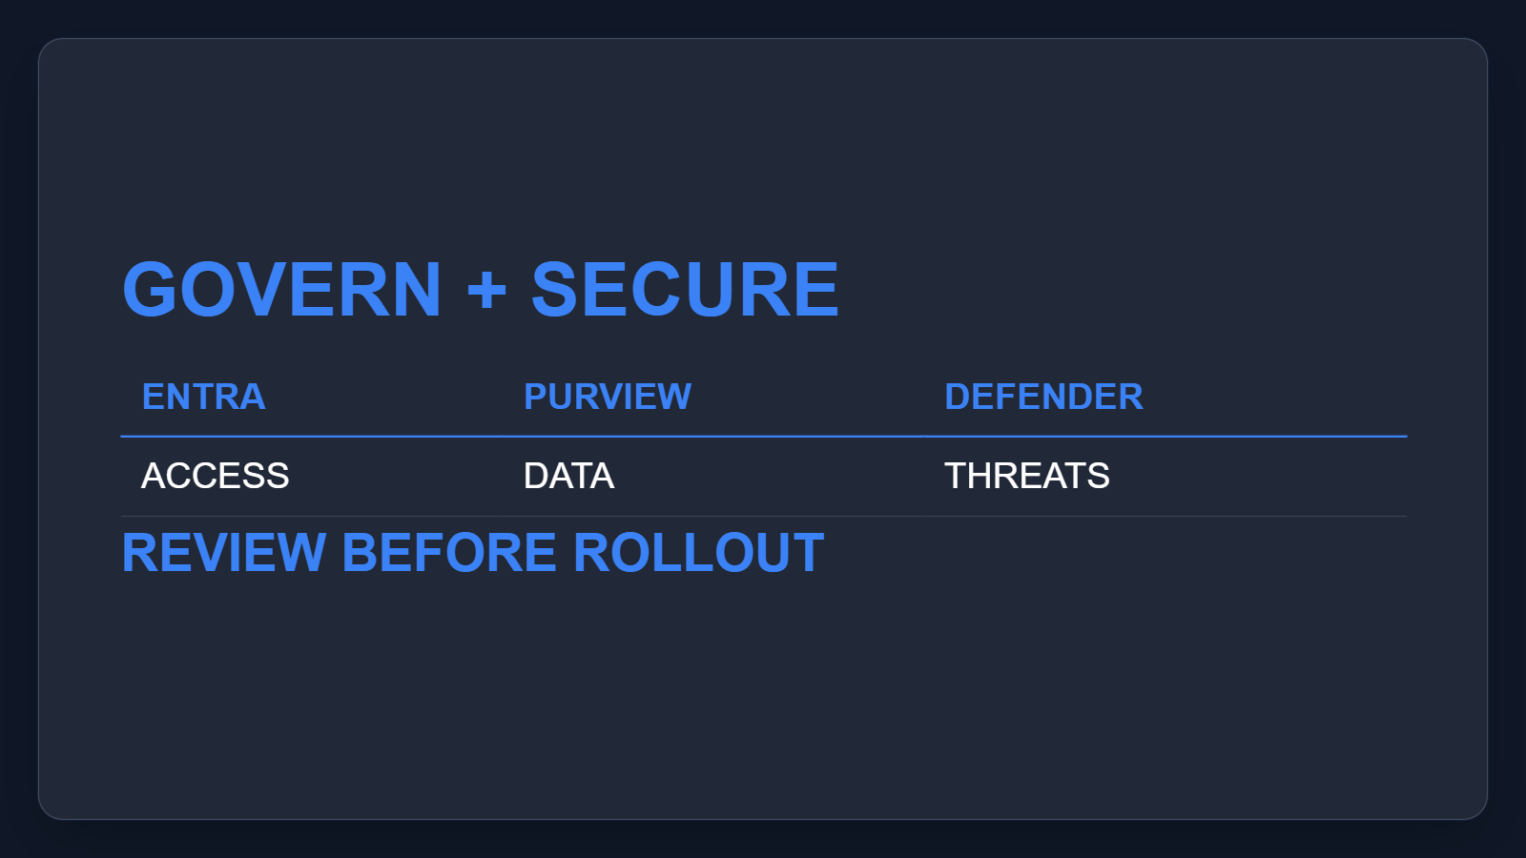
3. Govern and secure access
Govern and secure access as one path. Pair lifecycle review, Entra controls, Purview data checks, and Defender signals for every agent before wider rollout.
Sources: Microsoft Agent 365 overview
4 / 6
Notes:
3. Govern and secure access
Govern and secure access as one path. Pair lifecycle review, Entra controls, Purview data checks, and Defender signals for every agent before wider rollout.
Evidence: overview connects registry, Microsoft 365 admin center, Entra, and Purview with lifecycle and permissions; the secure section identifies Defender threat detection.
Evidence: Governance and security connect lifecycle controls, Entra permissions, Purview protection, and Defender detection. [ev-05] Microsoft Agent 365 overview
Citations
[ev-05] Microsoft Agent 365 overview: https://learn.microsoft.com/en-us/microsoft-agent-365/overview
[ev-06] Microsoft Agent 365 overview: https://learn.microsoft.com/en-us/microsoft-agent-365/overview

Slide 5
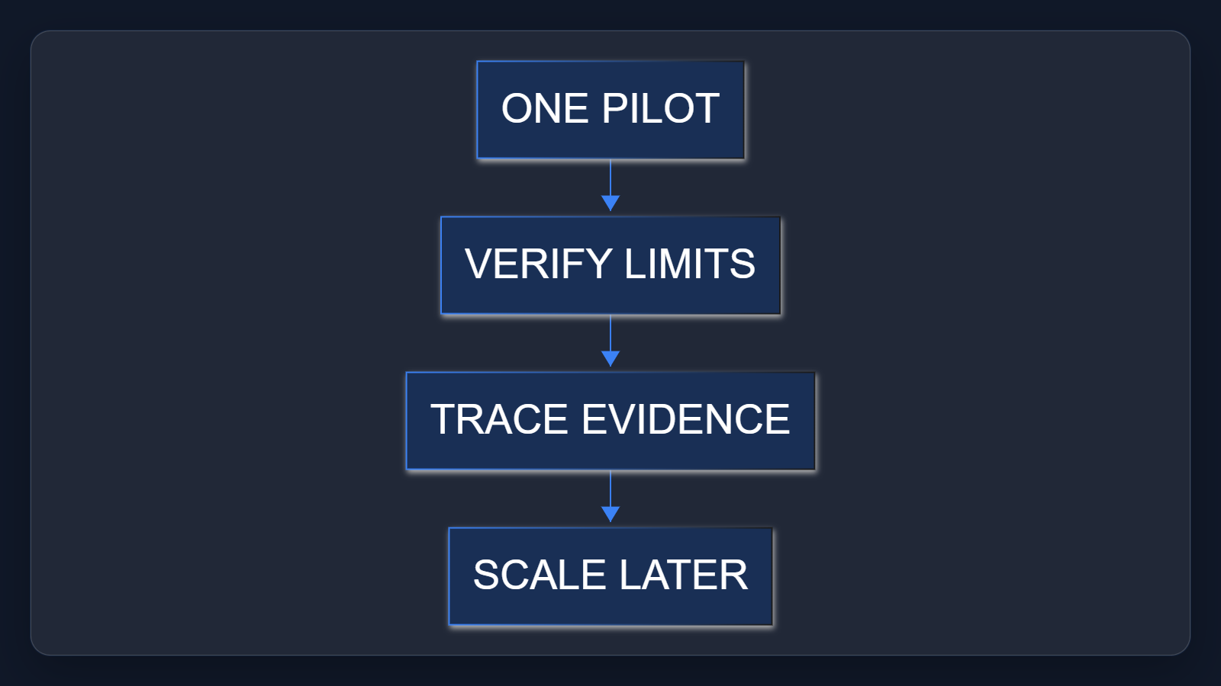
4. Pilot before expansion
Keep the current agent and add only needed SDK pieces. Pilot one owned use case, verify licenses and preview limits, then scale only from evidence and review.
Sources: Microsoft Agent 365 SDK and CLI · Quickstart: Connect an Existing Agent to Agent 365 · Microsoft Agent 365 - Service Descriptions
5 / 6
Notes:
4. Pilot before expansion
Keep the current agent and add only needed SDK pieces. Pilot one owned use case, verify licenses and preview limits, then scale only from evidence and review.
Evidence: the SDK extends existing agents without creating or hosting them. The quickstart and service description make validation, assigned licenses, preview status, and plan availability explicit checks.
Evidence: SDK integration extends existing agents with enterprise capabilities without creating or hosting the agent. [ev-07] Microsoft Agent 365 SDK and CLI
Evidence: A pilot must verify prerequisites, licenses, preview limits, and telemetry before scaling. [ev-09] Quickstart: Connect an Existing Agent to Agent 365
Citations
[ev-07] Microsoft Agent 365 SDK and CLI: https://learn.microsoft.com/en-us/microsoft-agent-365/developer/
[ev-08] Microsoft Agent 365 SDK and CLI: https://learn.microsoft.com/en-us/microsoft-agent-365/developer/
[ev-09] Quickstart: Connect an Existing Agent to Agent 365: https://learn.microsoft.com/en-us/microsoft-agent-365/developer/get-started
[ev-10] Quickstart: Connect an Existing Agent to Agent 365: https://learn.microsoft.com/en-us/microsoft-agent-365/developer/get-started
[ev-11] Quickstart: Connect an Existing Agent to Agent 365: https://learn.microsoft.com/en-us/microsoft-agent-365/developer/get-started
[ev-12] Microsoft Agent 365 - Service Descriptions: https://learn.microsoft.com/en-us/office365/servicedescriptions/microsoft-agent-365/microsoft-agent-365

Slide 6
Sources. Every claim traces to one.
Microsoft Agent 365 - Service Descriptions retrieved 2026-10-06
https://learn.microsoft.com/en-us/office365/servicedescriptions/microsoft-agent-365/microsoft-agent-365
Microsoft Agent 365 overview retrieved 2026-10-06
https://learn.microsoft.com/en-us/microsoft-agent-365/overview
Microsoft Agent 365 SDK and CLI retrieved 2026-10-06
https://learn.microsoft.com/en-us/microsoft-agent-365/developer/
Quickstart: Connect an Existing Agent to Agent 365 retrieved 2026-10-06
https://learn.microsoft.com/en-us/microsoft-agent-365/developer/get-started
agent-365-2026-03-am-michael-kokoro-onnx
6 / 6
Notes:
Sources. Every claim traces to one.
Bottom line: use Agent 365 as the control plane for one accountable pilot; verify ownership, access, action traces, licenses, and preview limits before scaling.
Sources for every claim in this deck.
Citations
Microsoft Agent 365 - Service Descriptions: https://learn.microsoft.com/en-us/office365/servicedescriptions/microsoft-agent-365/microsoft-agent-365
Microsoft Agent 365 overview: https://learn.microsoft.com/en-us/microsoft-agent-365/overview
Microsoft Agent 365 overview: https://learn.microsoft.com/en-us/microsoft-agent-365/overview
Microsoft Agent 365 SDK and CLI: https://learn.microsoft.com/en-us/microsoft-agent-365/developer/
Microsoft Agent 365 overview: https://learn.microsoft.com/en-us/microsoft-agent-365/overview
Microsoft Agent 365 overview: https://learn.microsoft.com/en-us/microsoft-agent-365/overview
Microsoft Agent 365 SDK and CLI: https://learn.microsoft.com/en-us/microsoft-agent-365/developer/
Microsoft Agent 365 SDK and CLI: https://learn.microsoft.com/en-us/microsoft-agent-365/developer/
Quickstart: Connect an Existing Agent to Agent 365: https://learn.microsoft.com/en-us/microsoft-agent-365/developer/get-started
Quickstart: Connect an Existing Agent to Agent 365: https://learn.microsoft.com/en-us/microsoft-agent-365/developer/get-started
Quickstart: Connect an Existing Agent to Agent 365: https://learn.microsoft.com/en-us/microsoft-agent-365/developer/get-started
Microsoft Agent 365 - Service Descriptions: https://learn.microsoft.com/en-us/office365/servicedescriptions/microsoft-agent-365/microsoft-agent-365

