Slide 1
Datadog for Claude Cowork. Observability by conversation.
The Datadog plugin and connector let Claude query Datadog logs, metrics, traces, dashboards and monitors through the Datadog MCP Server.
DECISION Pilot the Datadog connector with one team, keep Datadog permissions scoped, and treat the Preview status as a rollout risk.
datadog-cowork-plugin-2026-05-am-michael-kokoro-onnx
1 / 8
Notes:
Datadog for Claude Cowork. Observability by conversation.
The Datadog plugin and connector let Claude query Datadog logs, metrics, traces, dashboards and monitors through the Datadog MCP Server.
Datadog for Claude Cowork. Your telemetry, one question away. Here is what the plugin does, how it connects, and where a team should be careful.
The Datadog Model Context Protocol server bridges your observability data to agents. Logs, metrics, traces, dashboards, and monitors become things you can simply ask about.
For Claude, including Cowork, the official connector is the recommended path, and it adds in-product visualizations. Claude Code installs the same server as a plugin from the official marketplace.
Setup is short. Choose your Datadog site, then sign in with OAuth in the browser. Keys are an alternative, and any older manual server or custom connector should be removed first.
Access is not widened. You still need the Datadog permissions for the data you query, and the plugin states that no Datadog credentials are sent to the model provider.
Tool groups can be switched on or off, so a team can expose only the products it needs. Start with one narrow toolset.
Treat the preview label as a rollout risk. The server is HIPAA eligible, yet you own compliance for the tools you connect, and government sites are not supported. Pilot with one team, keep permissions tight, then expand.
Evidence: The Datadog MCP Server bridges Datadog observability data to AI agents, so logs, metrics, traces, dashboards and monitors can be queried in natural language. [ev-01] Datadog MCP Server
Evidence: For Claude, including Claude Cowork, the official Datadog connector is the recommended path and includes MCP Apps for in-product visualizations. [ev-05] Set Up the Datadog MCP Server
Evidence: Claude Code installs the Datadog plugin from the official Anthropic Plugin Marketplace; the plugin bundles the MCP Server with skills and auto-updates. [ev-06] Set Up the Datadog MCP Server
Evidence: Setup asks you to choose a Datadog site and sign in with OAuth in the browser; API and application keys are a supported alternative. [ev-07] Set Up the Datadog MCP Server
Evidence: Remove any separately registered Datadog MCP server or custom connector first to avoid conflicts. [ev-14] Datadog Claude Code Plugin
Evidence: You need Datadog permissions for the resources you query, and the plugin states that no Datadog credentials are sent to the AI model provider. [ev-10] Set Up the Datadog MCP Server
Evidence: Groups of MCP tools can be enabled or disabled with the toolsets command. [ev-11] Datadog Claude Code Plugin
Evidence: The Datadog plugin and its marketplace listing are in Preview. [ev-03] Datadog Claude Code Plugin
Evidence: The Datadog MCP Server is HIPAA-eligible, customers remain responsible for the compliance of the AI tools they connect, and the server is not supported on the Datadog government sites. [ev-12] Datadog MCP Server
Citations
[ev-01] Datadog MCP Server
[ev-02] Datadog Claude Code Plugin
[ev-03] Datadog Claude Code Plugin
[ev-04] Datadog | Claude by Anthropic
[ev-05] Set Up the Datadog MCP Server
[ev-06] Set Up the Datadog MCP Server
[ev-07] Set Up the Datadog MCP Server
[ev-08] Datadog Claude Code Plugin
[ev-09] Datadog Claude Code Plugin
[ev-10] Set Up the Datadog MCP Server
[ev-11] Datadog Claude Code Plugin
[ev-12] Datadog MCP Server
[ev-13] Set Up the Datadog MCP Server
[ev-14] Datadog Claude Code Plugin
[ev-15] Set Up the Datadog MCP Server

Slide 2
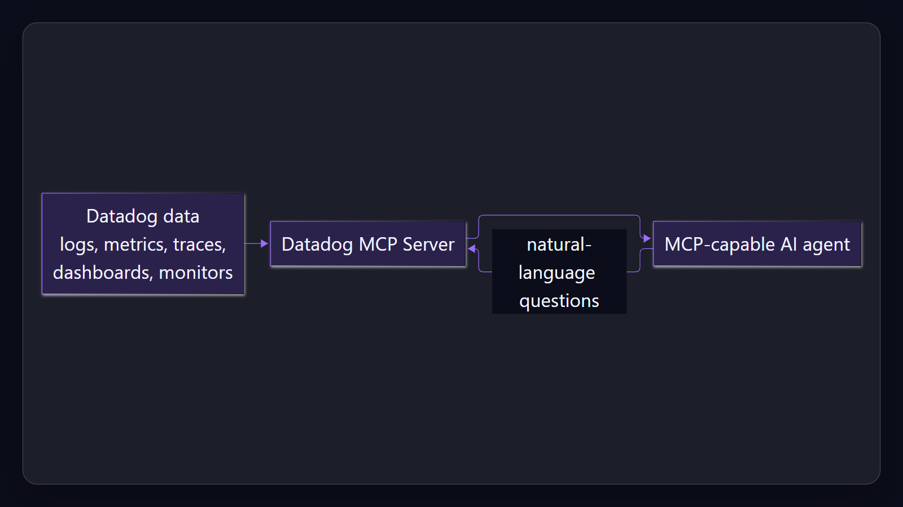
A bridge. Not a dashboard.
The Datadog MCP Server links your observability data to any agent that speaks the Model Context Protocol, so you ask instead of clicking through screens.
Sources: Datadog MCP Server · Datadog Claude Code Plugin
2 / 8
Notes:
A bridge. Not a dashboard.
The Datadog MCP Server links your observability data to any agent that speaks the Model Context Protocol, so you ask instead of clicking through screens.
Explain that the plugin is a bridge to Datadog data for MCP agents.
Evidence: The Datadog MCP Server bridges Datadog observability data to AI agents, so logs, metrics, traces, dashboards and monitors can be queried in natural language. [ev-01] Datadog MCP Server
Citations
[ev-01] Datadog MCP Server: https://docs.datadoghq.com/mcp_server/
[ev-02] Datadog Claude Code Plugin: https://github.com/datadog-labs/claude-code-plugin

Slide 3
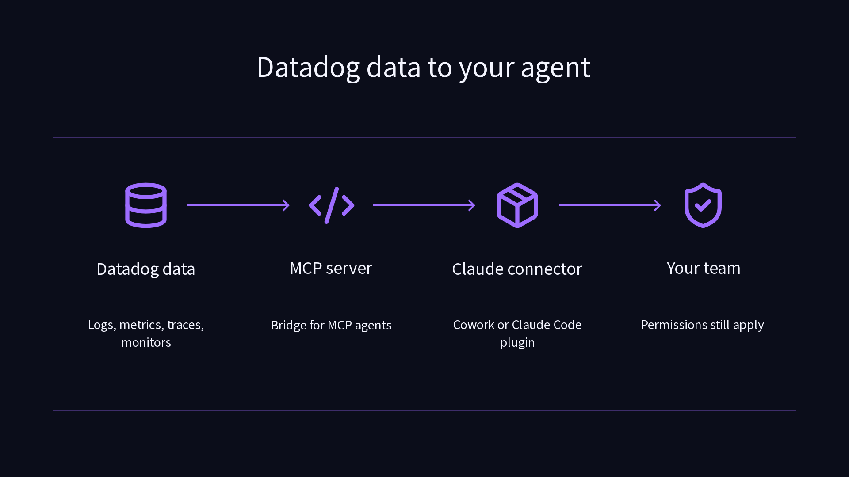
Where it runs. Cowork and Claude Code.
Claude, including Cowork, uses the official connector. Claude Code installs the plugin from the official Anthropic marketplace.
Sources: Set Up the Datadog MCP Server
3 / 8
Notes:
Where it runs. Cowork and Claude Code.
Claude, including Cowork, uses the official connector. Claude Code installs the plugin from the official Anthropic marketplace.
Show the path from Datadog data to the team through the connector or plugin.
Evidence: For Claude, including Claude Cowork, the official Datadog connector is the recommended path and includes MCP Apps for in-product visualizations. [ev-05] Set Up the Datadog MCP Server
Evidence: Claude Code installs the Datadog plugin from the official Anthropic Plugin Marketplace; the plugin bundles the MCP Server with skills and auto-updates. [ev-06] Set Up the Datadog MCP Server
Citations
[ev-05] Set Up the Datadog MCP Server: https://docs.datadoghq.com/mcp_server/setup/
[ev-06] Set Up the Datadog MCP Server: https://docs.datadoghq.com/mcp_server/setup/

Slide 4
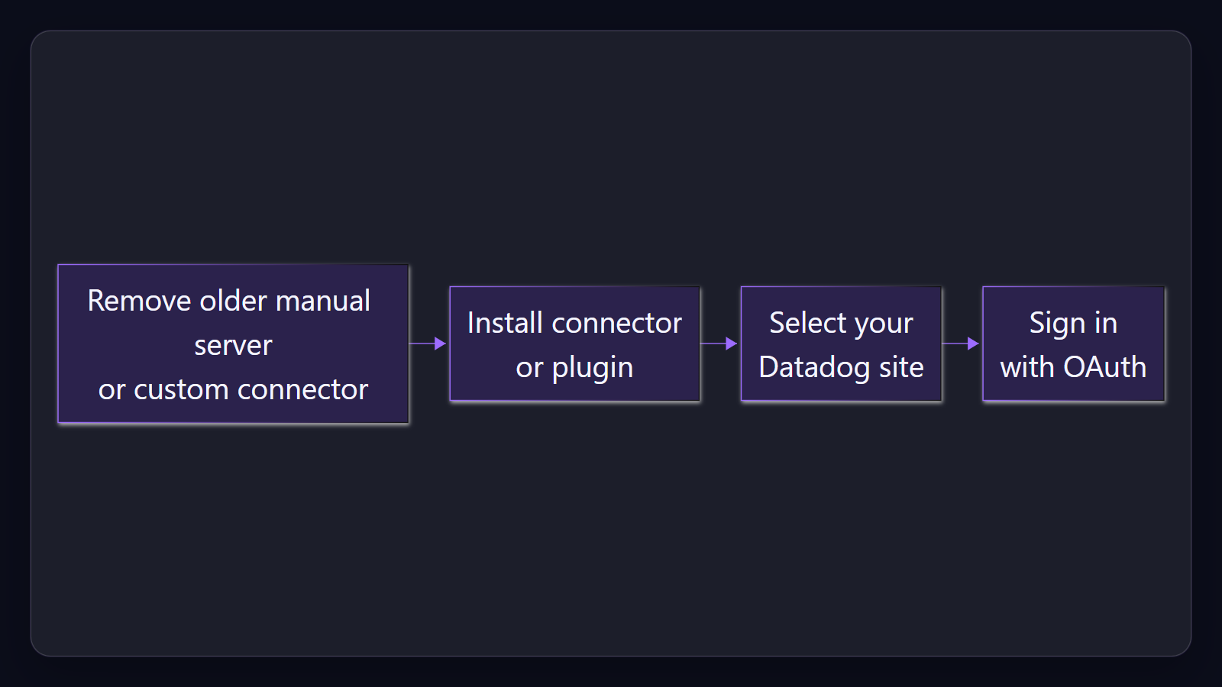
Set up. Pick a site, sign in.
Choose your Datadog site and sign in with OAuth. Keys are supported, and older manual servers or custom connectors should be removed first.
Sources: Set Up the Datadog MCP Server · Datadog Claude Code Plugin
4 / 8
Notes:
Set up. Pick a site, sign in.
Choose your Datadog site and sign in with OAuth. Keys are supported, and older manual servers or custom connectors should be removed first.
Walk through the guided setup and the conflict warning.
Evidence: Setup asks you to choose a Datadog site and sign in with OAuth in the browser; API and application keys are a supported alternative. [ev-07] Set Up the Datadog MCP Server
Evidence: Remove any separately registered Datadog MCP server or custom connector first to avoid conflicts. [ev-14] Datadog Claude Code Plugin
Citations
[ev-07] Set Up the Datadog MCP Server: https://docs.datadoghq.com/mcp_server/setup/
[ev-08] Datadog Claude Code Plugin: https://github.com/datadog-labs/claude-code-plugin
[ev-14] Datadog Claude Code Plugin: https://github.com/datadog-labs/claude-code-plugin
[ev-15] Set Up the Datadog MCP Server: https://docs.datadoghq.com/mcp_server/setup/

Slide 5
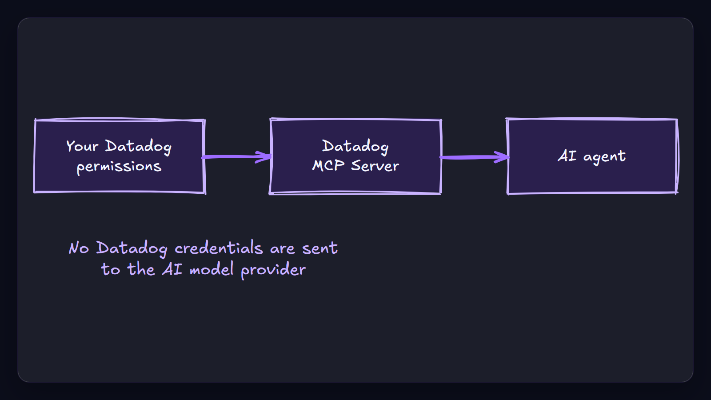
Access. Your permissions still apply.
You need Datadog permissions for the resources you query, and no Datadog credentials are sent to the model provider.
Sources: Set Up the Datadog MCP Server · Datadog Claude Code Plugin
5 / 8
Notes:
Access. Your permissions still apply.
You need Datadog permissions for the resources you query, and no Datadog credentials are sent to the model provider.
Stress that the plugin does not widen access.
Evidence: You need Datadog permissions for the resources you query, and the plugin states that no Datadog credentials are sent to the AI model provider. [ev-10] Set Up the Datadog MCP Server
Citations
[ev-10] Set Up the Datadog MCP Server: https://docs.datadoghq.com/mcp_server/setup/
[ev-09] Datadog Claude Code Plugin: https://github.com/datadog-labs/claude-code-plugin

Slide 6
Control. Choose the toolsets.
Enable or disable groups of MCP tools so the agent sees only the Datadog products your team needs.
Groups of MCP tools can be enabled or disabled with the toolsets command.
Datadog Claude Code Plugin
Sources: Datadog Claude Code Plugin
6 / 8
Notes:
Control. Choose the toolsets.
Enable or disable groups of MCP tools so the agent sees only the Datadog products your team needs.
Recommend starting with one narrow toolset.
Evidence: Groups of MCP tools can be enabled or disabled with the toolsets command. [ev-11] Datadog Claude Code Plugin
Citations
[ev-11] Datadog Claude Code Plugin: https://github.com/datadog-labs/claude-code-plugin

Slide 7
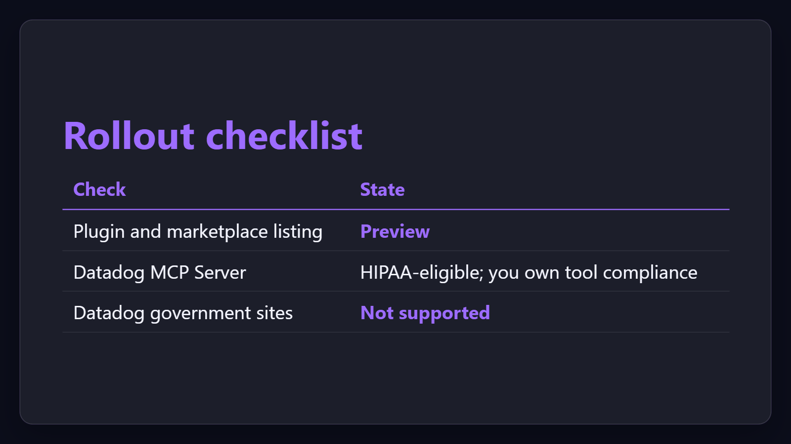
Risk. Preview, compliance, site limits.
The plugin is in Preview. The server is HIPAA-eligible, but you own compliance for connected tools, and the government sites are unsupported.
Sources: Datadog Claude Code Plugin · Datadog | Claude by Anthropic · Datadog MCP Server · +1 more
7 / 8
Notes:
Risk. Preview, compliance, site limits.
The plugin is in Preview. The server is HIPAA-eligible, but you own compliance for connected tools, and the government sites are unsupported.
Close with the pilot recommendation and the preview caveat.
Evidence: The Datadog plugin and its marketplace listing are in Preview. [ev-03] Datadog Claude Code Plugin
Evidence: The Datadog MCP Server is HIPAA-eligible, customers remain responsible for the compliance of the AI tools they connect, and the server is not supported on the Datadog government sites. [ev-12] Datadog MCP Server
Citations
[ev-03] Datadog Claude Code Plugin: https://github.com/datadog-labs/claude-code-plugin
[ev-04] Datadog | Claude by Anthropic: https://claude.com/marketplace/plugins/datadog
[ev-12] Datadog MCP Server: https://docs.datadoghq.com/mcp_server/
[ev-13] Set Up the Datadog MCP Server: https://docs.datadoghq.com/mcp_server/setup/

Slide 8
Sources. Every claim traces to one.
Datadog MCP Server retrieved 2026-09-29
https://docs.datadoghq.com/mcp_server/
Datadog Claude Code Plugin retrieved 2026-09-29
https://github.com/datadog-labs/claude-code-plugin
Datadog | Claude by Anthropic retrieved 2026-09-29
https://claude.com/marketplace/plugins/datadog
Set Up the Datadog MCP Server retrieved 2026-09-29
https://docs.datadoghq.com/mcp_server/setup/
datadog-cowork-plugin-2026-05-am-michael-kokoro-onnx
8 / 8
Notes:
Sources. Every claim traces to one.
The Datadog plugin and connector let Claude query Datadog logs, metrics, traces, dashboards and monitors through the Datadog MCP Server.
Sources for every claim in this deck.
Citations
Datadog MCP Server: https://docs.datadoghq.com/mcp_server/
Datadog Claude Code Plugin: https://github.com/datadog-labs/claude-code-plugin
Datadog Claude Code Plugin: https://github.com/datadog-labs/claude-code-plugin
Datadog | Claude by Anthropic: https://claude.com/marketplace/plugins/datadog
Set Up the Datadog MCP Server: https://docs.datadoghq.com/mcp_server/setup/
Set Up the Datadog MCP Server: https://docs.datadoghq.com/mcp_server/setup/
Set Up the Datadog MCP Server: https://docs.datadoghq.com/mcp_server/setup/
Datadog Claude Code Plugin: https://github.com/datadog-labs/claude-code-plugin
Datadog Claude Code Plugin: https://github.com/datadog-labs/claude-code-plugin
Set Up the Datadog MCP Server: https://docs.datadoghq.com/mcp_server/setup/
Datadog Claude Code Plugin: https://github.com/datadog-labs/claude-code-plugin
Datadog MCP Server: https://docs.datadoghq.com/mcp_server/
Set Up the Datadog MCP Server: https://docs.datadoghq.com/mcp_server/setup/
Datadog Claude Code Plugin: https://github.com/datadog-labs/claude-code-plugin
Set Up the Datadog MCP Server: https://docs.datadoghq.com/mcp_server/setup/

