Slide 1
Microsoft Plugin Architecture: reuse the core, govern each host
Bottom line: standardize skills and MCP, then govern compatibility and ownership for each host.
DECISION Standardize skills and MCP; govern compatibility and ownership per host.
microsoft-plugin-architecture-2026-04-am-michael-kokoro-onnx
1 / 6
Notes:
Microsoft Plugin Architecture: reuse the core, govern each host
Bottom line: standardize skills and MCP, then govern compatibility and ownership for each host.
Bottom line: standardize skills and MCP, then govern compatibility and ownership for each host.
Cowork uses a Microsoft 365 app package. Declarative agents use MCP or REST API actions. GitHub Copilot uses plugin packages with portable and client-specific parts.
Reuse skill logic and MCP configuration where tested. Keep authentication, manifests, discovery and client-only components inside each host package.
REST API actions remain supported in declarative agents. Agent Plugins 1.0 adds portability, while legacy GitHub Copilot plugins continue to load.
Assign one owner per capability and service. Publish a host compatibility matrix, version each package, and add routes only when demand justifies lifecycle cost.
Evidence: Three host routes use different delivery contracts: Cowork uses Microsoft 365 app packages; declarative agents use MCP or API actions; GitHub Copilot uses plugin packages. [ev-01] Build plugins for Copilot Cowork
Evidence: Skills and MCP configuration can be reusable, while manifests, discovery, authentication and client-specific components remain host-specific. [ev-03] Build plugins for Copilot Cowork
Evidence: Cowork packages skills and connectors in a standard Microsoft 365 app package. [ev-01] Build plugins for Copilot Cowork
Evidence: Microsoft 365 declarative agents support MCP and REST API plugins as in-agent actions; REST API tools are defined in the plugin manifest. [ev-04] MCP and API plugins for declarative agents
Evidence: GitHub Agent Plugins 1.0 ports skills and MCP configuration across compatible clients; client-specific components and legacy plugins remain supported. [ev-07] About GitHub Copilot plugins
Citations
[ev-01] Build plugins for Copilot Cowork
[ev-02] Build plugins for Copilot Cowork
[ev-03] Build plugins for Copilot Cowork
[ev-04] MCP and API plugins for declarative agents
[ev-05] MCP and API plugins for declarative agents
[ev-06] MCP and API plugins for declarative agents
[ev-07] About GitHub Copilot plugins
[ev-08] About GitHub Copilot plugins
[ev-09] About GitHub Copilot plugins

Slide 2
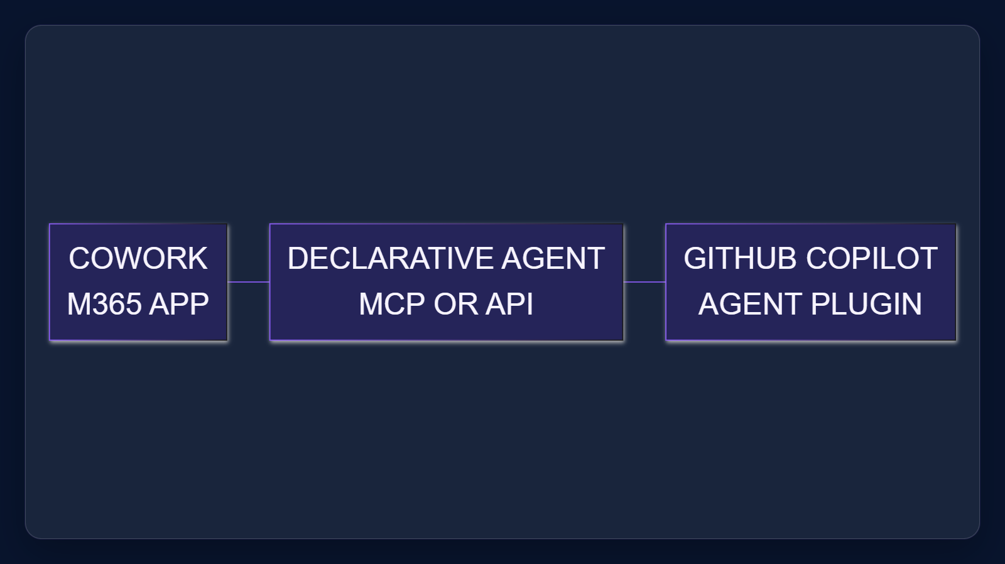
1. Choose the host route
Cowork uses a Microsoft 365 app package. Declarative agents use MCP or REST API actions. GitHub Copilot uses plugin packages with portable and client-specific parts.
Sources: Build plugins for Copilot Cowork · MCP and API plugins for declarative agents · About GitHub Copilot plugins
2 / 6
Notes:
1. Choose the host route
Cowork uses a Microsoft 365 app package. Declarative agents use MCP or REST API actions. GitHub Copilot uses plugin packages with portable and client-specific parts.
Evidence: the three selected official sources, retrieved 2026-10-06. Decision implication: name the host and package contract for every portfolio item; do not describe these routes as interchangeable.
Evidence: Three host routes use different delivery contracts: Cowork uses Microsoft 365 app packages; declarative agents use MCP or API actions; GitHub Copilot uses plugin packages. [ev-01] Build plugins for Copilot Cowork
Evidence: Cowork packages skills and connectors in a standard Microsoft 365 app package. [ev-01] Build plugins for Copilot Cowork
Evidence: Microsoft 365 declarative agents support MCP and REST API plugins as in-agent actions; REST API tools are defined in the plugin manifest. [ev-04] MCP and API plugins for declarative agents
Citations
[ev-01] Build plugins for Copilot Cowork: https://learn.microsoft.com/en-us/microsoft-365/copilot/cowork/cowork-plugin-development
[ev-02] Build plugins for Copilot Cowork: https://learn.microsoft.com/en-us/microsoft-365/copilot/cowork/cowork-plugin-development
[ev-04] MCP and API plugins for declarative agents: https://learn.microsoft.com/en-us/microsoft-365/copilot/extensibility/overview-plugins
[ev-05] MCP and API plugins for declarative agents: https://learn.microsoft.com/en-us/microsoft-365/copilot/extensibility/overview-plugins
[ev-07] About GitHub Copilot plugins: https://docs.github.com/en/copilot/concepts/agents/about-plugins
[ev-01] Build plugins for Copilot Cowork: https://learn.microsoft.com/en-us/microsoft-365/copilot/cowork/cowork-plugin-development
[ev-02] Build plugins for Copilot Cowork: https://learn.microsoft.com/en-us/microsoft-365/copilot/cowork/cowork-plugin-development
[ev-04] MCP and API plugins for declarative agents: https://learn.microsoft.com/en-us/microsoft-365/copilot/extensibility/overview-plugins
[ev-05] MCP and API plugins for declarative agents: https://learn.microsoft.com/en-us/microsoft-365/copilot/extensibility/overview-plugins
[ev-06] MCP and API plugins for declarative agents: https://learn.microsoft.com/en-us/microsoft-365/copilot/extensibility/overview-plugins

Slide 3
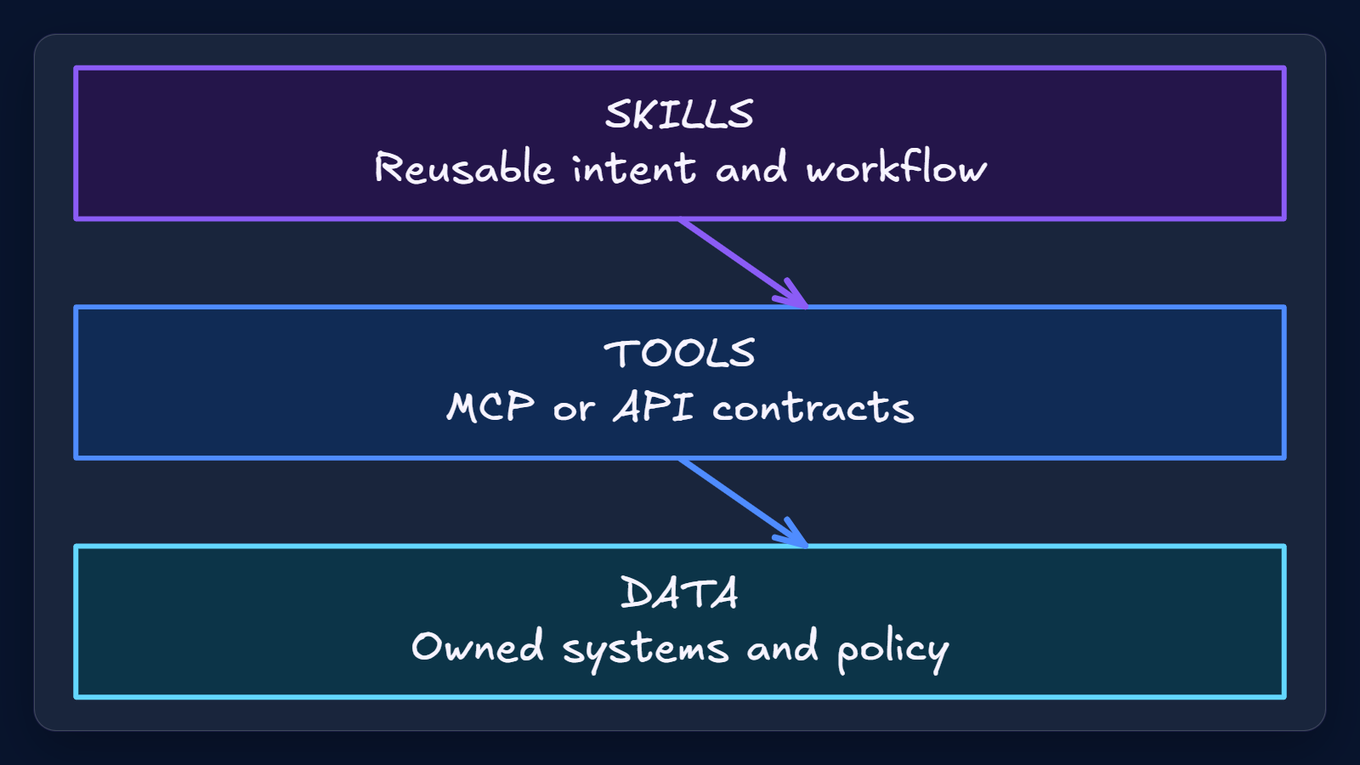
2. Reuse the core, not the wrapper
Reuse skill logic and MCP configuration where tested. Keep authentication, manifests, discovery and client-only components inside each host package.
Sources: Build plugins for Copilot Cowork · About GitHub Copilot plugins
3 / 6
Notes:
2. Reuse the core, not the wrapper
Reuse skill logic and MCP configuration where tested. Keep authentication, manifests, discovery and client-only components inside each host package.
Evidence: Cowork skill portability, declarative-agent MCP/API behavior, and GitHub Agent Plugins portability and legacy support. Interpretation: the reusable layer should be separated from host packaging and operations.
Evidence: Skills and MCP configuration can be reusable, while manifests, discovery, authentication and client-specific components remain host-specific. [ev-03] Build plugins for Copilot Cowork
Citations
[ev-03] Build plugins for Copilot Cowork: https://learn.microsoft.com/en-us/microsoft-365/copilot/cowork/cowork-plugin-development
[ev-07] About GitHub Copilot plugins: https://docs.github.com/en/copilot/concepts/agents/about-plugins
[ev-08] About GitHub Copilot plugins: https://docs.github.com/en/copilot/concepts/agents/about-plugins

Slide 4
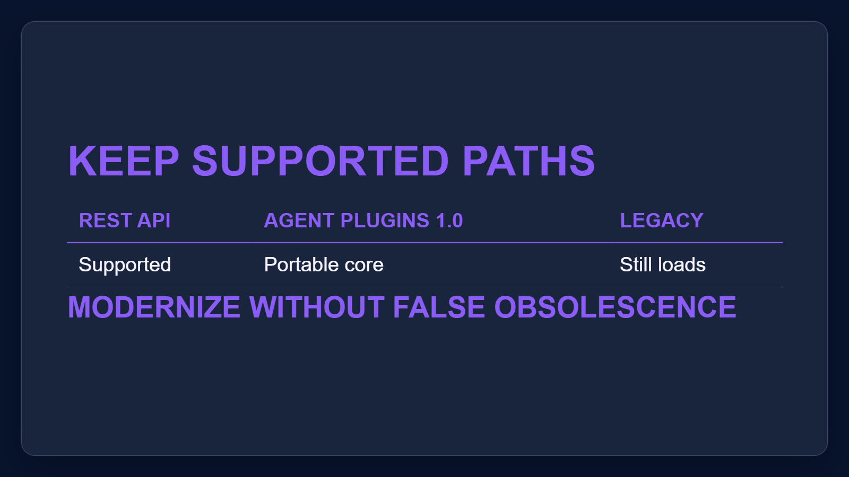
3. Preserve supported paths
REST API actions remain supported in declarative agents. Agent Plugins 1.0 adds portability, while legacy GitHub Copilot plugins continue to load.
Sources: MCP and API plugins for declarative agents · About GitHub Copilot plugins
4 / 6
Notes:
3. Preserve supported paths
REST API actions remain supported in declarative agents. Agent Plugins 1.0 adds portability, while legacy GitHub Copilot plugins continue to load.
Evidence: Microsoft Learn documents REST API plugins as declarative-agent actions; GitHub documents both Agent Plugins 1.0 and legacy Copilot plugins as supported.
Evidence: Microsoft 365 declarative agents support MCP and REST API plugins as in-agent actions; REST API tools are defined in the plugin manifest. [ev-04] MCP and API plugins for declarative agents
Evidence: GitHub Agent Plugins 1.0 ports skills and MCP configuration across compatible clients; client-specific components and legacy plugins remain supported. [ev-07] About GitHub Copilot plugins
Citations
[ev-04] MCP and API plugins for declarative agents: https://learn.microsoft.com/en-us/microsoft-365/copilot/extensibility/overview-plugins
[ev-05] MCP and API plugins for declarative agents: https://learn.microsoft.com/en-us/microsoft-365/copilot/extensibility/overview-plugins
[ev-06] MCP and API plugins for declarative agents: https://learn.microsoft.com/en-us/microsoft-365/copilot/extensibility/overview-plugins
[ev-07] About GitHub Copilot plugins: https://docs.github.com/en/copilot/concepts/agents/about-plugins
[ev-08] About GitHub Copilot plugins: https://docs.github.com/en/copilot/concepts/agents/about-plugins
[ev-09] About GitHub Copilot plugins: https://docs.github.com/en/copilot/concepts/agents/about-plugins

Slide 5
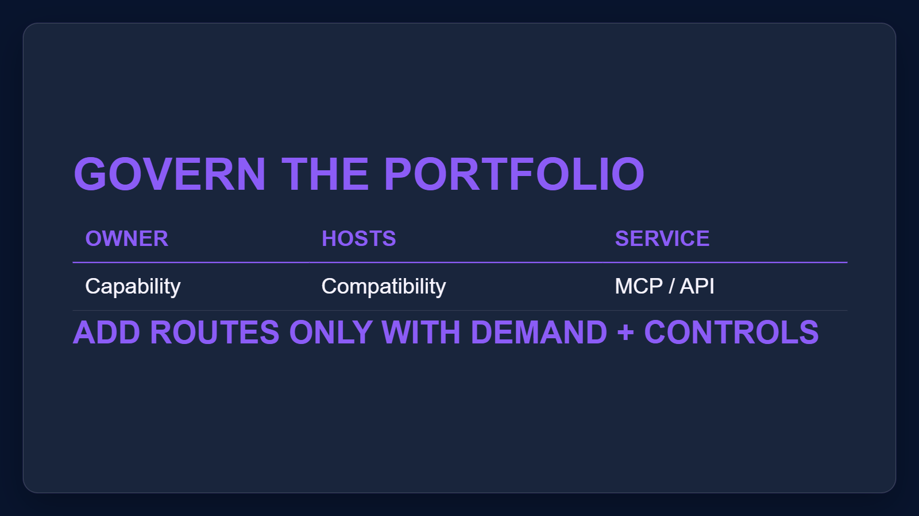
4. Govern a small portfolio
Assign one owner per capability and service. Publish a host compatibility matrix, version each package, and add routes only when demand justifies lifecycle cost.
Sources: Build plugins for Copilot Cowork · MCP and API plugins for declarative agents · About GitHub Copilot plugins
5 / 6
Notes:
4. Govern a small portfolio
Assign one owner per capability and service. Publish a host compatibility matrix, version each package, and add routes only when demand justifies lifecycle cost.
Proposed operating model, grounded in the documented route and compatibility boundaries. No source prescribes an enterprise org chart or ROI target.
Evidence: Three host routes use different delivery contracts: Cowork uses Microsoft 365 app packages; declarative agents use MCP or API actions; GitHub Copilot uses plugin packages. [ev-01] Build plugins for Copilot Cowork
Evidence: Skills and MCP configuration can be reusable, while manifests, discovery, authentication and client-specific components remain host-specific. [ev-03] Build plugins for Copilot Cowork
Citations
[ev-01] Build plugins for Copilot Cowork: https://learn.microsoft.com/en-us/microsoft-365/copilot/cowork/cowork-plugin-development
[ev-02] Build plugins for Copilot Cowork: https://learn.microsoft.com/en-us/microsoft-365/copilot/cowork/cowork-plugin-development
[ev-04] MCP and API plugins for declarative agents: https://learn.microsoft.com/en-us/microsoft-365/copilot/extensibility/overview-plugins
[ev-05] MCP and API plugins for declarative agents: https://learn.microsoft.com/en-us/microsoft-365/copilot/extensibility/overview-plugins
[ev-07] About GitHub Copilot plugins: https://docs.github.com/en/copilot/concepts/agents/about-plugins
[ev-03] Build plugins for Copilot Cowork: https://learn.microsoft.com/en-us/microsoft-365/copilot/cowork/cowork-plugin-development
[ev-07] About GitHub Copilot plugins: https://docs.github.com/en/copilot/concepts/agents/about-plugins
[ev-08] About GitHub Copilot plugins: https://docs.github.com/en/copilot/concepts/agents/about-plugins

Slide 6
Sources. Every claim traces to one.
Build plugins for Copilot Cowork retrieved 2026-10-06
https://learn.microsoft.com/en-us/microsoft-365/copilot/cowork/cowork-plugin-development
MCP and API plugins for declarative agents retrieved 2026-10-06
https://learn.microsoft.com/en-us/microsoft-365/copilot/extensibility/overview-plugins
About GitHub Copilot plugins retrieved 2026-10-06
https://docs.github.com/en/copilot/concepts/agents/about-plugins
microsoft-plugin-architecture-2026-04-am-michael-kokoro-onnx
6 / 6
Notes:
Sources. Every claim traces to one.
Bottom line: standardize skills and MCP, then govern compatibility and ownership for each host.
Sources for every claim in this deck.
Citations
Build plugins for Copilot Cowork: https://learn.microsoft.com/en-us/microsoft-365/copilot/cowork/cowork-plugin-development
Build plugins for Copilot Cowork: https://learn.microsoft.com/en-us/microsoft-365/copilot/cowork/cowork-plugin-development
Build plugins for Copilot Cowork: https://learn.microsoft.com/en-us/microsoft-365/copilot/cowork/cowork-plugin-development
MCP and API plugins for declarative agents: https://learn.microsoft.com/en-us/microsoft-365/copilot/extensibility/overview-plugins
MCP and API plugins for declarative agents: https://learn.microsoft.com/en-us/microsoft-365/copilot/extensibility/overview-plugins
MCP and API plugins for declarative agents: https://learn.microsoft.com/en-us/microsoft-365/copilot/extensibility/overview-plugins
About GitHub Copilot plugins: https://docs.github.com/en/copilot/concepts/agents/about-plugins
About GitHub Copilot plugins: https://docs.github.com/en/copilot/concepts/agents/about-plugins
About GitHub Copilot plugins: https://docs.github.com/en/copilot/concepts/agents/about-plugins

