Slide 1
Copilot Studio 2026: govern intent-to-action agents
Bottom line: use Copilot Studio as a governed agent platform, moving from business intent to useful action while funding workflows that merit scale, with rigor.
DECISION Fund governed agent scale where workflows merit managed automation.
copilot-studio-2026-07-am-michael-kokoro-onnx
1 / 6
Notes:
Copilot Studio 2026: govern intent-to-action agents
Bottom line: use Copilot Studio as a governed agent platform, moving from business intent to useful action while funding workflows that merit scale, with rigor.
Bottom line: use Copilot Studio as a governed agent platform, moving from business intent to useful action while funding workflows that merit scale, with rigor.
Copilot Studio is a low-code studio for building and managing agents. Teams create agents, workflows and agent flows tied to business data, systems and work channels.
Generative orchestration is the decision layer. It lets an agent choose topics, tools, knowledge or other agents, ask for missing input, and then compose the response.
Tools are where intent turns into action. Govern connectors, agent flows, prompts, REST APIs, MCP and computer use for both modern apps and legacy screens under policy.
Scale only with enterprise controls attached. Data policies, audit logs, Agent 365, Entra identities, spend controls and evaluations keep the platform managed at scale.
Evidence: Copilot Studio is a low-code studio for agents, workflows and agent flows that connect to business data and publish to work channels. [ev-01] Overview - Microsoft Copilot Studio
Evidence: Generative orchestration lets agents choose tools, knowledge, topics or other agents, ask for missing inputs and compose responses. [ev-04] Orchestrate agent behavior with generative AI
Evidence: Tools move intent to action through connectors, agent flows, prompts, REST APIs, MCP and computer use, with policy restrictions available. [ev-07] Add tools to custom agents
Evidence: Enterprise control includes data policies, audit visibility, Agent 365 governance, Entra agent identities and security controls. [ev-10] Security and governance
Evidence: Executives should treat Copilot Studio as a managed agent platform with monitoring, governance, evaluations, administration and policy gates. [ev-09] Add tools to custom agents
Citations
[ev-01] Overview - Microsoft Copilot Studio
[ev-02] Overview - Microsoft Copilot Studio
[ev-03] Overview - Microsoft Copilot Studio
[ev-04] Orchestrate agent behavior with generative AI
[ev-05] Orchestrate agent behavior with generative AI
[ev-06] Orchestrate agent behavior with generative AI
[ev-07] Add tools to custom agents
[ev-08] Add tools to custom agents
[ev-09] Add tools to custom agents
[ev-10] Security and governance
[ev-11] Security and governance
[ev-12] Security and governance
[ev-13] Security and governance
[ev-14] Overview - Microsoft Copilot Studio
[ev-15] Overview - Microsoft Copilot Studio

Slide 2
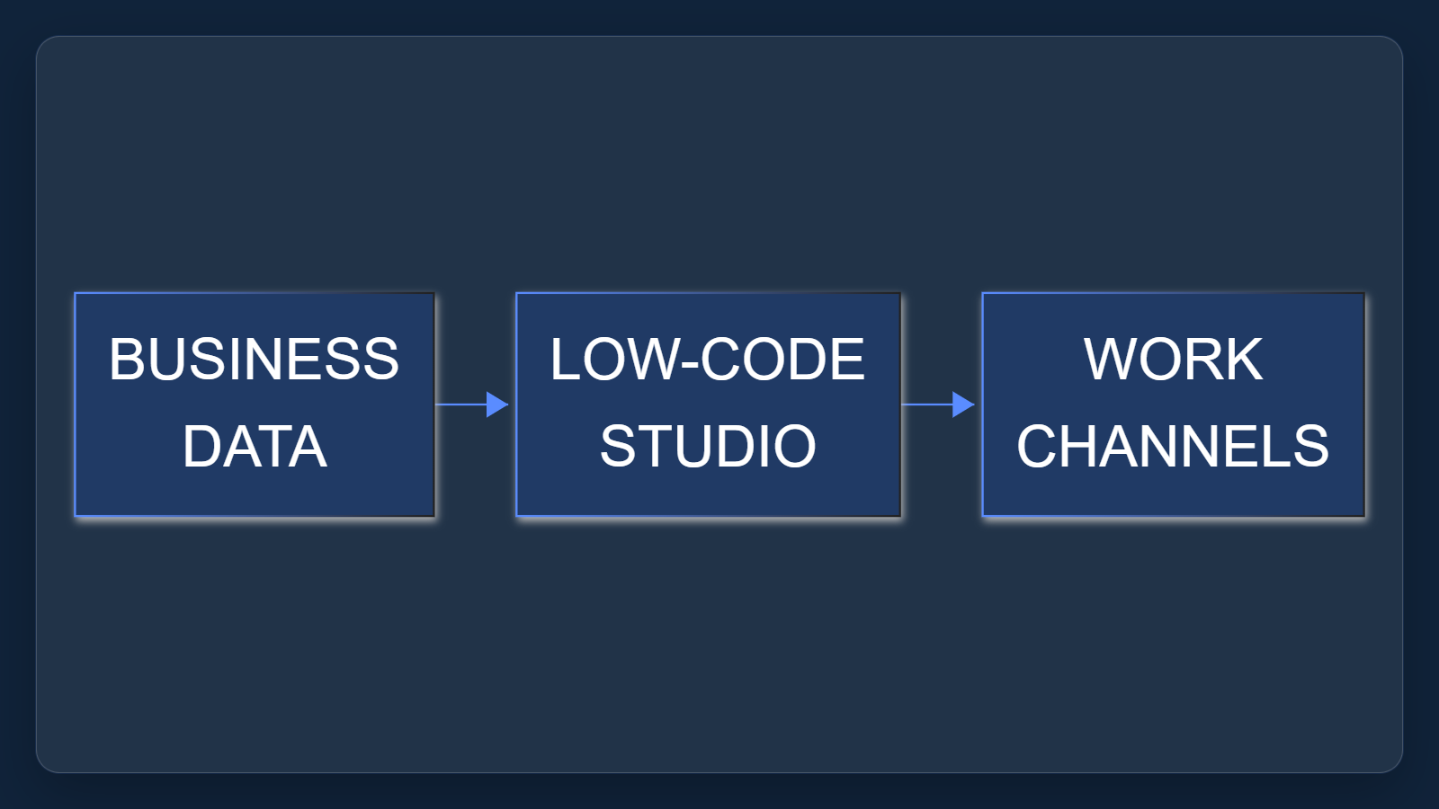
1. Managed build surface
Copilot Studio is a low-code studio for building and managing agents. Teams create agents, workflows and agent flows tied to business data, systems and work channels.
Sources: Overview - Microsoft Copilot Studio · Add tools to custom agents · Security and governance
2 / 6
Notes:
1. Managed build surface
Copilot Studio is a low-code studio for building and managing agents. Teams create agents, workflows and agent flows tied to business data, systems and work channels.
Evidence: Microsoft Learn overview retrieved through project intake. Interpretation: frame the executive decision as governed platform adoption, not isolated bot creation.
Evidence: Copilot Studio is a low-code studio for agents, workflows and agent flows that connect to business data and publish to work channels. [ev-01] Overview - Microsoft Copilot Studio
Evidence: Executives should treat Copilot Studio as a managed agent platform with monitoring, governance, evaluations, administration and policy gates. [ev-09] Add tools to custom agents
Citations
[ev-01] Overview - Microsoft Copilot Studio: https://learn.microsoft.com/en-us/microsoft-copilot-studio/fundamentals-what-is-copilot-studio
[ev-02] Overview - Microsoft Copilot Studio: https://learn.microsoft.com/en-us/microsoft-copilot-studio/fundamentals-what-is-copilot-studio
[ev-03] Overview - Microsoft Copilot Studio: https://learn.microsoft.com/en-us/microsoft-copilot-studio/fundamentals-what-is-copilot-studio
[ev-09] Add tools to custom agents: https://learn.microsoft.com/en-us/microsoft-copilot-studio/add-tools-custom-agent
[ev-10] Security and governance: https://learn.microsoft.com/en-us/microsoft-copilot-studio/security-and-governance
[ev-14] Overview - Microsoft Copilot Studio: https://learn.microsoft.com/en-us/microsoft-copilot-studio/fundamentals-what-is-copilot-studio
[ev-15] Overview - Microsoft Copilot Studio: https://learn.microsoft.com/en-us/microsoft-copilot-studio/fundamentals-what-is-copilot-studio

Slide 3
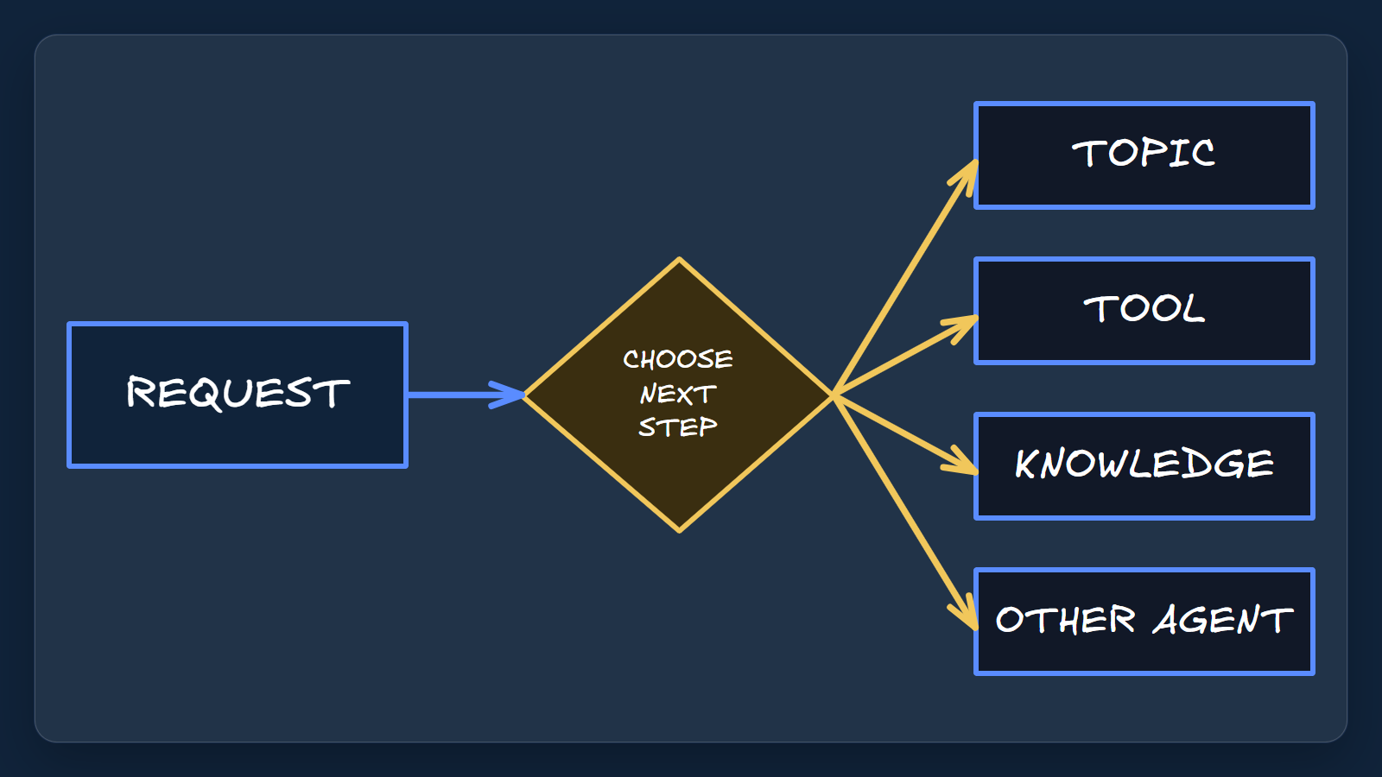
2. Orchestrate choices
Generative orchestration is the decision layer. It lets an agent choose topics, tools, knowledge or other agents, ask for missing input, and then compose the response.
Sources: Orchestrate agent behavior with generative AI
3 / 6
Notes:
2. Orchestrate choices
Generative orchestration is the decision layer. It lets an agent choose topics, tools, knowledge or other agents, ask for missing input, and then compose the response.
Evidence: orchestration documentation states the default for new standard-harness agents and the selection behavior. Interpretation: descriptions become operating metadata.
Evidence: Generative orchestration lets agents choose tools, knowledge, topics or other agents, ask for missing inputs and compose responses. [ev-04] Orchestrate agent behavior with generative AI
Citations
[ev-04] Orchestrate agent behavior with generative AI: https://learn.microsoft.com/en-us/microsoft-copilot-studio/advanced-generative-actions
[ev-05] Orchestrate agent behavior with generative AI: https://learn.microsoft.com/en-us/microsoft-copilot-studio/advanced-generative-actions
[ev-06] Orchestrate agent behavior with generative AI: https://learn.microsoft.com/en-us/microsoft-copilot-studio/advanced-generative-actions

Slide 4
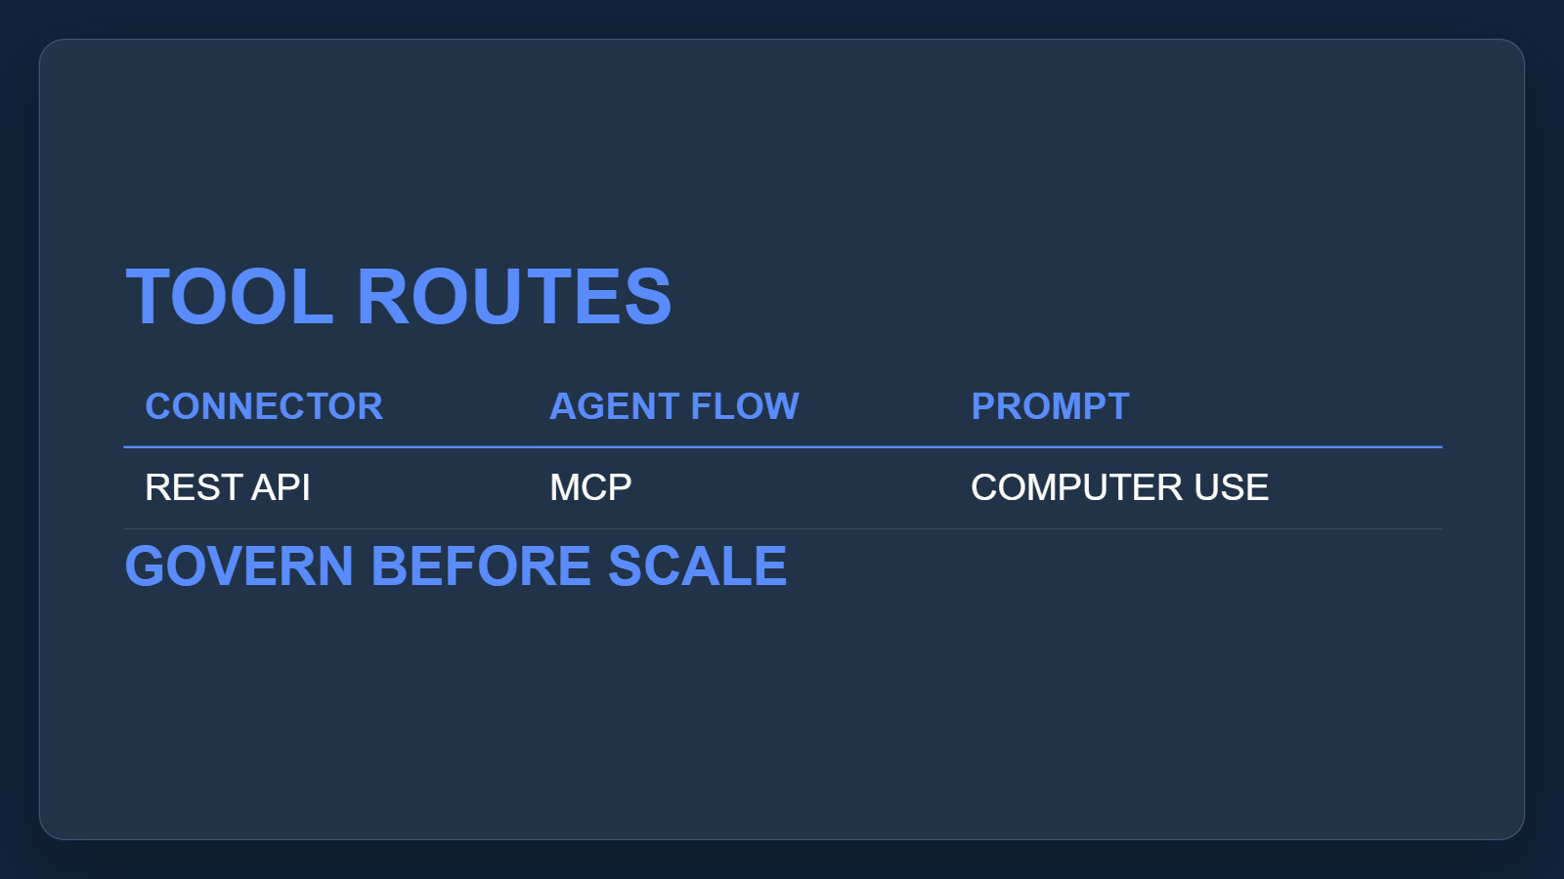
3. Tools execute work
Tools are where intent turns into action. Govern connectors, agent flows, prompts, REST APIs, MCP and computer use for both modern apps and legacy screens under policy.
Sources: Add tools to custom agents
4 / 6
Notes:
3. Tools execute work
Tools are where intent turns into action. Govern connectors, agent flows, prompts, REST APIs, MCP and computer use for both modern apps and legacy screens under policy.
Evidence: the tools article lists the supported tool mechanisms and notes governance policies can restrict tools and connectors. Interpretation: action reach needs portfolio policy.
Evidence: Tools move intent to action through connectors, agent flows, prompts, REST APIs, MCP and computer use, with policy restrictions available. [ev-07] Add tools to custom agents
Citations
[ev-07] Add tools to custom agents: https://learn.microsoft.com/en-us/microsoft-copilot-studio/add-tools-custom-agent
[ev-08] Add tools to custom agents: https://learn.microsoft.com/en-us/microsoft-copilot-studio/add-tools-custom-agent
[ev-09] Add tools to custom agents: https://learn.microsoft.com/en-us/microsoft-copilot-studio/add-tools-custom-agent

Slide 5
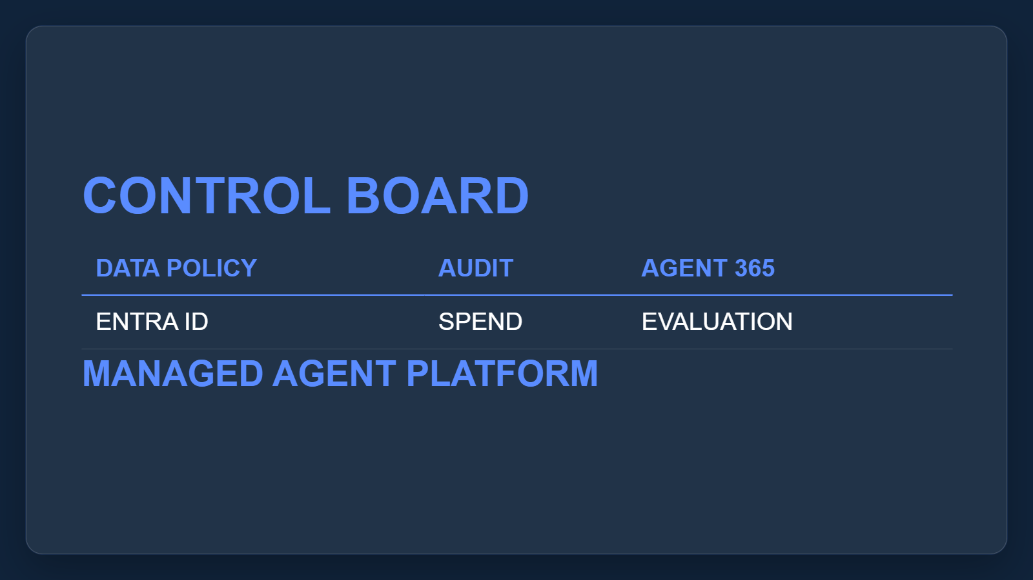
4. Govern the platform
Scale only with enterprise controls attached. Data policies, audit logs, Agent 365, Entra identities, spend controls and evaluations keep the platform managed at scale.
Sources: Security and governance · Add tools to custom agents · Overview - Microsoft Copilot Studio
5 / 6
Notes:
4. Govern the platform
Scale only with enterprise controls attached. Data policies, audit logs, Agent 365, Entra identities, spend controls and evaluations keep the platform managed at scale.
Evidence: governance documentation covers data policies, audit visibility, Agent 365 and Entra identities; overview covers evaluations and administration. Interpretation: fund platform operating controls with use-case rollout.
Evidence: Enterprise control includes data policies, audit visibility, Agent 365 governance, Entra agent identities and security controls. [ev-10] Security and governance
Evidence: Executives should treat Copilot Studio as a managed agent platform with monitoring, governance, evaluations, administration and policy gates. [ev-09] Add tools to custom agents
Citations
[ev-10] Security and governance: https://learn.microsoft.com/en-us/microsoft-copilot-studio/security-and-governance
[ev-11] Security and governance: https://learn.microsoft.com/en-us/microsoft-copilot-studio/security-and-governance
[ev-12] Security and governance: https://learn.microsoft.com/en-us/microsoft-copilot-studio/security-and-governance
[ev-13] Security and governance: https://learn.microsoft.com/en-us/microsoft-copilot-studio/security-and-governance
[ev-09] Add tools to custom agents: https://learn.microsoft.com/en-us/microsoft-copilot-studio/add-tools-custom-agent
[ev-10] Security and governance: https://learn.microsoft.com/en-us/microsoft-copilot-studio/security-and-governance
[ev-14] Overview - Microsoft Copilot Studio: https://learn.microsoft.com/en-us/microsoft-copilot-studio/fundamentals-what-is-copilot-studio
[ev-15] Overview - Microsoft Copilot Studio: https://learn.microsoft.com/en-us/microsoft-copilot-studio/fundamentals-what-is-copilot-studio

Slide 6
Sources. Every claim traces to one.
Overview - Microsoft Copilot Studio retrieved 2026-10-06
https://learn.microsoft.com/en-us/microsoft-copilot-studio/fundamentals-what-is-copilot-studio
Orchestrate agent behavior with generative AI retrieved 2026-10-06
https://learn.microsoft.com/en-us/microsoft-copilot-studio/advanced-generative-actions
Add tools to custom agents retrieved 2026-10-06
https://learn.microsoft.com/en-us/microsoft-copilot-studio/add-tools-custom-agent
Security and governance retrieved 2026-10-06
https://learn.microsoft.com/en-us/microsoft-copilot-studio/security-and-governance
copilot-studio-2026-07-am-michael-kokoro-onnx
6 / 6
Notes:
Sources. Every claim traces to one.
Bottom line: use Copilot Studio as a governed agent platform, moving from business intent to useful action while funding workflows that merit scale, with rigor.
Sources for every claim in this deck.
Citations
Overview - Microsoft Copilot Studio: https://learn.microsoft.com/en-us/microsoft-copilot-studio/fundamentals-what-is-copilot-studio
Overview - Microsoft Copilot Studio: https://learn.microsoft.com/en-us/microsoft-copilot-studio/fundamentals-what-is-copilot-studio
Overview - Microsoft Copilot Studio: https://learn.microsoft.com/en-us/microsoft-copilot-studio/fundamentals-what-is-copilot-studio
Orchestrate agent behavior with generative AI: https://learn.microsoft.com/en-us/microsoft-copilot-studio/advanced-generative-actions
Orchestrate agent behavior with generative AI: https://learn.microsoft.com/en-us/microsoft-copilot-studio/advanced-generative-actions
Orchestrate agent behavior with generative AI: https://learn.microsoft.com/en-us/microsoft-copilot-studio/advanced-generative-actions
Add tools to custom agents: https://learn.microsoft.com/en-us/microsoft-copilot-studio/add-tools-custom-agent
Add tools to custom agents: https://learn.microsoft.com/en-us/microsoft-copilot-studio/add-tools-custom-agent
Add tools to custom agents: https://learn.microsoft.com/en-us/microsoft-copilot-studio/add-tools-custom-agent
Security and governance: https://learn.microsoft.com/en-us/microsoft-copilot-studio/security-and-governance
Security and governance: https://learn.microsoft.com/en-us/microsoft-copilot-studio/security-and-governance
Security and governance: https://learn.microsoft.com/en-us/microsoft-copilot-studio/security-and-governance
Security and governance: https://learn.microsoft.com/en-us/microsoft-copilot-studio/security-and-governance
Overview - Microsoft Copilot Studio: https://learn.microsoft.com/en-us/microsoft-copilot-studio/fundamentals-what-is-copilot-studio
Overview - Microsoft Copilot Studio: https://learn.microsoft.com/en-us/microsoft-copilot-studio/fundamentals-what-is-copilot-studio

