Slide 1
Power Platform ALM: govern one release path
Bottom line: use one ALM path; ship a managed artifact, set target config, move data apart, and do DLP, test, license and approval checks before final go-live.
DECISION Fund one governed ALM path; ship managed artifacts and move data separately.
power-platform-2026-08-am-michael-kokoro-onnx
1 / 6
Notes:
Power Platform ALM: govern one release path
Bottom line: use one ALM path; ship a managed artifact, set target config, move data apart, and do DLP, test, license and approval checks before final go-live.
Bottom line: use one ALM path; ship a managed artifact, set target config, move data apart, and do DLP, test, license and approval checks before final go-live.
Treat the suite as one platform for apps, flows, sites, agents and Dataverse data. Put lifecycle, security, test and release choices in one clear decision frame.
Build change in an unmanaged solution, with source control as the source of truth. Export a managed solution as the build artifact that test and production receive.
Keep configuration and business records on separate tracks. Set connections, references and variables per target, then migrate table rows, because solutions carry no data.
Automate with pipelines, or use Azure DevOps or GitHub when the route needs it. Before final production, check DLP policy, tests, analytics, approvals and licenses.
Evidence: Power Platform ALM spans apps, automation, sites, agents and Dataverse; executives should manage it as one governed delivery path. [ev-01] Overview of application lifecycle management with Microsoft Power Platform
Evidence: Use source control as truth, build changes in unmanaged solutions, and export managed solutions as downstream build artifacts. [ev-03] Overview of application lifecycle management with Microsoft Power Platform
Evidence: Promote the same artifact through ordered stages; configure each target, and move Dataverse table records separately. [ev-09] Overview of pipelines in Power Platform
Evidence: Automate delivery with pipelines and CI/CD; Microsoft documentation points to Azure DevOps or GitHub for some scenarios. [ev-04] Overview of application lifecycle management with Microsoft Power Platform
Evidence: Before production, check DLP connector controls, tests, analytics, approvals and managed-environment licensing. [ev-02] Overview of application lifecycle management with Microsoft Power Platform
Citations
[ev-01] Overview of application lifecycle management with Microsoft Power Platform
[ev-02] Overview of application lifecycle management with Microsoft Power Platform
[ev-03] Overview of application lifecycle management with Microsoft Power Platform
[ev-05] Solution concepts
[ev-06] Solution concepts
[ev-07] Solution concepts
[ev-09] Overview of pipelines in Power Platform
[ev-10] Overview of pipelines in Power Platform
[ev-11] Overview of pipelines in Power Platform
[ev-12] Overview of pipelines in Power Platform
[ev-04] Overview of application lifecycle management with Microsoft Power Platform
[ev-08] Overview of pipelines in Power Platform
[ev-13] Overview of pipelines in Power Platform
[ev-14] Overview of pipelines in Power Platform
[ev-15] Overview of pipelines in Power Platform
[ev-16] Data policies
[ev-17] Data policies

Slide 2
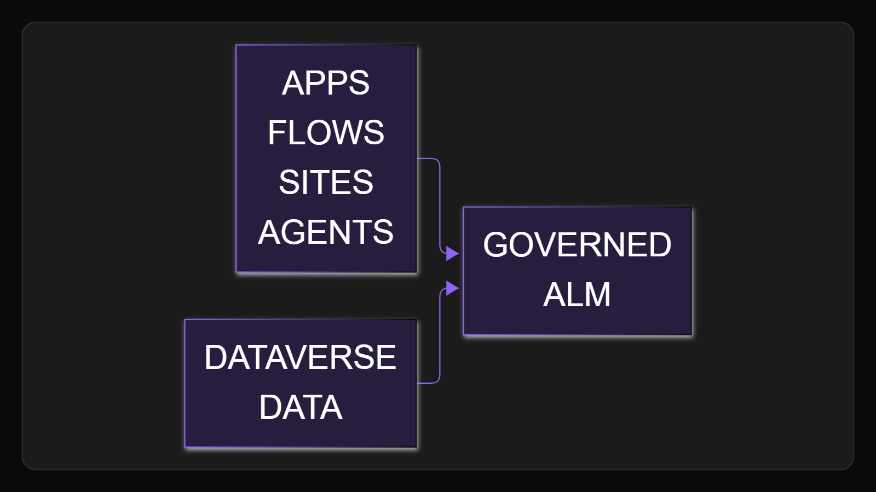
1. One platform
Treat the suite as one platform for apps, flows, sites, agents and Dataverse data. Put lifecycle, security, test and release choices in one clear decision frame.
Sources: Overview of application lifecycle management with Microsoft Power Platform
2 / 6
Notes:
1. One platform
Treat the suite as one platform for apps, flows, sites, agents and Dataverse data. Put lifecycle, security, test and release choices in one clear decision frame.
Evidence: ALM scope includes Power Apps, Power Automate, Power Pages, Copilot Studio and Dataverse, with governance, testing and release management as ALM disciplines. Interpretation: executives should avoid treating each workload as an isolated release path.
Evidence: Power Platform ALM spans apps, automation, sites, agents and Dataverse; executives should manage it as one governed delivery path. [ev-01] Overview of application lifecycle management with Microsoft Power Platform
Citations
[ev-01] Overview of application lifecycle management with Microsoft Power Platform: https://learn.microsoft.com/en-us/power-platform/alm/overview-alm
[ev-02] Overview of application lifecycle management with Microsoft Power Platform: https://learn.microsoft.com/en-us/power-platform/alm/overview-alm

Slide 3
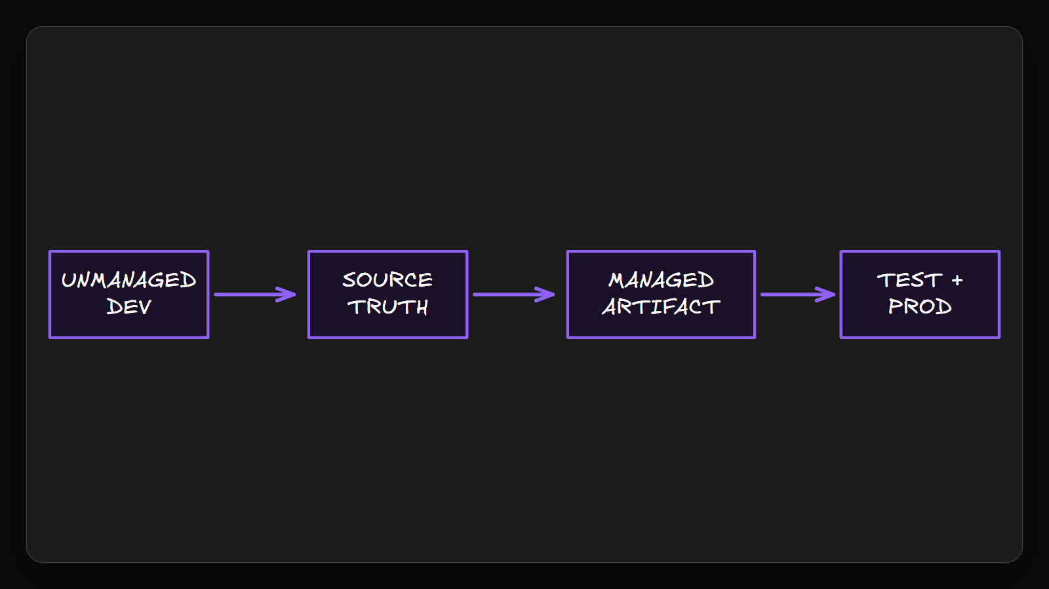
2. Managed artifact
Build change in an unmanaged solution, with source control as the source of truth. Export a managed solution as the build artifact that test and production receive.
Sources: Overview of application lifecycle management with Microsoft Power Platform · Solution concepts
3 / 6
Notes:
2. Managed artifact
Build change in an unmanaged solution, with source control as the source of truth. Export a managed solution as the build artifact that test and production receive.
Evidence: Microsoft Learn states source control should be the source of truth, unmanaged solutions are for development, and managed exports are build artifacts. Interpretation: test and production should receive the managed package, not ad hoc maker changes.
Evidence: Use source control as truth, build changes in unmanaged solutions, and export managed solutions as downstream build artifacts. [ev-03] Overview of application lifecycle management with Microsoft Power Platform
Citations
[ev-03] Overview of application lifecycle management with Microsoft Power Platform: https://learn.microsoft.com/en-us/power-platform/alm/overview-alm
[ev-05] Solution concepts: https://learn.microsoft.com/en-us/power-platform/alm/solution-concepts-alm
[ev-06] Solution concepts: https://learn.microsoft.com/en-us/power-platform/alm/solution-concepts-alm
[ev-07] Solution concepts: https://learn.microsoft.com/en-us/power-platform/alm/solution-concepts-alm

Slide 4
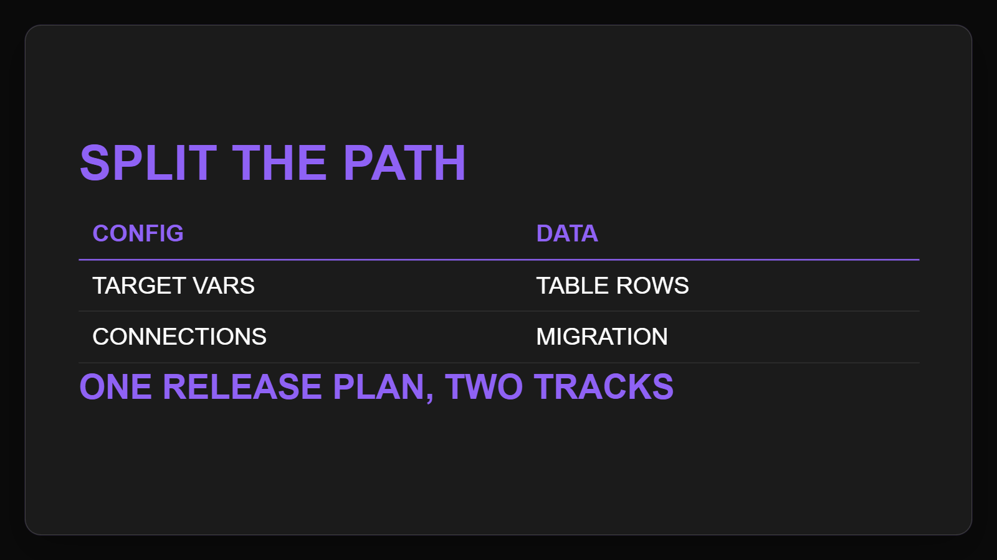
3. Config and data
Keep configuration and business records on separate tracks. Set connections, references and variables per target, then migrate table rows, because solutions carry no data.
Sources: Overview of pipelines in Power Platform
4 / 6
Notes:
3. Config and data
Keep configuration and business records on separate tracks. Set connections, references and variables per target, then migrate table rows, because solutions carry no data.
Evidence: pipelines deploy solution configuration such as connections, connection references and environment variables, while solutions do not contain Dataverse table data. Interpretation: deployment and data migration should be separately planned and validated.
Evidence: Promote the same artifact through ordered stages; configure each target, and move Dataverse table records separately. [ev-09] Overview of pipelines in Power Platform
Citations
[ev-09] Overview of pipelines in Power Platform: https://learn.microsoft.com/en-us/power-platform/alm/pipelines
[ev-10] Overview of pipelines in Power Platform: https://learn.microsoft.com/en-us/power-platform/alm/pipelines
[ev-11] Overview of pipelines in Power Platform: https://learn.microsoft.com/en-us/power-platform/alm/pipelines
[ev-12] Overview of pipelines in Power Platform: https://learn.microsoft.com/en-us/power-platform/alm/pipelines

Slide 5
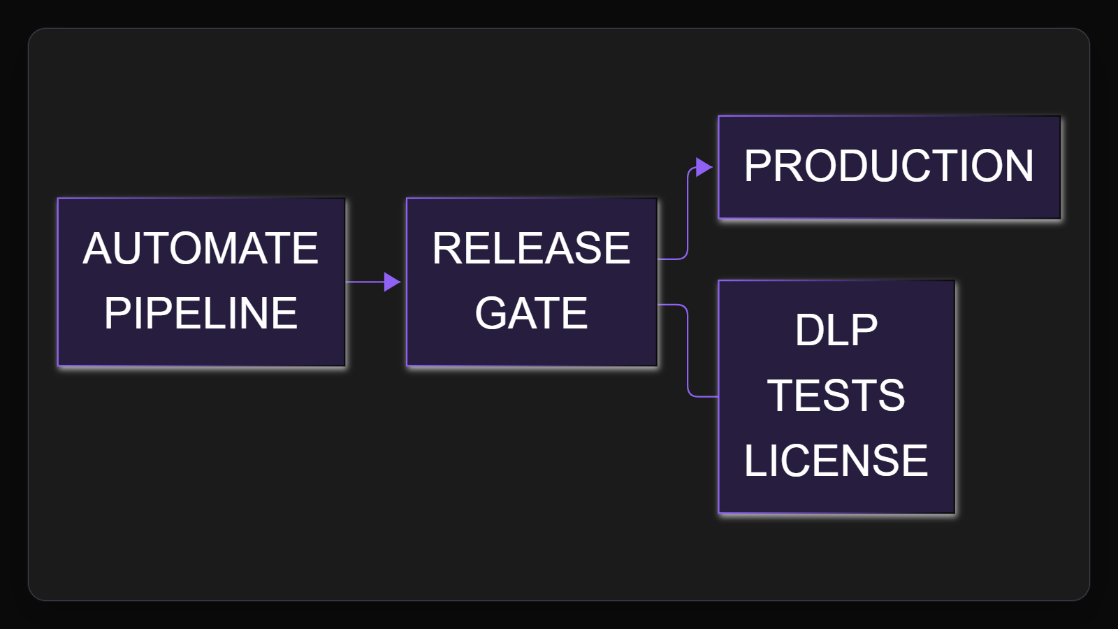
4. Release gate
Automate with pipelines, or use Azure DevOps or GitHub when the route needs it. Before final production, check DLP policy, tests, analytics, approvals and licenses.
Sources: Overview of application lifecycle management with Microsoft Power Platform · Overview of pipelines in Power Platform · Data policies
5 / 6
Notes:
4. Release gate
Automate with pipelines, or use Azure DevOps or GitHub when the route needs it. Before final production, check DLP policy, tests, analytics, approvals and licenses.
Evidence: sources cite automated pipelines, Azure DevOps CI/CD, GitHub for some scenarios, DLP connector controls, pipeline analytics, approval controls and managed-environment licensing. Interpretation: automation speeds promotion but should not bypass release governance.
Evidence: Automate delivery with pipelines and CI/CD; Microsoft documentation points to Azure DevOps or GitHub for some scenarios. [ev-04] Overview of application lifecycle management with Microsoft Power Platform
Evidence: Before production, check DLP connector controls, tests, analytics, approvals and managed-environment licensing. [ev-02] Overview of application lifecycle management with Microsoft Power Platform
Citations
[ev-04] Overview of application lifecycle management with Microsoft Power Platform: https://learn.microsoft.com/en-us/power-platform/alm/overview-alm
[ev-08] Overview of pipelines in Power Platform: https://learn.microsoft.com/en-us/power-platform/alm/pipelines
[ev-13] Overview of pipelines in Power Platform: https://learn.microsoft.com/en-us/power-platform/alm/pipelines
[ev-02] Overview of application lifecycle management with Microsoft Power Platform: https://learn.microsoft.com/en-us/power-platform/alm/overview-alm
[ev-14] Overview of pipelines in Power Platform: https://learn.microsoft.com/en-us/power-platform/alm/pipelines
[ev-15] Overview of pipelines in Power Platform: https://learn.microsoft.com/en-us/power-platform/alm/pipelines
[ev-16] Data policies: https://learn.microsoft.com/en-us/power-platform/admin/wp-data-loss-prevention
[ev-17] Data policies: https://learn.microsoft.com/en-us/power-platform/admin/wp-data-loss-prevention

Slide 6
Sources. Every claim traces to one.
Overview of application lifecycle management with Microsoft Power Platform retrieved 2026-10-06
https://learn.microsoft.com/en-us/power-platform/alm/overview-alm
Solution concepts retrieved 2026-10-06
https://learn.microsoft.com/en-us/power-platform/alm/solution-concepts-alm
Overview of pipelines in Power Platform retrieved 2026-10-06
https://learn.microsoft.com/en-us/power-platform/alm/pipelines
Data policies retrieved 2026-10-06
https://learn.microsoft.com/en-us/power-platform/admin/wp-data-loss-prevention
power-platform-2026-08-am-michael-kokoro-onnx
6 / 6
Notes:
Sources. Every claim traces to one.
Bottom line: use one ALM path; ship a managed artifact, set target config, move data apart, and do DLP, test, license and approval checks before final go-live.
Sources for every claim in this deck.
Citations
Overview of application lifecycle management with Microsoft Power Platform: https://learn.microsoft.com/en-us/power-platform/alm/overview-alm
Overview of application lifecycle management with Microsoft Power Platform: https://learn.microsoft.com/en-us/power-platform/alm/overview-alm
Overview of application lifecycle management with Microsoft Power Platform: https://learn.microsoft.com/en-us/power-platform/alm/overview-alm
Solution concepts: https://learn.microsoft.com/en-us/power-platform/alm/solution-concepts-alm
Solution concepts: https://learn.microsoft.com/en-us/power-platform/alm/solution-concepts-alm
Solution concepts: https://learn.microsoft.com/en-us/power-platform/alm/solution-concepts-alm
Overview of pipelines in Power Platform: https://learn.microsoft.com/en-us/power-platform/alm/pipelines
Overview of pipelines in Power Platform: https://learn.microsoft.com/en-us/power-platform/alm/pipelines
Overview of pipelines in Power Platform: https://learn.microsoft.com/en-us/power-platform/alm/pipelines
Overview of pipelines in Power Platform: https://learn.microsoft.com/en-us/power-platform/alm/pipelines
Overview of application lifecycle management with Microsoft Power Platform: https://learn.microsoft.com/en-us/power-platform/alm/overview-alm
Overview of pipelines in Power Platform: https://learn.microsoft.com/en-us/power-platform/alm/pipelines
Overview of pipelines in Power Platform: https://learn.microsoft.com/en-us/power-platform/alm/pipelines
Overview of pipelines in Power Platform: https://learn.microsoft.com/en-us/power-platform/alm/pipelines
Overview of pipelines in Power Platform: https://learn.microsoft.com/en-us/power-platform/alm/pipelines
Data policies: https://learn.microsoft.com/en-us/power-platform/admin/wp-data-loss-prevention
Data policies: https://learn.microsoft.com/en-us/power-platform/admin/wp-data-loss-prevention

