Slide 1
Microsoft: map needs to the right layer
Bottom line: Microsoft is a portfolio, not one system; first map the need to Windows, Microsoft 365, Azure or Copilot, then verify entitlements early.
DECISION Map needs to the right layer and confirm entitlements before committing.
microsoft-2026-05-am-michael-kokoro-onnx
1 / 6
Notes:
Microsoft: map needs to the right layer
Bottom line: Microsoft is a portfolio, not one system; first map the need to Windows, Microsoft 365, Azure or Copilot, then verify entitlements early.
Bottom line: Microsoft is a portfolio, not one system; first map the need to Windows, Microsoft 365, Azure or Copilot, then verify entitlements early.
Start with Windows when the decision is the PC experience: devices, desktop, apps and user productivity. It anchors the endpoint for users, not every cloud service.
Use Microsoft 365 when the need is everyday work: Office apps, email, files, meetings, sharing and collaboration. It packages work services, not custom infrastructure.
Use Azure when applications need cloud services: compute, storage, data and AI categories. It is the builder layer for apps and managed resources for teams.
Treat Copilot as AI assistance that sits inside selected workflows and licenses. Confirm access, grounding, service availability and subscription before commitments.
Evidence: Windows 11 is the client operating-system layer for PC experience and user productivity. [ev-01] Windows 11 overview for administrators | Microsoft Learn
Evidence: Microsoft 365 combines Office apps with online services for email, file storage, collaboration and meetings. [ev-03] Microsoft 365 for enterprise overview - Microsoft 365 Enterprise | Microsoft Learn
Evidence: Azure is the cloud-services layer for building and managing applications, including AI, compute and storage categories. [ev-05] Azure documentation | Microsoft Learn
Evidence: Copilot Chat provides AI assistance to eligible Microsoft 365 users for information, content and tasks. [ev-07] Overview of Microsoft Copilot Chat | Microsoft Learn
Evidence: Copilot capability and grounding depend on access point, service capacity and Microsoft 365 Copilot licensing. [ev-09] Overview of Microsoft Copilot Chat | Microsoft Learn
Evidence: The selected sources describe separate product layers: Windows, Microsoft 365, Azure and Copilot Chat. [ev-01] Windows 11 overview for administrators | Microsoft Learn
Citations
[ev-01] Windows 11 overview for administrators | Microsoft Learn
[ev-02] Windows 11 overview for administrators | Microsoft Learn
[ev-03] Microsoft 365 for enterprise overview - Microsoft 365 Enterprise | Microsoft Learn
[ev-04] Microsoft 365 for enterprise overview - Microsoft 365 Enterprise | Microsoft Learn
[ev-05] Azure documentation | Microsoft Learn
[ev-06] Azure documentation | Microsoft Learn
[ev-07] Overview of Microsoft Copilot Chat | Microsoft Learn
[ev-08] Overview of Microsoft Copilot Chat | Microsoft Learn
[ev-09] Overview of Microsoft Copilot Chat | Microsoft Learn
[ev-10] Overview of Microsoft Copilot Chat | Microsoft Learn

Slide 2
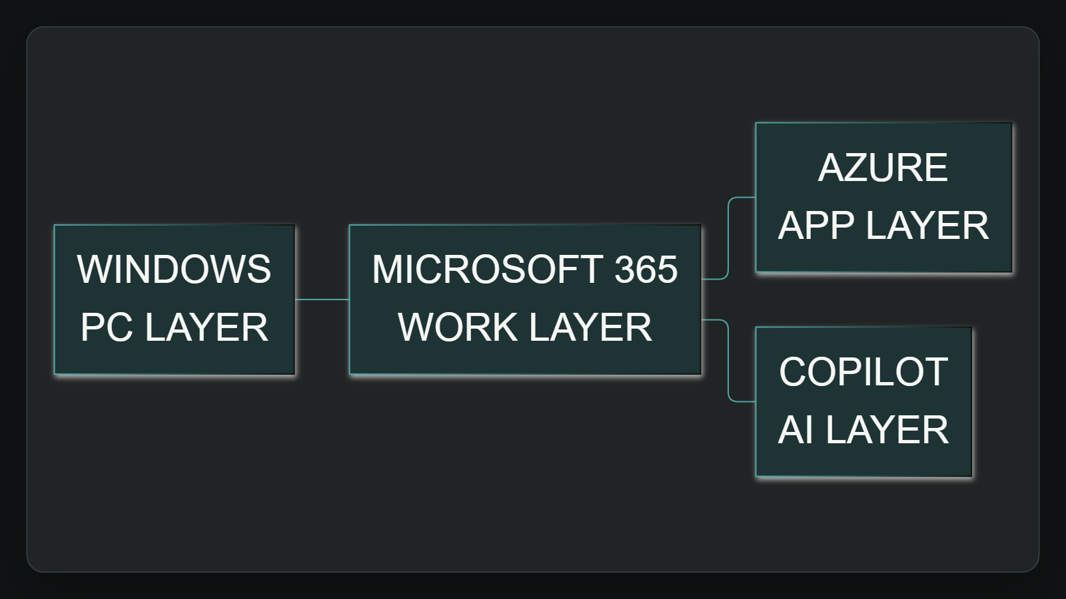
1. Windows is the PC layer
Start with Windows when the decision is the PC experience: devices, desktop, apps and user productivity. It anchors the endpoint for users, not every cloud service.
Sources: Windows 11 overview for administrators | Microsoft Learn · Microsoft 365 for enterprise overview - Microsoft 365 Enterprise | Microsoft Learn · Azure documentation | Microsoft Learn · +1 more
2 / 6
Notes:
1. Windows is the PC layer
Start with Windows when the decision is the PC experience: devices, desktop, apps and user productivity. It anchors the endpoint for users, not every cloud service.
Evidence: Windows 11 is described as a client operating system with productivity-oriented features. Interpretation: treat it as the endpoint layer before expanding into cloud or AI choices.
Evidence: Windows 11 is the client operating-system layer for PC experience and user productivity. [ev-01] Windows 11 overview for administrators | Microsoft Learn
Evidence: The selected sources describe separate product layers: Windows, Microsoft 365, Azure and Copilot Chat. [ev-01] Windows 11 overview for administrators | Microsoft Learn
Citations
[ev-01] Windows 11 overview for administrators | Microsoft Learn: https://learn.microsoft.com/en-us/windows/whats-new/windows-11-overview
[ev-02] Windows 11 overview for administrators | Microsoft Learn: https://learn.microsoft.com/en-us/windows/whats-new/windows-11-overview
[ev-01] Windows 11 overview for administrators | Microsoft Learn: https://learn.microsoft.com/en-us/windows/whats-new/windows-11-overview
[ev-04] Microsoft 365 for enterprise overview - Microsoft 365 Enterprise | Microsoft Learn: https://learn.microsoft.com/en-us/microsoft-365/enterprise/microsoft-365-overview?view=o365-worldwide
[ev-05] Azure documentation | Microsoft Learn: https://learn.microsoft.com/en-us/azure/
[ev-07] Overview of Microsoft Copilot Chat | Microsoft Learn: https://learn.microsoft.com/en-us/copilot/overview

Slide 3
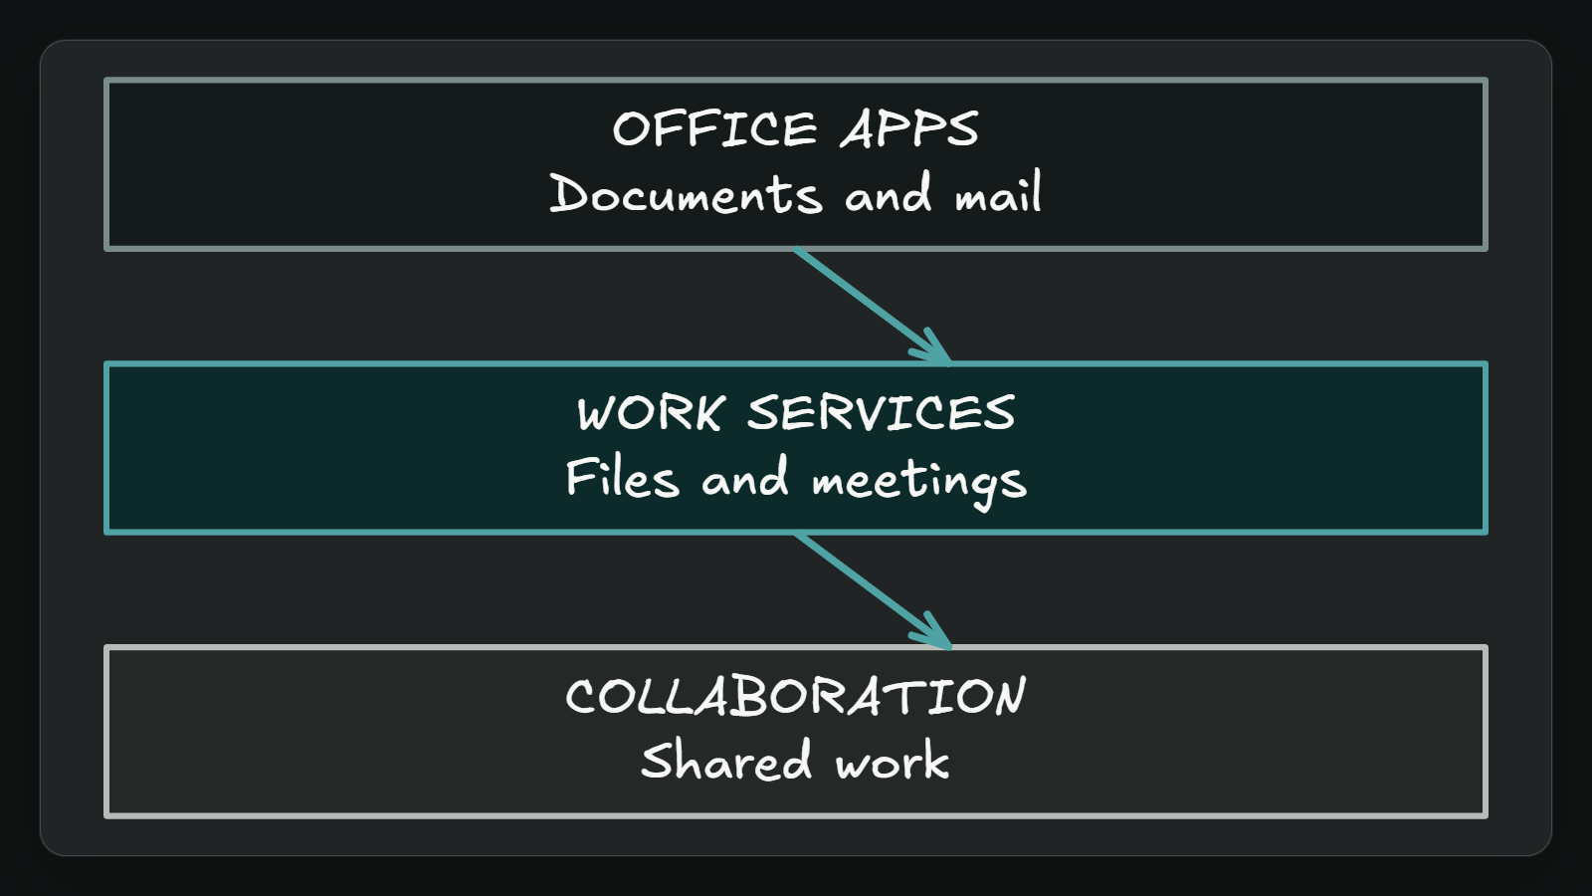
2. Microsoft 365 is work
Use Microsoft 365 when the need is everyday work: Office apps, email, files, meetings, sharing and collaboration. It packages work services, not custom infrastructure.
Sources: Microsoft 365 for enterprise overview - Microsoft 365 Enterprise | Microsoft Learn · Windows 11 overview for administrators | Microsoft Learn · Azure documentation | Microsoft Learn · +1 more
3 / 6
Notes:
2. Microsoft 365 is work
Use Microsoft 365 when the need is everyday work: Office apps, email, files, meetings, sharing and collaboration. It packages work services, not custom infrastructure.
Evidence: Microsoft 365 for enterprise combines Office apps with online services for email, storage, collaboration and meetings. Interpretation: this is the work-productivity layer.
Evidence: Microsoft 365 combines Office apps with online services for email, file storage, collaboration and meetings. [ev-03] Microsoft 365 for enterprise overview - Microsoft 365 Enterprise | Microsoft Learn
Evidence: The selected sources describe separate product layers: Windows, Microsoft 365, Azure and Copilot Chat. [ev-01] Windows 11 overview for administrators | Microsoft Learn
Citations
[ev-03] Microsoft 365 for enterprise overview - Microsoft 365 Enterprise | Microsoft Learn: https://learn.microsoft.com/en-us/microsoft-365/enterprise/microsoft-365-overview?view=o365-worldwide
[ev-04] Microsoft 365 for enterprise overview - Microsoft 365 Enterprise | Microsoft Learn: https://learn.microsoft.com/en-us/microsoft-365/enterprise/microsoft-365-overview?view=o365-worldwide
[ev-01] Windows 11 overview for administrators | Microsoft Learn: https://learn.microsoft.com/en-us/windows/whats-new/windows-11-overview
[ev-04] Microsoft 365 for enterprise overview - Microsoft 365 Enterprise | Microsoft Learn: https://learn.microsoft.com/en-us/microsoft-365/enterprise/microsoft-365-overview?view=o365-worldwide
[ev-05] Azure documentation | Microsoft Learn: https://learn.microsoft.com/en-us/azure/
[ev-07] Overview of Microsoft Copilot Chat | Microsoft Learn: https://learn.microsoft.com/en-us/copilot/overview

Slide 4
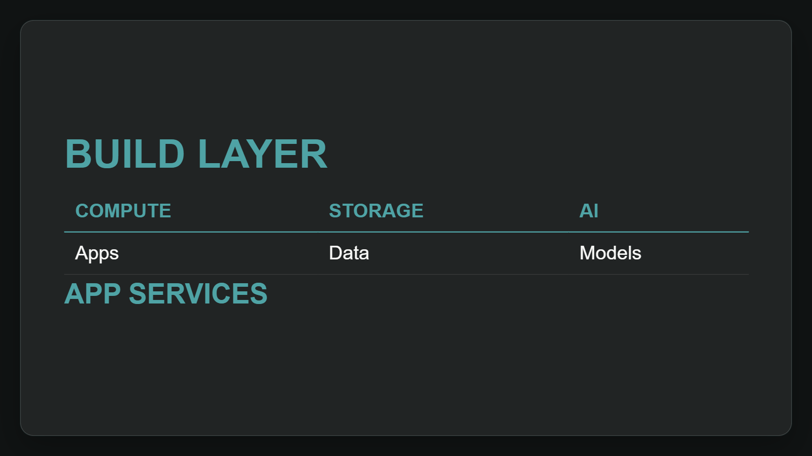
3. Azure builds apps
Use Azure when applications need cloud services: compute, storage, data and AI categories. It is the builder layer for apps and managed resources for teams.
Sources: Azure documentation | Microsoft Learn · Windows 11 overview for administrators | Microsoft Learn · Microsoft 365 for enterprise overview - Microsoft 365 Enterprise | Microsoft Learn · +1 more
4 / 6
Notes:
3. Azure builds apps
Use Azure when applications need cloud services: compute, storage, data and AI categories. It is the builder layer for apps and managed resources for teams.
Evidence: Azure documentation supports building and managing applications and lists AI, compute and storage categories. Interpretation: use Azure for application service needs.
Evidence: Azure is the cloud-services layer for building and managing applications, including AI, compute and storage categories. [ev-05] Azure documentation | Microsoft Learn
Evidence: The selected sources describe separate product layers: Windows, Microsoft 365, Azure and Copilot Chat. [ev-01] Windows 11 overview for administrators | Microsoft Learn
Citations
[ev-05] Azure documentation | Microsoft Learn: https://learn.microsoft.com/en-us/azure/
[ev-06] Azure documentation | Microsoft Learn: https://learn.microsoft.com/en-us/azure/
[ev-01] Windows 11 overview for administrators | Microsoft Learn: https://learn.microsoft.com/en-us/windows/whats-new/windows-11-overview
[ev-04] Microsoft 365 for enterprise overview - Microsoft 365 Enterprise | Microsoft Learn: https://learn.microsoft.com/en-us/microsoft-365/enterprise/microsoft-365-overview?view=o365-worldwide
[ev-05] Azure documentation | Microsoft Learn: https://learn.microsoft.com/en-us/azure/
[ev-07] Overview of Microsoft Copilot Chat | Microsoft Learn: https://learn.microsoft.com/en-us/copilot/overview

Slide 5
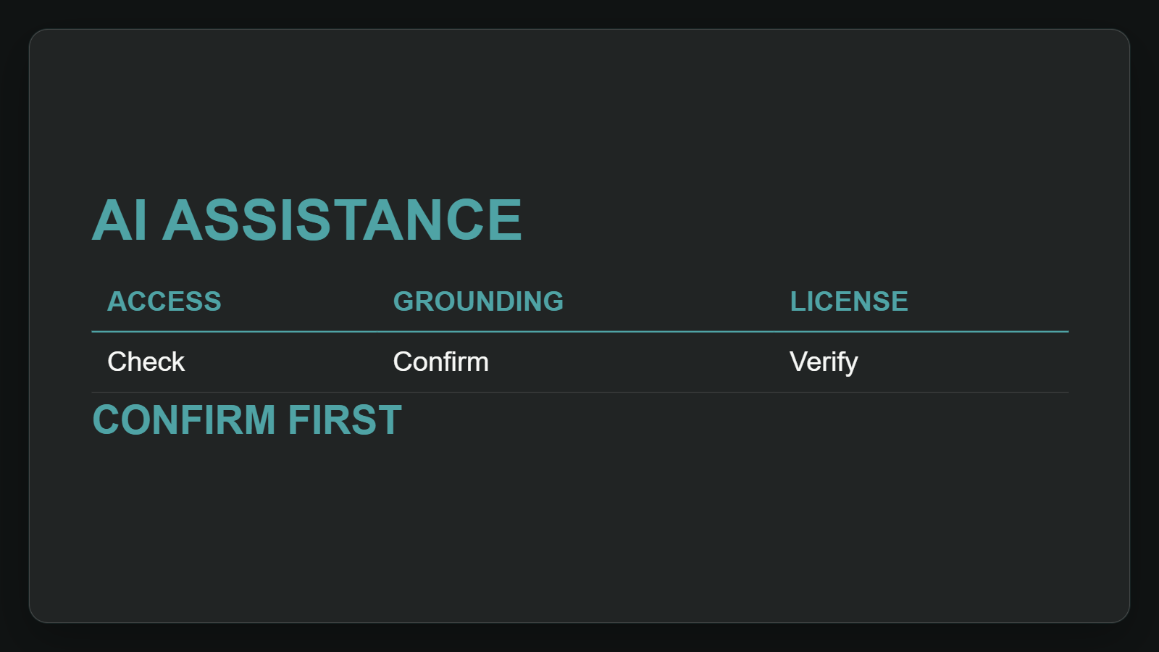
4. Copilot assists workflows
Treat Copilot as AI assistance that sits inside selected workflows and licenses. Confirm access, grounding, service availability and subscription before commitments.
Sources: Overview of Microsoft Copilot Chat | Microsoft Learn
5 / 6
Notes:
4. Copilot assists workflows
Treat Copilot as AI assistance that sits inside selected workflows and licenses. Confirm access, grounding, service availability and subscription before commitments.
Evidence: Copilot Chat helps eligible users find information, create content and complete tasks; grounding depends on access point and licensing. Interpretation: confirm entitlement before rollout.
Evidence: Copilot Chat provides AI assistance to eligible Microsoft 365 users for information, content and tasks. [ev-07] Overview of Microsoft Copilot Chat | Microsoft Learn
Evidence: Copilot capability and grounding depend on access point, service capacity and Microsoft 365 Copilot licensing. [ev-09] Overview of Microsoft Copilot Chat | Microsoft Learn
Citations
[ev-07] Overview of Microsoft Copilot Chat | Microsoft Learn: https://learn.microsoft.com/en-us/copilot/overview
[ev-08] Overview of Microsoft Copilot Chat | Microsoft Learn: https://learn.microsoft.com/en-us/copilot/overview
[ev-09] Overview of Microsoft Copilot Chat | Microsoft Learn: https://learn.microsoft.com/en-us/copilot/overview
[ev-10] Overview of Microsoft Copilot Chat | Microsoft Learn: https://learn.microsoft.com/en-us/copilot/overview

Slide 6
Sources. Every claim traces to one.
Windows 11 overview for administrators | Microsoft Learn retrieved 2026-10-06
https://learn.microsoft.com/en-us/windows/whats-new/windows-11-overview
Microsoft 365 for enterprise overview - Microsoft 365 Enterprise | Microsoft Learn retrieved 2026-10-06
https://learn.microsoft.com/en-us/microsoft-365/enterprise/microsoft-365-overview?view=o365-worldwide
Azure documentation | Microsoft Learn retrieved 2026-10-06
https://learn.microsoft.com/en-us/azure/
Overview of Microsoft Copilot Chat | Microsoft Learn retrieved 2026-10-06
https://learn.microsoft.com/en-us/copilot/overview
microsoft-2026-05-am-michael-kokoro-onnx
6 / 6
Notes:
Sources. Every claim traces to one.
Bottom line: Microsoft is a portfolio, not one system; first map the need to Windows, Microsoft 365, Azure or Copilot, then verify entitlements early.
Sources for every claim in this deck.
Citations
Windows 11 overview for administrators | Microsoft Learn: https://learn.microsoft.com/en-us/windows/whats-new/windows-11-overview
Windows 11 overview for administrators | Microsoft Learn: https://learn.microsoft.com/en-us/windows/whats-new/windows-11-overview
Microsoft 365 for enterprise overview - Microsoft 365 Enterprise | Microsoft Learn: https://learn.microsoft.com/en-us/microsoft-365/enterprise/microsoft-365-overview?view=o365-worldwide
Microsoft 365 for enterprise overview - Microsoft 365 Enterprise | Microsoft Learn: https://learn.microsoft.com/en-us/microsoft-365/enterprise/microsoft-365-overview?view=o365-worldwide
Azure documentation | Microsoft Learn: https://learn.microsoft.com/en-us/azure/
Azure documentation | Microsoft Learn: https://learn.microsoft.com/en-us/azure/
Overview of Microsoft Copilot Chat | Microsoft Learn: https://learn.microsoft.com/en-us/copilot/overview
Overview of Microsoft Copilot Chat | Microsoft Learn: https://learn.microsoft.com/en-us/copilot/overview
Overview of Microsoft Copilot Chat | Microsoft Learn: https://learn.microsoft.com/en-us/copilot/overview
Overview of Microsoft Copilot Chat | Microsoft Learn: https://learn.microsoft.com/en-us/copilot/overview

