Slide 1
Autopilot Agents: decide the operating model before the rollout
Bottom line: treat Copilot Autopilot as a bounded standing role, not a better chatbot. Approve one private-preview pilot only where a named leader owns the goal,…
DECISION Approve one narrow private-preview pilot only when a named business leader owns the goal, access boundary, cost guardrail, exception path and outcome review.
microsoft-autopilot-agents-r1
1 / 5
Notes:
Autopilot Agents: decide the operating model before the rollout
Bottom line: treat Copilot Autopilot as a bounded standing role, not a better chatbot. Approve one private-preview pilot only where a named leader owns the goal, access boundary, cost and outcomes.
Bottom line: treat Copilot Autopilot as a bounded standing role, not a better chatbot. Approve one private-preview pilot only where a named leader owns the goal, access boundary, cost and outcomes.
The shift is from asking for an answer to assigning a standing role. Autopilot was announced with identity, memory, a computer and workspace; leaders still set objectives and boundaries. That changes governance, not just productivity.
Foundry provides an architectural lens, not proof that every implementation is identical: identity establishes the role, while capability can change. The organization controls interactions, access and actions, and an accountable manager remains essential.
Pilot one recurring workflow with one team and one accountable owner. Reuse a blueprint for logic, but scope each instance to its own permissions and assignment. Because Copilot Autopilot remains private preview, require a stop condition and outcome review before expansion.
Evidence: Copilot Autopilot, previously called Scout, was announced as a persistent digital teammate with its own identity, memory, computer and workspace; people set its objective and boundaries and remain informed and in control. [ev-01] Introducing the new Copilot with Home, Code and Autopilot
Evidence: Microsoft said Copilot Autopilot was expanding to private preview at the end of September 2026; the announcement does not establish general availability. [ev-04] Introducing the new Copilot with Home, Code and Autopilot
Evidence: As an architectural lens, Microsoft Foundry defines an autopilot by a persistent standing role and its own identity, security profile and accountable manager, not by a changing feature list. [ev-05] What is an autopilot in Microsoft Foundry?
Evidence: In the Foundry model, autonomy remains bounded: the organization controls when an autopilot responds, who it interacts with, what it accesses and which actions it can take. [ev-07] What is an autopilot in Microsoft Foundry?
Evidence: The Foundry blueprint model separates reusable agent logic and infrastructure from team-specific business access, with each created instance receiving its own identity, permissions and assignment. [ev-08] What is an autopilot in Microsoft Foundry?
Citations
[ev-01] Introducing the new Copilot with Home, Code and Autopilot
[ev-02] Introducing the new Copilot with Home, Code and Autopilot
[ev-03] Introducing the new Copilot with Home, Code and Autopilot
[ev-04] Introducing the new Copilot with Home, Code and Autopilot
[ev-05] What is an autopilot in Microsoft Foundry?
[ev-06] What is an autopilot in Microsoft Foundry?
[ev-07] What is an autopilot in Microsoft Foundry?
[ev-08] What is an autopilot in Microsoft Foundry?
[ev-09] What is an autopilot in Microsoft Foundry?
[ev-10] What is an autopilot in Microsoft Foundry?

Slide 2
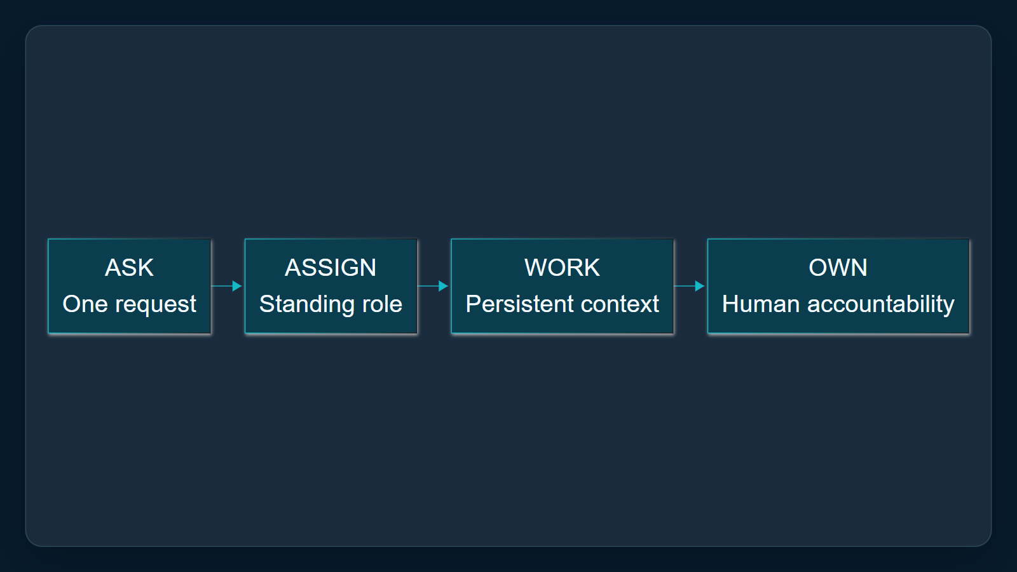
1. Change the unit of delegation
The shift is from asking for an answer to assigning a standing role. Autopilot was announced with identity, memory, a computer and workspace; leaders still set objectives and boundaries. That changes governance, not just productivity.
Sources: [ev-01] Introducing the new Copilot with Home, Code and Autopilot · [ev-02] Introducing the new Copilot with Home, Code and Autopilot · [ev-03] Introducing the new Copilot with Home, Code and Autopilot
2 / 5
Notes:
1. Change the unit of delegation
The shift is from asking for an answer to assigning a standing role. Autopilot was announced with identity, memory, a computer and workspace; leaders still set objectives and boundaries. That changes governance, not just productivity.
Evidence: Microsoft announcement, Autopilot section, retrieved 2026-10-06. Interpretation: a standing role changes the operating model. This is Copilot Autopilot, previously Scout, not Windows Autopilot device provisioning.
Evidence: Copilot Autopilot, previously called Scout, was announced as a persistent digital teammate with its own identity, memory, computer and workspace; people set its objective and boundaries and remain informed and in control. [ev-01] Introducing the new Copilot with Home, Code and Autopilot
Citations
[ev-01] Introducing the new Copilot with Home, Code and Autopilot: https://blogs.microsoft.com/blog/2026/09/25/introducing-the-new-copilot-with-home-code-and-autopilot/
[ev-02] Introducing the new Copilot with Home, Code and Autopilot: https://blogs.microsoft.com/blog/2026/09/25/introducing-the-new-copilot-with-home-code-and-autopilot/
[ev-03] Introducing the new Copilot with Home, Code and Autopilot: https://blogs.microsoft.com/blog/2026/09/25/introducing-the-new-copilot-with-home-code-and-autopilot/

Slide 3
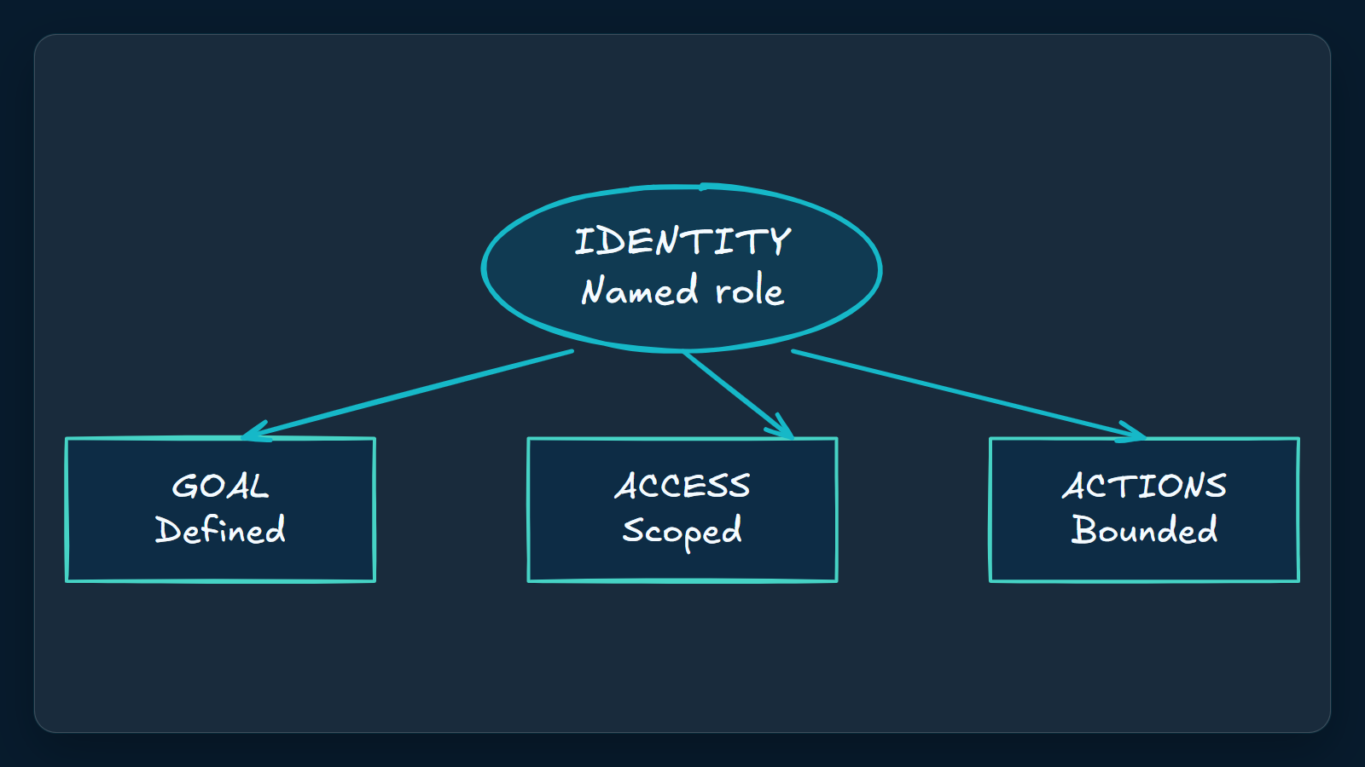
2. Govern identity before capability
Foundry provides an architectural lens, not proof that every implementation is identical: identity establishes the role, while capability can change. The organization controls interactions, access and actions, and an accountable manager remains essential.
Sources: [ev-05] What is an autopilot in Microsoft Foundry? · [ev-06] What is an autopilot in Microsoft Foundry? · [ev-07] What is an autopilot in Microsoft Foundry?
3 / 5
Notes:
2. Govern identity before capability
Foundry provides an architectural lens, not proof that every implementation is identical: identity establishes the role, while capability can change. The organization controls interactions, access and actions, and an accountable manager remains essential.
Evidence: Microsoft Foundry autopilot overview, opening definition and autonomy section, retrieved 2026-10-06. Applicability limit: architectural lens only; do not assert implementation equivalence with Copilot Autopilot.
Evidence: As an architectural lens, Microsoft Foundry defines an autopilot by a persistent standing role and its own identity, security profile and accountable manager, not by a changing feature list. [ev-05] What is an autopilot in Microsoft Foundry?
Evidence: In the Foundry model, autonomy remains bounded: the organization controls when an autopilot responds, who it interacts with, what it accesses and which actions it can take. [ev-07] What is an autopilot in Microsoft Foundry?
Citations
[ev-05] What is an autopilot in Microsoft Foundry?: https://learn.microsoft.com/en-us/azure/foundry/agents/concepts/autopilot-overview
[ev-06] What is an autopilot in Microsoft Foundry?: https://learn.microsoft.com/en-us/azure/foundry/agents/concepts/autopilot-overview
[ev-07] What is an autopilot in Microsoft Foundry?: https://learn.microsoft.com/en-us/azure/foundry/agents/concepts/autopilot-overview

Slide 4
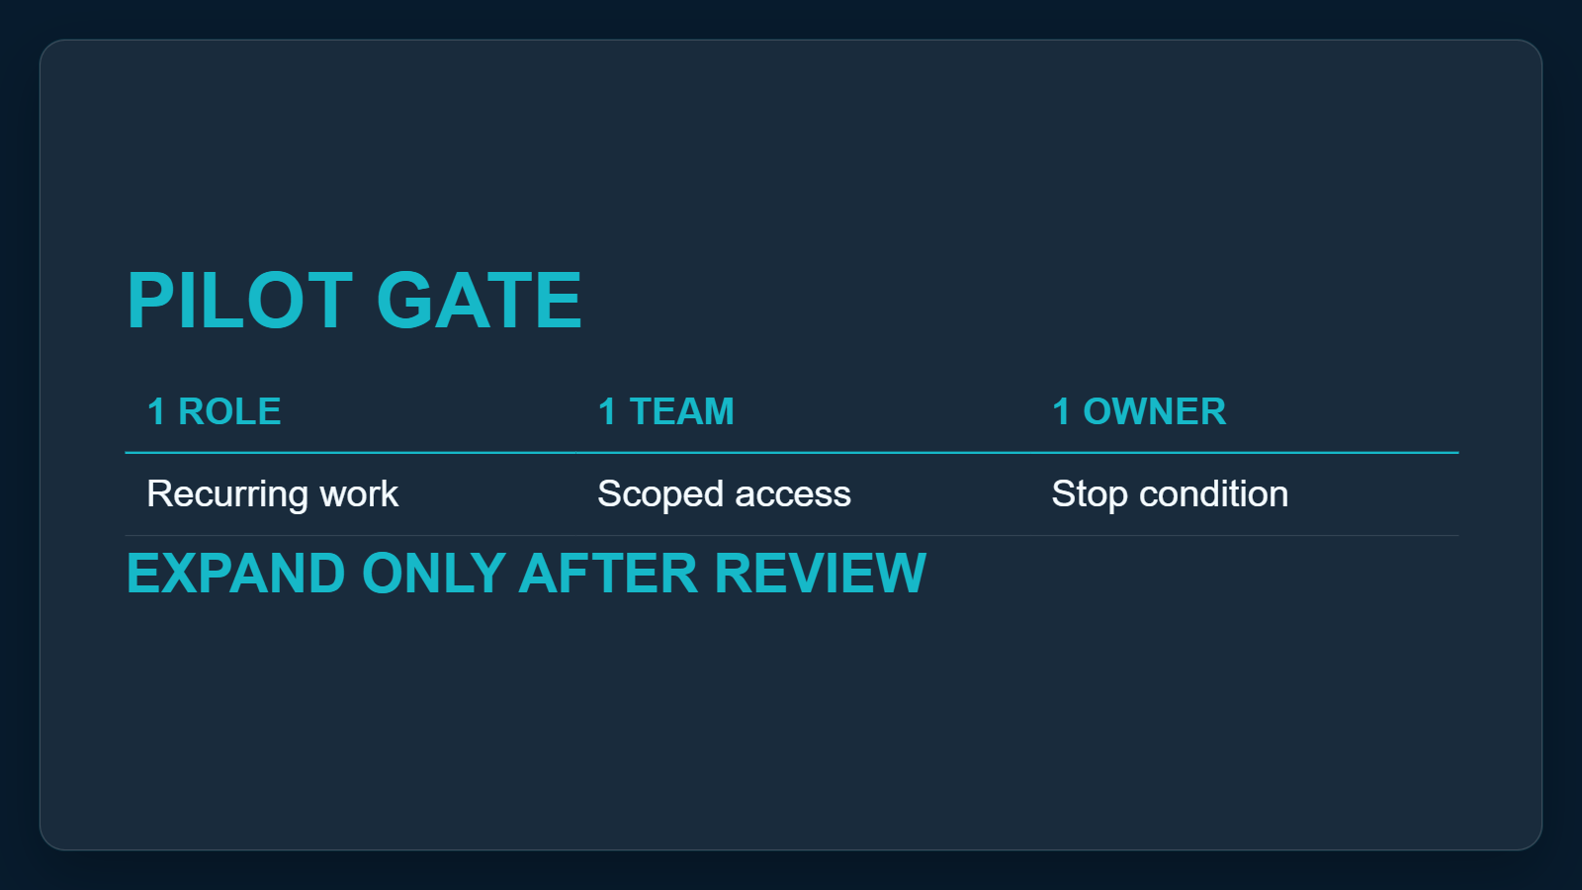
3. Pilot the role, not the technology
Pilot one recurring workflow with one team and one accountable owner. Reuse a blueprint for logic, but scope each instance to its own permissions and assignment. Because Copilot Autopilot remains private preview, require a stop condition and outcome review before expansion.
Sources: [ev-04] Introducing the new Copilot with Home, Code and Autopilot · [ev-08] What is an autopilot in Microsoft Foundry? · [ev-09] What is an autopilot in Microsoft Foundry?
4 / 5
Notes:
3. Pilot the role, not the technology
Pilot one recurring workflow with one team and one accountable owner. Reuse a blueprint for logic, but scope each instance to its own permissions and assignment. Because Copilot Autopilot remains private preview, require a stop condition and outcome review before expansion.
Evidence: Microsoft announcement private-preview statement and Microsoft Foundry blueprint section, retrieved 2026-10-06. Proposed action: one workflow, one team, one owner, explicit access boundary, cost guardrail, stop condition and review.
Evidence: Microsoft said Copilot Autopilot was expanding to private preview at the end of September 2026; the announcement does not establish general availability. [ev-04] Introducing the new Copilot with Home, Code and Autopilot
Evidence: The Foundry blueprint model separates reusable agent logic and infrastructure from team-specific business access, with each created instance receiving its own identity, permissions and assignment. [ev-08] What is an autopilot in Microsoft Foundry?
Citations
[ev-04] Introducing the new Copilot with Home, Code and Autopilot: https://blogs.microsoft.com/blog/2026/09/25/introducing-the-new-copilot-with-home-code-and-autopilot/
[ev-08] What is an autopilot in Microsoft Foundry?: https://learn.microsoft.com/en-us/azure/foundry/agents/concepts/autopilot-overview
[ev-09] What is an autopilot in Microsoft Foundry?: https://learn.microsoft.com/en-us/azure/foundry/agents/concepts/autopilot-overview
[ev-10] What is an autopilot in Microsoft Foundry?: https://learn.microsoft.com/en-us/azure/foundry/agents/concepts/autopilot-overview

Slide 5
Sources. Every claim traces to one.
Introducing the new Copilot with Home, Code and Autopilot retrieved 2026-10-06
https://blogs.microsoft.com/blog/2026/09/25/introducing-the-new-copilot-with-home-code-and-autopilot/
What is an autopilot in Microsoft Foundry? retrieved 2026-10-06
https://learn.microsoft.com/en-us/azure/foundry/agents/concepts/autopilot-overview
microsoft-autopilot-agents-r1
5 / 5
Notes:
Sources. Every claim traces to one.
Bottom line: treat Copilot Autopilot as a bounded standing role, not a better chatbot. Approve one private-preview pilot only where a named leader owns the goal, access boundary, cost and outcomes.
Sources for every claim in this deck.
Citations
Introducing the new Copilot with Home, Code and Autopilot: https://blogs.microsoft.com/blog/2026/09/25/introducing-the-new-copilot-with-home-code-and-autopilot/
Introducing the new Copilot with Home, Code and Autopilot: https://blogs.microsoft.com/blog/2026/09/25/introducing-the-new-copilot-with-home-code-and-autopilot/
Introducing the new Copilot with Home, Code and Autopilot: https://blogs.microsoft.com/blog/2026/09/25/introducing-the-new-copilot-with-home-code-and-autopilot/
Introducing the new Copilot with Home, Code and Autopilot: https://blogs.microsoft.com/blog/2026/09/25/introducing-the-new-copilot-with-home-code-and-autopilot/
What is an autopilot in Microsoft Foundry?: https://learn.microsoft.com/en-us/azure/foundry/agents/concepts/autopilot-overview
What is an autopilot in Microsoft Foundry?: https://learn.microsoft.com/en-us/azure/foundry/agents/concepts/autopilot-overview
What is an autopilot in Microsoft Foundry?: https://learn.microsoft.com/en-us/azure/foundry/agents/concepts/autopilot-overview
What is an autopilot in Microsoft Foundry?: https://learn.microsoft.com/en-us/azure/foundry/agents/concepts/autopilot-overview
What is an autopilot in Microsoft Foundry?: https://learn.microsoft.com/en-us/azure/foundry/agents/concepts/autopilot-overview
What is an autopilot in Microsoft Foundry?: https://learn.microsoft.com/en-us/azure/foundry/agents/concepts/autopilot-overview

