Slide 1
PPCC 2026: turn conference learning into one governed pilot
PPCC 2026 is an upcoming opportunity to connect agents, apps, automation, trusted data, and governance to a concrete executive pilot decision.
DECISION Recommendation: send a focused team to PPCC 2026 to return with one governed AI, app, and automation pilot charter.
power-platform-community-conference-2026-11-am-michael-kokoro-onnx
1 / 6
Notes:
PPCC 2026: turn conference learning into one governed pilot
PPCC 2026 is an upcoming opportunity to connect agents, apps, automation, trusted data, and governance to a concrete executive pilot decision.
Bottom line: recommend sending a focused cross-functional team to PPCC 2026 with one objective: return with a governed AI, app, and automation pilot proposal.
This is a recommendation, not a measured outcome. Treat the event as a structured learning sprint for business, platform, data, and risk leaders.
PPCC runs October 27 through 29 at the MGM Grand in Las Vegas. Applied workshops run before and after the main conference.
Microsoft frames PPCC around Copilot, agents, apps, automation, and data. The program connects those capabilities to trusted data, implementation, architecture, and governance. That is the bridge from innovation ambition to execution controls.
After the event, require one pilot charter naming the workflow, owner, trusted data, guardrails, and a testable success measure. Expand only when that evidence supports the next decision.
Evidence: PPCC 2026 runs October 27-29 at the MGM Grand in Las Vegas. [ev-01] Register now for PPCC 2026: Come for the learning, stay for the community
Evidence: Microsoft frames PPCC around Copilot, agents, apps, automation, and data. [ev-01] Register now for PPCC 2026: Come for the learning, stay for the community
Evidence: PPCC covers agents, apps, automation, and trusted data as governed business solutions. [ev-02] Register now for PPCC 2026: Come for the learning, stay for the community
Evidence: The FAQ emphasizes implementation, architecture, governance, and AI-driven scenarios. [ev-03] FAQ | PPCC26
Evidence: Applied workshops run October 25-26 and October 30, outside the main conference. [ev-04] FAQ | PPCC26
Citations
[ev-01] Register now for PPCC 2026: Come for the learning, stay for the community
[ev-02] Register now for PPCC 2026: Come for the learning, stay for the community
[ev-03] FAQ | PPCC26
[ev-04] FAQ | PPCC26
[ev-05] FAQ | PPCC26

Slide 2
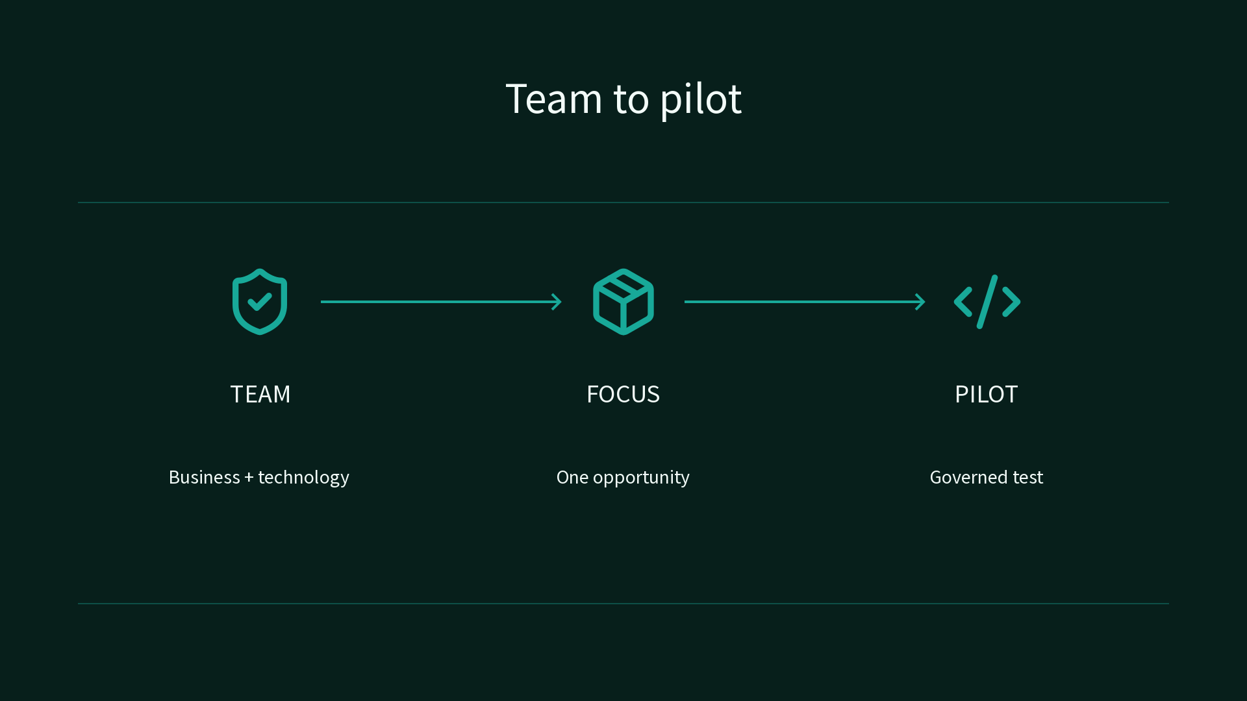
Bottom line: send a focused team with one pilot objective
Recommendation: send a focused business, platform, data, and risk team with one mandate: return with a governed AI, app, and automation pilot charter.
Sources: Register now for PPCC 2026: Come for the learning, stay for the community
2 / 6
Notes:
Bottom line: send a focused team with one pilot objective
Recommendation: send a focused business, platform, data, and risk team with one mandate: return with a governed AI, app, and automation pilot charter.
State clearly that this is a recommendation, not a measured outcome.
Evidence: Microsoft frames PPCC around Copilot, agents, apps, automation, and data. [ev-01] Register now for PPCC 2026: Come for the learning, stay for the community
Citations
[ev-01] Register now for PPCC 2026: Come for the learning, stay for the community: https://www.microsoft.com/en-us/power-platform/blog/2026/08/13/register-now-for-ppcc-2026-come-for-the-learning-stay-for-the-community/

Slide 3
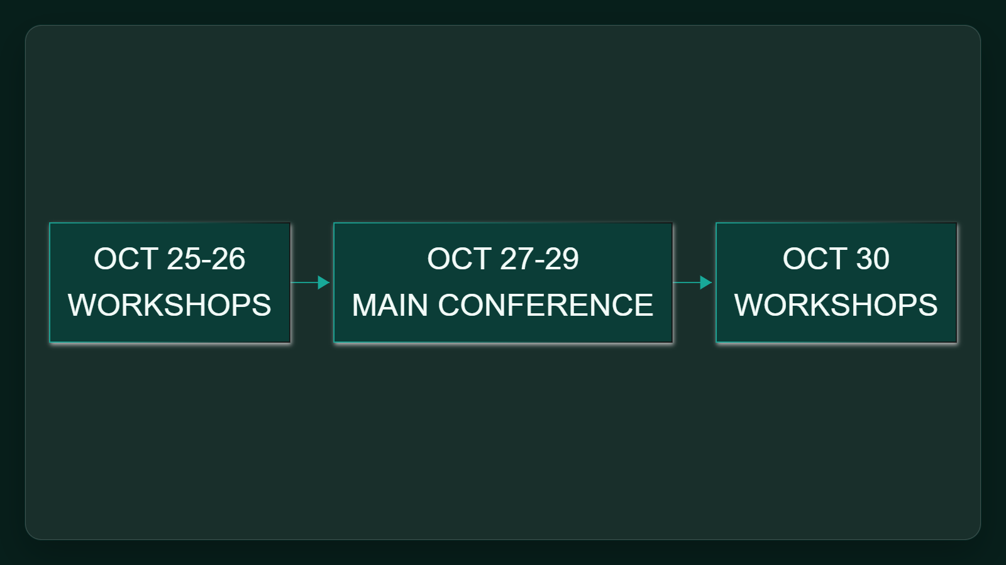
Use the full conference week deliberately
Main conference: October 27-29 at the MGM Grand in Las Vegas. Workshops: October 25-26 and October 30.
Sources: Register now for PPCC 2026: Come for the learning, stay for the community · FAQ | PPCC26
3 / 6
Notes:
Use the full conference week deliberately
Main conference: October 27-29 at the MGM Grand in Las Vegas. Workshops: October 25-26 and October 30.
Show the sequence without discussing registration prices.
Evidence: PPCC 2026 runs October 27-29 at the MGM Grand in Las Vegas. [ev-01] Register now for PPCC 2026: Come for the learning, stay for the community
Evidence: Applied workshops run October 25-26 and October 30, outside the main conference. [ev-04] FAQ | PPCC26
Citations
[ev-01] Register now for PPCC 2026: Come for the learning, stay for the community: https://www.microsoft.com/en-us/power-platform/blog/2026/08/13/register-now-for-ppcc-2026-come-for-the-learning-stay-for-the-community/
[ev-04] FAQ | PPCC26: https://powerplatformconf.com/faq
[ev-05] FAQ | PPCC26: https://powerplatformconf.com/faq

Slide 4
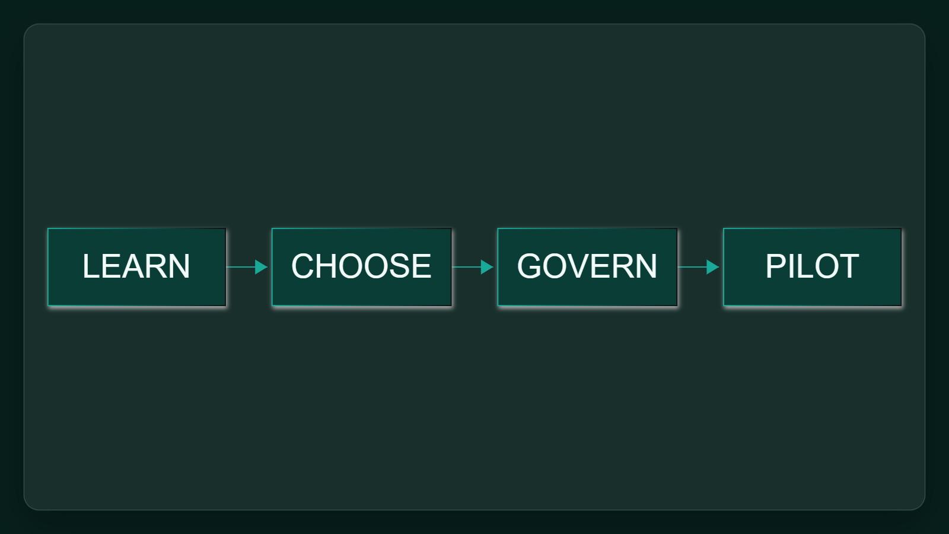
Connect innovation ambition to execution controls
PPCC connects agents, apps, automation, and trusted data with implementation, architecture, governance, and AI-driven scenarios.
Sources: Register now for PPCC 2026: Come for the learning, stay for the community · FAQ | PPCC26
4 / 6
Notes:
Connect innovation ambition to execution controls
PPCC connects agents, apps, automation, and trusted data with implementation, architecture, governance, and AI-driven scenarios.
Keep the focus on executive execution rather than a product feature list.
Evidence: PPCC covers agents, apps, automation, and trusted data as governed business solutions. [ev-02] Register now for PPCC 2026: Come for the learning, stay for the community
Evidence: The FAQ emphasizes implementation, architecture, governance, and AI-driven scenarios. [ev-03] FAQ | PPCC26
Citations
[ev-02] Register now for PPCC 2026: Come for the learning, stay for the community: https://www.microsoft.com/en-us/power-platform/blog/2026/08/13/register-now-for-ppcc-2026-come-for-the-learning-stay-for-the-community/
[ev-03] FAQ | PPCC26: https://powerplatformconf.com/faq

Slide 5
Require one pilot charter after the event
Ask the team to return with the workflow, owner, trusted data, guardrails, and testable success measure for one pilot. Expansion should depend on that evidence, not conference enthusiasm.
The FAQ emphasizes implementation, architecture, governance, and AI-driven scenarios.
FAQ | PPCC26
Sources: FAQ | PPCC26
5 / 6
Notes:
Require one pilot charter after the event
Ask the team to return with the workflow, owner, trusted data, guardrails, and testable success measure for one pilot. Expansion should depend on that evidence, not conference enthusiasm.
Close with the proposed deliverable and avoid inventing an owner or deadline.
Evidence: The FAQ emphasizes implementation, architecture, governance, and AI-driven scenarios. [ev-03] FAQ | PPCC26
Citations
[ev-03] FAQ | PPCC26: https://powerplatformconf.com/faq

Slide 6
Sources. Every claim traces to one.
Register now for PPCC 2026: Come for the learning, stay for the community retrieved 2026-10-05
https://www.microsoft.com/en-us/power-platform/blog/2026/08/13/register-now-for-ppcc-2026-come-for-the-learning-stay-for-the-community/
FAQ | PPCC26 retrieved 2026-10-05
https://powerplatformconf.com/faq
power-platform-community-conference-2026-11-am-michael-kokoro-onnx
6 / 6
Notes:
Sources. Every claim traces to one.
PPCC 2026 is an upcoming opportunity to connect agents, apps, automation, trusted data, and governance to a concrete executive pilot decision.
Sources for every claim in this deck.
Citations
Register now for PPCC 2026: Come for the learning, stay for the community: https://www.microsoft.com/en-us/power-platform/blog/2026/08/13/register-now-for-ppcc-2026-come-for-the-learning-stay-for-the-community/
Register now for PPCC 2026: Come for the learning, stay for the community: https://www.microsoft.com/en-us/power-platform/blog/2026/08/13/register-now-for-ppcc-2026-come-for-the-learning-stay-for-the-community/
FAQ | PPCC26: https://powerplatformconf.com/faq
FAQ | PPCC26: https://powerplatformconf.com/faq
FAQ | PPCC26: https://powerplatformconf.com/faq

