Slide 1
Autopilot Agents: decide the operating model before the rollout
Bottom line: Copilot Autopilot is a bounded standing role, not a chatbot. Pilot privately with one owner, scoped access, cost guardrail and review.
DECISION Approve one narrow private-preview pilot only when a named business leader owns the goal, access boundary, cost guardrail, exception path and outcome review.
microsoft-autopilot-agents-r1
1 / 5
Notes:
Autopilot Agents: decide the operating model before the rollout
Bottom line: Copilot Autopilot is a bounded standing role, not a chatbot. Pilot privately with one owner, scoped access, cost guardrail and review.
Bottom line: Copilot Autopilot is a bounded standing role, not a chatbot. Pilot privately with one owner, scoped access, cost guardrail and review.
The shift is from asking for an answer to assigning a standing role. Autopilot brings identity, memory and a workspace; leaders still own objectives and boundaries. Governance changes with the unit of delegation.
Foundry is an architectural lens, not proof of identical implementation. Identity anchors the standing role; the organization still bounds interactions, access and actions, with a manager accountable for the role.
Pilot one recurring workflow with one team and owner. Reuse blueprint logic, but scope each instance to its own permissions and assignment. While Autopilot is private preview, require a stop condition and review before expansion.
Evidence: Copilot Autopilot, previously Scout, was announced as a persistent digital teammate with its own identity, memory, computer and workspace; people set objectives and boundaries and remain in control. [ev-01] Introducing the new Copilot with Home, Code and Autopilot
Evidence: Microsoft said Copilot Autopilot was expanding to private preview at the end of September 2026; the announcement does not establish general availability. [ev-04] Introducing the new Copilot with Home, Code and Autopilot
Evidence: As an architectural lens, Microsoft Foundry defines an autopilot by its standing role, identity, security profile and accountable manager, not by a changing feature list. [ev-05] What is an autopilot in Microsoft Foundry?
Evidence: In the Foundry model, autonomy remains bounded: the organization controls when an autopilot responds, who it interacts with, what it accesses and which actions it can take. [ev-07] What is an autopilot in Microsoft Foundry?
Evidence: The Foundry blueprint model separates reusable logic and infrastructure from team-specific access; each instance receives its own identity, permissions and assignment. [ev-08] What is an autopilot in Microsoft Foundry?
Citations
[ev-01] Introducing the new Copilot with Home, Code and Autopilot
[ev-02] Introducing the new Copilot with Home, Code and Autopilot
[ev-03] Introducing the new Copilot with Home, Code and Autopilot
[ev-04] Introducing the new Copilot with Home, Code and Autopilot
[ev-05] What is an autopilot in Microsoft Foundry?
[ev-06] What is an autopilot in Microsoft Foundry?
[ev-07] What is an autopilot in Microsoft Foundry?
[ev-08] What is an autopilot in Microsoft Foundry?
[ev-09] What is an autopilot in Microsoft Foundry?
[ev-10] What is an autopilot in Microsoft Foundry?

Slide 2
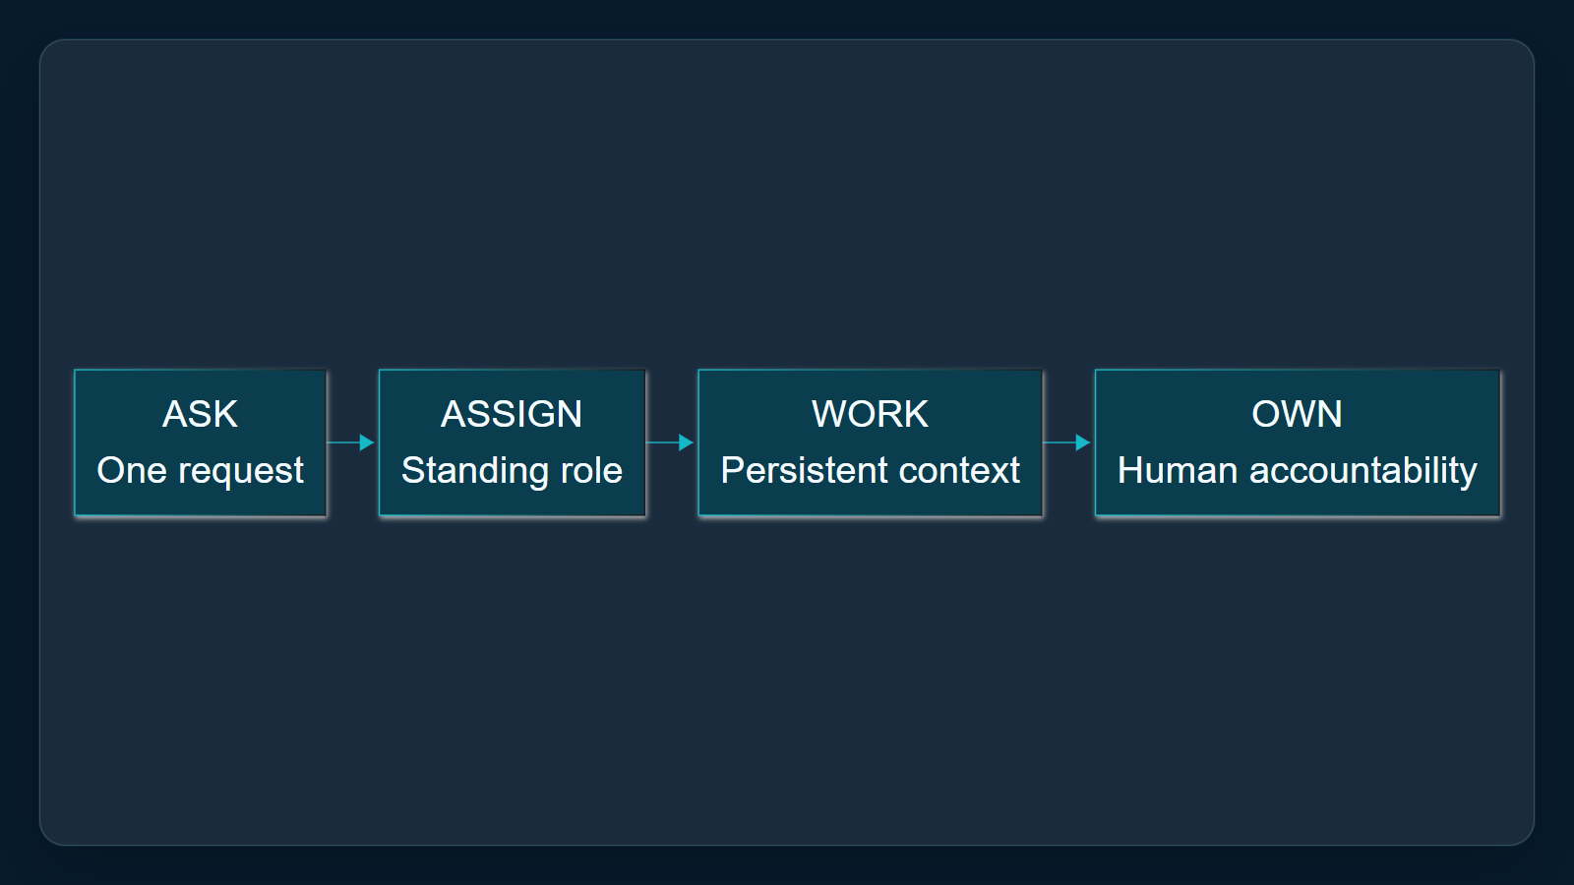
1. Change the unit of delegation
The shift is from asking for an answer to assigning a standing role. Autopilot brings identity, memory and a workspace; leaders still own objectives and boundaries. Governance changes with the unit of delegation.
Sources: [ev-01] Introducing the new Copilot with Home, Code and Autopilot · [ev-02] Introducing the new Copilot with Home, Code and Autopilot · [ev-03] Introducing the new Copilot with Home, Code and Autopilot
2 / 5
Notes:
1. Change the unit of delegation
The shift is from asking for an answer to assigning a standing role. Autopilot brings identity, memory and a workspace; leaders still own objectives and boundaries. Governance changes with the unit of delegation.
Evidence: Microsoft announcement, Autopilot section, retrieved 2026-10-06. Interpretation: a standing role changes the operating model. This is Copilot Autopilot, previously Scout, not Windows Autopilot device provisioning.
Evidence: Copilot Autopilot, previously Scout, was announced as a persistent digital teammate with its own identity, memory, computer and workspace; people set objectives and boundaries and remain in control. [ev-01] Introducing the new Copilot with Home, Code and Autopilot
Citations
[ev-01] Introducing the new Copilot with Home, Code and Autopilot: https://blogs.microsoft.com/blog/2026/09/25/introducing-the-new-copilot-with-home-code-and-autopilot/
[ev-02] Introducing the new Copilot with Home, Code and Autopilot: https://blogs.microsoft.com/blog/2026/09/25/introducing-the-new-copilot-with-home-code-and-autopilot/
[ev-03] Introducing the new Copilot with Home, Code and Autopilot: https://blogs.microsoft.com/blog/2026/09/25/introducing-the-new-copilot-with-home-code-and-autopilot/

Slide 3
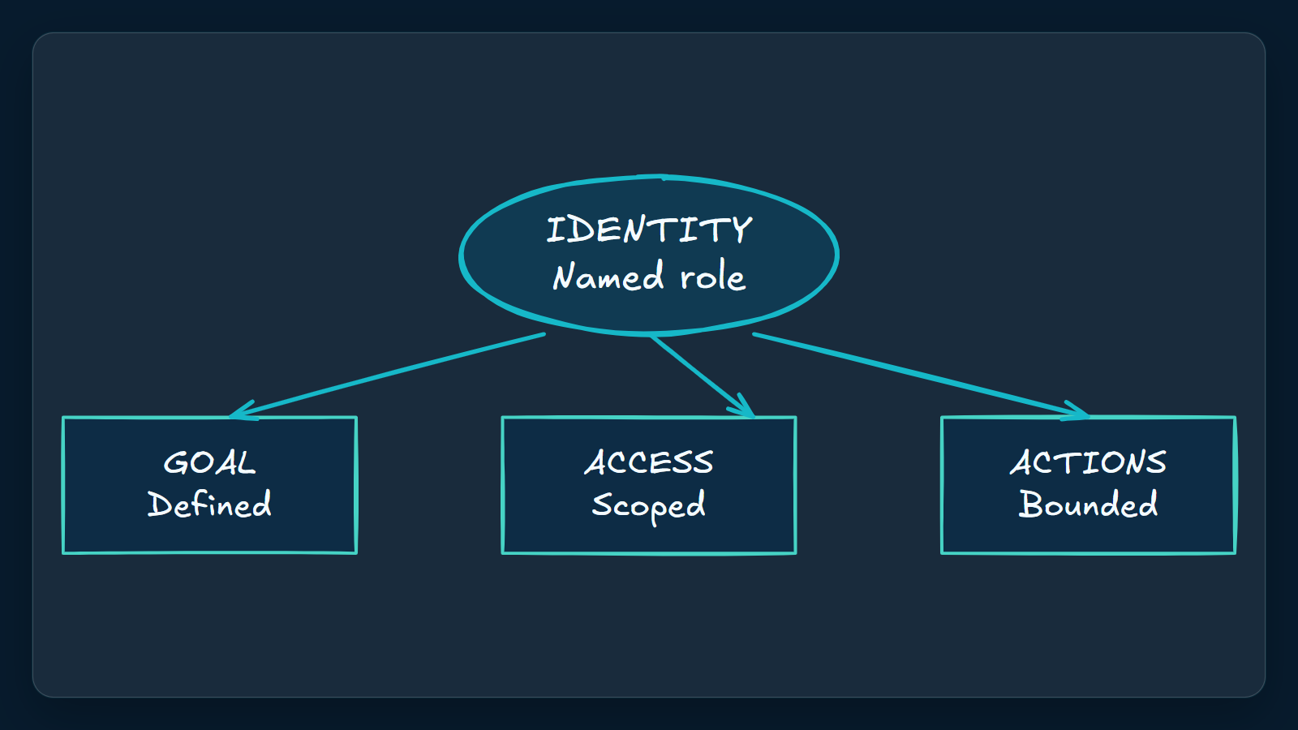
2. Govern identity before capability
Foundry is an architectural lens, not proof of identical implementation. Identity anchors the standing role; the organization still bounds interactions, access and actions, with a manager accountable for the role.
Sources: [ev-05] What is an autopilot in Microsoft Foundry? · [ev-06] What is an autopilot in Microsoft Foundry? · [ev-07] What is an autopilot in Microsoft Foundry?
3 / 5
Notes:
2. Govern identity before capability
Foundry is an architectural lens, not proof of identical implementation. Identity anchors the standing role; the organization still bounds interactions, access and actions, with a manager accountable for the role.
Evidence: Microsoft Foundry autopilot overview, opening definition and autonomy section, retrieved 2026-10-06. Applicability limit: architectural lens only; do not assert implementation equivalence with Copilot Autopilot.
Evidence: As an architectural lens, Microsoft Foundry defines an autopilot by its standing role, identity, security profile and accountable manager, not by a changing feature list. [ev-05] What is an autopilot in Microsoft Foundry?
Evidence: In the Foundry model, autonomy remains bounded: the organization controls when an autopilot responds, who it interacts with, what it accesses and which actions it can take. [ev-07] What is an autopilot in Microsoft Foundry?
Citations
[ev-05] What is an autopilot in Microsoft Foundry?: https://learn.microsoft.com/en-us/azure/foundry/agents/concepts/autopilot-overview
[ev-06] What is an autopilot in Microsoft Foundry?: https://learn.microsoft.com/en-us/azure/foundry/agents/concepts/autopilot-overview
[ev-07] What is an autopilot in Microsoft Foundry?: https://learn.microsoft.com/en-us/azure/foundry/agents/concepts/autopilot-overview

Slide 4
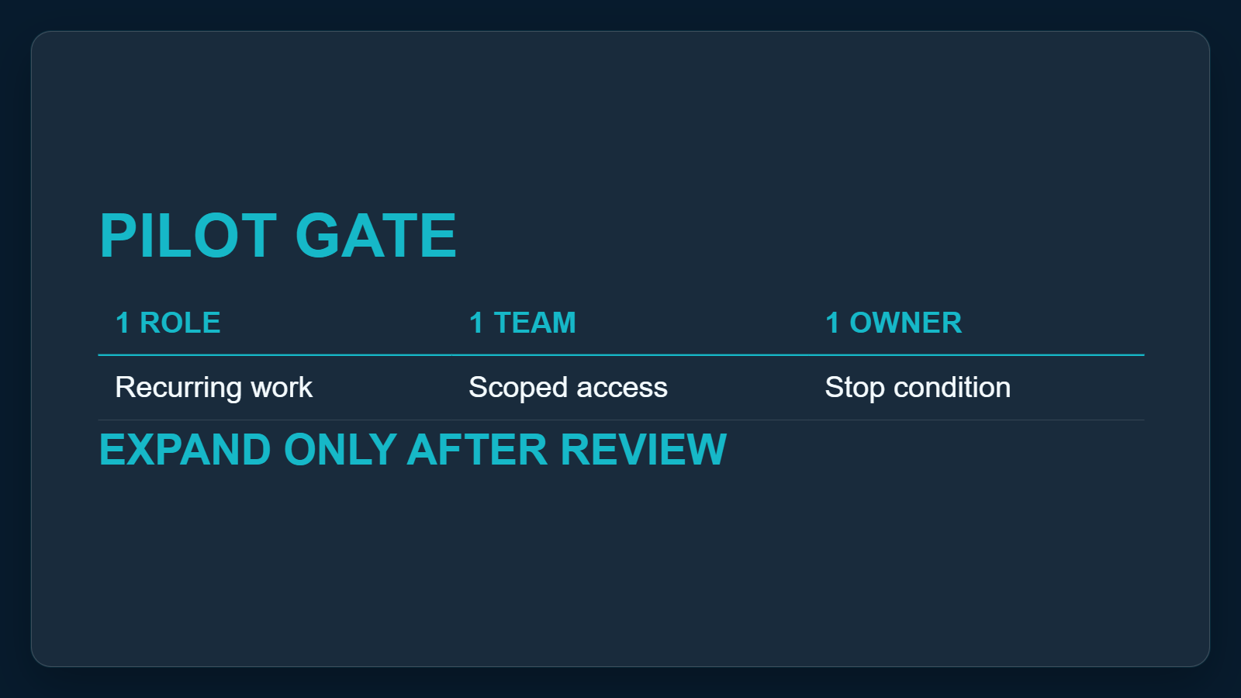
3. Pilot the role, not the technology
Pilot one recurring workflow with one team and owner. Reuse blueprint logic, but scope each instance to its own permissions and assignment. While Autopilot is private preview, require a stop condition and review before expansion.
Sources: [ev-04] Introducing the new Copilot with Home, Code and Autopilot · [ev-08] What is an autopilot in Microsoft Foundry? · [ev-09] What is an autopilot in Microsoft Foundry?
4 / 5
Notes:
3. Pilot the role, not the technology
Pilot one recurring workflow with one team and owner. Reuse blueprint logic, but scope each instance to its own permissions and assignment. While Autopilot is private preview, require a stop condition and review before expansion.
Evidence: Microsoft announcement private-preview statement and Microsoft Foundry blueprint section, retrieved 2026-10-06. Proposed action: one workflow, one team, one owner, explicit access boundary, cost guardrail, stop condition and review.
Evidence: Microsoft said Copilot Autopilot was expanding to private preview at the end of September 2026; the announcement does not establish general availability. [ev-04] Introducing the new Copilot with Home, Code and Autopilot
Evidence: The Foundry blueprint model separates reusable logic and infrastructure from team-specific access; each instance receives its own identity, permissions and assignment. [ev-08] What is an autopilot in Microsoft Foundry?
Citations
[ev-04] Introducing the new Copilot with Home, Code and Autopilot: https://blogs.microsoft.com/blog/2026/09/25/introducing-the-new-copilot-with-home-code-and-autopilot/
[ev-08] What is an autopilot in Microsoft Foundry?: https://learn.microsoft.com/en-us/azure/foundry/agents/concepts/autopilot-overview
[ev-09] What is an autopilot in Microsoft Foundry?: https://learn.microsoft.com/en-us/azure/foundry/agents/concepts/autopilot-overview
[ev-10] What is an autopilot in Microsoft Foundry?: https://learn.microsoft.com/en-us/azure/foundry/agents/concepts/autopilot-overview

Slide 5
Sources. Every claim traces to one.
Introducing the new Copilot with Home, Code and Autopilot retrieved 2026-10-06
https://blogs.microsoft.com/blog/2026/09/25/introducing-the-new-copilot-with-home-code-and-autopilot/
What is an autopilot in Microsoft Foundry? retrieved 2026-10-06
https://learn.microsoft.com/en-us/azure/foundry/agents/concepts/autopilot-overview
microsoft-autopilot-agents-r1
5 / 5
Notes:
Sources. Every claim traces to one.
Bottom line: Copilot Autopilot is a bounded standing role, not a chatbot. Pilot privately with one owner, scoped access, cost guardrail and review.
Sources for every claim in this deck.
Citations
Introducing the new Copilot with Home, Code and Autopilot: https://blogs.microsoft.com/blog/2026/09/25/introducing-the-new-copilot-with-home-code-and-autopilot/
Introducing the new Copilot with Home, Code and Autopilot: https://blogs.microsoft.com/blog/2026/09/25/introducing-the-new-copilot-with-home-code-and-autopilot/
Introducing the new Copilot with Home, Code and Autopilot: https://blogs.microsoft.com/blog/2026/09/25/introducing-the-new-copilot-with-home-code-and-autopilot/
Introducing the new Copilot with Home, Code and Autopilot: https://blogs.microsoft.com/blog/2026/09/25/introducing-the-new-copilot-with-home-code-and-autopilot/
What is an autopilot in Microsoft Foundry?: https://learn.microsoft.com/en-us/azure/foundry/agents/concepts/autopilot-overview
What is an autopilot in Microsoft Foundry?: https://learn.microsoft.com/en-us/azure/foundry/agents/concepts/autopilot-overview
What is an autopilot in Microsoft Foundry?: https://learn.microsoft.com/en-us/azure/foundry/agents/concepts/autopilot-overview
What is an autopilot in Microsoft Foundry?: https://learn.microsoft.com/en-us/azure/foundry/agents/concepts/autopilot-overview
What is an autopilot in Microsoft Foundry?: https://learn.microsoft.com/en-us/azure/foundry/agents/concepts/autopilot-overview
What is an autopilot in Microsoft Foundry?: https://learn.microsoft.com/en-us/azure/foundry/agents/concepts/autopilot-overview

