Slide 1
Copilot: choose the right AI assistant for the job
Bottom line: Copilot is a family, not one tool; choose Chat, Microsoft 365, GitHub, or Studio by job, then verify access, licensing, and grounding.
DECISION Choose by job; verify access, licensing, grounding, and output scope.
copilot-2026-07-am-michael-kokoro-onnx
1 / 6
Notes:
Copilot: choose the right AI assistant for the job
Bottom line: Copilot is a family, not one tool; choose Chat, Microsoft 365, GitHub, or Studio by job, then verify access, licensing, and grounding.
Bottom line: Copilot is a family, not one tool; choose Chat, Microsoft 365, GitHub, or Studio by job, then verify access, licensing, and grounding.
Copilot Chat fits research and drafting. It can summarize web information, rewrite content, analyze files, create images, use agents, and ask supported work questions.
Microsoft 365 Copilot brings AI into work apps. Grounding, user permissions, compliance controls and license level shape what it can answer for each person.
GitHub Copilot fits coding workflows in developer tools. Copilot Studio builds agents and workflows connected to organizational data, systems, and channels for teams.
Make the decision after the fit is clear. Check permissions, license tier, and grounding so leaders know what each output can and cannot use in practice.
Evidence: Copilot Chat supports research, content generation, file analysis, images, agents, and supported organizational questions. [ev-01] Overview of Microsoft Copilot Chat
Evidence: Microsoft 365 Copilot is shaped by organizational grounding, user permissions, compliance controls, work-app access, and license level. [ev-03] What is Microsoft Copilot?
Evidence: GitHub Copilot supports coding work in editors, the command line, and GitHub, including completing code, edits, validation, and workflow support. [ev-05] GitHub Copilot · Your AI coding agent · GitHub
Evidence: Copilot Studio is a low-code route for building agents and workflows connected to organizational data, systems, and channels. [ev-07] Overview - Microsoft Copilot Studio
Evidence: The executive choice is job first, then access, licensing, grounding, and output scope. [ev-01] Overview of Microsoft Copilot Chat
Citations
[ev-01] Overview of Microsoft Copilot Chat
[ev-02] Overview of Microsoft Copilot Chat
[ev-03] What is Microsoft Copilot?
[ev-04] What is Microsoft Copilot?
[ev-05] GitHub Copilot · Your AI coding agent · GitHub
[ev-06] GitHub Copilot · Your AI coding agent · GitHub
[ev-07] Overview - Microsoft Copilot Studio
[ev-08] Overview - Microsoft Copilot Studio

Slide 2
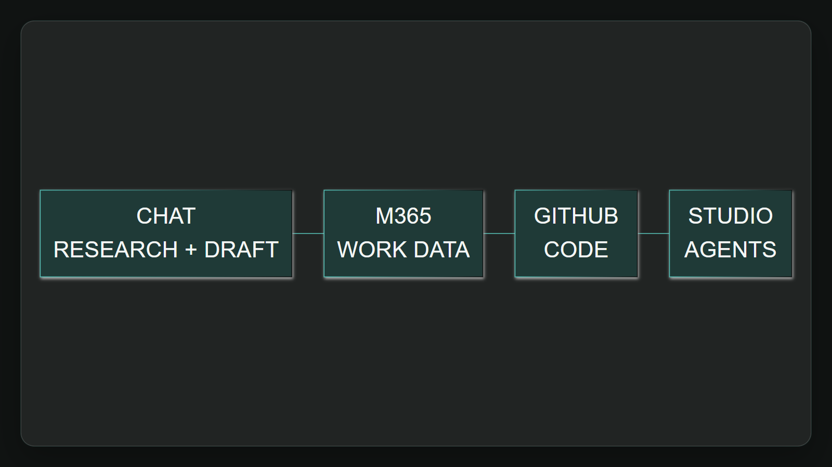
1. Choose by job
Copilot Chat fits research and drafting. It can summarize web information, rewrite content, analyze files, create images, use agents, and ask supported work questions.
Sources: Overview of Microsoft Copilot Chat · What is Microsoft Copilot? · GitHub Copilot · Your AI coding agent · GitHub · +1 more
2 / 6
Notes:
1. Choose by job
Copilot Chat fits research and drafting. It can summarize web information, rewrite content, analyze files, create images, use agents, and ask supported work questions.
Evidence: ev-01 lists Copilot Chat research, generation, file analysis, images, agents, and supported organizational questions. Interpretation: make the task the first routing filter.
Evidence: Copilot Chat supports research, content generation, file analysis, images, agents, and supported organizational questions. [ev-01] Overview of Microsoft Copilot Chat
Evidence: The executive choice is job first, then access, licensing, grounding, and output scope. [ev-01] Overview of Microsoft Copilot Chat
Citations
[ev-01] Overview of Microsoft Copilot Chat: https://learn.microsoft.com/en-us/copilot/overview
[ev-02] Overview of Microsoft Copilot Chat: https://learn.microsoft.com/en-us/copilot/overview
[ev-01] Overview of Microsoft Copilot Chat: https://learn.microsoft.com/en-us/copilot/overview
[ev-02] Overview of Microsoft Copilot Chat: https://learn.microsoft.com/en-us/copilot/overview
[ev-03] What is Microsoft Copilot?: https://learn.microsoft.com/en-us/copilot/microsoft-365/microsoft-365-copilot-overview
[ev-04] What is Microsoft Copilot?: https://learn.microsoft.com/en-us/copilot/microsoft-365/microsoft-365-copilot-overview
[ev-05] GitHub Copilot · Your AI coding agent · GitHub: https://github.com/features/copilot
[ev-07] Overview - Microsoft Copilot Studio: https://learn.microsoft.com/en-us/microsoft-copilot-studio/fundamentals-what-is-copilot-studio
[ev-08] Overview - Microsoft Copilot Studio: https://learn.microsoft.com/en-us/microsoft-copilot-studio/fundamentals-what-is-copilot-studio

Slide 3
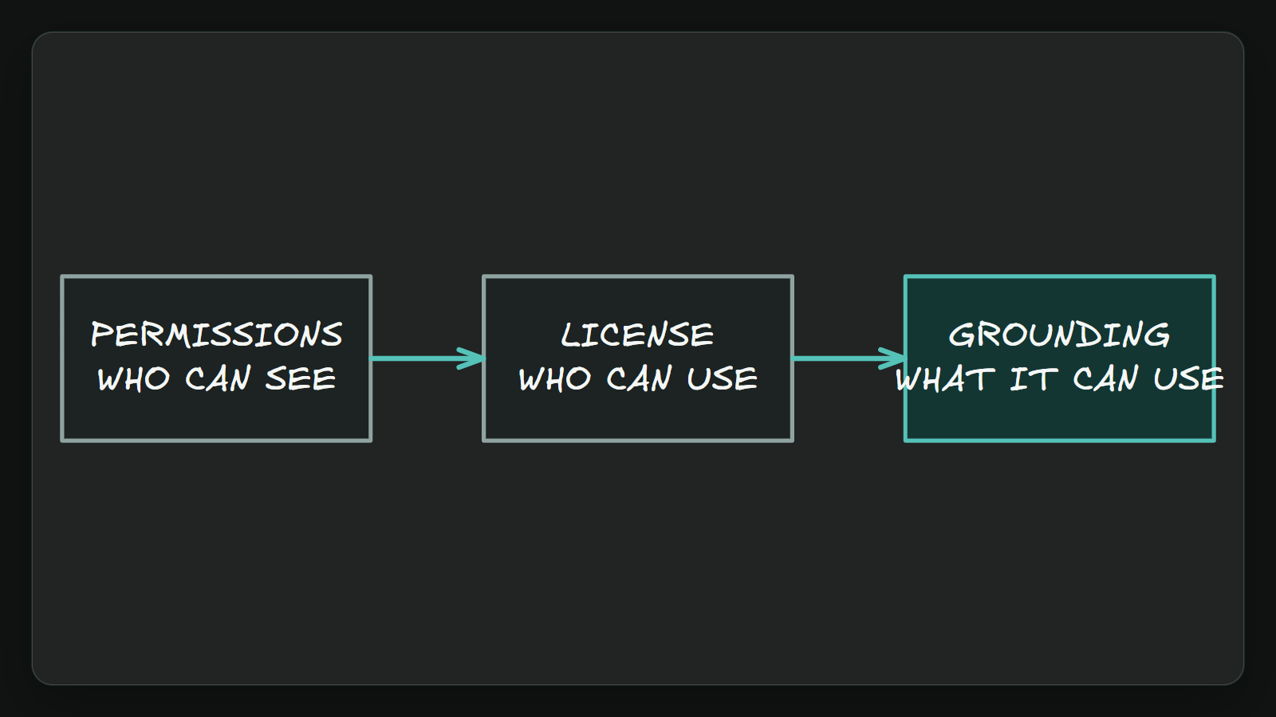
2. Govern access
Microsoft 365 Copilot brings AI into work apps. Grounding, user permissions, compliance controls and license level shape what it can answer for each person.
Sources: What is Microsoft Copilot? · Overview of Microsoft Copilot Chat · GitHub Copilot · Your AI coding agent · GitHub · +1 more
3 / 6
Notes:
2. Govern access
Microsoft 365 Copilot brings AI into work apps. Grounding, user permissions, compliance controls and license level shape what it can answer for each person.
Evidence: ev-03 documents grounding, organizational data, user permissions, and compliance; ev-04 ties the full work-app experience to the Microsoft 365 Copilot add-on license.
Evidence: Microsoft 365 Copilot is shaped by organizational grounding, user permissions, compliance controls, work-app access, and license level. [ev-03] What is Microsoft Copilot?
Evidence: The executive choice is job first, then access, licensing, grounding, and output scope. [ev-01] Overview of Microsoft Copilot Chat
Citations
[ev-03] What is Microsoft Copilot?: https://learn.microsoft.com/en-us/copilot/microsoft-365/microsoft-365-copilot-overview
[ev-04] What is Microsoft Copilot?: https://learn.microsoft.com/en-us/copilot/microsoft-365/microsoft-365-copilot-overview
[ev-01] Overview of Microsoft Copilot Chat: https://learn.microsoft.com/en-us/copilot/overview
[ev-02] Overview of Microsoft Copilot Chat: https://learn.microsoft.com/en-us/copilot/overview
[ev-03] What is Microsoft Copilot?: https://learn.microsoft.com/en-us/copilot/microsoft-365/microsoft-365-copilot-overview
[ev-04] What is Microsoft Copilot?: https://learn.microsoft.com/en-us/copilot/microsoft-365/microsoft-365-copilot-overview
[ev-05] GitHub Copilot · Your AI coding agent · GitHub: https://github.com/features/copilot
[ev-07] Overview - Microsoft Copilot Studio: https://learn.microsoft.com/en-us/microsoft-copilot-studio/fundamentals-what-is-copilot-studio
[ev-08] Overview - Microsoft Copilot Studio: https://learn.microsoft.com/en-us/microsoft-copilot-studio/fundamentals-what-is-copilot-studio

Slide 4
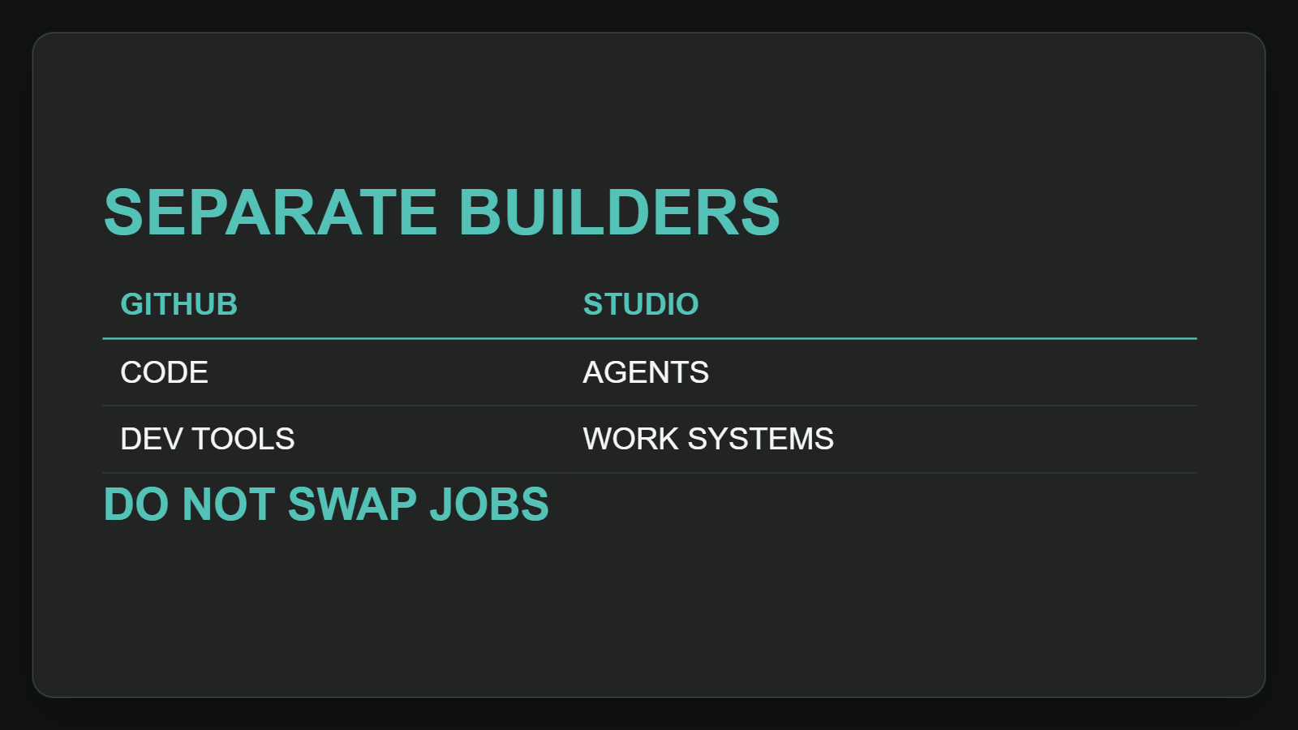
3. Separate builders
GitHub Copilot fits coding workflows in developer tools. Copilot Studio builds agents and workflows connected to organizational data, systems, and channels for teams.
Sources: GitHub Copilot · Your AI coding agent · GitHub · Overview - Microsoft Copilot Studio
4 / 6
Notes:
3. Separate builders
GitHub Copilot fits coding workflows in developer tools. Copilot Studio builds agents and workflows connected to organizational data, systems, and channels for teams.
Evidence: ev-05 and ev-06 place GitHub Copilot in coding surfaces; ev-07 and ev-08 define Copilot Studio as a low-code agent and workflow builder connected to organizational systems.
Evidence: GitHub Copilot supports coding work in editors, the command line, and GitHub, including completing code, edits, validation, and workflow support. [ev-05] GitHub Copilot · Your AI coding agent · GitHub
Evidence: Copilot Studio is a low-code route for building agents and workflows connected to organizational data, systems, and channels. [ev-07] Overview - Microsoft Copilot Studio
Citations
[ev-05] GitHub Copilot · Your AI coding agent · GitHub: https://github.com/features/copilot
[ev-06] GitHub Copilot · Your AI coding agent · GitHub: https://github.com/features/copilot
[ev-07] Overview - Microsoft Copilot Studio: https://learn.microsoft.com/en-us/microsoft-copilot-studio/fundamentals-what-is-copilot-studio
[ev-08] Overview - Microsoft Copilot Studio: https://learn.microsoft.com/en-us/microsoft-copilot-studio/fundamentals-what-is-copilot-studio

Slide 5
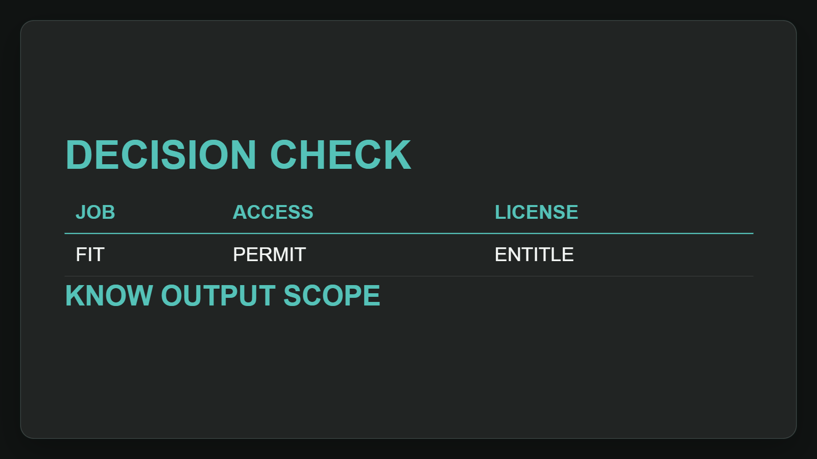
4. Run decision checks
Make the decision after the fit is clear. Check permissions, license tier, and grounding so leaders know what each output can and cannot use in practice.
Sources: What is Microsoft Copilot? · Overview of Microsoft Copilot Chat · GitHub Copilot · Your AI coding agent · GitHub · +1 more
5 / 6
Notes:
4. Run decision checks
Make the decision after the fit is clear. Check permissions, license tier, and grounding so leaders know what each output can and cannot use in practice.
Evidence: ev-02 and ev-03 show available information depends on access point, license, grounding, and permissions. Interpretation: output scope should be part of the executive decision gate.
Evidence: Microsoft 365 Copilot is shaped by organizational grounding, user permissions, compliance controls, work-app access, and license level. [ev-03] What is Microsoft Copilot?
Evidence: The executive choice is job first, then access, licensing, grounding, and output scope. [ev-01] Overview of Microsoft Copilot Chat
Citations
[ev-03] What is Microsoft Copilot?: https://learn.microsoft.com/en-us/copilot/microsoft-365/microsoft-365-copilot-overview
[ev-04] What is Microsoft Copilot?: https://learn.microsoft.com/en-us/copilot/microsoft-365/microsoft-365-copilot-overview
[ev-01] Overview of Microsoft Copilot Chat: https://learn.microsoft.com/en-us/copilot/overview
[ev-02] Overview of Microsoft Copilot Chat: https://learn.microsoft.com/en-us/copilot/overview
[ev-03] What is Microsoft Copilot?: https://learn.microsoft.com/en-us/copilot/microsoft-365/microsoft-365-copilot-overview
[ev-04] What is Microsoft Copilot?: https://learn.microsoft.com/en-us/copilot/microsoft-365/microsoft-365-copilot-overview
[ev-05] GitHub Copilot · Your AI coding agent · GitHub: https://github.com/features/copilot
[ev-07] Overview - Microsoft Copilot Studio: https://learn.microsoft.com/en-us/microsoft-copilot-studio/fundamentals-what-is-copilot-studio
[ev-08] Overview - Microsoft Copilot Studio: https://learn.microsoft.com/en-us/microsoft-copilot-studio/fundamentals-what-is-copilot-studio

Slide 6
Sources. Every claim traces to one.
Overview of Microsoft Copilot Chat retrieved 2026-10-06
https://learn.microsoft.com/en-us/copilot/overview
What is Microsoft Copilot? retrieved 2026-10-06
https://learn.microsoft.com/en-us/copilot/microsoft-365/microsoft-365-copilot-overview
GitHub Copilot · Your AI coding agent · GitHub retrieved 2026-10-06
https://github.com/features/copilot
Overview - Microsoft Copilot Studio retrieved 2026-10-06
https://learn.microsoft.com/en-us/microsoft-copilot-studio/fundamentals-what-is-copilot-studio
copilot-2026-07-am-michael-kokoro-onnx
6 / 6
Notes:
Sources. Every claim traces to one.
Bottom line: Copilot is a family, not one tool; choose Chat, Microsoft 365, GitHub, or Studio by job, then verify access, licensing, and grounding.
Sources for every claim in this deck.
Citations
Overview of Microsoft Copilot Chat: https://learn.microsoft.com/en-us/copilot/overview
Overview of Microsoft Copilot Chat: https://learn.microsoft.com/en-us/copilot/overview
What is Microsoft Copilot?: https://learn.microsoft.com/en-us/copilot/microsoft-365/microsoft-365-copilot-overview
What is Microsoft Copilot?: https://learn.microsoft.com/en-us/copilot/microsoft-365/microsoft-365-copilot-overview
GitHub Copilot · Your AI coding agent · GitHub: https://github.com/features/copilot
GitHub Copilot · Your AI coding agent · GitHub: https://github.com/features/copilot
Overview - Microsoft Copilot Studio: https://learn.microsoft.com/en-us/microsoft-copilot-studio/fundamentals-what-is-copilot-studio
Overview - Microsoft Copilot Studio: https://learn.microsoft.com/en-us/microsoft-copilot-studio/fundamentals-what-is-copilot-studio

