Slide 1
Copilot Code
1 / 5
Copilot Code: approve a narrow, governed preview pilot
Bottom line: pilot Copilot Code for one small purpose-built solution, with IT policy set first, a named owner, scoped data, a spend limit and an explicit stop-or-expand review.
DECISION Approve one bounded Frontier pilot only after IT sets the execution, permission, data, GitHub and spend policies and names an accountable business owner.
copilot-code-r1
Notes:
Copilot Code: approve a narrow, governed preview pilot
Bottom line: pilot Copilot Code for one small purpose-built solution, with IT policy set first, a named owner, scoped data, a spend limit and an explicit stop-or-expand review.
Bottom line: pilot Copilot Code for one small purpose-built solution, with IT policy set first, a named owner, scoped data, a spend limit and an explicit stop-or-expand review.
Code is for outcome-led builders, not a replacement for developer tools. Describe a dashboard, team tool, site, transform, automation or script; Code builds a live preview, keeps revertible versions and can publish cloud apps to Copilot Managed Runtime for your organization.
Local mode works inside a chosen folder and asks approval by default for network, extensions or MCP, shell commands and outside-folder access. Cloud mode is isolated. Microsoft says existing Microsoft 365 governance applies, with audit visibility into code, commands and file activity.
IT must confirm license and enablement, then set auto-approve, execution location, GitHub, organizational data and spend policies. Recommendation: one low-risk business use case, one owner, least data needed, a budget cap, and a stop-or-expand review before broader access.
Evidence: Copilot Code is a preview build experience in the Microsoft Copilot app that requires Frontier access; the selected sources do not establish general availability. [ev-preview] Copilot Code overview (Frontier)
Evidence: Microsoft frames Code as a shift from files alone toward small purpose-built solutions: users describe software in natural language, see a live result, iterate, and can revert to an earlier version. [ev-fourth-unit] Introducing the new Copilot with Home, Code and Autopilot
Evidence: Cloud projects can publish interactive apps to Copilot Managed Runtime for people in the organization, while local projects work inside a chosen project folder. [ev-publish] Copilot Code overview (Frontier)
Evidence: Local mode asks for approval by default before network calls, extensions or MCP use, shell commands, or file access outside active projects; cloud mode runs in a secure isolated environment. [ev-approval-default] Copilot Code overview (Frontier)
Evidence: Copilot Code follows Microsoft 365 governance, security and compliance controls, and administrators can audit generated code, commands run, and files read or written. [ev-governance] Copilot Code overview (Frontier)
Evidence: For work accounts, IT must provide a Copilot license and organization-level enablement, and can configure auto-approve, execution location, GitHub connections, organizational data access and spend limits; documented defaults can change during preview. [ev-license-enable] Manage Copilot Code for your organization (Frontier)
Citations
[ev-preview] Copilot Code overview (Frontier)
[ev-frontier] Copilot Code overview (Frontier)
[ev-fourth-unit] Introducing the new Copilot with Home, Code and Autopilot
[ev-build] Copilot Code overview (Frontier)
[ev-versions] Copilot Code overview (Frontier)
[ev-publish] Copilot Code overview (Frontier)
[ev-local] Copilot Code overview (Frontier)
[ev-cloud] Copilot Code overview (Frontier)
[ev-approval-default] Copilot Code overview (Frontier)
[ev-governance] Copilot Code overview (Frontier)
[ev-audit] Copilot Code overview (Frontier)
[ev-license-enable] Manage Copilot Code for your organization (Frontier)
[ev-spend] Copilot Code (Frontier) requirements
[ev-auto-approve] Manage Copilot Code for your organization (Frontier)
[ev-execution] Manage Copilot Code for your organization (Frontier)
[ev-github] Manage Copilot Code for your organization (Frontier)
[ev-org-data] Manage Copilot Code for your organization (Frontier)
[ev-corroboration] New Microsoft Copilot brings Home, Code and Autopilot together

Slide 2
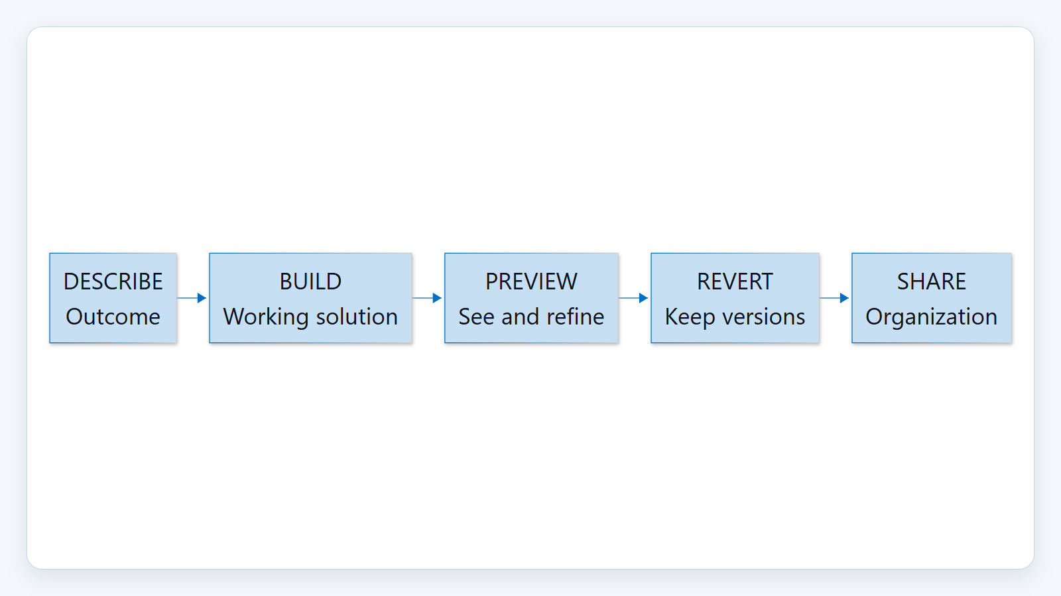
Copilot Code
2 / 5
1. Shift from answers to small solutions
Code is for outcome-led builders, not a replacement for developer tools. Describe a dashboard, team tool, site, transform, automation or script; Code builds a live preview, keeps revertible versions and can publish cloud apps to Copilot Managed Runtime for your organization.
Sources: Copilot Code overview (Frontier) · Introducing the new Copilot with Home, Code and Autopilot · New Microsoft Copilot brings Home, Code and Autopilot together
Notes:
1. Shift from answers to small solutions
Code is for outcome-led builders, not a replacement for developer tools. Describe a dashboard, team tool, site, transform, automation or script; Code builds a live preview, keeps revertible versions and can publish cloud apps to Copilot Managed Runtime for your organization.
Evidence: Microsoft announcement and Copilot Code overview, retrieved 2026-10-20. Microsoft calls purpose-built solutions a fourth unit of knowledge work; that framing is attributed, not an independent market conclusion. Code remains a Frontier preview and is distinct from GitHub Copilot, its coding agent, Visual Studio Code, Copilot Studio and Copilot Pages.
Evidence: Copilot Code is a preview build experience in the Microsoft Copilot app that requires Frontier access; the selected sources do not establish general availability. [ev-preview] Copilot Code overview (Frontier)
Evidence: Microsoft frames Code as a shift from files alone toward small purpose-built solutions: users describe software in natural language, see a live result, iterate, and can revert to an earlier version. [ev-fourth-unit] Introducing the new Copilot with Home, Code and Autopilot
Evidence: Cloud projects can publish interactive apps to Copilot Managed Runtime for people in the organization, while local projects work inside a chosen project folder. [ev-publish] Copilot Code overview (Frontier)
Citations
[ev-preview] Copilot Code overview (Frontier): https://learn.microsoft.com/en-us/copilot/code/overview
[ev-frontier] Copilot Code overview (Frontier): https://learn.microsoft.com/en-us/copilot/code/overview
[ev-fourth-unit] Introducing the new Copilot with Home, Code and Autopilot: https://blogs.microsoft.com/blog/2026/09/25/introducing-the-new-copilot-with-home-code-and-autopilot/
[ev-build] Copilot Code overview (Frontier): https://learn.microsoft.com/en-us/copilot/code/overview
[ev-versions] Copilot Code overview (Frontier): https://learn.microsoft.com/en-us/copilot/code/overview
[ev-corroboration] New Microsoft Copilot brings Home, Code and Autopilot together: https://news.microsoft.com/source/emea/2026/09/new-microsoft-copilot-brings-home-code-and-autopilot-together/
[ev-publish] Copilot Code overview (Frontier): https://learn.microsoft.com/en-us/copilot/code/overview
[ev-local] Copilot Code overview (Frontier): https://learn.microsoft.com/en-us/copilot/code/overview

Slide 3
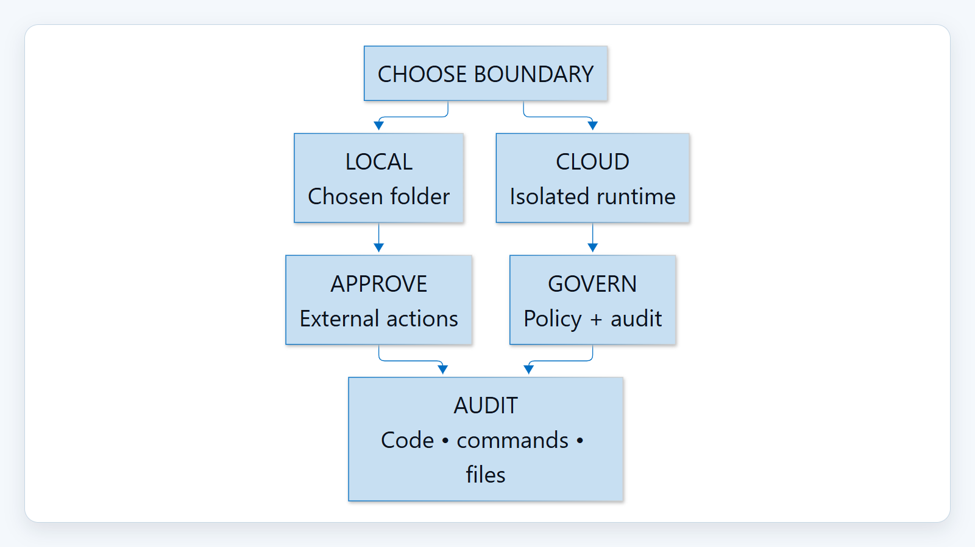
Copilot Code
3 / 5
2. Choose the execution boundary deliberately
Local mode works inside a chosen folder and asks approval by default for network, extensions or MCP, shell commands and outside-folder access. Cloud mode is isolated. Microsoft says existing Microsoft 365 governance applies, with audit visibility into code, commands and file activity.
Sources: Copilot Code overview (Frontier)
Notes:
2. Choose the execution boundary deliberately
Local mode works inside a chosen folder and asks approval by default for network, extensions or MCP, shell commands and outside-folder access. Cloud mode is isolated. Microsoft says existing Microsoft 365 governance applies, with audit visibility into code, commands and file activity.
Evidence: Copilot Code overview, build location, Stay in control, and Data protection sections, retrieved 2026-10-20. The permission statement is a documented default, not a guarantee against administrator or user policy changes.
Evidence: Local mode asks for approval by default before network calls, extensions or MCP use, shell commands, or file access outside active projects; cloud mode runs in a secure isolated environment. [ev-approval-default] Copilot Code overview (Frontier)
Evidence: Copilot Code follows Microsoft 365 governance, security and compliance controls, and administrators can audit generated code, commands run, and files read or written. [ev-governance] Copilot Code overview (Frontier)
Citations
[ev-approval-default] Copilot Code overview (Frontier): https://learn.microsoft.com/en-us/copilot/code/overview
[ev-cloud] Copilot Code overview (Frontier): https://learn.microsoft.com/en-us/copilot/code/overview
[ev-governance] Copilot Code overview (Frontier): https://learn.microsoft.com/en-us/copilot/code/overview
[ev-audit] Copilot Code overview (Frontier): https://learn.microsoft.com/en-us/copilot/code/overview

Slide 4
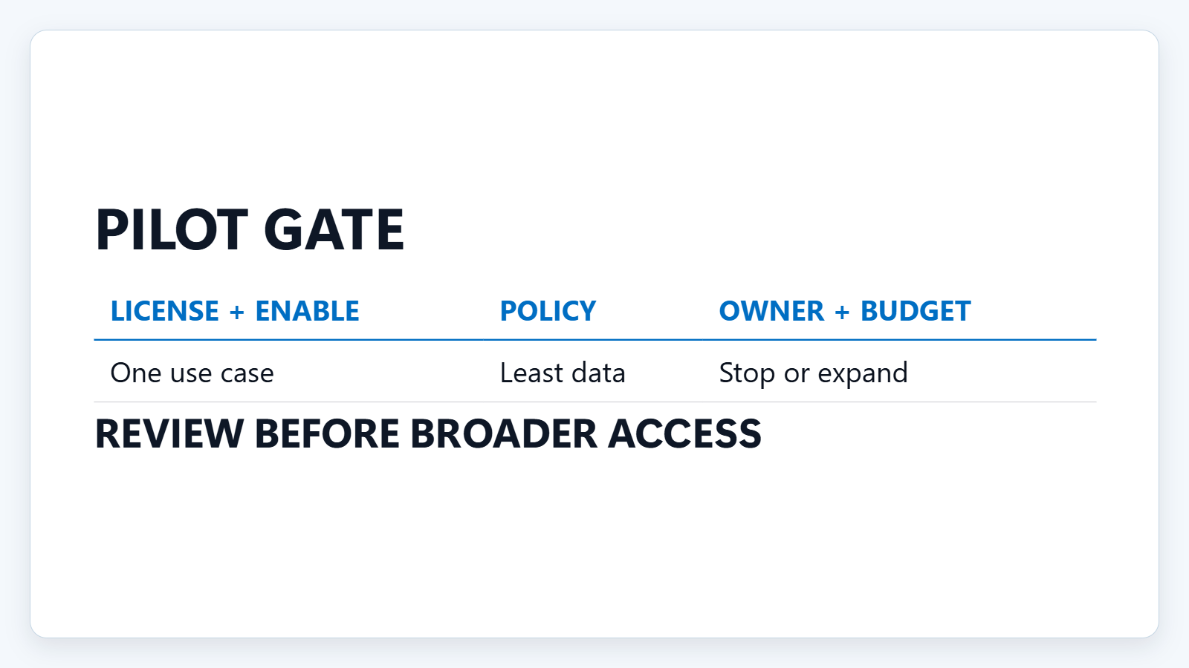
Copilot Code
4 / 5
3. Configure first, then pilot narrowly
IT must confirm license and enablement, then set auto-approve, execution location, GitHub, organizational data and spend policies. Recommendation: one low-risk business use case, one owner, least data needed, a budget cap, and a stop-or-expand review before broader access.
Sources: Manage Copilot Code for your organization (Frontier) · Copilot Code (Frontier) requirements · Copilot Code overview (Frontier)
Notes:
3. Configure first, then pilot narrowly
IT must confirm license and enablement, then set auto-approve, execution location, GitHub, organizational data and spend policies. Recommendation: one low-risk business use case, one owner, least data needed, a budget cap, and a stop-or-expand review before broader access.
Evidence: requirements and admin pages, retrieved 2026-10-20. Documented defaults include auto-approve on, execution location cloud-only on, GitHub off, and organizational data on for cloud and off for local. These are preview documentation states and may change. The pilot guardrails are recommendations, not product guarantees.
Evidence: For work accounts, IT must provide a Copilot license and organization-level enablement, and can configure auto-approve, execution location, GitHub connections, organizational data access and spend limits; documented defaults can change during preview. [ev-license-enable] Manage Copilot Code for your organization (Frontier)
Citations
[ev-license-enable] Manage Copilot Code for your organization (Frontier): https://learn.microsoft.com/en-us/copilot/code/code-admin
[ev-spend] Copilot Code (Frontier) requirements: https://learn.microsoft.com/en-us/copilot/code/code-requirements
[ev-auto-approve] Manage Copilot Code for your organization (Frontier): https://learn.microsoft.com/en-us/copilot/code/code-admin
[ev-execution] Manage Copilot Code for your organization (Frontier): https://learn.microsoft.com/en-us/copilot/code/code-admin
[ev-github] Manage Copilot Code for your organization (Frontier): https://learn.microsoft.com/en-us/copilot/code/code-admin
[ev-org-data] Manage Copilot Code for your organization (Frontier): https://learn.microsoft.com/en-us/copilot/code/code-admin
[ev-preview] Copilot Code overview (Frontier): https://learn.microsoft.com/en-us/copilot/code/overview

Slide 5
Copilot Code
5 / 5
Sources. Every claim traces to one.
Copilot Code overview (Frontier) retrieved 2026-10-20
https://learn.microsoft.com/en-us/copilot/code/overview
Introducing the new Copilot with Home, Code and Autopilot retrieved 2026-10-20
https://blogs.microsoft.com/blog/2026/09/25/introducing-the-new-copilot-with-home-code-and-autopilot/
Manage Copilot Code for your organization (Frontier) retrieved 2026-10-20
https://learn.microsoft.com/en-us/copilot/code/code-admin
Copilot Code (Frontier) requirements retrieved 2026-10-20
https://learn.microsoft.com/en-us/copilot/code/code-requirements
New Microsoft Copilot brings Home, Code and Autopilot together retrieved 2026-10-20
https://news.microsoft.com/source/emea/2026/09/new-microsoft-copilot-brings-home-code-and-autopilot-together/
copilot-code-r1
Notes:
Sources. Every claim traces to one.
Bottom line: pilot Copilot Code for one small purpose-built solution, with IT policy set first, a named owner, scoped data, a spend limit and an explicit stop-or-expand review.
Sources for every claim in this deck.
Citations
Copilot Code overview (Frontier): https://learn.microsoft.com/en-us/copilot/code/overview
Copilot Code overview (Frontier): https://learn.microsoft.com/en-us/copilot/code/overview
Introducing the new Copilot with Home, Code and Autopilot: https://blogs.microsoft.com/blog/2026/09/25/introducing-the-new-copilot-with-home-code-and-autopilot/
Copilot Code overview (Frontier): https://learn.microsoft.com/en-us/copilot/code/overview
Copilot Code overview (Frontier): https://learn.microsoft.com/en-us/copilot/code/overview
Copilot Code overview (Frontier): https://learn.microsoft.com/en-us/copilot/code/overview
Copilot Code overview (Frontier): https://learn.microsoft.com/en-us/copilot/code/overview
Copilot Code overview (Frontier): https://learn.microsoft.com/en-us/copilot/code/overview
Copilot Code overview (Frontier): https://learn.microsoft.com/en-us/copilot/code/overview
Copilot Code overview (Frontier): https://learn.microsoft.com/en-us/copilot/code/overview
Copilot Code overview (Frontier): https://learn.microsoft.com/en-us/copilot/code/overview
Manage Copilot Code for your organization (Frontier): https://learn.microsoft.com/en-us/copilot/code/code-admin
Copilot Code (Frontier) requirements: https://learn.microsoft.com/en-us/copilot/code/code-requirements
Manage Copilot Code for your organization (Frontier): https://learn.microsoft.com/en-us/copilot/code/code-admin
Manage Copilot Code for your organization (Frontier): https://learn.microsoft.com/en-us/copilot/code/code-admin
Manage Copilot Code for your organization (Frontier): https://learn.microsoft.com/en-us/copilot/code/code-admin
Manage Copilot Code for your organization (Frontier): https://learn.microsoft.com/en-us/copilot/code/code-admin
New Microsoft Copilot brings Home, Code and Autopilot together: https://news.microsoft.com/source/emea/2026/09/new-microsoft-copilot-brings-home-code-and-autopilot-together/

