Slide 1
Quality

Slide 2
What is Quality?
“In technical usage, quality can have two meanings: 1. the characteristics of a product or service that bear on its ability to satisfy stated or implied needs; 2. a product or service free of deficiencies. According to Joseph Juran, quality means “fitness for use;” according to Philip Crosby, it means “conformance to requirements.”
-- American Society for Quality (www.asq.org/glossary/q.html)
Juran
  “fitness for use”
Crosby
  “conformance to requirements”
Notes:
Juran’s definition also describes Customer view of Quality
Crosby’s definition fits in with Producer’s view of Quality

Slide 3
Quality is…
Quality is meeting customer requirements
Meeting product and service requirements
Delivery on Schedule, Cost within budget, aiming for zero defects
Setting measurable goals and improving performance

Slide 4
Quality is…
“(1)The degree to which a system, component, or process meets specified requirements.
(2) The degree to which a system, component, or process meets customer or user needs or expectations.” IEEE Standard (Std 610.12-1990 )

Slide 5
Perspectives of quality…
Management
  contractual commitments are met and the result should foster enduring business from the customer
Project Manager
  achievement of goals as per project success criteria
Developer
  no rework; code works as desired
Tester
  application should be free of errors/ problems
Customer
  product should be fit for use and meet needs
QA
  standardised processes have been adhered to

Slide 6
Quality – evolving views
Past | Present
Quality is the responsibility of the blue-collar worker | Quality is the responsibility of all workers and the management
Defects should be hidden from the customer | Defects should be highlighted to the customer with a preventive/corrective action
Quality problems lead to history | Quality problems lead to conducive environment (A work atmosphere that has no detrimental effects on the employees physical or mental wellbeing and is suitable for the tasks required. )
Minimum documentation would suffice for quality problems | Documentation is essential ‘lessons learned’ so that mistakes are not repeated
Increased quality will increase project costs | Improved quality saves money and increases business
Quality is internal issue | Quality is customer focused

Slide 7
Quality today
Quality is defined by the customer
Quality is a competitive weapon
Quality is integral part of planning
Quality requires organization-wide commitment
Prevention over Inspection
  “Cease dependence on inspection to achieve quality. Eliminate the need for massive inspection by building quality into the product in the first place.”
  -- (W Edwards Deming, Out of the Crisis)

Slide 8
Quality…
An attribute of something that can be measured and compared
Conformity to specified and implicit requirements and process standards
  applies to product and process

Slide 9
Important…
Quality is not absolute. It is subject to contexts and constraints.
Quality criteria are not always independent.
GRADE is not QUALITY
  products have grades. For example, a car manufacturer may have different versions of the same car – each version offering something “extra”.
Notes:
Low grade is acceptable but poor quality is not

Slide 10
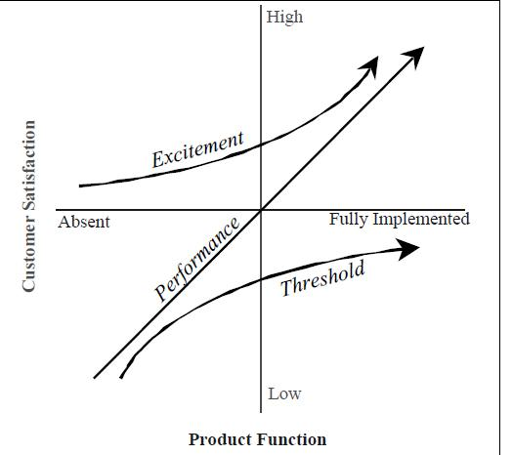
Prof. Noriaki Kano’s model
Threshold attributes
Performance attributes
Excitement attributes

Slide 11
Why does quality matter in business?
Meeting customer expectations is most important
Quality improvement leads to increase productivity, cost effectiveness and profitability
Cost of poor quality
  cost of fixing defects, rework, scrap/waste, penalties, loss of reputation…..

Slide 12
What does 99% quality performance mean?
Two unsafe landings in Chicago airport everyday
16,000 lost pieces of mail per hour
20,000 incorrect drug prescriptions every year
500 incorrect surgical operations performed every week
50 newborn babies dropped by doctors each day
22,000 cheques deducted from wrong accounts each hour
(Paul F Wilson, Larry D Dell, Gaylord F Anderson, Root Cause Analysis: A Tool for Total Quality Management, quoted by L Charles Smeby, Fire and Emergency Services Administration: Management and Leadership Practices)

Slide 13
Six Sigma
Developed by Motorola
Seeks to improve quality of process outputs by removing causes of defects and minimising variability in processes
A 6 sigma level ensures not more than 3.4 defects per million opportunities
  process operating at defect level of 0.00034%
Notes:
1. Important methodologies used in Six Sigma for process/quality improvement:
SIPOC – Supplier-Input-Process-Output-Customer a.k.a. ‘Know Your Customer’ approach
DMAIC – Define-Measure-Analyze-Implement/Improve-Control
DMADV – Define-Measure-Analyze-(Re)Design-Verify
2. Measurement is the backbone of Six Sigma
3. Sigma stands for Standard Deviation represented by the Greek Symbol ‘σ’

Slide 14
Aspects of software quality: McCall’s factors
Efficiency
Integrity
Reliability
Usability
Accuracy
Maintainability
Testability
Flexibility
Interface facility
Reusability
Transferability
Notes:
Efficiency – minimum usage of computing resources by the application
Integrity – preventing unauthorized access
Reliability – MTBF – uninterrupted service for a long period of time – measure of up time
Usability – effort required to learn and use the system
Maintainability – MTTR – measure of down time
Testability – effort required to test an application when revised
Flexibility – a.k.a. Scalability – effort required to add new features
Interface facility (OR) Interoperability – coupling aspects of the application with other (external) applications when redeveloped in new environment
Reusability – ability of the application to use existing code base when application is redeveloped in new environment
Transferability (OR) Portability – ease of migrating the application to new environment (operating system, platform, language, etc.)
Correctness (OR) Accuracy – ability of the application to work exactly as per specifications

Slide 15
Formal definitions : QC and QA
Quality Control
“(1)A set of activities designed to evaluate the quality of developed or manufactured products. “
Quality Assurance
“(1) A planned and systematic pattern of all actions necessary to provide adequate confidence that an item or product conforms to established technical requirements.
(2) A set of activities designed to evaluate the process by which products are developed or manufactured.”
IEEE Standard (Std 610.12-1990 )

Slide 16
Measurement and Quality
“I often say that when you can measure what you are speaking about, and express it in numbers, you know something about it; but when you cannot measure it, when you cannot express it in numbers, your knowledge is of a meagre and unsatisfactory kind…”
-- Baron Kelvin
From 'Electrical Units of Measurement', a lecture delivered at the Institution of Civil Engineers, London (3 May 1883), Popular Lectures and Addresses (1889), Vol. 1, 73. Quoted in American Association for the Advancement of Science, Science (Jan-Jun 1892), 19, 127.
“In God we trust; all others must bring data.”
-- attributed to W Edwards Deming

Slide 17
Quality Measures and Metrics
Measures
  raw numbers from measuring a product or process.
  lines of code, number of defects, total effort expended, duration
Metrics
  useful ratios or percentages derived from the measures
  Examples: defect density (DD) is defined as the number of defects per thousand lines of code (KLOC)

Slide 18
Some metrics used in HCLT
Schedule variance
Effort variance
Defect density
Review efficiency
Defect removal efficiency
Productivity
SLA compliance
Mean Time to Repair (MTTR)
Defect flow rate
Fix Validity index
Notes:
Schedule Variance (also known as Duration Variance) = (Actual Duration – Planned Duration)/Planned Duration
Effort Variance = (Actual Effort usually expressed in person days or hours – Planned Effort)/Planned Effort
Defect Density = (Number of defects / size of work product (KLOC or FP)) (OR) (Number of defects / person hour of work)
Review Efficiency (also referred to as Review Effectiveness) = (Number of defects detected and removed in reviews/Total number of defects)

