Slide 1
Good Informatics Practices

Slide 2
What is GIP?
Good Informatics Practice (GIP) describes one comprehensive model for aligning the IT and Informatics functions that support Life and Health Science organizations with the strategic, commercial and regulatory goals of the business.
GIP applies to the governance and regulations, people, processes, technology and data that make up the Information Ecosystem.

Slide 3
Intended Audience of GIP
Life and Health Sciences Industry Technology Practitioners
Auditors and Regulators
Internal Quality Organizations

Slide 4
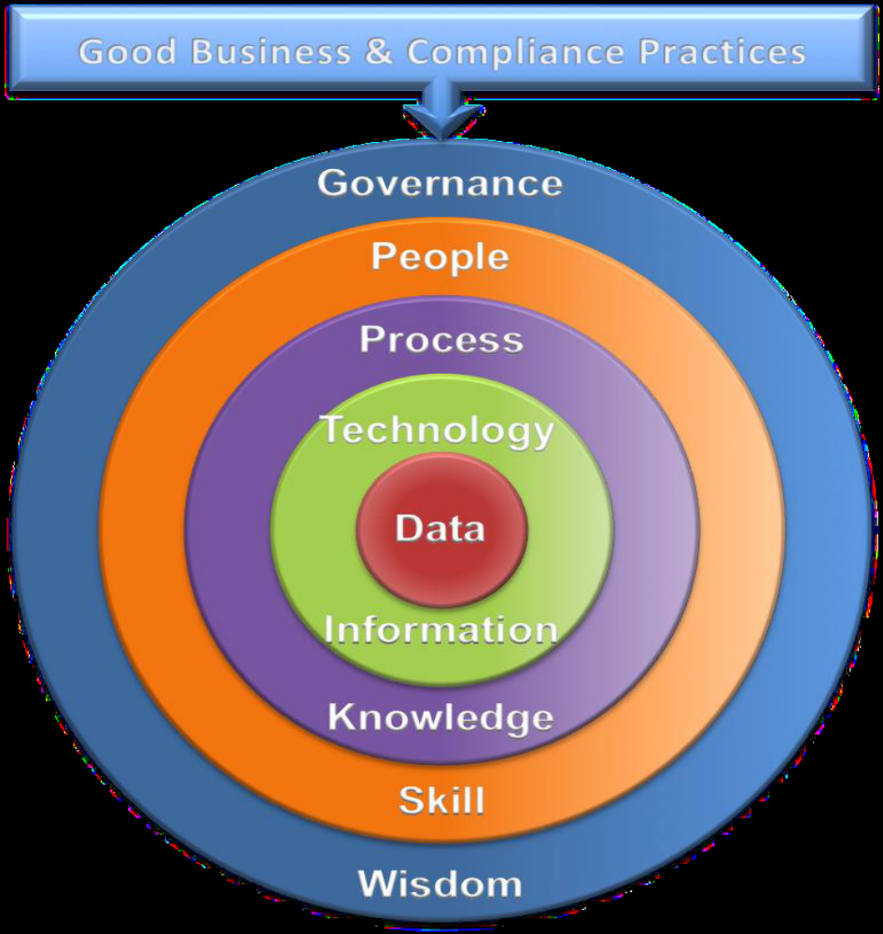
What is GIP?

Slide 5
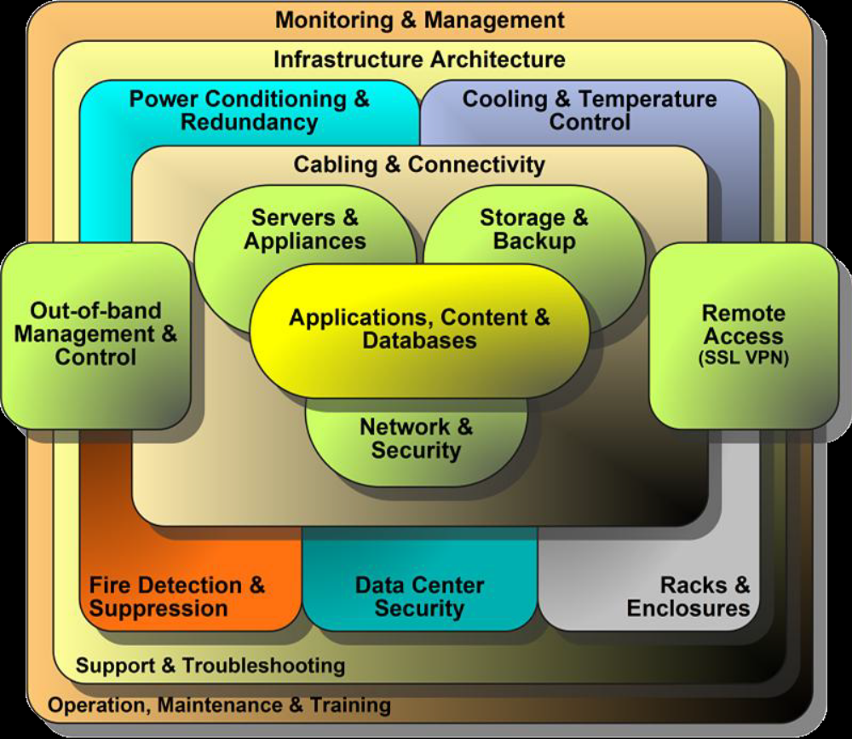
Technology Governance GIPs

Slide 6
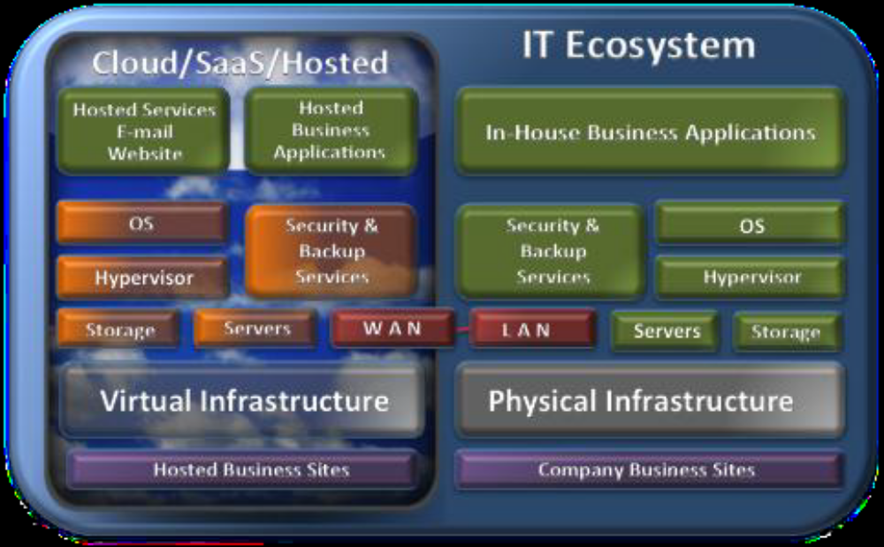
Technology Governance GIPs

Slide 7
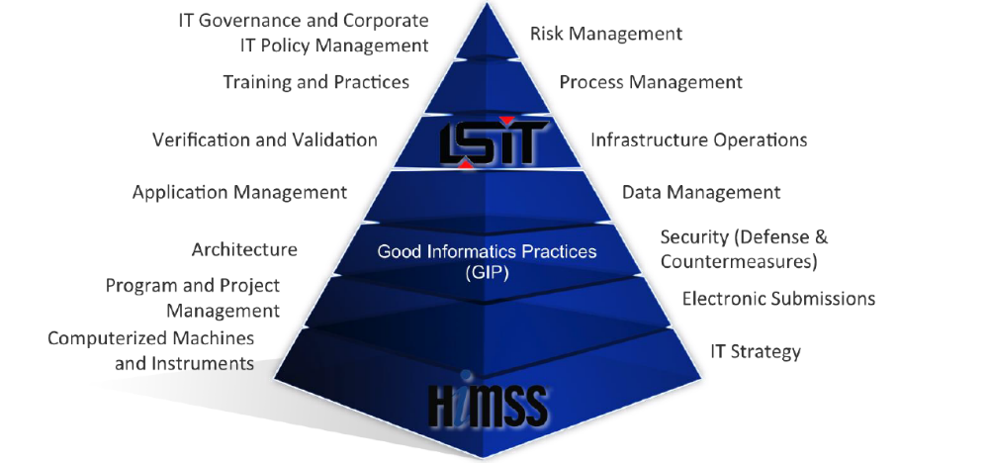
GIP body of knowledge

