Slide 1
Java: An introduction

Slide 2
Brief history of Java
Creation of Java Language → By team named “Green” with members lead by James Arthur Gosling
Originally called Oak (1991)
First version of Java was released: 1995
FOSS (GPL):
  FOSS is a free and open source software and GNU General Public License
  The GNU General Public License is a free, copy-left license for software and other kinds of works
Netscape Navigator Internet browser was the first Java enabled browser
Notes:
Copyleft is used describe the practice of using copyright law to offer the right to distribute copies and modified versions of a work and requiring that the same rights be preserved in modified versions of the work

Slide 3
Versions
JDK 1.0 (1995)
JDK 1.1 (1997)
J2SE 1.2 (1998) ) →Playground
J2SE 1.3 (2000) → Kestrel
J2SE 1.4 (2002) → Merlin
J2SE 5.0 (2004) → Tiger
Java SE 6 ( 2006) → Mustang
Java SE 7 (2011) →Dolphin
Called Java2
Version for the session

Slide 4
Tell me why
Why do we have so many versions?
Java started as a language originally targeting the digital cable television industry but it was ahead of its time for this industry. The Internet was beginning to boom at that time and Java turned out to be just right for it.
Eventually more APIs were added and Java (just like any other language) progressively evolved in terms of providing more features for security, reflection mechanism, newer utility classes etc. A quick look at API page ..\docs\technotes\guides\lang\index.html, will give a idea what was added to the API in which version.
Therefore with each version, the scope of the language has increased in terms of features .

Slide 5
Features: Simple
Syntax similar to C/C++
  Same types of loops
  Same data types
Error-free code
  no pointers
  no array index out of bounds problems
  no explicit memory allocation & de-allocation
Java is able to overcome memory related problems by the virtue of Garbage collection which is a tool that attempts to free unreferenced memory (memory occupied by objects that are no longer in use by the program) also called garbage, in program

Slide 6
Feature: Object oriented programming
Object-oriented programming is a method of implementation in which programs are organized as cooperative collections of objects, each of which represents an instance of some class, and whose classes are all members of a hierarchy of classes united via inheritance relationships.
Grady Booch

Slide 7
Programming approaches
Structured Approach
  Based on functions
  goto branching
  C, C++, COBOL, Pascal
  Some disadvantages: No constructs for encapsulation, chances of code repetition, No strong data hiding concept, difficult to debug
Object-oriented Approach
  Smalltalk, Java, C#,

Slide 8
Object-Oriented Programming Concepts
Object
Class
Abstraction
Encapsulation
Inheritance

Slide 9

Object
A thing in a real world that can be either physical or conceptual. An object in object oriented programming can be physical or conceptual.
Conceptual objects are entities that are not tangible in the way real-world physical objects are.
Bulb is a physical object. While college is a conceptual object.
Conceptual objects may not have a real world equivalent. For instance, a Stack object in a program.
Object has state and behavior.
What is the state and behavior of this bulb?

Slide 10
Attributes and Operations
The object’s state is determined by the value of its properties or attributes.
Properties or attributes → member variables or data members
The object’s behaviour is determined by the operations that it provides.
Operations → member functions or methods

Slide 11
Putting it together
object
A bulb:
It’s a real-world thing.
Can be switched on to generate light and switched off.
It has real features like the glass covering, filament and holder.
It also has conceptual features like power.
A bulb manufacturing factory produces many bulbs based on a basic description / pattern of what a bulb is.
methods
member variables
class

Slide 12
Class
A class is a construct created in object-oriented programming languages that enables creation of objects.
Also sometimes called blueprint or template or prototype from which objects are created.
It defines members (variables and methods).
A class is an abstraction.

Slide 13

Abstraction
Abstraction denotes essential characteristics of an object that distinguish it from all other kinds of objects and thus provide crisply defined conceptual boundaries, relative to the perspective of the viewer.
-Grady Booch
Abstraction is the process of taking only a set of essential characteristics from something.
Example
  For a Doctor→ you are a Patient
    Name, Age, Old medical records
  For a Teacher→ you are a Student
    Name, Roll Number/RegNo, Education background
  For HR Staff→ you are ______________
    ___________,_____________,___________
You

Slide 14
Java Class
public class Student{
public int regno;
public String name;
public void display()
{
//display statements
}
}
Creating Student Object
Student s= new Student();
s.display(); → access members using ‘.’
public data member
public member function
More on classes in the later sessions

Slide 15
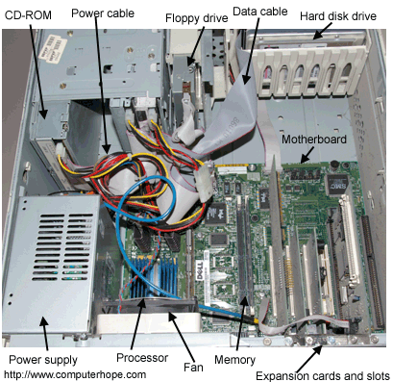
Encapsulation
Would you like it if your CPU is given to you like this?
What are the problems if it were given to you like this?
Encapsulation is the process of compartmentalizing the elements of abstraction that constitute its structure and behavior; encapsulation serves to separate the contractual interface of an abstraction and its implementation.
- Grady Booch
Encapsulation is binding data and operations that work on data together in a construct.
Encapsulation involves Data and Implementation Hiding.

Slide 16
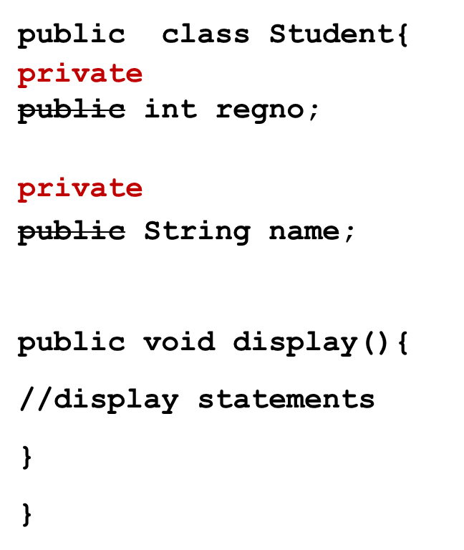
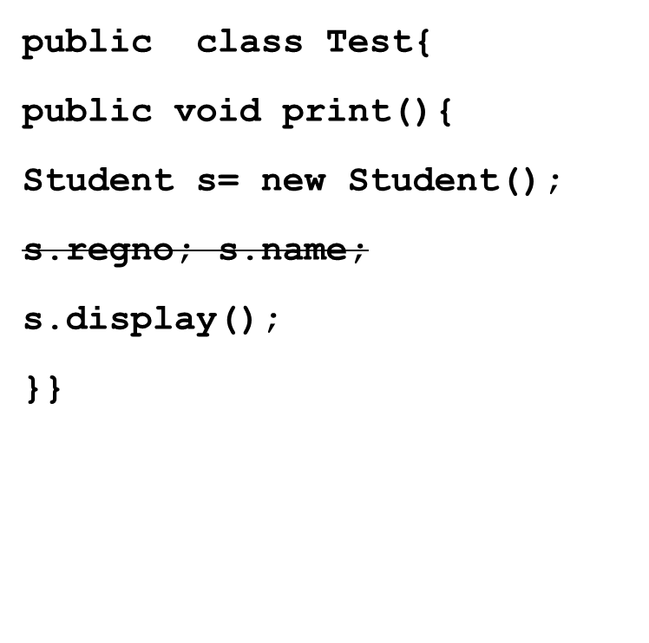
Data and Implementation hiding in Java class
public vs private access specifiers
visible
Change in implementation of display() does not affect Test class.
More on this in the later sessions
Not visible to any other class other than Student class

Slide 17
Inheritance and Polymorphism
Inheritance defines relationship among classes, wherein one class share structure or behavior defined in one or more classes.
- Grady Booch
Animal
legs
tail
run()
CatFamily
paddedClaws
whiskers
Dog
bark()
Tiger
growl()
Cat
meow()
More on this in the inheritance section

Slide 18
Portable and platform independent…
Before we understand portability and platform independence, we need to understand a few concepts.
Java Code can be compiled anywhere
Bytecode can be executed anywhere
  Write-once-run-anywhere
Let’s begin by writing a simple java program to understand this.

Slide 19
Simple Hello World in Java
Understanding
Portable and platform independent
Hello.java
public class Hello{
public static void main( String args[])
{
System.out.println(“Hello World!”);
}}
Special statement used to display data on console. ‘println’ causes the next print statement to be printed in the next line.
main() is a method from where program execution begins.
Save the file as Hello.java. A public class must be saved in the same name as class name. More on this in package section.

Slide 20
Feature: Portable
Java source code can be compiled in any java-aware system. Also when java code executes, it behavior is exactly same in any java-aware system.
There are no platform-specific code in java programs that causes compilation problems in any other OS. (For example in C if you include conio.h library, this will work only in Window OS and will not work in linux).
Also some features that were considered not portable in C/C++ (like sizes of int, right shift operator behavior etc.) were eliminated for Java.
So, Java programs are portable, which implies that they behave the same way when executed in any system and produce the same result.
But what is Platform Independence then? Let us compile our code first which will take us there.

Slide 21
Environment to compile and execute
Compile java programs
  From command prompt
  Through an IDE (Integrated development environment)
    Eclipse →Apache
    NetBeans →Oracle SDN
    JBuilder → Borland
    Integrated Development Environment → IBM
But what is an IDE?

Slide 22
IDE
  Integrated development environment (sometimes also called integrated debugging environment or interactive development environment or integrated design environment) is an GUI interface that allows programmers to build and test (and sometimes design) their application.
  Typically IDE consists of
    An editor where code can be written.
    A compiler: Some IDEs (like all of them listed in previous slide) compile as and when the code is written. In eclipse, redline underline is used to indicate compilation errors and yellow underline is used to indicate warnings.
    Run and Debug features
    Tools to create language specific components
    Context sensitive help (In eclipse, ctrl spacebar)
    Tools for auto-build (packaging a JEE application in eclipse)

Slide 23
Setup JDK
http://java.com/en/download/index.jsp or find appropriate link in http://www.oracle.com/technetwork/indexes/downloads
Download Java based on the type of OS
  Windows
  Linux
  Mac OS
  Solaris
Install JDK

Slide 24
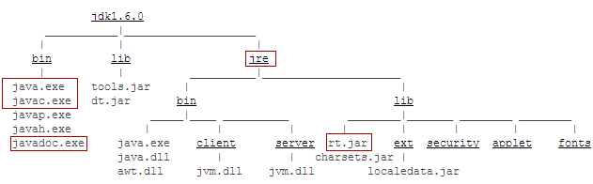
JDK installation directory
Java Runtime Environment
Java virtual machine
Java Executables
Java Predefined Classes like
String, Date, Math etc

Slide 25
Compilation and execution model ( from command prompt)
Compile
  C:\MyJava>javac Hello.java
Byte code
Source code
Hello.class
javac
Hello.java
compilation
execution
java
Execute
  C:\MyJava>java Hello
Platform specific code

Slide 26
Other useful javac options
javac [ options ] [ sourcefiles ]
sourcefiles can also include relative or absolute path components
–d directory
  Set the destination directory for class files.
  D:\ javac –d bin Test.java places Test.class in D:\bin folder. Please note that the bin folder exist before giving this command
-nowarn
  Disable warning messages.
-version
  Displays the version used for compilation
-target
  Generate class files for specific VM version

Slide 27
Other useful java options
java [ options ] class [ argument ... ]
-verbose:class
  Display information about each class loaded.
-verbose:gc
  Report on each garbage collection event
-version
  Display version information and exit.
-showversion
  Display version information and continue.
-?
-help
  Display usage information and exit.
later

Slide 28
About Eclipse 3.6 IDE
IDE where Java programs can be written, compiled and executed.
Open source
JRE needs to be installed before eclipse is installed.
3.6 release of the Eclipse Project is developed on a mix of Java 1.4, Java 5 and Java 6 VMs
Available for different OS(Windows, Mac OS, Linux, Solaris, IBM AIX, HP-UX)

Slide 29
Activity: Writing code in Eclipse IDE
To start Eclipse double-click on the file "eclipse.exe“.
Enter the workspace (path) where you want store your java files.
Close the Welcome screen.
There are many perspective that Eclipse provides. By default Java Perspective is opened.
Select from the menu File -> New-> Java project. Enter the project name as Java1. Select "Create separate source and output folders".
Right click on src folder on the left under Java1 and select New -> Class
Enter the name of the class as “Hello”. Make sure “public static void main” is ticked. Click finish.
Enter the print statement in the source code file that opens.

Slide 30
Compile and execute
Compilation happens automatically. Note that red lines appear in case there are errors. Yellow lines are for warnings.
Right click on your Java class and select Run-as-> Java application

Slide 31
Bytecode, JRE
Java Bytecode is produced when Java programs are compiled.
To execute Java program, JRE must be installed in the system
JRE or Java Runtime environment contains
  Java Virtual Machine
  Standard class libraries (APIs)
  Java Plug-in
  Java Webstart
JRE gets installed automatically when JDK is installed. JRE can be installed independent of JDK as well. This will mean that Java programs can be executed in that system.

Slide 32
Feature: Platform Independent
A Java program requires JVM (part of JRE) to execute Java code. When java application starts to executes, that Java Virtual Machine also starts.
Bytecode has instructions that Java Virtual Machine can understand and execute.
JVM converts the Bytecode to machine specific code.
Java Bytecode can be copied on to any machine that has JVM and executed. This is what makes Java Platform Independent.
“Write Once, Run any where”
Is JVM platform independent?
No, since JVM needs to convert the byte code to machine specific code, it is different for each machine or OS, since each OS has its own native language.
That is the reason why JDK/JRE is available for different platforms.
Sun Microsystems claims that there are over 4.5 billion JVM-enabled devices!

Slide 33
JVM: perspectives
JVM can be looked as
  a runtime instance: JVM life cycle begins when applications starts to run ( that is when main method is called) and ends when the application ends.
  the abstract specification: Specification that Java team at Sun (Oracle) provides which tells JVM makers how they must design JVM for their OS.
  a concrete implementation: JVM that is build specific for a specific OS based on abstract specification.
When we talk about JVM in these sessions we mean a runtime instance of JVM

Slide 34
Feature: Robust
Reliable →that the code works as desired in normal circumstances for specified periods of time.
Robustness → the code responding appropriately in abnormal circumstances.
Features that make Java robust
  Strong Error handling mechanism: Lot of checks are done at the compilation itself. More checks are performed at runtime system to make sure that code does not malfunction.
  Automatic garbage collection

Slide 35
Error handling in java
Compilation error : generated by the compiler. Examples of situation when it arises:
  incorrect syntax, bracket mismatch, if keywords are used as variables
  Using uninitialized variables
  Unreachable code: while(false){…}
  Strong type checking
Run-time error : generated by the JVM.
  Examples of situation when it arises:
    Attempt to divide an integral value by 0 or access array index beyond the defined range.
    Trying to access a class that does not exist at runtime. (What happens if you delete Hello.class and then run Hello.
  Java has strong exception handing mechanism that allows programmers to handle such errors and come out of the situation gracefully.

Slide 36
Automatic garbage collection
The garbage collector is a tool that attempts to free unreferenced memory (memory occupied by objects that are no longer in use by the program) also called garbage, in program.
Automatic garbage collection is an integral part of Java and its run-time system.
Java technology has no pointers. So there is no question of allocation and freeing by programmers.
Does that mean Java does not support dynamic memory allocation?
No. It means that Java takes care of memory and relieves the programmers from memory-related hazels.
java –verbose:gc can be used to get more information about garbage collection process. (-verbose:gc -XX:+PrintGCDetails -XX:+PrintGCTimeStamps)
More on this in classes session

Slide 37
Recall of features that we have seen so far
Simple
  Object oriented language
Portable
Platform independent
Robust

Slide 38
Feature: Multithreaded
At the OS level, smallest unit of work that can be scheduled, is a thread.
Thread is a sequence of execution of code.
A process consists of one or more threads.
Multiple threads in the same program share same resources.
Unlike a multiple process, multiple threads in a process share same memory location. That is why threads are sometimes called Light weight process.
Java Standard API has rich set of classes that allows us to work with multiple threads simultaneously
More in Threads section

Slide 39
Feature: Dynamic Linking
The Java class loader(a represented by a class called ClassLoader) is a part of the Java Runtime Environment that dynamically loads Java classes into the Java Virtual Machine.
It links classes with the executing code.
Usually classes are only loaded on demand- only the classes specified in the code are loaded.
JVM class loaders looks for the classes specified in the the following order-
  Bootstrap classes → loads java libraries (rt.jar etc.)
  Extensions classes → loads external libraries in lib/ext paths. For example, <JAVA_HOME>/lib/ext etc.
  Classes in classpath→loads classes in CLASSPATH environment variable or system property java.class.path. (By default, the java.class.path property's value is ‘.’)

Slide 40
Activity: Understanding Classpath
public class Student{
public String name;
public void display(){
System.out.print(“Welcome “);
System.out.println(name);}
}
public class StudentTest{
public static void main(String args[]){
Student object= new Student();
object.name=“Gayathri”;
object.display();}
}
C:\MyJava\Student.java
C:\MyJava\StudentTest.java

Slide 41
Set Classpath
To successfully compile StudentTest, Student.class must be in the classpath
To set the classpath temporarily in command line
In the command prompt, enter the command
SET CLASSPATH=C:/MyJava;%CLASSPATH%;.
3. Go to D:\MyJava and compile StudentTest.java.
4. Execute StudentTest class (because that is where the main method is !)

Slide 42
Classpath
Classpath is an environment variable that java compiler and JVM (system class loader) uses to locate the classes in the file system.
Command to specify classpath
  javac –classpath directory1;directory2
  javac –classpath C:/MyJava
Command to specify uncompiled source file to be compiled and included in the classpath
  javac – sourcepath directory1;directory2
  javac –sourcepath C:/MyJava

Slide 43
Feature: Security
Security is in-built into
  Java's language rules
    Has no syntax for pointers. So it is impossible to access illegal memory
    Has extensive syntax (like private, protected) to secure data from being accessed by illegal objects
    Comprehensive API with support for a wide range of cryptographic services and for Authentication and Access Control
    Secure communication
  Java Compiler
    Flags error on illegal conversions
    Also makes sure that all java's language rules are adhered to

Slide 44
Java Runtime System
  The Java class loader and the bytecode verifier makes no assumptions about the primary source of the bytecode. (It could be that bytecode is produced by java compiler or some malicious compiler or may be hand written)
  JRE does 3 levels of checks
    class loader – loads the class and confines objects to the space demarcated for it
    bytecode verifier verifies classes after loading to make sure no illegal operation is performed like –illegal access to private variables, type-safe casting, array bound checking etc.
    security manager - determines what resources a class downloaded from a network can access such as reading and writing to the local files, creating a new process. Sandbox security model for applets, policy files needed for any java network application to access disk.

Slide 45
Feature: Performance
JIT (Just-in-Time Compilation)
GC (Garbage Collector) runs as low priority thread
JNI (Java Native Interface)
More on this coming up later sections

Slide 46
Interpreter vs JIT
Java Bytecodes were originally designed to be interpreted by JVM meaning bytecode are translated to machine code without it being stored anywhere.
Since bytecode verifier (which is part of JVM) performs runtime checks, line by line execution was important.
Since speed became an issue, Just-in-Time Compilation (JIT) came into being. JIT converts chunks of code, stores it temporarily in memory and then executes the converted code.
JIT compilers are typically bundled with or are a part of a virtual machine and do the conversion to native code at runtime, on demand.
The compiler also does automatic register allocation and some optimization when it produces the bytecodes.
Therefore, JIT is hybrid compiler.
Notes:
compiler

Slide 47
JNI
Java Native Interface is way in which Java code can call native methods or functions like C++ or C.
This feature of Java allows to
  unleash platform-specific features or program library
  make use of code is already written native language then Java code can make use of existing code
  improve performance

Slide 48
Summary of the features of Java Language
Simple
  Object oriented language
Portable and platform independent
Robust
Multithreaded
Dynamic Linking
Secure
Performance

Slide 49
Flavors Of Java
JSE
  Java Standard Edition formerly known as J2SE.
  This forms the core part of Java language.
JEE
  Java Enterprise Edition formerly known as J2EE.
  These are the set of packages that are used to develop distributed enterprise-scale applications.
  These applications are deployed on JEE application servers.
JME
  Java Micro Edition formerly known as J2ME.
  These are the set of packages is used to develop application for mobile devices and embedded systems.
Our focus

Slide 50
Commenting source code
Why should you comment your code?
How much should you comment?
3 types of comment
    Single line comment : //
    Multi-line comment: /* */
    Documentation Comment (Doc comment): /** */
For standard Java class library, Sun supplies HTML documentation that you can download from the oracle’s site.

Slide 51
Example for single line and multiline comments
public class College{
public String name;
//public int id;
public void display(String user){
/*System.out.println(“User:”);
System.out.println(user);*/
System.out.println(“Name:”);
System.out.print(name);
return “welcome”;
}
}

Slide 52
Some Guidelines for Doc comments
Who owns and edits the Doc Comments: usually the programmer
Doc comments for classes, methods, fields:
  Brief description of what it does. In case longer description is required, link to an external document (word, pdf) can be included.
  For methods, whether they are thread-safe and what runtime exception they throw must be specified.
Proper indentation of documentation for better readability.
Entities for the less-than (<) and greater-than (>) symbols should be written &lt; and &gt;. Likewise, the ampersand (&) should be written &amp;.
Revisit this after threads and exception
Visit this after finishing Java
For More Information http://download.oracle.com/javase/1.4.2/docs/tooldocs/windows/javadoc.html#documentationcomments

Slide 53
Example
/** This class is used to represent a college.
* @author Murali
* @version 1.0, 08/16/2010
*/
public class College{
/** Name of the college */
public String name;
/** This method is used to display and return the welcome message.
* @param user is the name of the user
* @return returns the welcome message
*/
public String display(String user){
System.out.println(user);
System.out.print(name);
return “welcome”;
}
a special keyword that the Javadoc tool can process called Annotation

Slide 54
/** This is where the program execution begins.*/
public static void main(String args[]){
College collegeObject= new College();
collegeObject.name="XYZ College";
collegeObject.display("Deepak");
}
}

Slide 55
javadoc
Tool that is used to produce HTML pages by parsing through the documentation comment in java source code.
Produces documentation for public and protected classes/members.
Works on entire package or a single source file
Usage on source file
  javadoc sourcefilename.java

Slide 56
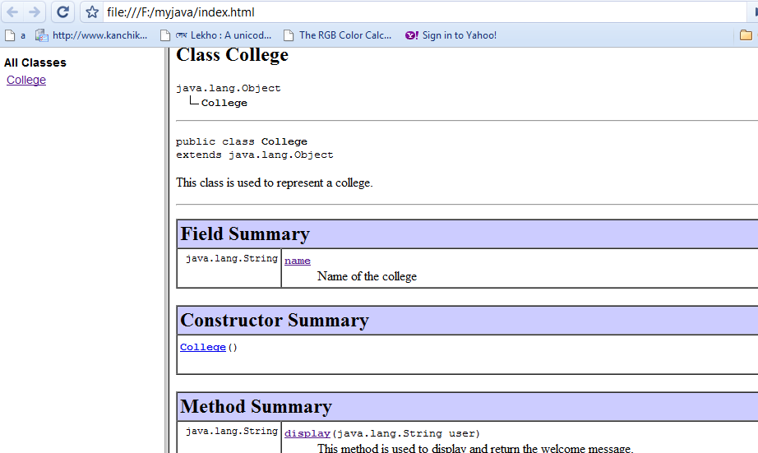
Use the following command to generate java documentation.
javadoc College.java
Check out the files that are generated. Did you notice where the commented lines are inserted ?
Javadoc –version –author filename.java

Slide 57
Nesting comments
Valid Nesting
/* // */ /** // */
///* */ // /** */
Invalid Nesting
/* */ and /** */ nested with itself and nested with each other gives error.
/* /* */ */
/** /* */ */

Slide 58
Annotations
Annotations are extra text starting with @ symbol that are added in the Java program to provide information about a program.
Annotations do not directly affect program semantics.
They provide information about the program to tools and libraries, which can in turn affect the semantics of the running program.
Annotations can be read from source files, class files, or reflectively at run time.

Slide 59
Uses
Annotations for the compiler
  Example:
    @SuppressWarnings : can be used by the compiler to detect errors or suppress warnings
  Annotations for the application servers and tools
    Application server tools can process annotation information to generate code etc for services it provides like security etc.
    javadoc tool uses annotations like @author etc.
Runtime processing — Some annotations are available to be examined at runtime.

