Slide 1
Basic Elements Of Java
Data types, operators and statements

Slide 2
Primitive data types
Primitive data types are basic data types.
  Integer type: byte, short, int, long
  Floating point types: float, double
  Character data types : char
  Boolean data type: boolean
2

Slide 3
Ranges of Primitive data types
Type | Size in Bytes | Min Range | Max Range
byte | 1 | -2⁷ | 2⁷-1
short | 2 | -2¹⁵ | 2¹⁵-1
int | 4 | -2³¹ | 2³¹-1
long | 8 | -2⁶³ | 2⁶³-1
char | 2 | 0 | 2¹⁶-1
float | 4
double | 8
boolean | JVM Specific (typically 1)
Why 16 bits for char?

Slide 4

Unicode Character
UNICODE is a 16 bit character.
They are generally represented in hexadecimal format
“\u” in beginning of the character is used to represent hexadecimal character.
The characters represented include all basic English letters, numbers, special characters and characters from other languages also !
For example, Character ‘A’ represented in unicode as ‘\u0041’ – which is the number 65 in base 10.
The Unicode Standard encodes characters in the range U+0000..U+10FFFF
You could write the entire java code as
\u0069\u006e\u0074 \u0061;
This above code represents
int a;

Slide 5

Why Unicode?
Limitation of ASCII/Extended ASCII
  Limited number of bits therefore does not have capability to represent multi-lingual characters
Unicode
  Has 16 bits, therefore has ability to represent multi-lingual characters
  Industry standard
  Internationalization
What is UTF 8 and UTF 16 then?
5

Slide 6
More on Unicode
Definition from http://www.unicode.org/glossary/#unicode_encoding_form
Unicode transformation format is character encoding form that assigns each Unicode scalar value to a unique code unit sequence. The Unicode Standard defines three Unicode encoding forms:
  UTF 8
  UTF 16
  UTF 32
Java 6 char supports UTF 16.
Example: Printing char in Hindi
  System.out.println("\u0905”);
6

Slide 7
Variables
Variable name must begin with
  a letter (A-Z, a-z, or any other language letters supported by UFT 16)
  An underscore (_)
  A dollar ($)
after which it can be sequence of letters/digits.
Digits: 0-9 or any Unicode that represents digit.
Length of the variable name is unlimited
Java reserved words should not be used as variable names.

Slide 8
Variable Naming Convention
Must begin with lower case
Must always begin your variable names with a letter, not "$" or "_".
Avoid abbreviations, use meaningful names.
If a variable consists of two or more words, then the second and subsequent words should start with upper case.
For example, rowHeight.
8
Notes:
http://download.oracle.com/javase/tutorial/java/nutsandbolts/variables.html

Slide 9
Keywords/ Reserved words
abstract | continue | for | new | switch
assert | default | goto | package | synchronized
boolean | do | if | private | this
break | double | implements | protected | throw
byte | else | import | public | throws
case | enum | instanceof | return | transient
catch | extends | int | short | try
char | final | interface | static | void
class | finally | long | strictfp | volatile
const | float | native | super | while
9

Slide 10
More on Keywords
goto and const are unused keywords. They are reserved for future use.
null, true and false are not keywords. However, they cannot be used as identifiers.
Java classes are not keywords.
10

Slide 11
Constants
Value of a constant cannot be changed once a value is assigned.
final keyword in front of the variable denotes constant.
final double PI=3.14;
Constant Naming Convention
  All rules that apply for a variable also applies to constants except the one below
  Constants must be all in UPPER CASE. In cases where you have more than one word making up constant, words must be separated by underscore.

Slide 12
Literals
A literal is the value assigned to a variable. For example 7 is a literal.
The literals available in java:
  Integer Literal
  Floating Point Literal
  Character Literal
  Boolean Literal
  String Literal

Slide 13
Integer Literals
Integer literals are by default int (32 bits).
There are four ways to represent integer numbers in the Java language:
        decimal (base 10): 10, -1;
        octal (base 8) : 07,010;
        hexadecimal (base 16): 0xf,0xF,0x11
        long literals: 4000000000 or x = 4000000000l
      int i=0xFF;
      final long k=35L;
13

Slide 14
Floating-Point Literals
Floating-Point literals are by default double (64 bits).
They can be represented as
  32.4, .24
  3E1, 3e-1
  32.4D , 3E1D, 3e-1D 32.4d , 3E1d, A suffix of D or d also could be added to improve readability for double literals.
  32.1F , 32.1f
final double PI=3.14;
float f=2.1e10f;

Slide 15
Character Literals
1. Character Literal:
'a‘, or '@’
2. Unicode Character Literal:
'\u0041'; // The letter A
3. Escape Sequences Literals:
‘\n’ (enter key), ‘\t’ (tab key)
4. Octal character literals:
'\101’ (A)
char c=‘z’;
final char m=‘\101’;
15

Slide 16
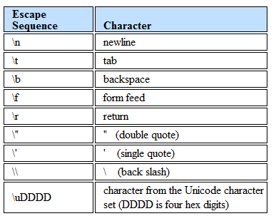
Escape Sequence
\DDD
Character from the Unicode characters
set (DDD is octal digits)

Slide 17
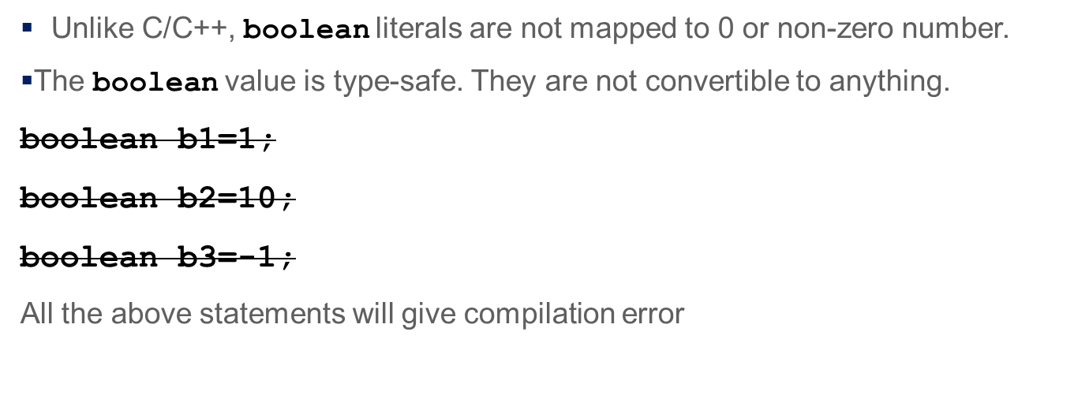
Boolean literals
true
false
boolean b=true;
final boolean b=false;

Slide 18
String Literals
“Bill Gates”
“Thank You”
"\u0041\u0069 “ (Ai)
String is a type defined by java standard library.
String s= “Welcome”;
final String=“Fly\n”;
18

Slide 19
Variable Declarations
Local declarations
  Declarations made inside a method
  A local variable must always be initialized to a value before it can be used in calculations or display.
  If a variable is used without initialization, compiler will flag an error.
Class declarations
  Declarations made outside a method
  A class variable is automatically assigned a default value if it is not initialized.
  There are two types of class declarations
    Instance declaration
    Static declaration
More on this in classes session

Slide 20
Example
public class Student {
public String name;
public int rollno;
public void display(){
String title ;
System.out.print(title);
System.out.println(name);
title=“Roll No.:”;
System.out.print(title);
System.out.println(rollno);}}}
Or String name=“ab”;
Class declarations
=“Name:”
Local declaration
Must be initialized.
Otherwise you get compilation error !

Slide 21
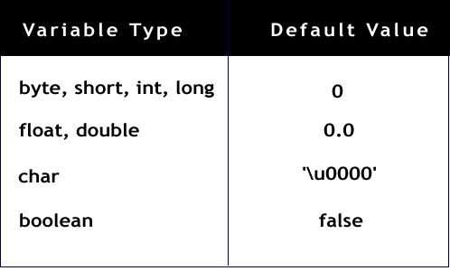
Default Values
String/
any other Object
null

Slide 22
Arithmetic Unary Operators
+ - ++ --
Examples: –5, +5
Pre-increment: y=++x; //(x=x+1; and y=x;)
Post-increment: y=x++; //(y=x; and x=x+1;)
Examples
int k=10;
k++; //value becomes 11
char ch=‘X’;
ch++; // (ch = ‘Y’)
int i=-10;
int k=i++;
What will be the value of k?
float d=+3.4f;
Will the following code compile?
double f= d++;
22

Slide 23
Arithmetic Binary Operator
+ - * / %
Example:
int a = 5;
int b = 2;
int c = a + b;
System.out.println(5%2); // output is 1
remainder operator
23

Slide 24
Relational Operators
< > >= <= == !=
Example:
int i=10;
int j=20;
System.out.println( i>j );
// output is false
System.out.println(i==10);
// output is true
What will happen when you do this?
System.out.println(i=10);

Slide 25
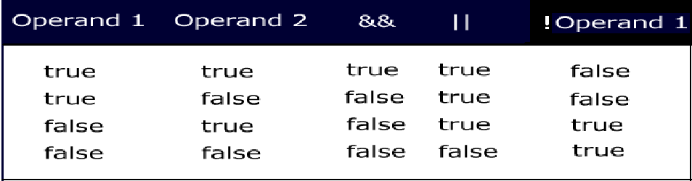
Conditional Logical Operators
&& || ! ?:
Logical operators are binary operators that require boolean values as operands.
Does not work if the operands are int
25

Slide 26
Short circuit operators
&& and || are also called short circuit operators because they are optimized.
&& checks if the first condition is false. If it is so then it doesn't evaluate the second condition.
|| checks if the first condition is true. If it is so then it doesn't evaluate the second condition.
Example :-
int i=0;
int j=10;
System.out.println( i>j || j>i ); // prints true
Example for ! :-
int i=0;
int j=10;
System.out.println(! (i>j)); // prints true
26

Slide 27
Guess what the result of this code is?
public class Example{
public static void main(String args[]){
int i=0;
int j=2;
boolean b= (i>j) && (j++>i);
System.out.println(j);
}
}

Slide 28
Ternary operator
Syntax of ?:
<variable> = (boolean expression) ? <value to assign if true> : <value to assign if false>
Example :-
int i=10;
double j=10.1;
int k=(i>j)?10:20;
System.out.println(k); // outputs 20
What is the problem with the code below assuming i, j and k are declared as in the example above?
int k=(j=i)?10:20;

Slide 29
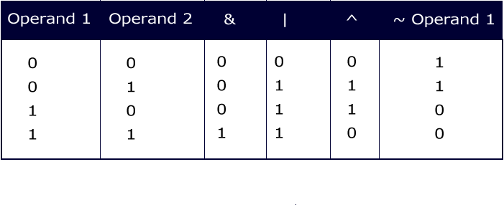
Integer Bitwise Operators
~ & | ^
They convert the integral data types into their binary form and then perform operations according the table.

Slide 30
Example : Integer Bitwise Operators
public class AndOrNotEx{
public static void main(String str[]){
byte x=1; // 0000 0001
byte y=3; // 0000 0011
System.out.println(x&y); // prints 1
System.out.println(x|y); // prints 3
System.out.println(x^y); // prints 2
System.out.println(~x); // prints -2
}
}
Can you arrive at all of these without executing the code?
(for ~x explanation is in the next slide)
What will happen if you change byte to double?

Slide 31
More bitwise
byte x=1; // 0000 0001
System.out.println(~x); // prints -2
Explanation:
~x is 1111 1110.
This is a –ve number. To get the value of –ve number, find its 2’s compliment.
2’s compliment is 1’s compliment +1
1’s compliment of 1111 1110 is 0000 0001
+1 1
------------
0000 0010 → 2
Since the number is –ve the result is -2
What is the value of ~ -2?
31

Slide 32
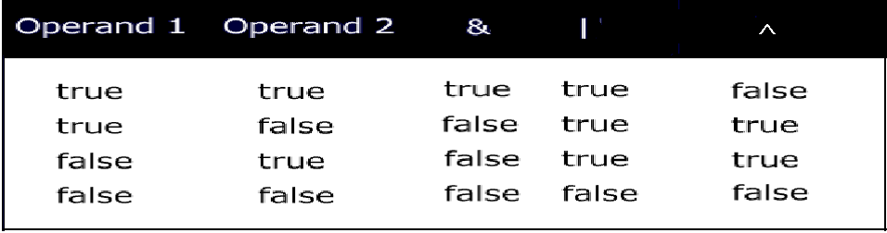
Logical Operators
& | ^
What will happen when you compile the following statement:
if(~(1>2))
System.out.println(“OK");

Slide 33
Example: Logical Operators
public class Example{
public static void main(String args[])
{
int i=0;
int j=2;
boolean b= (i>j) & (j++>i);
System.out.println(j); //prints 3
}
}
Compare this with short circuit operator &&.
33

Slide 34
Compound Operators
+= -= *= /= %= &= |= ^=
Example:
int a = 10;
int b=2;
a+=b; // means a=(int)(a+b);
double d=45.3;
d/=1.2;

Slide 35
Shift operators
In case of right shift there is always a debate whether the left bits that get vacant during the shift must retain the sign of the original number or not.Some people believe that the sign must be retained → Arithmetic Shift.Others believe it must not be retained → Logical Shift
That is the reason why Java came up with two shift operators >> for Arithmetic Shift and >>> for Logical Shift. (Recall the non-portability feature of Java)
>> the SHIFT RIGHT operator
<< the SHIFT LEFT operator
>>> the UNSIGNED SHIFT RIGHT operator
System.out.println(2<<1); // prints 4
System.out.println(-1>>2); // prints -1
System.out.println(-1>>>2); // prints 1073741823
35

Slide 36
Activity
Find out what happens if you try to shift more than the number of bits in an int ?
System.out.println(2<<32);
System.out.println(2>>32);
System.out.println(2>>>32);
System.out.println(2<<33);
System.out.println(2>>33);
System.out.println(2>>>33);
36

Slide 37
Precedence
Operators Associativity
-------------------------------------------------------
[] . () methodCall() left to right
! ~ ++ -- - + new (cast) right to left
* / % left to right
+ - left to right
>> >>> << left to right
< > <= >= instanceof left to right
== != left to right
& left to right
^ left to right
| left to right
&& left to right
|| left to right
?: left to right
= += -= *= /= >>= <<= >>>= &= ^= |= left to right

Slide 38
Conversions
Widening Conversions (achieved by automatic or implicit conversion)
Narrowing Conversions (achieved by casting or explicit conversion)
Overall magnitude not lost
All primitives are convertible to each other except for boolean.
38

Slide 39
Automatic or implicit conversion
The conversion in the direction indicated happens automatically.
byte→short→int→long→float→double
char
When an arithmetic operation happens between different numeric types, the result of the operation is always of the higher numeric data type.
If an arithmetic operation happens between any integer type except long, the result is an int.
Similarly when arithmetic operation happens between floating points the result is double.
39

Slide 40
Loss of information
There could be loss of some information during conversion of the following:
int → float
long→float
long→ double
Example
int i=76543210;
float f= i; → 7.6543208E7
40

Slide 41
Assignment conversions- integers
int i=10;
int b=10;
int k=i+b; // ok
2. byte b1=20; // ok
short s=10; // ok
But byte b=39078; // error
3. int b=10;
byte b1=b; //error
But final int b=10;
byte b1=b; //ok
Integer literals are int
When the integer literals are within the range of the specifies integer data types, the conversion automatically happen. In case the literal is beyond range then compiler flags an error.
This again is one if the strict type-checking that compiler does.
41
Notes:
float f = 32.3f;

Slide 42
Assignment conversions- double
int f = 32;
float t=f; //ok
int k=t; //error
Guess what happens if you compile this statement?
float f = 32.3;
Floating point literals are double.
So double value cannot be assigned to float.
What should be done to correct this?
42

Slide 43
Arithmetic operators conversions
1. byte b1=20, b2=30;
int i=b1+b2; // ok
But byte b=b1+b2; // error
Same is the case with short
Since arithmetic operations between integer types results in int (except when it involves long), b1+b2 yields error (possible loss of precision)
2. byte b=b+1; // error
But byte b+=1; // ok
because compiler converts this as byte=(byte)(b+1);
3. byte c=10; // ok
byte c1=-c; // error
4. byte c2=c1+1; // Error : possible loss of precision
But byte c2=++c1; // ok
Compound assignment operator and pre/post increment/ decrement operator does the conversions required.
43

Slide 44
char conversions
char c=‘A’;
int i=c;
Assigns unicode value of A to int
2. char c=65;// ok
65 is within the range of char
char c=-65; // error
4. int ii=65;
char c=ii; //error
What change can you make in int’s declaration so that the code compiles?
5. char c=‘A’;
short s=c ; // error
Though short and char are 16 bits! Why should compiler not allow this?

Slide 45
Explicit conversion or casting
Any conversion between primitives (excluding boolean) that is not possible implicitly can be done explicitly.
Conversions like (a) double to long, (b) char to byte etc.
This is done through what is called casting.
Example:
    int k=10;
    char b=k; // error
Casting makes the error disappear:
char b=(char)k;
byte b=(byte)128;
What will be the value when you print b? Compute and arrive at this by yourself.
Notes:
128 is 10000000. Since 8th bit for a byte represents a –ve number, 10000000 is –ve.
To get the value of – ve number find its 2s complement (1s compliment +1)
1s compliment of 128 is 01111111
+1 is 10000000 which is 128.
Since the number is a –ve number the result is -128.

Slide 46
Flow control statements
Conditional Statements
  if statement
  switch statement
Loops
  for statement
  enhanced for statement
  while statement
  do-while statement
Loops can have break or continue.
General Syntax Notation
  Anything inside square brackets [… ] means it is optional
  statement(s) could be either a single statement or a block of statement enclosed in with curly brackets “{…}”
Coming up later
46

Slide 47
if statement
Syntax:
if (condition) statement(s)
[else statement(s)] ;
if statement are same as that in C except that the condition must always evaluate to a boolean value.
47

Slide 48
if example
if(x==y) x++;
if (x>y) y++;
else x++;
if(true) {
y++;
System.out.println(“OK”);
}
Will this work?
if(1) System.out.println(“OK”);
48

Slide 49
Activity: if statement
Tax slabs for general
0 to 1,80,000 No tax
1,80,001 to 5,00,000 10%
5,00,001 to 8,00,000 20%
Above 8,00,000 30%
Income tax slabs 2011-2012 for Women
0 to 1,90,000 No tax
1,90,001 to 5,00,000 10%
5,00,001 to 8,00,000 20%
Above 8,00,000 30%
Write if statements to achieve this.
Make sure that you indent the code well so that it is readable.
49

Slide 50
switch Statement
Syntax:
switch (expression){
[case expression: statement(s)]
…
[default: statement(s)]
}
switch statement is also very similar to the one in C
switch expression must be either integer value (not long) or char. In Java SE and later, String can also be used in switch statement's expression
case expression must evaluate to a constant/final value.
break statement after every set of case statements will prevent fall-through.
So when do you use switch statement instead of if statement?
50

Slide 51
switch Example 1
switch (week) {
case 1: System.out.println(“Sunday”);
break;
case 2: System.out.println(“Monday”);
break;
case 3: System.out.println(“Tuesday”);
break;
case 4: System.out.println(“Wednesday”);
break;
case 5: System.out.println(“Thrusday”);
break;
case 6: System.out.println(“Friday”);
break;
case 7: System.out.println(“Saturday”);
break;
}
51

Slide 52
switch Example 2
switch(x){
case ‘m’:
case ‘M’:
System.out.print(“Male”);
break;
case ‘f’:
case ‘F’:
System.out.print(“Female”);
break;
default:
System.out.print(“Male”);
}
Fall through
52

Slide 53
for Loop
Syntax
  for(initialization;condition;iteration) statement(s);
for statement (like in C) is used to iterate through a set of statements over a range of values specified and computed by the for loop itself.
The initialization expression is
  used to initialize variable(s)
    more than one variable initialization is separated by commas)
    can also include initialization with declaration
  executed only once when the loop begins.
53

Slide 54
When the condition expression
  Must evaluate to a boolean value
  Loop iterates till the condition is true
  Only one condition can be specified; multiple conditions can be combined using logical operators
  is evaluated at the beginning of each loop
The iteration expression
  is usually an increment or decrement expression of the variable initialized in the initialization expression
  is evaluated at the beginning of each loop
54

Slide 55
for loop- Example 1
public class ________
{
/* This program checks if a ______ is a _______. */
public static void main(String str[]){
int num = 5;
boolean flag=true;
for (int i=2;i<=num/2;i++){
if(num%i==0){
flag=false;
System.out.println(“_______”);
return;
}
}
if (flag) System.out.println(“______");
}}
Notice the way i is initialized in the for loop. i is not available outside the for loop.
Can you guess what this code does and fill in the blanks?
55

Slide 56
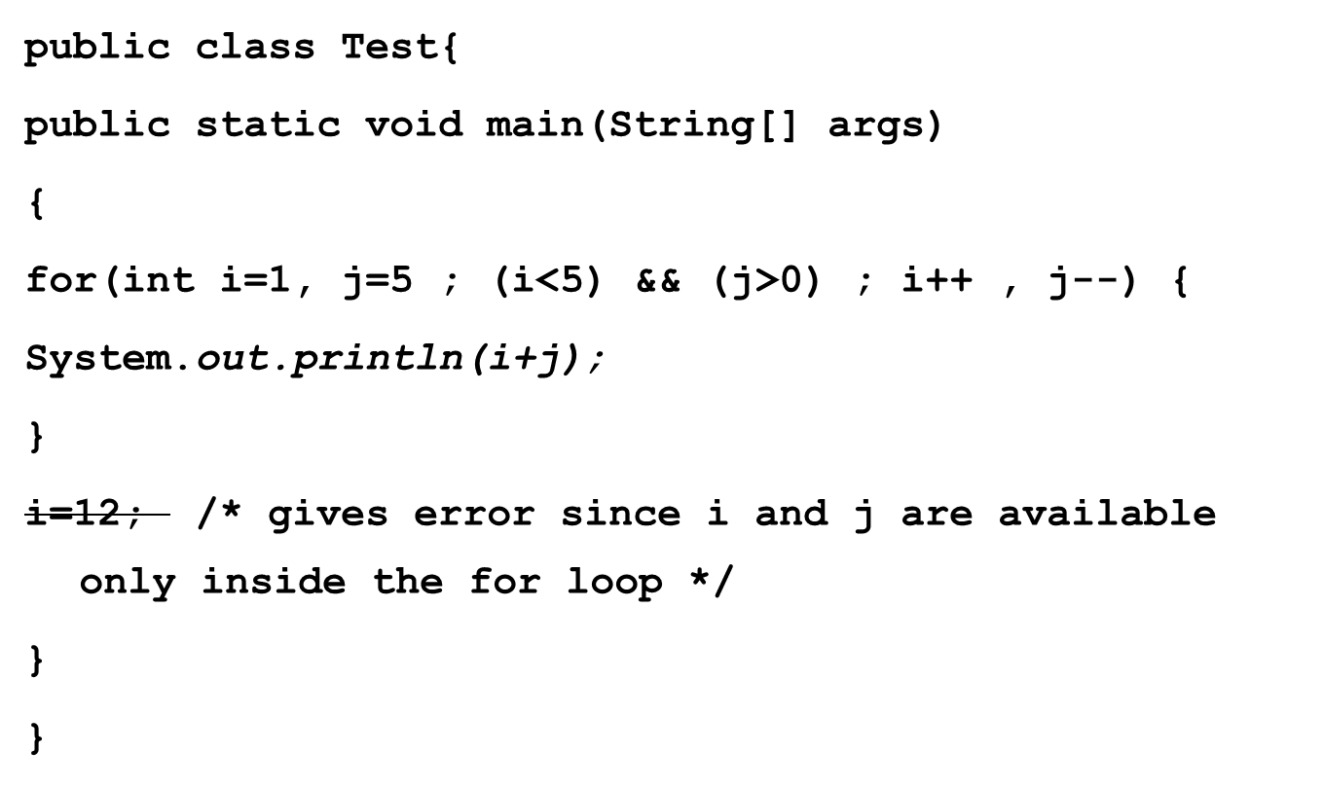
for loop multiple declarations- Example 2
56

Slide 57
for loop omitting options - Example 3
int j=10;
for(; j>0 ;j--) {
System.out.println(j);}
int j=10;
for(;j>0;) {j--; System.out.println(j);}
int j=10;
for(;;j--) {
if(j<0) break;
System.out.println(j);}
for(;;){…}
What is the purpose of the statement above?
57

Slide 58
while and do-while loop
while(condition) statement(s);
do statement(s) while(condition);
Like in C, while and do-while statement is used to iterate through a set of statements till the condition remains true.
while evaluates the condition before at the beginning of each iteration whereas do-while evaluates condition only at the end of each iteration.
Therefore, do-while guarantees that the loop statements are executed at least once.
Condition expression must result in ___________
Can you think of a situation where you would prefer do-while instead of while?
58

Slide 59
while loop- Example
int j=10002;
while(true)
{
if(j/13 ==0) break;
else
j++;
}
What will happen if true is changed to false
59

Slide 60
Activity: do-while loop
public class Test1 {
public static void main(String[] args) {
// TODO Auto-generated method stub
int f1=0,f2=1;
System.out.println(f1);
System.out.println(f2);
do {
f2=f1+f2;
System.out.println(f2);
}while(f2<10);}
}
What is the program trying to do?
There is problem with this code. Can you correct this code by just inserting a line?
What will the code display after correction?
60
Notes:
f1=f2;

Slide 61
Test your understanding
Select the statement (s) are ideal for the scenarios.
Statements
Scenarios
User has to enter his/her information. After he/she finishes entering information, a choice whether he/she wants to change some the details is prompted (Y/N). IF Y is entered he can re-enter the details again.
Sum of first 50 odd numbers
Easiest way to write infinite loop.
Any of the 5 different types of Graph is to be displayed based on the user’s choice.
if statement
switch statement
while statement
do-while statement
for statement

Slide 62
Tell me why?
while(false) { statement;} → unreachable code error
But
if(false) { statement;} → unreachable code error
Why?
Reason is Java does not have conditional compilation statement. The java language creators decided to leave the if statement with false condition to enable programmers to use conditional compilation kind of statements in java.
Example:
final boolean DEBUG = false;
if (DEBUG) { y=10; }
62

Slide 63
break and continue
break (as in C) is used to break out of the loop. It is also used with switch statement (which we have already seen).
continue (as in C) is used to skip the rest of the statements in the loop and start with a new iteration
63

Slide 64
break and continue- Example
public class Prime
{
public static void main(String str[]){
int num = 5;
boolean flag=true;
for (int i=2;i<=num/2;i++){
if(num%i!=0) continue;
flag=false;
System.out.println("Not Prime");
break;
}
if (flag) System.out.println("Prime");
}}
64

Slide 65
Labeled continue/break statements
In cases where there are multiple loops, when we break out or continue the loop, the immediate loop breaks or continues.
break and continue statement can also be used with labels to indicate from which outer loops should it break out or continue.
The outer loop where the break or continue must happen is labeled.
Note that labeled break/ continue will work only if the labels are provided for the loops in which they are enclosed.
65

Slide 66
Labeled continue/break statements
Example:
first: for(int i=0;i<2;i++)
for(int j=1;j>0;j--)
if(i!=j)
continue first;
else
System.out.println(i+j);
//prints 2
When i=0 and j=1

