Slide 1
Classes and Methods

Slide 2
Quick Revision
What is a Class?
What is an Object?
What is encapsulation and how will you achieve this in Java?

Slide 3

Public & Private Access Specifiers/modifiers
public access modifier can be used with class declarations and member declaration.
private access modifier can be used only with inner class declarations and all member declarations ( variable and methods).
Name
Registration number
Name of the degree
Current Semester
Student
What will you declare as private among the above attributes?
If your answer is all of them, then it is right.
Generally a class is responsible for the integrity of its data. Therefore exposing the data within the class may prove to be dangerous.
Notes:
Let us take an example of a Student object. This object represents a student in a college. What are the attributes of a student?
Now, it is the responsibility of Student class to make sure that
Name should not be null.
Registration number is automatically generated. Every new student gets a new registration number that is unique.
Name of the degree and current semester should always have proper values.
In other words, it is the student object’s responsibility to ensure that the data associated with it is valid.

Slide 4
Making attributes/variables private
public class Student{
private String name;
private int regNo;
private String degreeName;
private int currentSemester;
…
}
What is the use of a class if other classes cannot access any of its data?
For example, Exam class will want to know regNos of all students.
Result class will want to update the currentSemester once the student passes.

Slide 5
Accessors and Mutators
Accessor
  Getter method
  Used to return the value of the attribute
  Sometimes values may be same as the value of attribute, sometimes logic could be written to return the value expected by other classes. (Example coming up)
Mutator
  Setter method
  Used to assign a value of the attribute
  Logic to check the sanity of the value assigned to the attribute is written in the method

Slide 6
Example with getter and setter
public class Student{
private String name;
private int regNo;
private String degreeName;
private int currentSemester;
public String getName()
public void setName(String nm)
public int getRegNo()
regNo cannot be set by any other class
public String getDegreeName()
public void setDegreeName(String dnm)
public int getCurrentSemester()
public void setCurrentSemester(int i)
Instance variables of Student class
Instance methods of Student class

Slide 7
Full Example
public class Student{
private String name;
private int regNo;
private String degreeName;
private int currentSemester;
public String getName(){return properCase(name);}
private String properCase(String nm){
// Logic to be written later
return nm;
}
public void setName(String nm){
if(nm==null)
System.out.println("Name cannot be null");
else
name=nm;
}
Values returned may not be same as attribute
Logic to make sure name is not null.
What more checks do you need to perform here to make sure names are valid

Slide 8
public int getRegNo(){ return regNo; }
public String getDegreeName(){ return degreeName; }
public void setDegreeName(String dnm){
if(dnm==null)
System.out.println("Degree name cannot be null");
else
degreeName=dnm;}
public int getCurrentSemester(){
return currentSemester;}
public void setCurrentSemester(int i){
if((i<0) || (i<currentSemester ))
System.out.println("Invalid value for current semester");
else
currentSemester=i;
}}

Slide 9
Points to Note
Take a look at the way the methods are named
Getters
  are named beginning with “get” followed by the name of the variable beginning with upper case
  Has no arguments
  Returns the value of type which usually same as that of the variable
Setters
  are named beginning with “set” followed by the name of the variable beginning with upper case
  Has no return value (void)
  Takes an argument of usually same type as that of the attribute

Slide 10
Back to Conventions
Writing code that follows conventions makes it easy for others to identify in your code.
Local variable names must begin with _______ case.
Constants names must begin with _______ case.
Class name must begin with uppercase and each subsequent word with an upper case letter. Names must be meaningful.
Methods must be named like variables: name must begin with lower case and each subsequent word beginning with an upper case letter.
In other words, members of the class are to be named in lower case (unless they are constants).
Method names are generally verbs and variables name are nouns.
Class names, variable names and method names syntactically can be same, but it is better to give different names where ever possible to avoid confusion.

Slide 11
Accessing attributes using .
How do you create a Student object?
Student s= new Student();
Access any member of a class, use . operator
s.name or s.getCurrentSemester();
What will the code below print?
public class Test{
public static void main(String str[]){
Student s= new Student();
System.out.println(s.getName());}
Is it correct to allow creation of Student objects without name. Also registration number needs to be auto-generated as and when student object is created.

Slide 12
Constructor
Need a way in which only valid Student objects are created.
Need to provide values for student object at the time of creation.
Need a constructor!
The constructor is a special method for every class that helps initialize the object members at the time of creation.
It is a special method because
  it has the same name as the class name
  does not have a return type.
  Can be called only using ‘new’ keyword when object gets created.
There can be more than one constructor for a class.
Only when constructor is called, space for it is allocated. Declaration of variable of class type does not consume any memory!

Slide 13
Constructor Example
public class Student{
private String name;
private int regNo;
private String degreeName;
private int currentSemester;
/*Constructors 1 for student who have decided the degree they are going to enroll into */
public Student(String nm, String d){
setName(nm);
regNo=generateRegno();
setDegreeName(d);
setCurrentSemester(1);}
A constructor has the same name as the class and has no return value.
Found a place where registration number can be assigned.

Slide 14
/*Constructors 2 for student who have not decided the degree they are going to enroll into */
public Student(String nm){
setName(nm);
regNo=generateRegno();
setCurrentSemester(1);}
private int generateRegno(){
int nextNo=1;
//logic to generate regNo will be written later
return nextNo;}
// add setter and getters
}

Slide 15
Creating objects by calling constructors
public class StudentTest{
public static void main(String args[]){
//Creating object using constructor 1
Student student1=
new Student(“John”, “M.C.A.”);
//Creating object using constructor 2
Student student2= new Student(“Mary”);
}
}
What will happen if we create a Student object like we created in session 1?
Student student1= new Student();

Slide 16
No argument constructor
new Student() will try to invoke a constructor similar to the one below
class Student{
public Student(){..}
}
An error will be generated since there is no no-argument constructor defined
If we want Student objects to be created using new Student() then we must provide a constructor. (We do not want such creations for the reasons we already discussed)
But then how did it work in the first session? We never wrote any constructor there!

Slide 17
Compiler generated constructor
When no constructors are defined for a class, compiler automatically inserts a constructor that takes no argument.
public class Student{
public long regno;
public String name;
…
}
public Student()
{
super();
}
Compiler inserts
Learn about this in inheritance

Slide 18
Memory allocations
Local variables are created in Stack.
Objects are created are created in Heap. It is like allocating memory using malloc.
What is returned back to the program on invoking new is a reference that is again in Stack.
C++ programmers can compare this with the reference in C++. Sort of alias name for an variable.
For C programmers, references is like constant pointer to a variable that is a pointer using which value of the variable can be changed but pointer itself cannot be changed to point to some other variable. The variable here is an object.
In Java, all variables that created for objects are references.

Slide 19
Memory allocation by example:
public void test(){
int i;
Student s=new Student(“Mary”);
s.setCurrentSemester(2);
}
HEAP
name:Mary
regNo:1
currentSemester:2
degreeName:null
STACK
i
s

Slide 20
Multiple references to an object
Student student1= new Student(“Mary”);
Student student2=student1;
student1.setName(“Merry Mary”);
System.out.println(student2.getName());
HEAP
This code snippet prints “Merry Mary”
name:Mary
regNo:1
currentSemester:2
degreeName:null
STACK
student1
student2

Slide 21
null
Just declaration of a variable for a class does not create an object.
Student s;
STACK
s
s reference points to nothing or null.
Default value of an object reference is null.
Based on the scope of the declaration (local or class) either compile-time or run-time error is generated on invoking a method on a reference which is null .
Calling an instance method on a null object gives runtime error called NullPointerException

Slide 22
Local vs Class declarations for an reference
public class Test{
Student student;
public void test(){
student.display();
}
On executing the code above, an error occurs at runtime java.lang.NullPointerException
public class Test{
public void test(){
Student student;
student.display();
}
On executing the code above , an error occurs at compile time.
Do you recall something similar. Can you figure out why this is so?
Another point to note about scope in Java is that there is no global declarations!

Slide 23
Why this?
How can you invoke an instance method?
Through object reference, that is
s.getName();
But we called instance methods from constructor without any object?
public Student(String nm){
setName(nm);
…
}
Similarly we can call any instance method/ constructor from any other instance method/ constructors of the same class. Like getName() called instance method propercase(name).
public String getName(){
return properCase(name);
}

Slide 24
On what object are we calling these methods?
Right, it all began from main()method.
First student1 was created – new invoked the constructor. student1 got created. So setName() was called on student1 object.
Second student2 was created – new invoked the constructor. student2 got created. So setName() was called on student2 object.
Call is made on the object which invoked the method in the first place.
Instance method and constructor call it as the current object or this.
Compiler converts the code as:
public Student(String nm){
this.setName(nm);
…
}
public String getName(){
return this.properCase(name);
}

Slide 25
this
this is a keyword used only inside an constructors or instance method and is used to refer to the current object.
this is like a hidden reference that compiler provides to refer to current object.
From programmer’s point of view this comes handy in two places
  To distinguish between local and class variables in cases where they are same
  To call a constructor from another constructor of the same class

Slide 26
this to distinguish between local and class variables
In the example below, the name of the parameter for Student constructor and name of the attribute are same. Both are “name”.
In cases where there is a name clash, local names are considered.
public class Student{
String name;
…
Student(String name){
this.name=name;
regNo=generateRegno();
currentSemester=1; }}

Slide 27
Calling constructor from another constructor
public class Student{
String name;
…
public Student(String name, String d){
this(name);
setDegreeName(d);
}
public Student(String name){
setName(name);
regNo=generateRegno();
setCurrentSemester(1);
}
…
}
calls
When there are many constructors, pretty much most initialization statements are repeated in all constructors.
Instead of this repetition, it would be better if common initialization could be put on one constructor and all constructors can call this constructor.
That is when this() comes into picture.
Calling constructors is possible either by using new or by using this().
this() can be called only from constructor.
Call to this() must be the first statement in the constructor.

Slide 28
instanceof
An instance is another name for object reference.
Class is also a user-defined data type (like struct in C)
instanceof is an operator that is used to check if the instance is a type of class.
Usage:
object-ref instanceof class-name
returns a boolean value.
Example:
Student s1= new Student(“Mary”);
System.out.println(s1 instanceof Student); // true
System.out.println(s1 instanceof College); //compilation error!
System.out.println(null instanceof Student); //false
At this point instanceof is not of much use to us.
The real benefit of it will be realized in inheritance section.

Slide 29
Destruction
Objects are created in __________.
Any thing created in heap space must be freed. Why? Why do you free memory that you allocate using malloc?
Heap is a memory location that is available to the executing application. It is also called a free store. That is the reason why allocation of memory in heap is also called dynamic allocation.
If memory is not released after use, at some point if dynamic allocations are more, there will be no space for further allocations. Hence it is recommended that memory is released after its use.
In languages like C and C++, memory allocated must be freed explicitly by the programmer.
In Java, objects are automatically freed by a background thread called Garbage Collector.

Slide 30
Garbage Collector
Object in java are garbage collected .
How will the Garbage Collector know when to free the object?
Garbage Collector frees the space
  if the object reference is set to null and no other object reference refers to that object OR
  if the object goes out of scope and its reference is not assigned to any other variable outside its scope.
Garbage Collector is a low priority background thread.
Therefore, one cannot really determine when an object will be garbage collected.
However, programmers can explicitly invoke Garbage Collector by calling
System.gc() or Runtime.getRuntime().gc();

Slide 31
Test your understanding
Student student1= new Student(“Mary”);
Student studentref=student1;
student1=null;
How many objects are created?
Will the student object created in the first line be garbage collected?
Ans: 1, No

Slide 32
Instance members – enough?
One important part of the Student class is the generation of the registration number.
The registration number for each student should be unique and continuous numbers must be assigned to students in the constructor when student objects are created.
Now to give each new object a unique registration number, a variable must be maintain that can hold the value of the last number allocated to the student object.
Let us try it with instance member.

Slide 33
public class Student{
private int gRegNo; //To store the last count of registration number
private String name;
private int regNo;
…
public Student(String nm){
regNo=generateRegno();
setCurrentSemester(1);
}
// increments gRegNo each time it is called.
private int generateRegno(){
gRegNo++;
return gRegNo;}
…
}

Slide 34
public static void main(String str){
Student student1= new Student(“Mary”);
Student student2= new Student(“John”);
System.out.println(student2.getRegNo());
}
student1
student2
Student
name:Mary
gRegNo:1
regNo:1
Student
name:John
gRegNo:1
regNo:1
Again 1! Should be 2

Slide 35
Test Your Understanding
How would you solve it in C if you had to assign a consecutive number to an array of struct variables?
Since gRegNo is part of every object, our objective is not achieved. What is needed is something like global variable in C. Something that is not part of any object.
You cannot have global variables in Java.
Class variables help us do the same thing here.

Slide 36
Types of members
Instance Member
  Members of a class that is called using instance.
  They are part of every object.
Class Member
  Members of a class that is called using class
  They are shared by objects of same class.
So far all the members that we have came across are ___________.

Slide 37
Class Members
Class Members are the members that are not part of any object but part of the class.
They are created using the static modifier.
A static members of a class is global to all objects created by that class.
All the objects of the class that declares the static variable can share the value of static variable.
Changes in static variable are visible to all objects of the class. And any object of that class can change the static variable.
Static variables are initialized even before the instance variables are initialized and can be accessed even if the objects are not created.
A static method can access only static variables. But an instance method/constructor can access both static and instance variables.

Slide 38
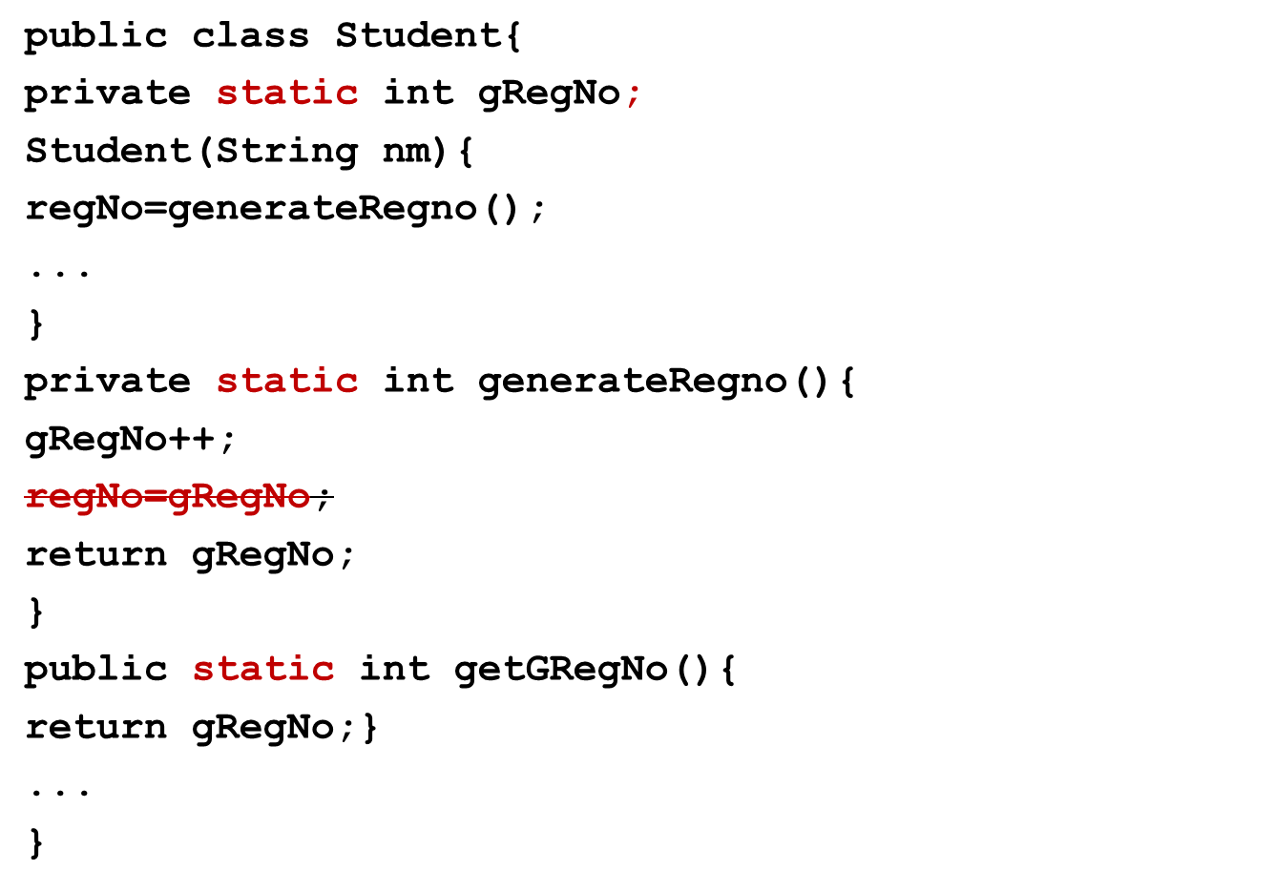
Example
constructor accessing static member
static method accessing static member
static method cannot access instance member

Slide 39
Accessing static members
Static members can be accessed in one of the two ways:
  objectRef.staticvariable or objectRef.staticFunction()
  This is not recommended practice because it does not make clear it look like they are class variables.
  ClassName.staticvariable or ClassName.staticFunction()
public class StudentTest(){
public static void main(String args[]){
Student student1= new Student(“Mary”);
Student student2;
System.out.println( Student.getGRegNo() );
System.out.println( student1.getGRegNo() );
System.out.println( student2.getGRegNo() );
}}

Slide 40
student1
gRegNo:2
Student
name:Mary
regNo:1
student2
Student
name:John
regNo:2

Slide 41
Tell me how?
In Java there is no global scope. There is only stack and heap. Then, how are static members stored?
JVM Memory is actually divided into 3 sections
  the Stack
  The Heap
  the Method Area
The Method Area has information about classes that is part of the executing code-
  information about methods
  information about static variables.
  the Constant Pool for both strings and literals

Slide 42
Tell me how?
main() is a static method and is part of class. Then how is it that main can access instance members?
A static method cannot access instance methods directly or using this. This is because,
  Instance methods can be accessed only through instances.
  static methods can be accessed even without an instance. Since instance variables are part of object, when static method accesses instance variable directly, there is a big question mark as to where is this instance variable.
But if an instance is created inside a static method, using this instance, one can always call instance members.
public static void main(String args[]){
Student student1= new Student(“Mary”);
student1.setCurrentSemester(2);}
  If main() method is part of a class, then it does not need any instance to call any static method of that class.

Slide 43
Exploring modifiers of main()
public static void main(String args[])
Can also be written as
static public void main(String args[])
But public static is preferred
main() method is
  is public so that JVM can access this method
  static so JVM need not create an object of this class to call main method.

Slide 44
Class constants
final keyword makes a variable declaration constant.
A final member of a class either has to be initialized where it is declared or must be initialized in all the constructors of the class.
If static modifier is also included, then the variable becomes class constant.
public class Student{
public static final int MAX_STUDENTS=3000;
..
}
Note that while local variable can be made final, it cannot be made static!

Slide 45
Arrays
Array is a data structure that can hold a number of values of a data type.
Arrays in java are like objects; they are created in heap.
To create an array new keyword has to be used.
In the example (in the next slide) num is a reference that points to an array of object created in the heap.
Please note in the for loop a very handy method that is used to get the length of the array.
Array elements are automatically initialized to the default value based on the type of the array.
Creating int num[] does not create an array.
Also int num[3] is wrong syntax.
Subscript can be before or after variable declaration.

Slide 46
Arrays- creating and initializing
int sum=0,mul=0;
int num[]= new int[5];
for(int i=0;i<num.length;i++){
sum=sum+num[i];
mul=mul*num[i];
}
Allocating 5 spaces for int
Declaring array of type int
Returns the size of the array
Accessing array elements
int num[]= new int[5]; or int[] num= new int[5];
num[0]
num[1]
num[2]
num[3]
num[4]
0
num
0
0
0
0
automatically initialized to 0

Slide 47
public class ArrayTest{
static int num[];
public static void main(String args[]){
System.out.println(num);
System.out.println(num[0]);
}
}
prints null
error at runtime.
Can you recall the exception that it throws?
The member variable num in the above code is an object reference. Since the num object is not created, num is assigned a value null. This, as we have seen earlier, is what happens in case of object references.
If we try to print an array element which is not created, an error occurs at run time.

Slide 48
Initializing arrays
int [] a=new int[] {1,2,4,8,26};
Or simply
int [] a= {1,2,4,8,26};
The subscript can appear either before pr after the variable name.
The first syntax comes handy when we need to send an anonymous array to a method call
method(new int[] {1,2,4,8,26});

Slide 49
Empty Array
int a[]= new int[0];
The above statement creates an array of length 0 indicating an empty array.
This is different from array being null.
There are many cases in which an "empty" object can be used instead of a null object reference.
This is usually preferable since it helps eliminate one of the most common problems encountered during development -- the NullPointerException

Slide 50
Enhanced for loop statement
Convenient way to iterate through arrays ( and collection)
Syntax:
for(datatype variable: array) statement(s);
Example 1:
int a[]= {1,2,3,4,5};
for(int j:a)
System.out.println(j);
Example 2:
Student s[]= new Student [2];
s[0]= new Student(“Mary”);
s[1]= new Student(“John”); for(Student s1:s)
System.out.println(s1.getName());
The variable in the for-each statement must be of same type as that of elements in the array

Slide 51
Multidimensional arrays
Declaration and creating
  int[][] m= new int[3][3];
Initlalizing
  int[][] matrix= new int[][] {{0,0},{0,0,0},{0,0,1}};
  int[][] matrix= {{0,0},{0,0,0},{0,0,1}};
Accessing
  System.out.println(matrix[0][0]);
Length
  matrix[0].length → 2
  matrix.length → 3

Slide 52
Activity: Constant array
How will you create a constant array?
What does it mean when you declare a constant array?

Slide 53
Command Line Arguments
While executing a java program from the command line, arguments can be sent to the java program from the command line.
Command line arguments are sent as string arrays through main function’s argument.
Command line argument counting begins only after the “java ClassName”.
public class Test{
public static void main(String args[]){
System.out.println(" length: "+args.length);
// Length=0
System.out.println(args[0]); // Mary
}}

Slide 54
Activity: Command Line Arguments
Checkout what happens if you run Test with and without supplying command line arguments ?
Why doesn't the first line end up in NullPointerException?
This is because when there are no arguments passed, the JVM creates a 0 length array and passes to main()→ main(new int[0])
When an array of length 0 indicates an empty array. Note that this is different from array being null. That is why NullPointerException is not thrown. ArrayIndexOutOfBoundsException is thrown!
Notes:
Line 1 returns 0 but line two throws ArrayIndexOutOfBoundsException at runtime

Slide 55
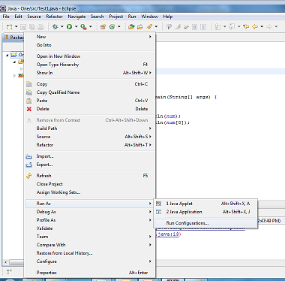
Command Line Arguments in Eclipse
Right click on the Project and select RunAs→Run Configuration.

Slide 56
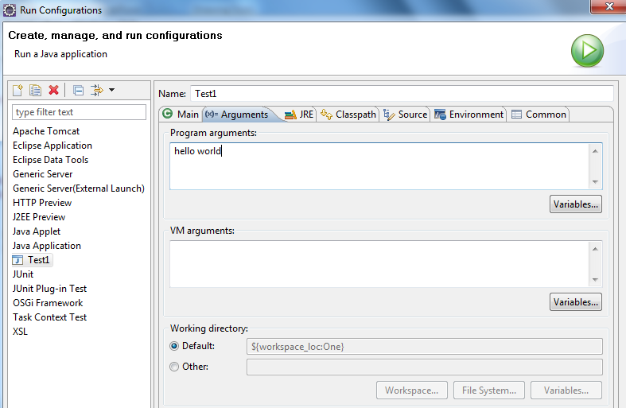
Move to the 2nd tab called Arguments. In the Program arguments section provide command line arguments separated by spaces

Slide 57
String class
String class has been part of Java right from its inception.
In Java, strings can be created without using char array.
The String class has convenient methods that allows working with strings.
Constructors:
String()
String(String s)
Examples of creating String object:
String s=“abc”;
String s= new String();
String s= new String(“Hello”);
String s1= new String(s);

Slide 58
Methods of String class:
int length()
Returns the length of this string
  String s= new String(“Hello”);
  System.out.println(s.length());
  //prints 5
char charAt(int index)
Returns the character at the specified index
  String s="Have a nice day";
  System.out.println(s.charAt(0));
  // prints H
Notes:
1)length():
2) charAt(int index) :

Slide 59
String concatenation can be done in two ways:
+: Not a method but an operator that can be used with strings (Unlike C++, there no operator overloading in Java. However + is overloaded for strings for programmer convenience.)
  String s1=“abc”,s2=“def”;
  String s3=s1+s2; // returns abcdef
  String s4=s1+1; // returns abc1
  String s5=s1+”ee”; // returns abcee
  String s4=s1+true; // returns abctrue
  String s4=s1+’d’; // returns abcd
  String s4=null+ s1; // returns nullabc
String concat(String str)
  String s1=“java”.concat(“c”);//returns “javac”

Slide 60
To compare if two strings are the same, equals methods are used.
boolean equals(Object object)
boolean equalsIgnoreCase(String anotherString)
Example:
String s1=“abc”;
String s2=“sbc”;
String s3=“ABC”;
s1.equals(s2) ;//returns false
s1.equalsIgnoreCase(s3) );//returns true
We will look at Object class later. For our understanding let us replace String for Object.
Notes:
We shall look at Object class later. For

Slide 61
Tell me why?
Why do we require equals() method to compare Strings ? Can we not compare using ==?
== works fine with primitive data types.
But with references, (since they are like pointers) , == will actually compare the addresses.
What we are want here is to check equality of value of strings.
  String s1= “abc”;
  String s2=new String(s1);
  System.out.println(s1==s2); // returns false
  System.out.println(s1.equals(s2)); // returns true

Slide 62
To work with parts of a string, we have two methods
Index begins from 0.
public String substring(int beginIndex)
public String substring(int beginIndex, int endIndex)
Example:
“icecream".substring(3); // returns “cream“
“icecream".substring(0,3); // returns “ice”
To remove with leading and trailing whitespace
String trim()
" ice cream “.trim() // returns ice cream

Slide 63
Compares two strings lexicographically. The comparison is based on the Unicode value of each character in the strings
public int compareTo(String anotherString)
public int compareToIgnoreCase(String str)
Example:
String s1="ABC";String s2="acc";
s2.compareTo(s1)
returns 32
s2.compareToIgnoreCase(s1)
returns 1
Notes:
1)

Slide 64
Converting primitives to String
static String valueOf(XXX b)
where XXX includes all primitives like byte, short, int, long, float, double, char, boolean.
  Example:
  int i=String.valueOf(1224);
Tokenizing string
String[] split(String regex)
  Example :
  String str="apple,mango,banana";
  String list[]=str.split(",");
  for(String s:list) System.out.println(s);

Slide 65
Can you guess what these methods do?
String toLowerCase()
String toUpperCase()
String replace(char oldChar, char newChar)
String replaceAll(String reg,String replacement)
boolean startsWith(String prefix)
public boolean endsWith(String suffix)

Slide 66
Activity: using String class
Can you write code for properCase() methods now?

Slide 67
Immutability
Immutability means something that cannot be changed.
Strings are immutable in Java. What does this mean?
String literals are very heavily used in applications and they also occupy a lot of memory.
Therefore for efficient memory management, all the strings are created and kept by the JVM in a place called string pool (which is part of Method Area).
Garbage collector does not come into string pool.
How does this save memory?
Let us find out….

Slide 68
String s1="ABC";
String s2="ABC";
When Strings are created this way by assigning literals to the variable straight, JVM checks if the string is available in the pool. If not it creates one. Otherwise it assigns it to the existing reference .
s1
ABC
String pool
s2
String s1="ABC";
s1=“DEF”
This string object remains intact. This is not changed.
When a value of a string reference is changed, a new string is created in the pool and that is assigned to the reference.
Strings are Immutable Objects.
That means that, once created, String object cannot be changed!
s1
ABC
DEF

Slide 69
s1
ABC
s2
DEF
Assigning string references:
String s1="ABC";
String s2=s1;
s2=“DEF”;
System.out.println(s1);// prints ABC
String pool

Slide 70
Activity: Test your understanding
String s1="ABC";
String s2=s1;
System.out.println(s1==s2);
s2="DEF";
System.out.println(s1==s2);
String s4="ABC";
System.out.println(s1==s4);
Notes:
true
false
True
String s4=new String("ABC");
System.out.println(s1==s4);
False
Constructor:
String(String newStr)
String s1="ABC";
String s2=new String(“ABC”);
If we want a new string object created that does not point to the same string object in the pool, then we use another type of constructor new String(String newStr).
This constructor creates a newString outside the string pool. If there is no string represented by newStr in the pool then it also adds newStr in the pool.
Another important point is that the garbage collector does not go to the string pool. Therefore we have to be very careful when we work with the strings.
If we have too many string manipulations and intermediate string creations then we must consider using StingBuilder class which is new in Java 1.5.
We shall eventually look at StringBuilder class.
true, false, true

Slide 71
Activity: Test your understanding
String student1= “Mary”;
String studentref=“John”;
String studentref=student1;
student1=null;
How many instances of String will be eligible for garbage collected?
Ans: None

Slide 72
String comparison when created using constructors
s1
ABC
String s1="ABC";
String s4=new String("ABC");
System.out.println(s1==s4);
//Prints : false
The String constructor creates the string outside the string pool in the heap.
If there is no string represented by the string created, then this string gets added to the pool also.
String s5=new String(“MQ");
String pool
s4
ABC
String pool
MQ
s5
MQ

Slide 73
Test your understanding
String s1= "abc";
s1=s1.replace('a', 'A');
s1.replace('b', 'B');
What will the code print?
How many Strings are created in the pool?

Slide 74
Alternate to String class
Abc
abc
ABc
In the example in the previous slide, 3 strings were created in the pool. What was needed after the 3rd line was the last string ABc.
Since garbage collector does not go to the string pool, we have to be very careful when we work with the strings.
If there are lots of String manipulations in your application and you are concerned about memory, then String class should not be used.
JSE comes with another class for such operations –StringBuilder or StringBuffer class

