Slide 1
Class and Methods-Part2

Slide 2
Arguments passing
Arguments passing in java is always ‘pass by value’.
Two types of arguments can be passed in a method call
        Primitive type
        Reference type
In java, the arguments are passed by values -- whether we pass primitive type or reference type.
Let us understand this with examples.

Slide 3
Passing primitive type
public class Test{
public static void swap(int reg1,int reg2){
int temp;
temp=reg1;
reg1=reg2;
reg2=temp; }
public static void main(String args[]){
int r1=10, r2=20;
swap(r1,r2);
System.out.println(“r1=”+ r1);
System.out.println(“r2=”+r2);
}
}
The program prints r1=10 and r2=20.

Slide 4
In the example in the previous slide, two arguments of int type are passed to a swap method from main.
In swap method, the value of the 2 arguments passed are exchanged.
When the method returns to main, the values changed are not reflected.
In this case of primitive, changed values of arguments passed are not reflected back in the calling method.
Hence primitives are passed by value.

Slide 5
Passing reference type
public class Test{
public static void swap(Student p,Student q){
Student temp;
temp=p;
p=q;
q=temp;
}
public static void main(String a[]){
Student s1=new Student(“John”);
Student s2=new Student(“Mary”);
swap(s1,s2);
System.out.println(“s1=”+ s1.getName());
System.out.println(“s2=”+ s2.getName()
}
}
The program prints :
s1=John
s2=Mary

Slide 6
stack
After swap(), s1 and s2 of main remains unchanged and p and q are no longer available.
q
p
heap
swap(s1,s2)
s2
s1
Mary..
John..
main()
In this case of reference too we find that the changed values of arguments passed are not reflected back in the calling method.
Hence references are also passed by value

Slide 7
Changing the member variable value of an object reference that is passed
What if we change the value of a member of an object in the method to which we pass a reference?
public class Test{
public static void change(Student p){
p.setName(“Mary”);
}
public static void main(String args[]){
Student s1=new Student(“John”);
change(s1);
System.out.println(“s1=”+ s1.getName());}
}
Prints Mary.

Slide 8
stack
heap
p
John
Mary
change(s1)
s1
main()
Since s1 in main and p in change points to the same student object in the heap, when name attribute is changed, the change happens in the object which is in the heap.
Change made to the member variable of a object in the called method is reflected in the calling method.

Slide 9
Activity : What about arrays?
Suppose we were to write a sort method that takes an array of Student objects and sorts the array based on their names.
Will the change be reflected in the calling method?

Slide 10
Passing Arrays
stack
s
heap
sort(s1)
0
s1
1
Mary..
main()
John..
Changes made to the array content in the called method are reflected in the calling method.

Slide 11
Test your understanding
What is the result when you execute the following?
Can you explain what is happening in this case?
class StudentTest{
public static void main(String args[]){
Student s1[]=new Student[2];
s1[0]=new Student("Mary");
s1[1]=new Student("John");
change(s1);
for(int i=0;i<s1.length;i++){
System.out.println("Name: " + s1[i].getName());
}
}
public static void change(Student s[]){
Student temp[]=new Student[1];
temp[0]= new Student("Meena");
s=temp; } }
Notes:
Prints Mary and John.
Changes not reflected

Slide 12
Var-args
Var-args allows a method to take multiple arguments of same type.
The number arguments may be 0, one or more.
In a method only the last argument can be of variable length.
void f(int… x)
  f()
  f(1)
  f(1,2) and so on
void go(int c, char… x)
  go(1,)
  go(1,’a’)
  go(1,’b’,’a’,’c’) and so on
void list(Student… a)
  list()
  list(new Student(“hari”));
  list(new Student(“hari”), new Student(“rama”));
and so on

Slide 13
Accessing var-args
Compiler interprets var-args like an array. Therefore accessing the var-args is like accessing array elements. Either for loop or enhanced for-loop could be used to iterate through var-args.
Subscript operator is used to access elements in var-args.
public class Person{
public Person(String name, String… nicknames)
{
if(nicknames.length!=0){
for(String nm:nicknames)
System.out.println(nm);
System.out.println(nicknames[0]);
} }}
What are the ways to create Person instance?
Another way to write the main method is:
public static void main(String... args)

Slide 14
Test your understanding
static void vararg1(int[] i)
and
static void vararg2(int… i))
Are both same ?
Notes:
No .
vararg1 requires one argument to be passed but vararg2 does not require any argument be passed.
vararg1 requires an array to be passed, but for vararg2 we can pass ints or int array.

Slide 15
Formatted Output
Java implements var-args for printf statement.
Java also has C-like printf method that can be used to format output.
Format specifiers : %[argument_index$][flags][width][.precision]conversion
  argument_index$: specifies position of the argument in the argument list, Ex 1$, 2$ etc
  flags: characters that specify the output format based on the type of output. Ex : - + etc
  width: positive integer that specifies the minimum number of characters to be written to the output
  precision: positive integer usually used to limit the number of characters (after decimal for floating points)
  conversion: a formatting character that is specified based on the type argument.
values within [] are optional
Notes:
From 1.5 onwards

Slide 16
Conversion characters
Extract from Java documentation
'd' | integral | The result is formatted as a decimal integer
'o' | integral | The result is formatted as an octal integer
'x', 'X' | integral | The result is formatted as a hexadecimal integer
'e', 'E' | floating point | The result is formatted as a decimal number in computerized scientific notation
'f' | floating point | The result is formatted as a decimal number
'g', 'G' | floating point | The result is formatted using computerized scientific notation or decimal format, depending on the precision and the value after rounding.
'b', 'B' | general | If the argument arg is null, then the result is "false". If arg is a boolean or Boolean, then the result is the string returned by String.valueOf(). Otherwise, the result is "true".
's', 'S' | general | If the argument arg is null, then the result is "null". If arg implements Formattable, then arg.formatTo is invoked. Otherwise, the result is obtained by invoking arg.toString().
any type
Only a few covered at this point.

Slide 17
Flags
  -: Left justify this argument
  +: Include a sign (+ or -) with this argument
  0: Pad this argument with zeroes
  ,: Use locale-specific grouping separators (i.e., the comma in 123,456)
  (: Enclose negative numbers in parentheses
  Also conversion character %n can be used for inserting a new line

Slide 18
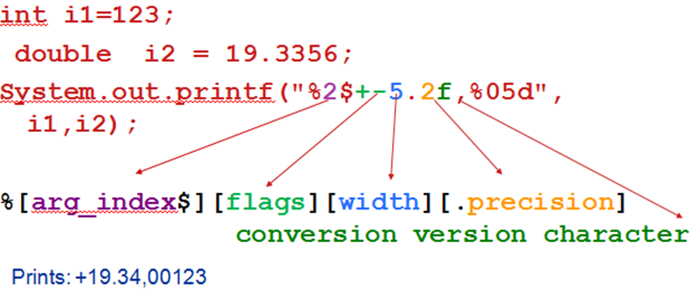
Example 1

Slide 19
Example 2
public class Test{
public static void main(String[] args) {
long n = 123456;
System.out.printf("%d%n", n); //123456
System.out.printf("%07d %n", n); //0123456
System.out.printf("%+7d%n", n); //+123456
System.out.printf("%,7d%n", n); //123,456
System.out.printf("%+,7d%n", n); //+123,456
int x=20;
System.out.printf("%x%n", x); //14
System.out.printf("%o%n", x); //24
int y=-20;
System.out.printf("%+3d%n", y); //-20
System.out.printf("%(3d%n", y); //(20)
    System.out.printf("%b%n", (x>y)); //true

Slide 20
  double pi=3.141593;
  System.out.printf("%f%n", pi); //3.141593
  System.out.printf("%.3f%n", pi); //3.142
  System.out.printf("%10.3f%n", pi); // 3.142
  System.out.printf("%10.3f%n", pi); //000003.142
  System.out.printf("%-10.5g%n", pi); // 3.1416
  String s= "Hello";
  System.out.printf("This is %s%n",s);
  // This is Hello
  System.out.printf("%3$s %2$f %1$d %3$s %n",n,pi,s);
  // Hello 3.141593 123456 Hello
  }
}

Slide 21
Overloading
Like many OOPs languages, Java also provides method overloading feature.
Overloading refers to the methods in a class having same name but different arguments.
If same method names are used to define multiple methods in a class, then the methods are said to be overloaded.
Overloaded methods must have same name but there must be a difference in other parts of the signature.
Signature of a method includes the name of the method and its parameters (excluding the return type).

Slide 22
Overloading Rules and Resolution
Same method names in a class having different
  types of arguments or
  number of arguments or
  order of arguments
Complier resolves the overloaded method using the following steps
  Exact Match
  Automatic Conversion
  More Specific Match
  Ambiguous Match/No Match

Slide 23
Resolution Flow
List1:All the methods where the name and number of arguments of calling method == name and number of arguments of called method
List1 is empty
yes
Error
no
List2: From list1, find all the methods that exactly match the argument type of calling method.
Error: No matching method found
yes
List2 contains > 1 element

Slide 24
no
List2 contains 1 element
yes
no
Matching method found
List3: Find all the methods from List1 where arguments of calling methods are automatically convertible into arguments of called methods.
yes
List3 contains= 1 element
no

Slide 25
no
List3 contains 0 element
yes
Error
no
List4: Find among the methods in List 3 methods which are more specific
List4 contains 1 element
yes
Matching method found
no
Error

Slide 26
Example
Instead of thinking of names for each sort method, we just have one sort and distinguish the sorts based on the argument we send.
public class CollegeUtility {
public static void sort(Student s[]){..}
public static void sort(Faculty c[]){..}
public static void sort(Facility c[]){..}
}
Overloading sort method – much simpler

Slide 27
Example for exact match
public class StudentTest{
public static void display( int regno)
{
System.out.println(“Registration No. "+regno);
}
public static void display(String name)
{
System.out.println(“Name. "+name);
}
public static void main(String str[]){
Student s1=new Student(“Mary”);
display(s1.getName());
display(s1.getRegNo());
}
}

Slide 28
Example for automatic conversion
Do you recall the conversion sequence that we did in “Basic elements of Java” session?
public class StudentTest{
public static void display(long regno)
{
System.out.println(“Registration No. "+regno);
}
public static void display(String name)
{
System.out.println(“Name. "+name);
}
public static void main(String str[]){
Student s1=new Student(“Mary”);
display(s1.getName());
display(s1.getRegNo());
}}
int automatically convertible to long

Slide 29

Example for more specific
public class Fee {
int id;
double amtPaid;
void pay(int id,double amt)
{
this.id=id;
amtPaid=amt;
}
void pay(int id,float amt){
this.id=id;
amtPaid=amt; }
public static void main(String[] args) {
Fee f1= new Fee();
f1.pay(123,400);
}
}
int automatically convertible to is both float and double.
But since float appears first in the list from int, float is more specific.

Slide 30
Example for ambiguous call
int automatically convertible to is both float and double.
In this case the 1st argument 123 is converted to float and 2nd argument 400 to double for the 1st overloaded method. Vice versa happens for the 2nd.
Hence the call is ambiguous.
public class Fee {
int id;
double amtPaid;
void pay(float id,double amt)
{
this.id=id;
amtPaid=amt;
}
void pay(double id,float amt)
{
this.id=id;
amtPaid=amt; }
public static void main(String[] args) {
Fee f1= new Fee();
f1.pay(123,400);
}
}

Slide 31
Overloading with var-args
class AddVarargs {
static void go(int x, int y)
{
System.out.println("int,int");
}
static void go(byte... x) {
System.out.println("byte... ");
}
public static void main(String[] args){
byte b = 5;
go(b,b);
}
}
Prints int,int
The var-args will be the last argument that will be resolved.
Reason for this is simply because var-args was introduced only from java 1.5.

Slide 32
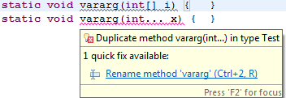
More on with var-args
  static void vararg(int[] i){}
  static void vararg(int... x){}
  cannot be overloaded
  Compiler converts:
  vararg(int... x){}→ vararg(int[] i){}

Slide 33
Tell me how?
If compiler does this conversion, how does the call vararg(1,2,3) work then? vararg(1,2,3) will not match the if the argument is of type array!
  vararg(int... x){}→ vararg(int[] i){}
Compiler also converts the call statement to make it pass an array instead of commas separated ints, as shown below
  vararg(1,2,3}→ vararg(new int[]{1,2,3}

Slide 34
Test your understanding
What will the code print?
public class Test{
static void count(int… objs)
{
System.out.println(objs.length);
}
public static void main(String[] args) {
Fee f1= new Fee();
f1.pay(123,400);
count(1, 2, 3);
count(1,2);
count(1);
}
}
Prints:
3
2
1

Slide 35
public class Test{
static void count(String… objs)
{
System.out.println(objs.length);
}
public static void main(String[] args)
{
Fee f1= new Fee();
f1.pay(123,400);
count(“1”, “2”, “3”);
count(“1”,”2”);
count();
}
}
Prints:
3
2
0
Why?

Slide 36
Tell me why?
The same code behaves differently for references and primitive type var-args. How is it different for references?
The call to count in the previous slide gets converted as follows:
count(null,null,null)
count(null,null);
count(null);
The last call treats null to be set to the array object rather than consider one of the elements of array as null. Therefore, the invoking length on null object throws NullPointerException.
For the code print 1 the call must be
count(new String[] { null }); → prints 1

Slide 37
Some more on var-args
public class Test{
public static void f(double... d){
System.out.println("doubles");
}
public static void main(String[] args) {
f(1.2, 2.2); // doubles
f(1,2); //doubles
}
}
Compiler converts var-args call depending on the type of the var-args function defined.
In the above case, call to f(1,2) is converted to
f(new int[]{1, 2})

Slide 38
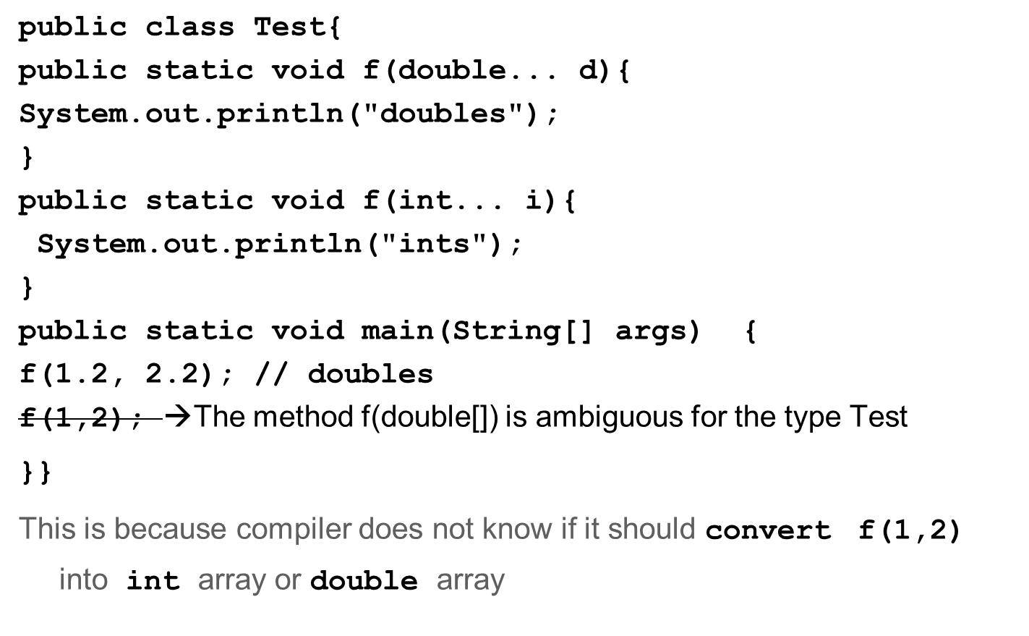
Tell me why?

Slide 39
Array of varargs
The example demonstrates how to declare array of var-args.
The display method takes array of var-args.
public class Test {
void display(String[]... vals) {
for(int i = 0; i < vals.length; i++) {
for(int j = 0; j < vals[i].length; j++) {
System.out.println(vals[i][j]);
} }
}
public static void main(String[] args) {
Test t = new Test();
String[] s1 =new String[]{“Red,",”Yellow"};
String[] s2 = new String[]{“Mars",“Jupiter"};
t.display(s1, s2);
}
}

Slide 40
Initializers
Initializers are blocks of code used to initialize member variables.
    Non-Static Initializers
      Used to initialize instance variables
      Invoked every time object is created
      Syntax
        { <<statements>>}
    Static Initializers
      Used to initialize static variables
      Invoked once when the class is loaded
      Syntax
        static { <<statements>>}

Slide 41
Why are they needed?
The declarations and initialization of fields can be done in same line like this: int var=1;
Initializers are required for initializations that require a set of java statements for computing the initialization variable.
For instance if the initial value is to be read from a file, then the set of file statements can be put in the initialization block. Another place where this may be required in the use of for-loop for initializing arrays.
The Compiler copies instance initializer block into every constructor. Therefore, this can be used to share a block of code between multiple constructors.
The static initializer is the only place to initialize static fields in cases where initialization exceeds more than a statement.

Slide 42
Example
This is an example that creates fee list for the student from rollnumber 1 to 50, feeList[0] represents marks for student 1 and so on.
feeList[0] is initialized to 100, which is the minimum that a student has to pay.
Constants have to be initialized in the place of their declaration. If there is a static block their initialization can be done in this block too.
  public class FeeList{
  public static final int MAX;
  private static int feeList[]= new int[MAX];
  private static int count=-1;
  public String name=null;
  static{
  MAX=50;
  for(int i=0;i<MAX;i++)
  feeList[i]=100;
  }

Slide 43
  {
  if(count>=MAX){
  {System.out.print("cannot exceed 50");
  System.exit(0);}
  count++;
  }
  }
  Test(){}
  Test(String nm){
  this.name=nm;
  }
  Test(String nm, int mar){
  this.name=nm;
  markList[count]=mar;
  }
  }
Max of 50 students. Bounds checking done here

Slide 44
Another place to initialize fields
Can you list out all the places where we can initialize instance variables?
Another way to initialize variable is by assigning initializing methods to the fields.
It is recommended that the final modifier is added to the initializing method.
final methods will be discussed in inheritance section

Slide 45
Example
public class Test{
private static int[] numbers=init();
private byte[] bytes=initb();
public final int[] initb(){
bytes= new int[50];
for (int i = 0; i < numbers.length; i++) {
bytes[i] = i;
return bytes;
}
static final public int[] init(){
numbers= new int[50];
for (int i = 100; i < numbers.length; i++) {
numbers[i] = i+2;
}
return numbers;
}}

Slide 46
Initializations order
It is important to understand when each of the initialization takes place.
Static blocks are executed only once when the class is loaded while instance blocks are invoked each time the instance is created.
First static initializations happen in the order of the declaration.
Then instance initializations happen. And the appropriate constructors are invoked. (This is obvious since compiler copies instance block into the constructor)
Static initializations does not require instance to be created. It just requires invocation of any method of the class (static).

Slide 47
Understand by example
Can you guess what the output will be?
public class W{
public W(){System.out.println("W constructor");}
}
public class Z{
W w= new W();
{
System.out.println("instance block");
}
static{
System.out.println("static block");
}
public Z(){System.out.println("Z constructor");
}
public static void main(String st[]){
System.out.println(“In main");
new Z(); new Z();
}}

Slide 48
Result
Result :
  static block
  In main
  W constructor
  instance block
  Z constructor
  W constructor
  instance block
  Z constructor
Can you guess what will be printed if you comment ‘new Z()’ in main()?
How will the output look if you have a static block for W class also?
Type the code and find and analyze the results.
How many .class files are created?

