Slide 1
Inheritance

Slide 2
Recall
What are the important features of object-oriented languages?
Inheritance is one of the important features of object-oriented languages

Slide 3
Activity: Reuse in real life
Suppose want to play music in the car. What will you do?
You will install a stereo system in the car or you will bring a music player in the car.
So, now, the Car contains a stereo system .
Suppose want a bigger car – now, some things like engine, steering wheel will remain the same, but the primary difference is that there should be more room inside the car. What will you do?
Go and buy a new car – the new car is likely to have all the features of the old car such as engine, steering wheel etc but will have more room inside
The New Car is a Old Car with more features.

Slide 4
Reuse in Object Oriented Language
Object Oriented Languages also implements reuse in the same way that we do in real life.
Using
  has-a
  is-a
Has-a or composition relationship is implemented by having a class having another class as its member, or rather an object having another object as its member.
  class Car{ Stereo s; …}
  class College { Teacher[] ts; Student ss[]; … }
Is-a is implemented through what we call inheritance relationship

Slide 5
Definition
Inheritance defines relationship among classes, wherein one class shares structure or behavior defined in one or more classes.
Grady Booch
Approach:
  Common properties of related classes can be defined in a generic class.
  This generic class can then be used by more specific classes through inheritance.
  Each of these specific class can add things that are unique to it.
As a result of inheritance hierarchical is formed.
The class that is inherited is called super class and the class that is inheriting is called a subclass.
Other names of super class – parent class, base class
Other names of subclass – child class, derived class

Slide 6
Example scenarios for inheritance
Student and Teacher are Person. Person can be a super class and Student and Teacher can be subclass of Person class. Student is-a Person, Teacher is-a Person
HOD is-a Teacher. Since Teacher is-a Person, HOD is also a Person
Written_Test and Viva are Test
Theory and Lab are ClassRoomSession
SeminarHall is a ClassRoom

Slide 7
Activity: match the following
Super class
Subclass
Fruit
Library
Cat
Bird
Parrot
Music
Tiger
Books
Apple
Mango

Slide 8
Syntax and symbols
extends keyword is used to indicate inheritance relationship.
Syntax:
  Class-name2 extends Class-name1
public class HOD extends Teacher{
/*Features of Teacher class automatically available.
add additional members */
}
Teacher
getFactId()
getName()
setFactID()
setName()
HOD
getDateOfJoining
viewGrade()

Slide 9
Members that are not accessible
All the features that are there in super class are there in subclass as well. But there are some restrictions with respect to what super class features (members) can be accessed from subclass.
Super class members that cannot be accessed from subclass
  private members
  Default members (if subclasses are in the different packages).
For example, HOD class cannot access factId, name or the static variable id of the Teacher class since they are private but can access most of the methods since they are public

Slide 10
Example: code for inheritance
HOD has dateofAppointment and viewGrade as additional features.
package teacher;
public class HOD extends Teacher{
private String dateOfAppointment;
public HOD(String nm, String dt){
super(nm);
dateOfAppointment=dt; }
public void viewGrade(Grade[] grades){
System.out.println(getName()+ " HOD viewing appraisal ");
for(Grade g:grades){
System.out.println("Faculty :"+ g.getFaculty().getName());
Calling super class constructor
Calling super class method

Slide 11
System.out.println("Student ID : "+ g.getStudent().getRegNo());
System.out.println("Grade: "+ g.getGrade());
}
}
public static void main(String str[]){
student.Student s1= new student.Student("Ravi");
student.Student s2= new student.Student(“Kumar");
HOD h=new HOD("Maverick","1.1.2006");
Teacher f= new Teacher("Sam");

Slide 12
System.out.println(“HOD Name "+ h.getName());
Grade g[]=new Grade[2];
g[0]=new Grade(f,s1,"CS-001", Grade.A);
g[1]=new Grade(f,s2,"CS-001", Grade.B);
h.viewGrade(g);
}
}
Calling super class method

Slide 13
super
Keyword super() or super(<parameters)>) is used to call the super class constructor.
  public HOD(String nm, String dt){
  super(nm); // calls Teacher(String name)
  }
super() (like this() ) can be called only from the constructor.
It must be the first statement of the constructor.
Which also implies that super() and this() cannot be used together.
Compiler inserts a super() statement in all constructor if subclass constructor does not explicitly call some form of super() that calls super class constructor.
This is to ensure initialization of super class members because they are also part of subclass.

Slide 14
Example : Compiler insertion of super
public HOD(String nm, String dt){
//super(nm);
dateOfAppointment=dt; }
…}
On compilation
Compilation error: cannot resolve symbol constructor Teacher()
If the super class does not have a no-argument constructor, a compile-time error occurs.
Therefore, for classes where super class does not have no-argument constructor, all subclass constructors must explicitly call appropriate super class constructor

Slide 15
public HOD(String nm, String dt){
//super(nm); dateOfAppointment=dt; }
..}
Compiler inserts
super();
Attempting to call
Teacher()
Since Teacher class does not have no-argument constructor this error occurs.
Therefore calling super(nm) becomes compulsory from constructor of HOD class since only one constructor is defined in Teacher class which takes one argument.

Slide 16
Calling super class methods
The super keyword can also be used to invoke super class methods from the subclass method.
  super.getName()
This becomes necessary only when subclass has redefined the method in super class.
More on this in overriding session

Slide 17
Initializations during subclass instance creation
Static initializations of super class: Static variables are initialized and static blocks are executed in the order of their appearance in the code.
Static initializations of subclass class : Static variables are initialized and static blocks are executed in the order of their appearance in the code.
Instance initializations of super class : Instance variables are initialized and instance blocks are executed in the order of their appearance in the code.
Super class constructor is executed.
Instance initializations of subclass class : Instance variables are initialized and instance blocks are executed in the order of their appearance in the code.
Subclass class constructor is executed.
Only after the super class part, sub class part happens.

Slide 18
Example: Order of initializations
class Order {
  int i;
  static {
  System.out.println("Order class static block ");
  }
  Order(){
  i=10;
  System.out.println("Order class constructor,i= " + i);
  }
  {
  System.out.println("Order class instance block,i= " + i);
  }
}

Slide 19
class SubOrder extends Order{
int j=9;
static {
System.out.println("SubOrder class static block");
}
SubOrder(){
j=15;
System.out.println("SubOrder class constructor,j= "+ j);
}
{
System.out.println("SubOrder class instance block,j= " + j);
}
public static void main(String str[]){
new SubOrder(); }}

Slide 20
And this is the result of executing the code…
Order class static block
SubOrder class static block
Order class instance block,i= 0
Order class constructor,i= 10
SubOrder class instance block,j= 9
SubOrder class constructor,j= 15

Slide 21
Conversion and casting
A subclass object reference can be converted to super class object reference automatically. But for vice versa, casting is required.
Need to convert will be clear in polymorphism.
Automatic conversion example
  Only members of Teacher class are accessible
  Teacher f= new HOD();
  f.getFactId(); //ok
  f.viewGrade(); //error
Casting conversion example
  We cast it back to HOD
    HOD h=(HOD) f;
    h.viewGrade(); //ok
Dangers of casting: if the original object is not of subclass type then a runtime exception will be thrown on accessing subclass methods.
  HOD h= (HOD) new Teacher(“x”));
// Runtime error-ClassCastException
Coming up!

Slide 22
protected access
protected access specifier for a member of class A allows access to the members of the classes in the same package as class A (same as default access specifier)
+
allows access to the members of the child classes of class A which are in different package.
Therefore for classes inside the same package, protected access specifier is same as that of default access specifier.
protected access specifier makes sense only for subclasses which are in different package from that of super class.
It is more complicated than this for other package subclasses → coming up

Slide 23
Example scenario for protected
Let us move the HOD class to a new package called admin.
If an existing teacher is made HOD, then our HOD class misfires. Why?
Because HOD constructor creates a new factId every time we call HOD constructor , but our scenario factId for existing teacher must be assigned.
To get around it, we create another constructor in HOD that takes factId and dateOfAppointment.
We need to set factId. Since factId is private we cannot access it from HOD.
None of the public, private and default access specifiers will be appropriate here. But protected access specifier for factId is appropriate here. We need to name also protected .
We will also add an no argument constructor in Teacher class which has protected access.
teacher
admin
Teacher
protected int factId;
HOD
HOD(Teacher t, String dt)

Slide 24
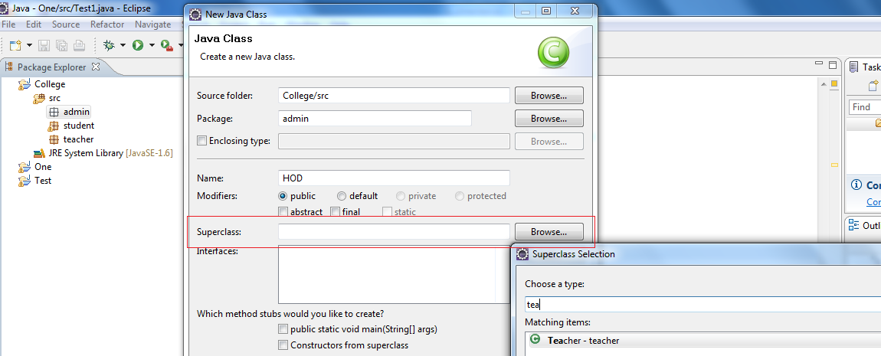
Activity : protected and super in eclipse
Create a new package called admin in the College project that is created.
Create HOD class and make sure you select super class as teacher.Teacher as shown in the figure.

Slide 25
Copy the following HOD code.
package admin;
import teacher.*;
import student.*;
import static teacher.Grade.*;
public class HOD extends Teacher {
private String dateOfAppointment;
public HOD(String nm, String dt){
super(nm);
dateOfAppointment=dt;}
public HOD(Teacher t, String dt){
this.name=t.getName();
this.factId=t.getFactId();
dateOfAppointment=dt;
}

Slide 26
public void viewGrade(teacher.Grade[] grades){
System.out.println(getName()+ " HOD viewing appraisal ");
for(teacher.Grade g:grades){
System.out.println("Faculty :"+ g.getFaculty().getName());
System.out.println("Student ID : "+ g.getStudent().getRegNo());
System.out.println("Grade: "+ g.getGrade());
}}
public static void main(String str[]){
Student s1= new Student("Ravi");
Student s2= new Student("Kumar");
HOD h=new HOD("Maverick","1.1.2006");
Teacher f= new Teacher("Sam");
teacher.Grade g[]=new teacher.Grade[2];
g[0]=new teacher.Grade(f,s1,"CS-001", A);
g[1]=new teacher.Grade(f,s2,"CS-001", B);
h.viewGrade(g);}}
Correct the errors by making changes to Teacher code.

Slide 27
List out the corrections you made and make sure your Teacher class looks like this.
package teacher;
public class Teacher{
protected int factId;
protected String name;
private static int id;
protected Teacher(){}
public int getFactId(){return factId;}
public String getName(){return name;}
public void setName(String name){this.name=name;}
private int generateId()
{id++;
return id;}
public static int getId(){return id;}
public Teacher(String name){this.name=name;
factId=generateId();}}

Slide 28
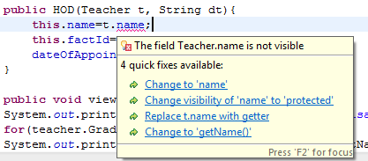
Tell me why?
Why can’t we access protected member through instance of super class? HOD class can access name through this but cannot access name through Teacher class instance t?
This is different from private members. A class can access private members even through its objects.
There are rules laid out by the java language specification about this.
The java language specification says ….

Slide 29
Subclass outside the package
(Java Language Specification)
6.6.2 Details on protected Access
A protected member or constructor of an object may be accessed from outside the package in which it is declared only by code that is responsible for the implementation of that object.
6.6.2.1 Access to a protected Member
Let C be the class in which a protected member m is declared. Access is permitted only within the body of a subclass S of C. In addition, if Id denotes an instance field or instance method, then: If the access is by a qualified name Q.Id, where Q is an ExpressionName, then the access is permitted if and only if the type of the expression Q is S or a subclass of S. If the access is by a field access expression E.Id, where E is a Primary expression, or by a method invocation expression E.Id(. . .), where E is a Primary expression, then the access is permitted if and only if the type of E is S or a subclass of S.
Let’s understand this by example

Slide 30
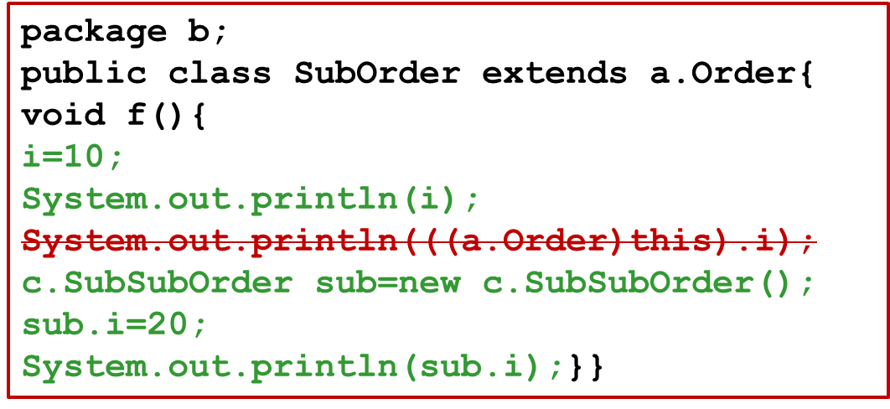
package a;
public class Order {
protected int I;}}
A class can access protected members that it has inherited, either through its own reference or its subclass references.
It cannot access protected members through its super class reference.
package c;
public class SubSubOrder extends b.SubOrder {}

Slide 31
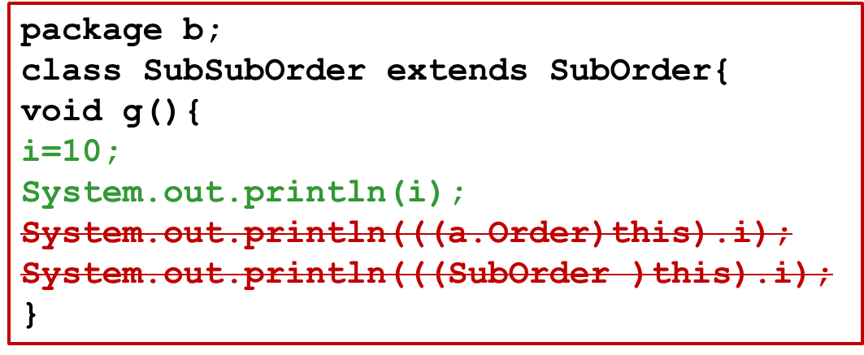
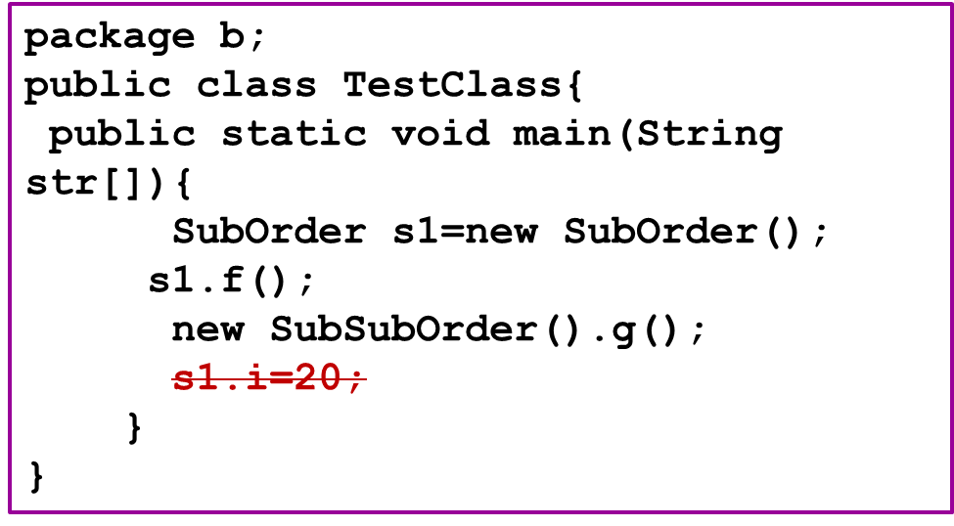
Attempting to access i through super class reference
protected member that is inherited cannot be accessed by the classes in the same package as that of the subclass.

Slide 32
Test your understanding
Match the folllowing
Access specifiers
Accessible…
public
protected
<default>
private
Within the class
In classes of the same package
In classes of different package
In subclasses of the same package
In subclasses of different package

Slide 33
Overriding
Many times we may have to redefine some of the existing features of a class in a subclass.
For example, a big car inheriting from a small car may retain its features like steering wheel but needs to have interiors like seats, seat cover etc of bigger size.
Redefinition of an inherited method declared in the super class by the subclass is called Overriding.
When a method is redefined there is some flexibility in terms of not having exactly same method declaration as the super class method.
They are defined by a set of 5 rules.

Slide 34
Rules
The signature of the method( method name + argument list) must exactly match.
The return type must be same or a subtype of the return type of super class method (covariant returns)
The access can be same or be increased.
(List of access specifiers in order of their increasing accessibility: private→default→protected→public)
Instance methods can be overridden only if they are inherited/visible by the subclass.
Exception thrown cannot be new exceptions or parent class exception.
More on this in exceptions session

Slide 35
Covariant Returns
The overridden method’s return type can also be a subtype of the original method return class’ subtype.
For example1:
  public class Teacher{
  public Teacher getInstance()
  {
  return new Teacher();}
  }
  public class HOD extends Teacher{
  public HOD getInstance()
  {
  return new HOD();
  }}

Slide 36
Access specifier rule
package admin;
public class HOD extends Teacher{
..
public void display(){
super.display();
System.out.println(
"Date of appointment "+dateOfAppointment);
}
}
package teacher;
public class Teacher{
..
protected void display(){
System.out.println(
"Name "+getName());
System.out.println("ID :"+factId) ;
}
}
Cannot have private or default access specifier for display()

Slide 37
Visibility rule
package teacher;
public class Teacher{
..
void display(){
System.out.println(
"Name "+getName());
System.out.println("ID :"+factId) ;
}
}
package admin;
public class HOD extends Teacher{
..
private void display(){
System.out.println(
"Name "+getName()); System.out.println(
"Date of appointment "+dateOfAppointment);
}
}
Can have any access specifier here. Since private and default methods are not inherited/visible !

Slide 38
@Override
When overriding a method, @Override annotation could be used
This tells the compiler that you intend to override a method in the superclass.
If, for some reason, the compiler detects that the method does not exist in one of the superclasses, it will generate an error.
@Override
public void display(){
System.out.println("Name "+getName());
System.out.println("Date of appointment "+dateOfAppointment);
}

Slide 39
Polymorphism
Polymorphism is an object-oriented language feature.
Polymorphism refers to an object’s ability to use a single method name to invoke one of different methods at run time – depending on where it is in the inheritance hierarchy.
It exists only when there is inheritance and the compiler uses dynamic binding to implement it.
Compiler resolves methods called on a object using
  Static binding/Early binding: Compiler resolves the call at the compile time
  Dynamic binding: Compiler resolves the call at the runtime
Overloading is resolved at compile-time. Sometimes this is also referred to as compile-time polymorphism.
Overriding uses run-time polymorphism or simply polymorphism.

Slide 40
Static Binding Example
HOD h = new HOD();
h.viewGrade();
h.getName();
Teacher t= new Teacher();
t.getName();
Since the type of object is known at compile time, to be either of type HOD in the first example or of type Teacher in the 2nd example, compiler knows which method to call and so can statically bind the method.

Slide 41
Polymorphism by example
package teacher;
public class Teacher{
..
public void display(){
System.out.println("Name "+getName()) ;
System.out.println("ID :"+factId) ;} }
package admin;
public class HOD extends Teacher{
…
public void display(){
System.out.println(
"Name "+getName());
System.out.println("Date of appointment "+dateOfAppointment);}
}
We defined display method in Teacher class and we have overridden this method in HOD class.

Slide 42
package teacher;
public class Test{
public static void print(Teacher f){
for(int j=0;j<f.length;j++)
f.display();}
What type of arguments can you pass in the call to print method?
public static void main(String str[]){
admin.HOD h =new admin.HOD(“Ned”,”1.1.2006”);
print(h);
Teacher f= new Teacher(“Sam”);
print(f);}}
Code prints HOD’s display() when HOD reference is passed and Teacher’s display() when Teacher reference is passes.
Even though the print method calls Teacher’s display(), based on the object type that is passed at runtime which display method to be called is decided.

Slide 43
HOD’s display()
Output:
Name :Ned
ID :1
Date of appointment 1.1.2006
Name :Sam
ID :2
Teacher’s display()

Slide 44
Polymorphism in action
Where is polymorphism used in real life applications?
Polymorphism allows us to write methods in a generic way.
Suppose we want to print a list of teachers who can evaluate answer sheets.
List of teachers could include HOD as well since HOD is also a teacher.
How will you define such a method that prints list of teachers?
public static void print(Teacher f[])
{
for(int j=0;j<f.length;j++)
f[j].display();
}

Slide 45
Array conversions and Polymorphism
Ways to call the print method:
public static void main(String str[]){
Teacher f[]=new Teacher[2];
f[0]=new HOD(“Ned”,”1.1.2006”);
f[1]=new Teacher(“Sam”);
print(f);
HOD f1[]=new HOD[2];
f1[0]=new HOD("Nedy","1.1.2006");
f1[1]=new HOD("Samy","1.1.2008");
print(f1); }
First print method resolution happens by exact match
Second print method resolution happens due to automatic conversion.
Polymorphic conversions happen at for the arrays as well. That is, an array of subclass objects can be automatically converted to array of superclass object.

Slide 46
instanceof
Usage:
object-ref instanceof class-name/interface-name
returns a boolean value.
Example:
HOD s1= new HOD(“Bobby”,”10.7.2002”);
System.out.println(s1 instanceof HOD); // true
System.out.println(s1 instanceof Teacher); // true
System.out.println(null instanceof Student);// false
Object o=s1;
System.out.println(o instanceof Student);// false
The statement below cause compilation error: inconvertible types
System.out.println(s1 instanceof Student);
System.out.println(s1 instanceof College);
later

Slide 47
Activity
What code will you add to print an HOD before HOD’s name in the the generic print method listed below if the actual instance type is HOD?
  public static void print(Teacher f[])
  {
  for(int j=0;j<f.length;j++)
  f[j].display();
  }
Notes:
if(f[j] instanceof admin.HOD)
System.out.print("HOD ");
f[j].display();

Slide 48
private method re-declaration and polymorphism
What happens if you re-declare a private method method in your subclass and call it using super class reference?
Can we still expect a polymorphic behavior?
Since the private and static methods are not inherited, they are not overridden.
As they are not overridden, there is no polymorphic behavior.

Slide 49
Test your understanding
public class A{
void f(){
System.out.println("in A:f()");
}
public static void main(String str[]){
A c= new B();
c.f();
}
}
class B extends A{
public void f(){
System.out.println("in B:f()");
}
public class A{
private void f(){
System.out.println("in A:f()");
}
public static void main(String str[]){
A c= new B();
c.f();
}
}
class B extends A{
public void f(){
System.out.println("in B:f()");
}
What will the code on the left print?
What will the code on the right print?
Notes:
in B:f()
in A:f()

Slide 50
Hiding .Vs. Overriding
Are static methods overridden?
Answer is No!
A method is said to be overridden only if it can take the advantage of runtime polymorphism!.
Otherwise it is only hidden.
So the static methods of the super class are hidden when they are redefined in the sub class.
The static methods of the super class cannot be redefined as non-static method in subclass or vice-versa.
While instance methods are overridden, class methods are only hidden
Also instance method cannot be overridden to be a class method and vice versa.

Slide 51
Example: Hiding
class ClassRoom{
static int capacity=50;
public static void printCapacity(){
System.out.println("Class Room seating capacity "+ capacity); }}
class SeminarHall extends ClassRoom{
static int capacity =500;
public static void printCapacity(){
System.out.println("Seminar Hall seating capacity "+ capacity); }
public static void main(String str[]){
ClassRoom examHall= new SeminarHall ();
examHall.printCapacity();
}}//Prints :Class Room seating capacity 50.

Slide 52
Member variable re-declaration
Can we have the same member variable name in super and subclass?
Yes, in such cases, subclass will have 2 members with same name – one that comes from its super class and one that it defines.
Member inherited from the super class can be accessed through super reference by converting subclass reference into super class reference.
package teacher;
public class Teacher{
…
public String achievements;
}}
package admin;
import teacher.*;
public class HOD extends Teacher{
…
public String achievements;

Slide 53
public static void main(String str[]){
HOD h=new HOD("Maverick","1.1.2006");
h.achievements="Best HOD";
Teacher f=h;
f.achievements="Best Faculty";
System.out.println(h.achievements);
System.out.println(f.achievements);
}}
Output: Best HOD
Best Faculty
achievement
dateOfJoining
h
f
name
achievement
factid

Slide 54
final Revisited
A method that is declared as final prevents an inheriting class from overriding that method.
A class that is declared as final prevents other classes from inheriting from it.
System, String class and all the wrapper classes (Boolean, Double, Integer etc.etc.) are final.

Slide 55
Example: final method
package student;
public class Grade{
public final String getGrade(){
…
}}
public class MyGrade extends Grade{
public final String getGrade(){
…
}}
Compilation error

Slide 56
Example: final class
package student;
public final class Grade{
…
}}
package student;
public class MyGrade extends Grade{
…
}}
Compilation error

Slide 57
Abstract class
Declaring a class as an abstract class prevents somebody from creating instances of that class.
Abstract methods are the methods that don’t have the method body. They are just declarations
While an abstract class can have abstract methods, it could also NOT have any abstract methods.
Bear in mind that even if a single method is abstract, the whole class must be declared abstract.
Please note that the classes that we have created so far are called concrete classes (classes from which you could create instances.
An abstract method must not be static.

Slide 58
Inheriting abstract class
A class can inherit from abstract class in two ways
  By Complete Implementation
    A class that inherits from the abstract class and override all the abstract methods by providing implementations specific to that class.
    This results in a concrete class
  By Partial Implementation
    A class that inherits from the abstract class and does NOT override one or more abstract method.
    Such class must be marked as an abstract class.

Slide 59
Example scenario for abstract class
College needs to maintain information a student or a faculty or a principal or a HOD.
If we notice carefully, most of the common information about all these entities are name, address, date of birth, unique id.
Imagine writing getters and setter for all these in all the classes (even if it were cut paste, it is not easy !)
Instead a generic class called Person with all common attributes can be created and have Teacher class, Student class and others inherit from Person.
But we don’t want anybody to create Person objects. In other words, a college needs not just a person but Teachers, Students etc.
To prevent instance creation we can mark Person as abstract.

Slide 60

Person
<<abstract>>
Teacher
…
getName()
getAddress()
…
Student
…
package general;
public abstract class Person{
//getters and setters
}
package student;
public class Student extends general.Person{
…}

Slide 61
Example scenario for abstract method
How to make sure each person must have a unique id?
Since every class has its own way of generating ID, the logic for this cannot be written in Person.
Yet we need to ensure that some method to generate ID is there in all classes that inherit from Person
Solution to this is to declare an abstract method in the Person class without any implementation. We will call this getUID()
Now any class that inherits from Person class must provide implementation for getUID()for it to be a concrete class.

Slide 62
Each person must have a unique id.
Teacher
Person
<<abstract>>
getUID()
…
getName()
getAddress()
<<abstract >>
getUID()
…
Student
getUID()
…
Since the implementation of id is dependent on the individual classes, we make the getUID() method abstract.

Slide 63
Example: Abstract class code
package general;
public abstract class Person{
private String name;
private String address;
protected Person(){}
public void setName(String name){
if(name==null)
System.out.println("Invalid name");
else
this.name=name;
}
public String getName(){
return name;}

Slide 64
public void setAddress(String address){
if(address==null)
System.out.println("Invalid name");
else
this.address=address;}
public String getAddress(){return address;}
public abstract int getUID();
public Person(String name, String address){
setName(name); setAddress(address);}
public Person(String name){
setName(name);
}
}
no implementation
Two constructors added here for member initialization.

Slide 65
Example: inheriting from abstract class
package student;
public class Student extends general.Person{
//remove getters and setter for name attribute
public int getUID(){return regNo;}
public Student(String nm, String d){
super(nm);
…}}
Abstract method implemented
package teacher;
public class Teacher extends general.Person{
//remove getters and setter for name attribute
public int getUID(){return factId;}
etc…}

Slide 66
Object
All classes in java, by default, inherit from a predefined java class called Object.
Object class is defined in java.lang package.
This class is the root of the class hierarchy.
All objects, including arrays, directly or indirectly inherit the methods of this class.
Even if we do not explicitly write code to inherit from Object, compiler inserts extends Object to our class if it finds no extends clause specified in our class definition.
Object class is a concrete class and has a no-argument constructor.

Slide 67
Application Hierarchy
java.lang.Object
general.Person
teacher.Teacher
student.Student
Multi-level hierarchy – multi-level inheritance
teacher.HOD
Java does not support inheritance from more than one class. That is, you can extend only from one class.
teacher.Teacher
student.Student
student.StudentTeacher
Notes:
.

Slide 68
Test your understanding
What will this code print?
Person s1= new Student(“Mary”);
System.out.println(s1 instanceof Teacher );

Slide 69
Object class - important methods
Two important methods (for now)
public String toString()
public boolean equals(Object obj)
public int hashCode()
protected void finalize() throws Throwable
// ignore throws Throwable for now

Slide 70
toString()
What will happen when we try to print objects like primitives?
Teacher f=new Teacher ("Tom");
System.out.println(f);
It prints: teacher.Teacher@f4a24a
This is because print methods (and many more methods) call toString() method on the Object to get the string representation of the object. It displays whatever the toString() method returns.
toString() method that is inherited from the Object class prints class name and the unique hashcode of the object. (Hashcode is an integer value that is associated with an object. )
  If we are not happy with this result, then we should override toString() method.
Notes:
public String toString() {
return getClass().getName() + '@' + Integer.toHexString(hashCode()) ;
}
)

Slide 71
Overriding toString()
package teacher;
public class Teacher{
…
@Override
public String toString(){
return getName()+" (" +factId+ ")“; }}
import teacher.*;
public class Test{
public static void main(String str[]){
Teacher f=new Teacher ("Tom");
System.out.println(f);
}}
Prints : Tom (1)

Slide 72
equals()
When will you say that two objects are same? When they point to the same location or if some or all of the data members have same values?
The answer depends on the kind of object and business logic of our application. So let us take Grade object.
We will call two Grade objects same if their grade attributes match.
Since == compares the addresses, we need equals() method – the kind we had in String class.
Object class already defines an equals() method but the implementation compares two references using == operator.
So all we need to do is override this method. Usually equals() implementation should not throw any exception in case classes being compared are not of same type. In such case false is returned.
Also note that syntactically == requires the objects of same type to be compared while equals() can be used to compare any two objects.

Slide 73
Overriding equals()
package student;
public class Grade{
@Override
public boolean equals(Object o){
if(o instanceof Grade){
Grade g=(Grade)o;
return g.getGrade().equals(getGrade())
}
else return false;
}
…}
getGrade() returns string and since String class has overridden the equals method so we get the desired result here

Slide 74
import student.*;
class Test{
public static void main(String str[]){
  Grade g=new Grade(new Student("Raja"),new int[]{ 80,85, 91,86, 82});
  Grade g1=new Grade(new Student("Rani"),new int[]{ 90,70, 89,78, 92});
  if(g.equals(g1))
  System.out.println("Same");
  else
  System.out.println("Differnt");
}
} }}

Slide 75
Activity: equals()
When will you say two Teachers objects are same?
When the factId of the two teachers object are same. So it is enough to test just the factId.
Write equals() method to do this.

Slide 76
hashCode()
This method returns a hash code value for the object. The implementation in Object class returns unique identifier for each object.
If you override equals, you must override hashCode.
HashCode values for equal objects must be same.
equals and hashCode must use the same set of fields.
Collection class like Hashtable. HashSet etc depend on this method heavily.

Slide 77
hashCode() contract by javadoc
Whenever it is invoked on the same object more than once during an execution of a Java application, the hashCode method must consistently return the same integer, provided no information used in equals comparisons on the object is modified. This integer need not remain consistent from one execution of an application to another execution of the same application.
If two objects are equal according to the equals(Object) method, then calling the hashCode method on each of the two objects must produce the same integer result.
It is not required that if two objects are unequal according to the equals(Object) method, then calling the hashCode method on each of the two objects must produce distinct integer results. However, the programmer should be aware that producing distinct integer results for unequal objects may improve the performance of hashtables.

Slide 78
Overriding hashcode ()
package student;
public class Grade{
@Override
public boolean equals(Object o){..}
public int hashCode(){
return g.getGrade().hashCode();
}
}
else return false
…}

Slide 79
finilize()
This methods is called just before the object is going to get garbage collector.
A subclass will have to overrides the finalize method to dispose of system resources or to perform other cleanup.
The finalize method is never invoked more than once by a Java virtual machine for any given object.
public class Test{
public void finalize() throws Throwable{
}
}

