Slide 1
Interface

Slide 2
Definition
An interface is a special type of construct that may have
  some constants :
  static and final
  some methods listed but with no implementations: abstract
All the members of interface are public
The modifiers (public, abstract static and final) need not be explicitly specified.
Interface cannot be instantiated.
They don’t automatically inherit from Object class.
They cannot have any java statements except declarations.

Slide 3
Interface as type
Like class, interface is also used to define a new type.
A class can inherit from an interface. A class inheriting from an interface is of interface type.
Also a class can inherit from more than one interface (but not from more than one class)
Any class that inherits from an interface must provide implementation for all the methods of the interface if it has to be a concrete class.
Hence interface serves as a mechanism to bind a class contractually to implement methods specified in the interface.
Usually project design at a very high level define interfaces to create a framework.

Slide 4
Syntax
Interface definition:
interface interface_name
{
[datatype variable_name=value; ]
[returntype method_name();]
}
Class implementing interface:
class class_name [extends class] implements interface_name_1 [, interface_name_2 … interface_name_n]
{
// implements methods in the interface_name
}
Like classes, interfaces can also be defined inside packages.
Therefore they have public or package access.

Slide 5
Example
public interface Shape {
  double PI=3.14;
  void area();
}
class Circle implements Shape {
  private double radius;
  Circle(double r){radius=r;}
public void area(){
System.out.println(PI* radius* radius);
}
public static void main(String a[]){
  Shape s= new Circle(10);//or Circle c= new Circle (10);
  s.area();}
}

Slide 6
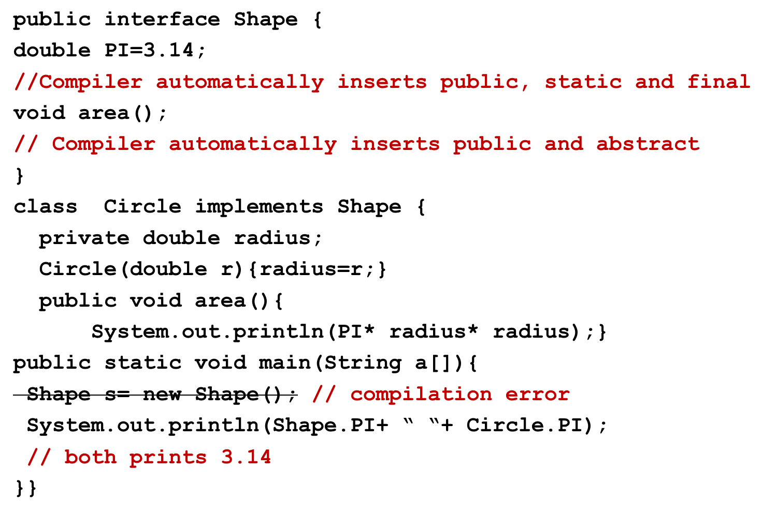
Points to note
If public is omitted a compilation error occurs.
Why?

Slide 7
instanceof
instanceof returns true or false when interface names are used except in case of final classes. In case of final class, it results in compilation error.
It never gives a compilation error.
1. Circle c= new Circle();
System.out.println(c instanceof Shape );// prints true
2. Student s= new Student(“Mary”);
System.out.println(s instanceof Shape );//prints false
System.out.println(s instanceof Circle);
// gives compilation error
3. class Square implements Shape{}
Square sq= new Square();
System.out.println(sq instanceof Circle);
// gives compilation error

Slide 8
Interface and casting
A class implementing an interface is automatically converted to the interface type.
This is very obvious and we used it in the example as well.
Shape s= new Circle(10);//
To convert an interface reference back to the original class type requires explicit casting
Circle c =(Circle)s;
Any reference can be converted to interface type by explicit casting.
  Student s= new Student(“Meera”);
  Shape s1=(Shape) s; //no error
  But
  Circle c=(Circle)s; // error

Slide 9
extending interface
Interfaces themselves can inherit from one another using extend clause.
In such cases, the implementing class must implement all the methods of the interface including those from the inherited interface.
  interface X {void x();}
  interface Y extends X{void y();}
  class Z implements Y{
  public void x(){}
  public void y(){} }
For example, when we come to collection framework we will find that root of the framework has Collection interface and then we have a list of interfaces that inherit from Collection like List, Set etc.
These type of scenarios are common in framework implementation where top of the hierarchy consists significantly of interfaces. This will be more clearer once we understand the use of interface.

Slide 10
Test your understanding
What is the difference between abstract class and interface?
Abstract class can have any type of member variables
Abstract class can even have all methods implemented or can have partial implementation or no implementation at all.
Interface does not fall into Object hierarchy.
Class can inherit only from one abstract class but many interfaces.

Slide 11
Tell me why?
We can incorporate the same logic using abstract class.
public abstract class Shape {
double PI=3.14;
void area();}
Then why do we need interfaces?
Yes interface can be used instead of abstract classes. But one drawback of abstract class is once a class extends abstract class, it cannot extend from any other class since Java does not support multiple inheritance.
That is, if you replace Shape interface with the above class, then Circle class cannot inherit from any other class.
If you have to reuse some implementation, then use inheritance via class.
But what other use does inheritance have?
Hint: What does polymorphism offer?

Slide 12
Uses
Interfaces are used to
  used to share constants
  used to set standards/define contracts
  used just to tag a class, so objects of its class can represent another type
  overcome the issues that arise because Java does not support multiple inheritance.

Slide 13
Shared constants
A large application may have lot of constants that will be used by many or all parts of the application. Java does not provide facility to have global variables. But this disadvantage can be overcome by using interface that serves as a convenient place to put all the shared constants.
public interface TeachingStaff {
int RETIREMENT_AGE=60;
int MAX_SUBJECTS=2; }
class AnyClass{
void f(){
System.out.println(TeachingStaff.RETIREMENT_AGE); }}
or
import static teacher.TeachingStaff.*;
class AnyClass{
void f(){System.out.println(MAX_SUBJECTS);}
}

Slide 14


Set standards/ define contracts
I am not sure if I will fit into those non-standard holders !
Most devices have adopted me as standard. I am cool!
When a large project is designed there are many teams with each team focusing on some aspect of the application
At some point the applications of each of these teams will have to be integrated to work together.
Therefore it is important that all the teams have a common agreement on how they expose parts of their application so that applications can interact with each other.
Thus, interfaces are created as a standard for the application and teams to work with this as baseline.

Slide 15
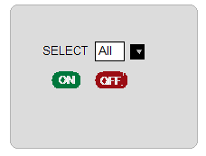
Scenario for defining contracts
Designing a remote control
Need one remote control to start and stop many devices
Team B: makers of lamp devices
Lamp
Night Lamp
AC
…
Team C: makers of AC and other devices
Team A: makers of remote control

Slide 16
Design –Step 1
Team A
class RemoteControl{
public void pressOn(){}
public void pressOff(){}
}
Team B
class Lamp{
public void on(){}
public void off(){}
}
class NightLamp extends Lamp{
public void on(){}
public void off(){}}
Classes identified by Teams
Team C
class AC{
public void switchOn(){}
public void switchOff(){}
}
Team A: pressOn() and pressOff()
which devices. Where are the devices.
I need a common class to represent all these devices.
This device can be passed a parameter to pressOn() and pressOff()

Slide 17
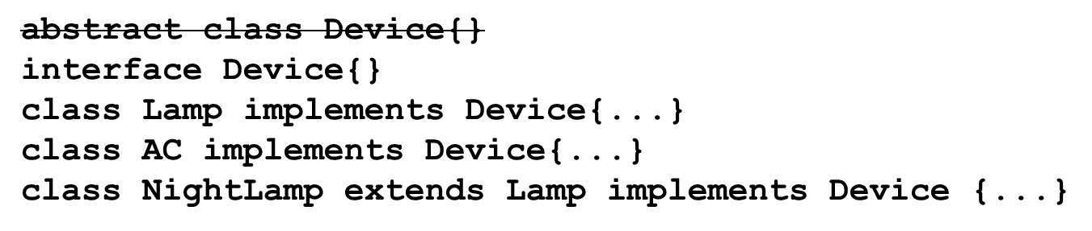
Design -Step 2
Team C : let us have an abstract class called Device from which all the other devices will inherit.
Team B: I cannot extends from Device, because my NightLamp already extends from Lamp… java does not support multiple inheritance!
Team C: Ok then we can make Device an interface!

Slide 18
Team A: Ok this is fine with us. Now I can represent an array of Devices
Team A: But now I run into another problem.
Which method on device do I call? Because while team B is using on and off as methods, team C is using
switchOn and switchOff.
I think there must be a CONTRACT between RemoteControl class and other Devices.
And the contract is this. ONLY those devices which provide methods named on() and off() can be switched on or off by the remote control.
class RemoteControl{
Device devices[];
public void pressOn(){
for(Device d:devices)
d.???
}
}
public void pressOff(){
for(Device d:devices)
d.???
}
}

Slide 19
Design -Step 3
Team C: Well then what we can do is have on and off methods declared in the Device interface.
Team B: Yes, this will ensure that we implement on and off methods.
Team A: That solves the matter.
interface Device{
void on();
void off();
}

Slide 20
class RemoteControl{
Device d[];
public void pressOn(){
for(Device d:devices)
d.on();
}
public void pressOff(){
for(Device d:devices)
d.off();
}}
class Lamp implements Device{
public void on(){}
public void off(){}
}
interface Device{
void on();
void off();
}
class AC implements Device{
public void switchOn(){}
public void switchOff(){}
}
class NightLamp extends Lamp{
public void on(){}
public void off(){}
}
Team C: I have a new device which got added -geyser.
Team A: No problem.. Just implement Device interface
Team C: Interface saved us. It helps application scale and extend !

Slide 21
An example from JSE on contracts
JSE has many classes that does lot of common programming utility methods.
But for our classes to make use of those methods, we must abide by some rules (or contracts).
This is because the utility methods need to call back the methods defined in our classes to implement certain parts of functionality.
Let us understand this by taking an example.
Comparable class in java.util package is a good example to understand this concept.

Slide 22
Comparable
java.util.Arrays
int binarySearch(<primitiveType> a, <primitiveType> key)
void sort(<primitiveType> [] a)
int binarySearch(Object[] a,Object key)
void sort(Object[] a)
Arrays class in JSE has utility methods such as sorting, searching implemented efficiently .
All the methods in this class are static like ______class.
binarySearch requires the array be sorted prior to making this call. If it is not sorted, the results are undefined. The search location begins from 0.
How can we make use of these say for Student class?
Let us understand the complexity it involves.
Notes:
System

Slide 23


Can you sort my objects too. I don’t want to remember the faster sorting method algorithm. I have to spend time to learn, implement test. Please sort my objects too.
Student class
Well, Circle also asked me the same question the other day. My dilemma is how will I know which of the fields of your class is to be used to compare?
Let us do this, you provide me implementation for compare which I will call from my sorting algorithm .
java.util.Arrays
And how am I supposed to do that. I can pass student objects to your methods … how can I pass methods… we don’t have function pointers in Java?

Slide 24


That is not a problem. I will have an arrangement with Comparable interface of JSE. It has a method called compareTo which returns an int . If you implement Comparable then I can call this method on your object when I want to compare.
Oh that’s good idea. I shall implement compareTo method.
No ! you need to implement the Comparable interface and implement compareTo method. Because I need a guarantee that you have indeed implemented and so I am going to test if your class implements Comparable!
Yes, boss

Slide 25
Comparable
java.util.Arrays
int binarySearch(<primitiveType> a, <primitiveType> key)
void sort(<primitiveType> [] a)
int binarySearch(Object[] a,Object key)
void sort(Object[] a)
<<interface>>
java.lang.Comparable<T>
Replace T with the type of class that you are going to use
int compareTo(T o)
Arrays class requires objects of Comparable type to be passed to its methods so that utilities like sort and search could be used. Otherwise an exception will be thrown by the methods like sort and search at runtime.
So to make use of the methods in Arrays class, we must implement Comparable and provide implementation for compareTo().

Slide 26
Example1: Comparable
import java.util.Arrays;
class Circle implements Shape, Comparable<Circle> {
private double radius;
Circle(double r){radius=r;}
public void area(){
System.out.println(PI* radius* radius);}
public String toString(){
return "Circle with radius :"+radius;}
public int compareTo(Circle o){
return (int)(radius*100 -o.radius*100);
}

Slide 27
public static void main(String a[]){
Shape s[]= new Shape[3];
s[0]= new Circle(12);
s[1]= new Circle(10);
s[2]= new Circle(15);
Arrays.sort(s);
for(Shape s1:s)
System.out.println(s1);
}
}
Result:
Circle with radius :10.0
Circle with radius :12.0
Circle with radius :15.0

Slide 28
Interface objects only carrying method implementation
public class Student implements Comparable<Student>{
public int compareTo(Student o)
{
return (int)(regNo -o.regNo);
}
…
}
Hey buddy, you did fantastic job by providing a way to sort my Student objects.
But you know, sometimes other classes need to sort my objects by name! I can only provide one compareTo method… I am just not sure how to deal with this problem.

Slide 29
Oh! You just tell them that they need to provide me an object that implements Comparator . Comparator interface also has compare method. In this they can provide implementation for comparing 2 student object by name.
That is too good .. I don’t have to implement anything and they can sort in any way they want

Slide 30
Arrays and Comparator
java.util.Arrays:
  public static void sort(Object[] a, Comparator c)
java.util.Comparator<T>
  int compare(T o1, T o2)
  boolean equals(Object obj)
The equals is implemented in the Object class, so there will be no compilation error if this method is not included in the class.
However, Comparator explicitly specifies it in the class so that this is implemented appropriately.

Slide 31
Example: Comparator
import java.util.Arrays;
import java.util.Comparator;
import student.Student;
public class NameSortStudent implements Comparator<Student> {
public int compare(Student o1, Student o2){
return o1.getName().compareTo(o2.getName());
}
public static void main(String[] args) {
Student s[]= new Student[3];
s[0]=new Student("Rani");
s[1]= new Student("Sani");
s[2]= new Student("Ravi");
Arrays.sort(s,new NameSortStudent());
for(Student s1:s)
System.out.println(s1.getName());
}}

Slide 32
Marker class
Interfaces that do not have any methods or constants are called Marker interfaces.
Marker interfaces are used to tag a class so that the class is of the interface type.
Some examples of marker interface in JSE are:
  Cloneable
  Serializable
  Remote
We will look at Cloneable now. Serializable will be done in IO.

Slide 33
clone() method of Object class
protected Object clone() throws CloneNotSupportedException{}
clone() method in the Object class is intended to create copies of an object.
clone() method works appropriately for other classes that do not contain any object references as their attributes because the Object class implementation is just a bit-wise-copy .
If classes contains references then clone() method must be overridden.
For example , the clone() method works fine for Student and Teacher object but is not logically correct for the Grade class.

Slide 34
Scenario 1 : clone()
Teacher
factid =123
name
Teacher
factid =123
name
Object clone()
Object clone()
clone()
returned

Slide 35
Scenario 2 : clone()
factID
name
Problem here is that we need the new cloned object to point to new copy of student and grade object.
That is clone() needs to do “a deep copy”.
name
regNo
Grade
faculty
student
grade
Grade
faculty
student
grade
clone()
Object clone()
Object clone()
returned

Slide 36
clone()- protected method
What we observer is that clone() works for the class contains only primitive fields or references to immutable objects needs to be overridden for others.
That is the reason why Object class has made clone() protected. All classes that want to expose clone()must override the method to be public. This is true even for the classes for which the implementation of clone()by Object class is fine.

Slide 37
Cloneable interface
clone() method throws CloneNotSupportedException if a class that implements clone() method is not of type Cloneable
Classes overriding this method can choose to ignore this exception by removing it from declaration. However this is not recommended. By convention, classes overriding clone() must return object that is returned by calling super.clone. If this is done then x.clone().getClass() == x.getClass() will be true. If super.clone() is called then the method must either catch exception explicitly or must have this exception list . (We will understand this in exception class)
Classes that are interested in calling clone() method can check if the object is Cloneable. If so , it is sure that the object has implemented the clone() method appropriately.

Slide 38
Example: clone()
public class Student extends general.Person implements Cloneable{
public Object clone()throws CloneNotSupportedException{
return super.clone();}
…
}
public class Teacher extends general.Person implements Cloneable{
public Object clone()throws CloneNotSupportedException{
return super.clone();}
…
}

Slide 39
public class Grade implements Cloneable{ {
  private Teacher faculty;
  private Student student;
  private String subjectCode;
  private String grade;
public Object clone()throws CloneNotSupportedException{
Grade g=(Grade)super.clone();
// explicitly deep copy
g.faculty= (Teacher)faculty.clone();
g.student = (Student ) student.clone();
return g;
}
}
…
}

Slide 40
Tell me how?
How can we represent a teacher who is also a student? Many universities offer programs that allow Ph.D students to teach while they pursue their doctoral programs. Java does not have multiple inheritance. So, we need a way around it.
Though java does not support multiple inheritance using classes, it allows multiple inheritance using interfaces.
Idea here is to
  reuse the methods written Student class and Teacher class
  Also represent the object as instance of both Student and Teacher when need be.
Interface and composition could be used together to achieve this.

Slide 41
Scenario: Interface to implement multiple inheritance
The problem that we have to represent a Teacher who is also a Student can be solved in the following way:
  StudentTeacher class will extend from Student class→ no problem.
  Since we cannot extend Teacher class, we will create an interface which will act as intermediary between StudentTeacher and Teacher class. We shall call this a TeachingStaff . This interface will have all the methods that are in Teacher class.
  We shall have both StudentTeacher and Teacher implement this interface. So any object that is of type TeachingStaff represents is a teacher and will have to provide implementation for all the methods.
  To make sure that we reuse the code written in the Teacher class in StudentTeacher also, we create a private Teacher object inside StudentTeacher class. The interface methods will indirectly call the methods on this teacher object.

Slide 42
Student
Step 1
StudentTeacher
…
Indirect relationship through the interface
Step 2
<<interface>> TeachingStaff
Teacher
int getFactId()
void display()
…
int getFactId()
void display()
<<interface>> TeachingStaff
Step 3
StudentTeacher

Slide 43
Example :Interface to implement multiple inheritance
package teacher;
public interface TeachingStaff{
// important methods of Teacher class}
package teacher;
public class Teacher implements TeachingStaff{
/* implement all the methods of TeachingStaff */ }
package student;
import teacher.*;
public class StudentTeacher extends Student implements TeachingStaff{
/*implement all the methods of TeachingStaff*/
}

Slide 44
package teacher;
public interface TeachingStaff{
int getFactId();
String getName();
// and other methods of teacher class
}
------------------------------------------
package teacher;
public class Teacher extends general.Person implements TeachingStaff{
public int getFactId(){return factId;}
…
}

Slide 45
package student;
import teacher.*;
public class StudentTeacher extends Student implements TeachingStaff{
private Teacher t;
public StudentTeacher(String name) {
super(name); t= new Teacher(name); }
public int getFactId()
{return t.getFactId();}
public String getName(){
return t.getName(); }
// and other methods
}
Implementing interface methods

Slide 46
import teacher.*;
import student.*;
import admin.*;
class Test{
static void listInvigilators(TeachingStaff s[]){
  for(int i=0;i<s.length;i++){
  if(!(s[i] instanceof StudentTeacher))
  System.out.println(s[i].getName());
  else
  System.out.println(“*”+s[i].getName());
}}
public static void main(String str[]){
  TeachingStaff f[]=new TeachingStaff[3];
  f[0]=new HOD("Ned","1.3.2006");
  f[1]=new Teacher("Sam");
  f[2]= new StudentTeacher("Rohit");
  listInvigilators(f);
}}
Invigilators can be any type of teacher (either Teacher or StudentTeacher). listInvigilators() method uses TeachingStaff interface to hold references of Teacher and StudentTeacher.

