Slide 1

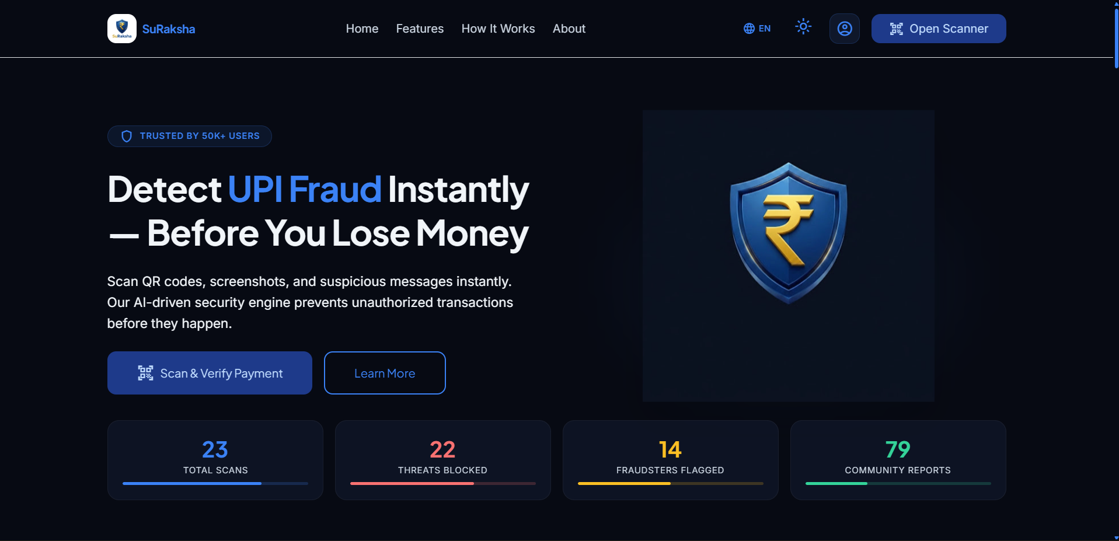
EUREKA! PITCH COMPETITION 2026 | SJCEM × IIT BOMBAY NEC
SURAKSHA AI
Real-Time Payment Risk & Fraud Intelligence Platform
"The payment is instant. The warning should be too."
An intelligent, privacy-first security layer evaluating QR codes, UPI IDs, payment screenshots, and phishing links before money leaves your account.
[FAST] <200ms Execution
[SHIELD] Multi-Modal AI
[PRIVACY] Zero-Data Retention
[ACTIVE PROTOTYPE] Validated across real payment attack scenarios
Notes:
[TIME: 0:00 - 0:30]
[WHAT TO SAY]: Judges, imagine you walk up to a busy retail counter. You scan the QR code, type ₹500, enter your UPI PIN, and hear the success chime. But two minutes later, the shopkeeper tells you he never received the money. Why? Because a scammer pasted a duplicate QR sticker right over the shop's original board. Or consider a small vendor who hands over ₹5,000 worth of goods because a customer flashes a doctored Google Pay confirmation screenshot. India processes billions of instant payments monthly, but fraud awareness takes hours. That is why we built Suraksha AI.
[ACTION]: Stand center stage, confident posture, no slide notes in hand.
[TRANSITION]: Let's look at the three critical fraud vectors plaguing our digital economy.

Slide 2


// THE DIGITAL PAYMENT CRISIS //
Instant Payments. Delayed Fraud Awareness.
01
02
03
Physical QR Sticker Swapping
Point-of-Sale Tampering
Fraudsters paste deceptive scam QR stickers over legitimate shop counter stands. Funds are silently diverted to attacker accounts at checkout.
[VULNERABILITY] Threat: Silent checkout fund diversion
Doctored Payment Screenshots
Digital Visual Image Forgery
Customers flash fabricated GPay / PhonePe receipt screenshots made via photo editing apps. Merchants hand over goods without receiving funds.
[VULNERABILITY] Threat: Merchants lose daily working capital
Phishing & Urgency Traps
Social Engineering Links
Scammers send WhatsApp / SMS links disguised as 'Cashback' or 'KYC Update'. Clicking triggers an unauthorized debit request (`upi://pay`).
[VULNERABILITY] Threat: Victims realize only after bank debit
Notes:
[TIME: 0:30 - 1:10]
[WHAT TO SAY]: Digital payments are fast and seamless, but fraud tactics have evolved to exploit the human interface before bank settlement. Today's payment scams target users through three distinct vectors: physical QR sticker swapping, doctored confirmation screenshots, and social engineering phishing links. The core problem is that users lack real-time risk intelligence at the exact moment of payment.
[ACTION]: Point to each of the 3 problem cards on the screen.
[TRANSITION]: Why does this vulnerability exist in our current apps? That brings us to our core insight.

Slide 3

// THE CORE INSIGHT //
The Security Gap Exists Before The Payment
[TRADITIONAL] Current Payment Experience
• Reactive Focus: Fraud is flagged only AFTER money is deducted via post-transaction dispute forms.
• Blind Trust in QR URLs: Apps parse raw links without validating physical counter sticker integrity.
• Zero Receipt Defense: Merchants have no built-in tools to detect Photoshop-edited receipts.
• Language Barrier: Technical security jargon confuses non-English speaking retail shopkeepers.
[PRE-AUTH SHIELD] Suraksha AI Zero-Trust
[PROACTIVE] Pre-Payment Warning: Analyzes threat parameters in <200ms BEFORE the user types their PIN.
[PROACTIVE] Cryptographic QR Shield: Validates HMAC SHA-256 merchant signatures to catch sticker swaps.
[PROACTIVE] In-Memory ELA Forensics: Applies 75% Q-factor Error Level Analysis in RAM to expose image tampering.
[PROACTIVE] Bilingual Intelligence: Seamless English & Devanagari Hindi translation protecting Tier-2/3 users.
Notes:
[TIME: 1:10 - 1:55]
[WHAT TO SAY]: Current banking apps focus on authentication—verifying who is paying with a PIN. But they never inspect whether the payment context itself is fraudulent. The critical security gap exists in the 3 seconds before the PIN is entered. Suraksha AI fills this gap with a zero-trust pre-payment inspection layer. In under 200 milliseconds, we evaluate the QR payload, receipt image integrity, and message urgency to give users an explainable risk verdict before money is transferred.
[ACTION]: Emphasize the contrast between reactive dispute forms and proactive pre-payment warnings.
[TRANSITION]: Let's look at the core solution architecture.

Slide 4
// THE SOLUTION //
Meet Suraksha AI: Multi-Modal Defense Grid
01. Live QR Scanner
WebRTC camera feed parses UPI URI, checks VPA blacklists & validates HMAC signatures.
02. Image Forensic ELA
RAM-only OpenCV JPEG Error Level Analysis detects doctored receipt screenshots.
03. NLP Message Validator
Naive Bayes & Regex heuristic matrix flags cashback / KYC urgency traps in <20ms.
04. Signed QR Generator
Empowers shopkeepers to generate cryptographically tamper-proof merchant QR codes.
THE ZERO-TRUST EVALUATION PIPELINE
User Input (QR / Image / SMS) ──> In-Memory Sanitization ──> Multi-Signal Evaluation (ELA + HMAC + NLP) ──> Weighted Risk Engine ──> Actionable HUD Verdict
[SAFE] Score 0–30: Trusted Merchant (Auto-Launch Payment) | [CAUTION] Score 31–70: Verify Identity | [HIGH RISK] Score 71–100: Block & Report
Notes:
[TIME: 1:55 - 2:15]
[WHAT TO SAY]: Suraksha AI operates across four unified pillars: a live QR scanner, an in-memory image forensics engine, a sub-20ms NLP text validator, and a cryptographic QR generator for merchants. Our pipeline ingests the raw payload, sanitizes it in volatile RAM, runs parallel multi-signal evaluation, and produces an instant risk verdict. Let me show you this in action right now.

Slide 5

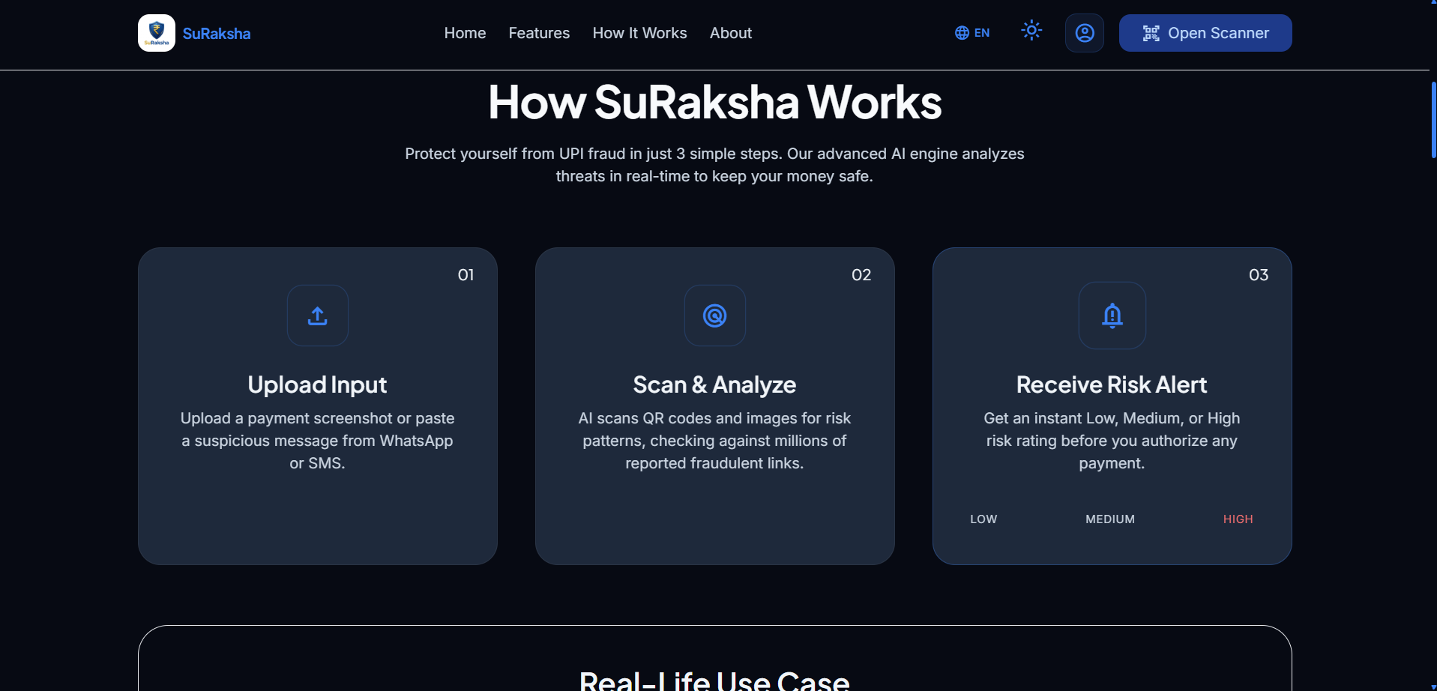
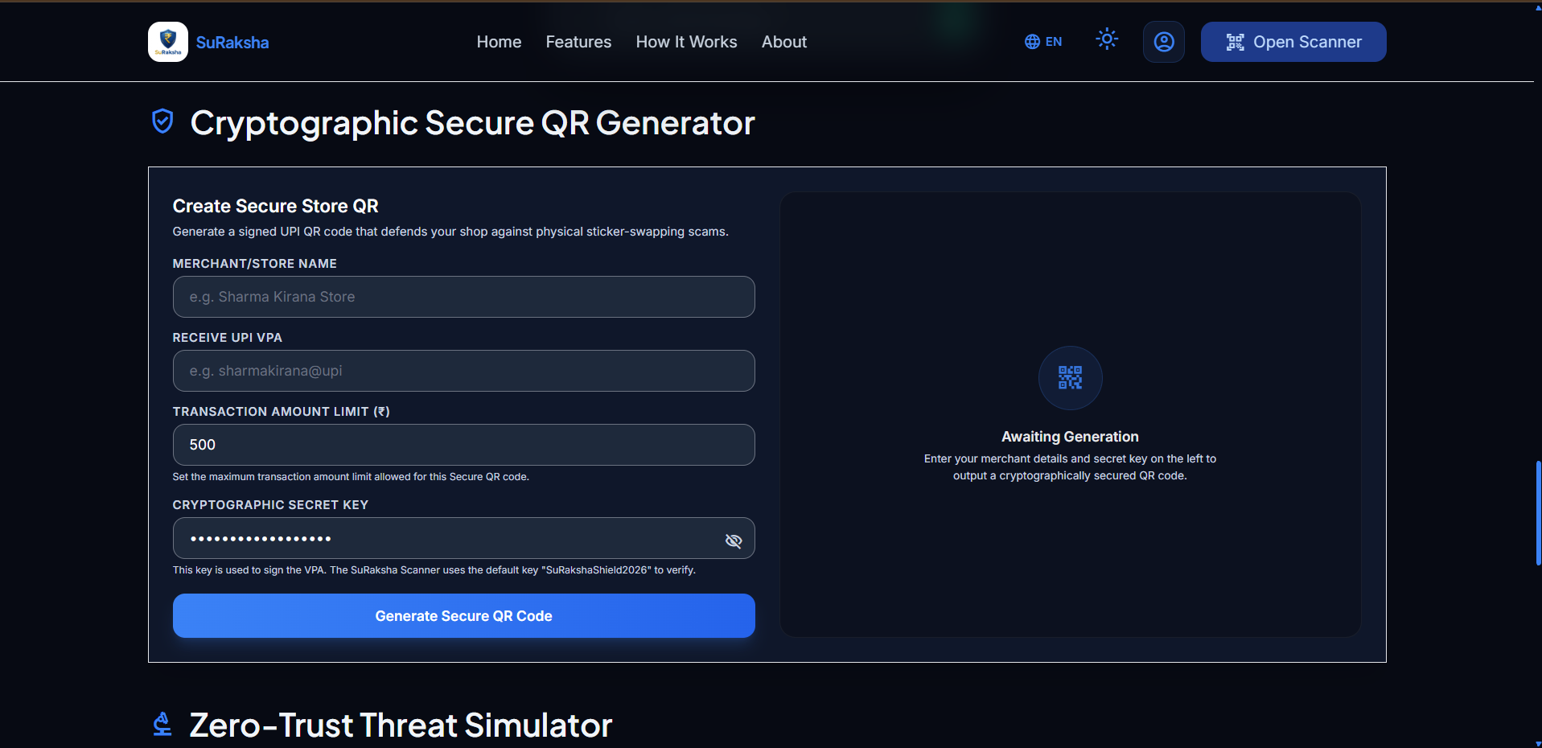
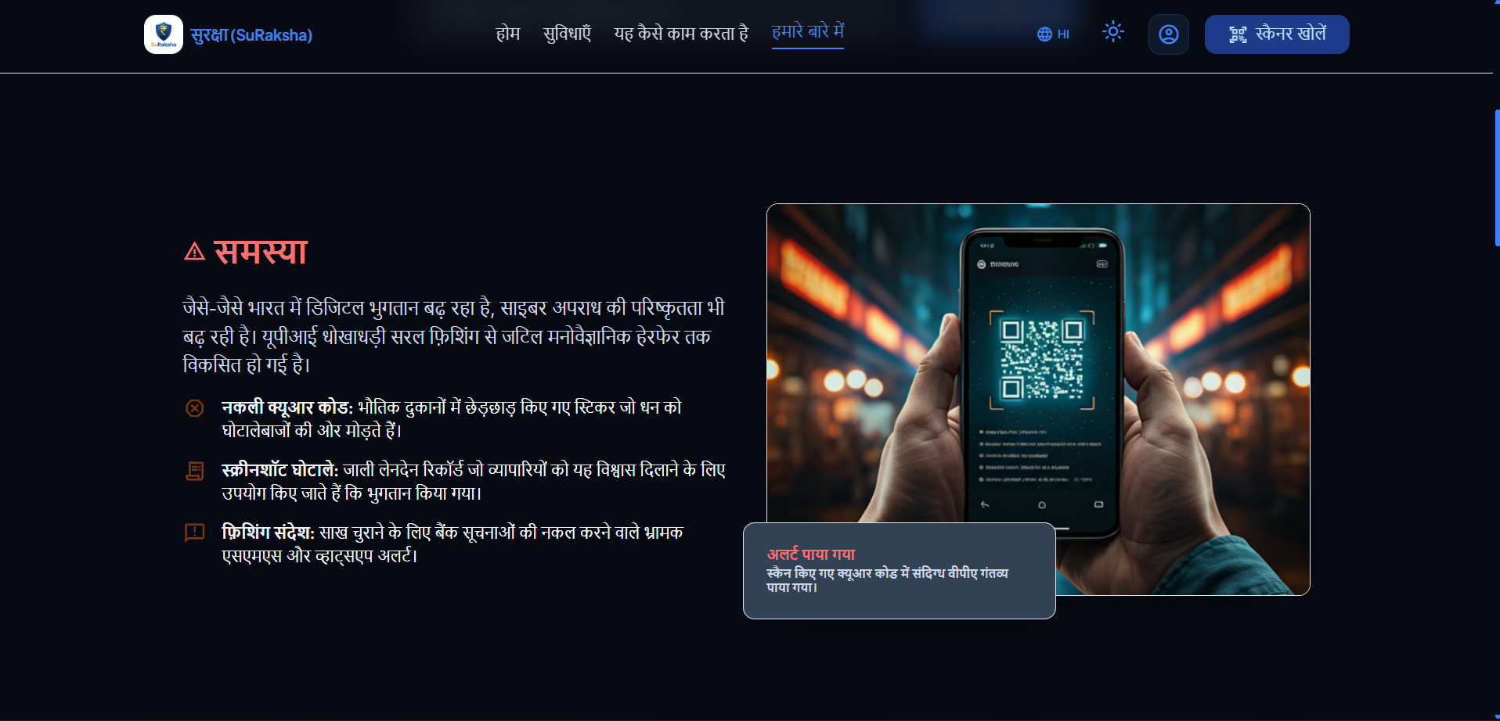
// PRODUCT EVIDENCE //
See Suraksha in Action: Real-Time Risk HUD
1. Multi-Modal Scanner
2. Explainable Threat HUD
3. Forensic ELA Analysis
Live camera QR & screenshot input interface
Calculates composite risk score with factor checklist
Exposes pixel modifications in doctored receipts
Notes:
[TIME: 2:15 - 3:15]
[WHAT TO SAY]: [LIVE DEMO DEMONSTRATION / BACKUP WALKTHROUGH]
1. First, we input a deceptive payment message offering cashback. In milliseconds, our NLP model flags urgency patterns and intent mismatches, calculating an 85% Critical Risk Score.
2. Second, a vendor uploads a payment screenshot. Our OpenCV Error Level Analysis inspects pixel compression noise in RAM without saving any file to disk, instantly flagging spliced text overlay.
3. Third, with one click, the entire UI translates dynamically into Hindi, ensuring vendors across India can understand the threat clearly.
[ACTION]: Execute live scan on localhost or present the 3 high-res UI panels.
[TRANSITION]: Let's look at the underlying technology that powers this engine.

Slide 6
// TECHNICAL ARCHITECTURE //
The Intelligence Behind Suraksha AI
Layer 1: Visual Image Forensics
Layer 2: Cryptographic QR Shield
Layer 3: NLP & Threat Intelligence
• 75% JPEG Error Level Analysis: Re-compresses in-memory byte streams to detect localized quantization noise.
• Laplacian Spatial Variance: Measures edge sharpness inconsistencies to detect sharp text overlays (Threshold > 2000).
• Zero-Disk Persistence: Bytes processed via `io.BytesIO` in volatile RAM without saving files to disk.
• HMAC SHA-256 Signatures: Merchants sign VPA parameters using private keys (`sign = SHA256(pn || pa || key)`).
• Merchant Registry Lookup: Matches scanned signatures against trusted databases to expose sticker swapping.
• Format & Scheme Integrity: Validates strictly formatted `upi://pay` URIs against spoofed deep links.
• Naive Bayes TF-IDF Model: Classifies SMS/chat strings into benign alerts vs social engineering traps in <20ms.
• Regex Heuristic Rules: Detects high-pressure triggers (account blocked, KYC update, cashback reward).
• Bilingual Translation: Regex word-boundary mapping ensures zero Hindi UI distortion.
Notes:
[TIME: 3:15 - 3:50]
[WHAT TO SAY]: Under the hood, Suraksha AI combines three lightweight, high-performance engines: OpenCV JPEG Error Level Analysis running in volatile RAM to protect privacy, HMAC SHA-256 cryptographic verification that validates merchant signatures to eliminate physical sticker swaps, and Multinomial Naive Bayes classification that parses conversational context in under 20 milliseconds. The entire evaluation pipeline executes with sub-200ms latency, delivering immediate protection on edge devices.
[TRANSITION]: How does this compare to traditional market solutions?

Slide 7
// COMPETITIVE DIFFERENTIATION //
From Payment Execution to Payment Risk Intelligence
Capability / Feature | Traditional UPI Apps | Server-Side Fraud Logs | Suraksha AI Platform
Inspection Timing | Post-PIN Entry | Post-Settlement Logs | Pre-Authorization (<200ms)
QR Sticker Swap Defense | None (Blind trust) | None | HMAC SHA-256 Validation
Screenshot Forgery Detection | None | None | In-Memory ELA Forensics
User Privacy Policy | Server Transaction Logs | Bulk Server Storage | Zero-Data Retention (RAM)
Language Inclusivity | Static / English | English Only | Dynamic English & Hindi
Notes:
[TIME: 3:50 - 4:15]
[WHAT TO SAY]: Mainstream payment apps focus on transaction throughput; they do not perform receipt forensics or cryptographic QR sticker verification. Backend banking logs catch fraud hours after settlement. Suraksha AI is built specifically for pre-authorization interception with explainable risk indicators and zero-data retention privacy.
[TRANSITION]: Now let's explore our commercialization strategy and market scalability.

Slide 8
// BUSINESS MODEL & SCALE //
Built for Users. Designed to Scale.
B2C: Consumer Shield
Freemium Mobile App
B2B: Merchant Protection
Retail Merchant Subscriptions
B2B2C / API: FinTech SDK
Enterprise Risk-as-a-Service
• Core Scanner: Free real-time QR & SMS phishing protection for everyday citizens.
• Premium Security HUD: Subscription tier with family protection, instant scam reporting, and cyber insurance link.
• Signed QR Certification: Monthly subscription for verified shopkeeper badges and tamper-proof counter stands.
• POS Screenshot Verifier: Instant audio chime and visual screen verification to protect shopkeepers from fake receipts.
• Pre-Auth Risk API: Microservice API licensing for neo-banks, payment aggregators, and digital wallets.
• Fraud Intelligence Feeds: Shared scammer VPA blacklist telemetry for financial institutions.
Notes:
[TIME: 4:15 - 4:40]
[WHAT TO SAY]: Our business model scales across three layers: a freemium consumer mobile app, a ₹99/month merchant subscription providing verified tamper-proof QR stands and instant receipt verification, and enterprise B2B2C API licensing for fintech payment aggregators and digital wallets. This creates an expanding network effect where every reported scam strengthens the intelligence engine across all platforms.
[TRANSITION]: Let's conclude with our core vision.

Slide 9

THE SURAKSHA AI VISION
DON'T DISCOVER THE SCAM AFTER YOU PAY. DISCOVER THE RISK BEFORE YOU PAY.
SURAKSHA AI — Making every digital payment an informed payment.
STAGE 1: PROTOTYPE
Working PWA, Flask microservice & OpenCV ELA engine validated across attack vectors.
STAGE 2: VALIDATION
Pilot trials with local retail shopkeepers in Tier-2/3 market corridors.
STAGE 3: SCALE
FinTech API licensing & multi-bank threat intelligence sharing.
Notes:
[TIME: 4:40 - 5:00]
[WHAT TO SAY]: Judges, digital payments should not only be fast—they must be informed and secure. Our mission is simple: Don't discover the scam after you pay. Discover the risk before you pay. We have a working prototype and a clear roadmap to secure India's digital transactions. Thank you. We are Suraksha AI.
[ACTION]: Step forward, deliver the final one-liner with conviction, and conclude.

