Slide 1

Mobile App Development Using:
Presented by Tyler Richey
Images from http://phonegap.com/

Slide 2
What exactly is “PhoneGap”?
“PhoneGap is a free and open source framework that allows you to create mobile apps using standardized web APIs for the platforms you care about.”
– phonegap.com
PhoneGap is an open source solution for building cross-platform mobile apps with standards-based Web technologies like HTML, JavaScript, and CSS.
Mobile Development Using PhoneGap

Slide 3
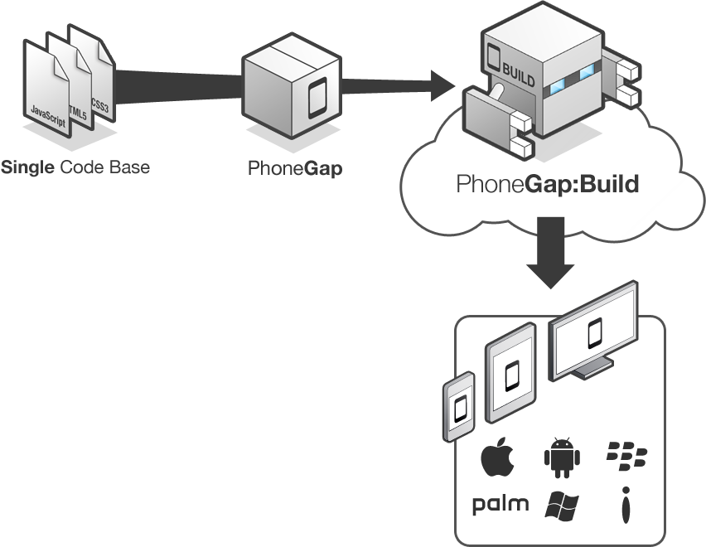
How does PhoneGap Work?
Include web code in a native app project:
  - assets/www/js/, css/, images/, etc.
Native code loads a URL to the web code through the device’s internal browser:
  - Extend a CordovaWebViewClient
  - super.loadUrl( “file:///android_asset/www/login.html” );
Apache Cordova exposes native device APIs through JavaScript:
  - navigator.device.capture.captureImage( captureSuccess(), captureError(), [options] );
Mobile Development Using PhoneGap

Slide 4
Apache Cordova
“Apache Cordova is a set of device APIs that allow a mobile app developer to access native device function such as the camera or accelerometer from JavaScript.”
– http://cordova.apache.org/
A platform-specific engine that exposes access to native device functionality through a series of JavaScript APIs.
Phonegap is actually an open source distribution of Cordova.
Mobile Development Using PhoneGap

Slide 5
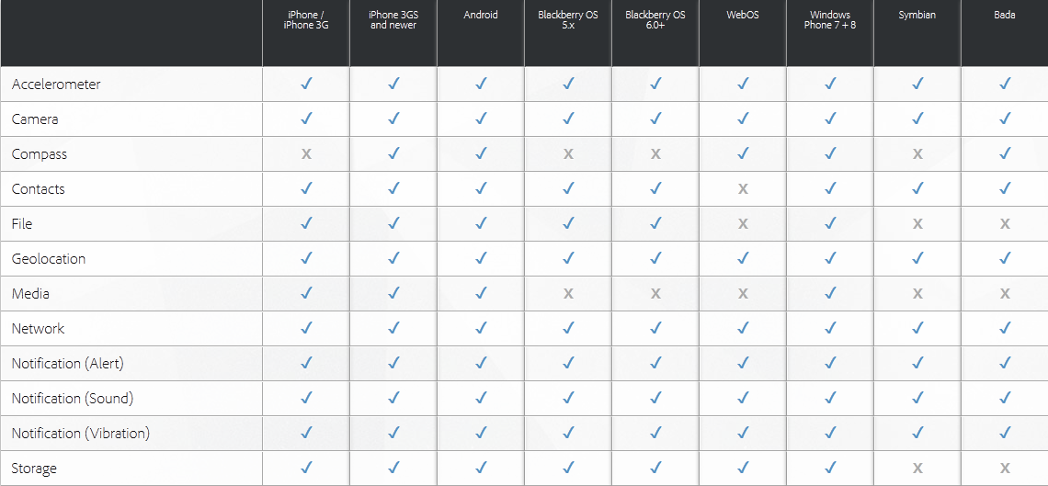
PhoneGap Platform Support
Mobile Development Using PhoneGap
Notes:
http://docs.phonegap.com/en/2.8.0/cordova_media_capture_capture.md.html#Capture for an example of taking a picture

Slide 6
Getting Started with Development
Integrated Development Environment
  Java IDE like Eclipse or IntelliJ for Android
  Xcode for iOS
Mobile Platform SDK
Apache Cordova
Mobile Devices
  Recommended for deployment/testing
  Emulators are alternative but not a true test
Getting Started guide available on phonegap.com
Mobile Development Using PhoneGap
Notes:
http://docs.phonegap.com/en/2.8.0/guide_getting-started_index.md.html#Getting%20Started%20Guides

Slide 7
jQuery Mobile
HTML5-based UI framework that provides a mobile application look and feel.
Built-in content and widgets are supported across mobile, tablet, and desktop platforms.
Visit http://jquerymobile.com/ and http://jquery.com/ for more details.
Mobile Development Using PhoneGap

Slide 8
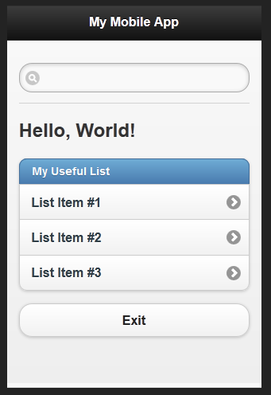
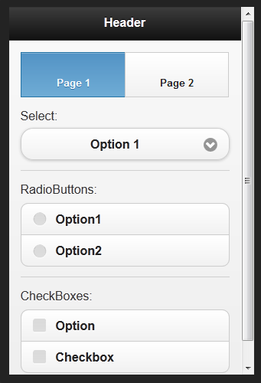
jQuery Mobile Continued
Mobile Development Using PhoneGap

Slide 9
Useful Plug-ins
Underscore.js – “a utility-belt library for JavaScript that provides a lot of the functional programming support”.
Knockout.js – Simplifies dynamic JavaScript UIs by incorporating a Model-View-View-Model pattern for dynamic data binding.
SimpleDialog2 – Provides an easy interface to build mobile dialogs pop-ups.
Mobile Development Using PhoneGap

Slide 10
PhoneGap Gotchas
5 MB HTML 5 local storage limit
Chrome Desktop testing requires local file access permission
Inconsistent mobile browser anomalies
Inconsistent performance among devices
Some native application code required - extend a CordovaWebViewClient and load the URL to the website.
Web code is not compiled and is accessible
Mobile Development Using PhoneGap

Slide 11
Any Questions?
Mobile Development Using PhoneGap
Notes:
http://phonegap.com/about/faq/

