Slide 1
Pick Up Game
A sports meet-up application!
Dayton Flores, Joseph Sharp Halpin, Erik Chow, Frank Frisbee

Slide 2
Costs of Playing Sports at Gyms
Playing any sport at a rec center can be costly
Even if it’s $5 a visit, that can still add up very fast
According to ChimeBank.com, “In 2016, Americans spent $19 billion on gym memberships… Americans spend $155 a month on health and fitness where $33 of that $155 is spent on gym fees” (Settembre, 2018)
https://www.marketwatch.com/story/this-is-the-insane-amount-millennials-are-spending-on-fitness-2018-01-21

Slide 3
Problems
No one to play sports with
Not enough people at the park/rec center
Your friends don’t like playing the same sports as you
Not enough friends playing sports
According to a study conducted by Harvard T.H. Chan School of Public Health poll, “almost three in four adults played sports when they were younger (73%) [and] only one in four (25%) continue to play sports as adults” (Datz & Blair, 2015)
https://www.hsph.harvard.edu/news/press-releases/poll-many-adults-played-sports-when-young-but-few-still-play/

Slide 4
Lowering Obesity
According to DatalysCenter, “A study of public high schools found that 29% of boys and 34% of girls are overweight and 16% of boys and girls are obese. At these schools, students who participated in one or more sports were much less likely to be overweight or obese.” (Sports Participation Prevent Youth Obesity, 2019)
Getting more people involved in playing sports could help lower obesity in America
https://www.datalyscenter.org/sites/datalyscenter.org/files/Sports_Participation_Prevent_Obesity.pdf

Slide 5

Our Solution
Pick Up Game will bring sports players together. The app lets users create an account and set up their own profile. They can then create events for others to view in the home tab. A user can see more information about an event and choose to meet up with other users.

Slide 6
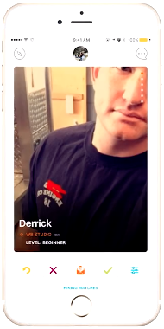
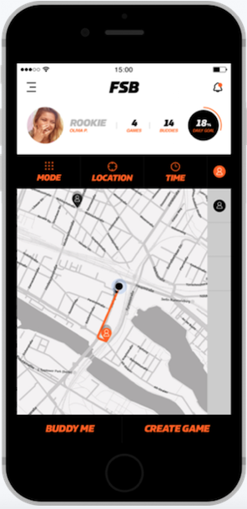
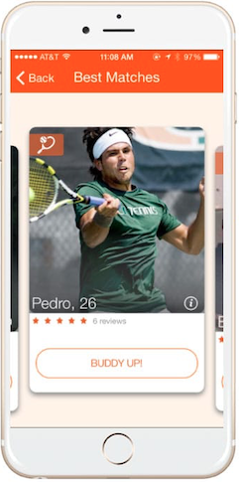
What Makes Them Average
Similar “Sports Tinder” apps (i.e. Bvddy, SportsBuddy, FindSomeBuddy) match people together through common interests
These apps match people before they meet, allowing users to remotely implicitly bias and/or discriminate

Slide 7
What Makes Us Special
We plan to allow people to create Events, and allow users to filter their feed based on what they’re looking for
Lack of online matchmaking allow users to focus on the event
Profiles can remain empty/anonymous, as not even a username or profile picture is required
If necessary, details regarding desired skill level can be entered in About the Event
246 high school students completed a survey, and 20% of whites, 29% of African Americans, and 42% multiracial/others experienced “online individual discrimination. Linear regressions revealed that individual racial discrimination was significantly over and above offline measures.” (Tynes, Giang, Williams, Thompson 2008).
https://www.sciencedirect.com/science/article/pii/S1054139X08004163

Slide 8
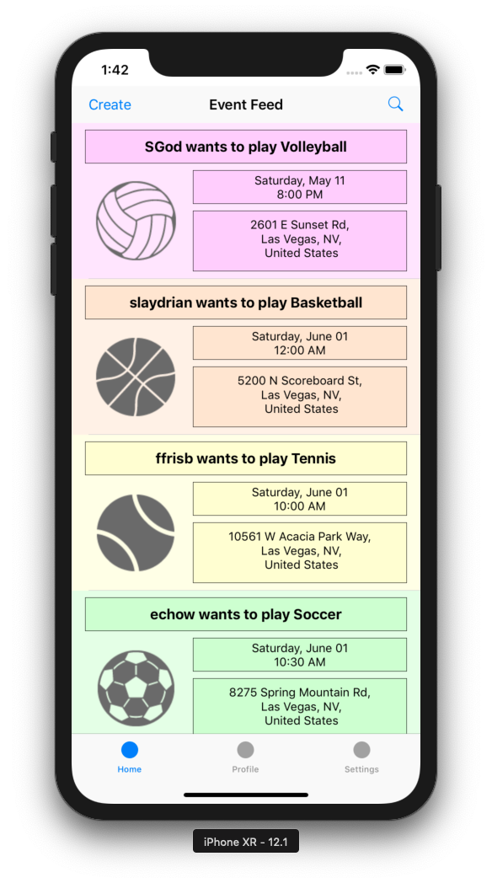
Notable Screens
Home Tab
Event feed incorporates Apple MapKit to filter city and switches from Settings Tab to filter sports
Also incorporates scrollable view for feed (each event will include date, username, sport, location, time)
Event can be clicked, which segues to Event Detail
Profile tab takes user to view own profile
Settings tab takes user to settings, where user can modify filters for home feed and edit profile

Slide 9
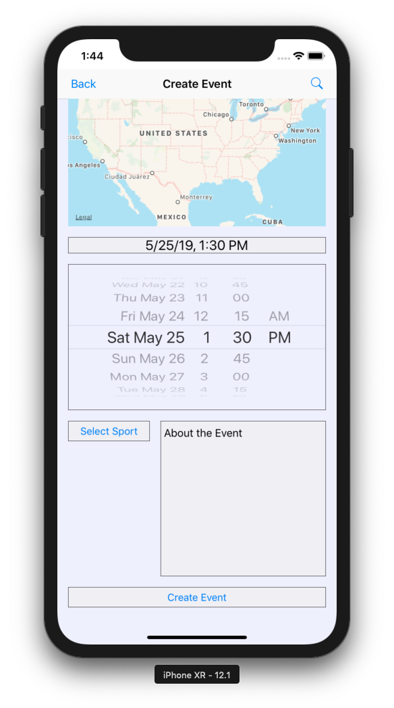
Notable Screens (continued)
Create Event
Uses Apple MapKit to select location, picker to filter date/time of event, table view to select sport, text field to describe event
Create Event only sends event to Firebase if all fields (besides About the Event) are entered
Incorporates UIAlert that will ask user to confirm creation of event

Slide 10
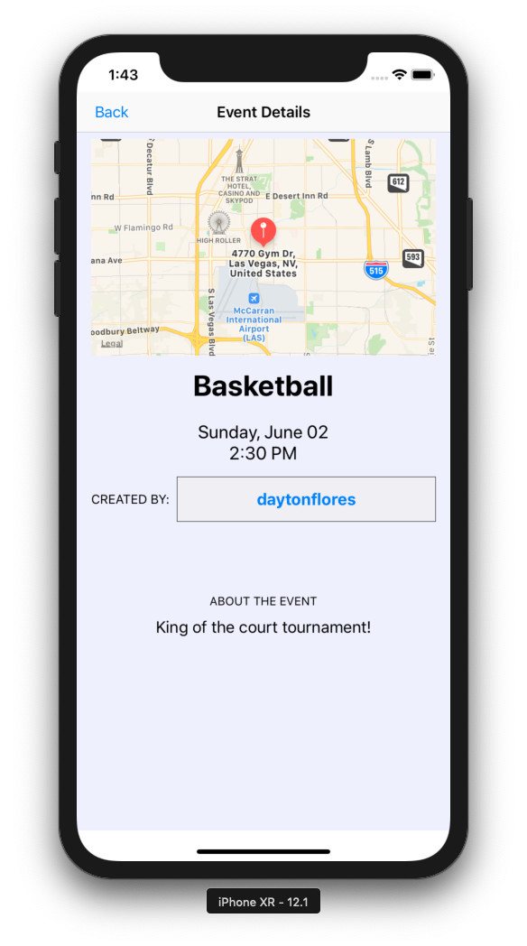
Notable Screens (continued)
Event Details
Event location shows as pin on Apple Map
Also displays sport, date/time, about the event, and username/anonymous
Username can be clicked from events in Event Detail, will segue to User Profile

Slide 11
Notable Functional Requirements
Search Button
When pressed this button will make a text box appear that the user can use to input an existing address. When the return button is pressed the Create Event Page Apple Map will show the searched location.
Apple Map
This will use latitude and longitude lines to show the user searched location on an Apple Map
Create Event Button
When pressed all data fields including; Create Event Page Search Button, Create Event Page Date/Time Picker View, and Create Event Page Drop Menu are pushed to the database. If all of the fields have been edited a segue is performed that takes the user to the Home Tab.

Slide 12
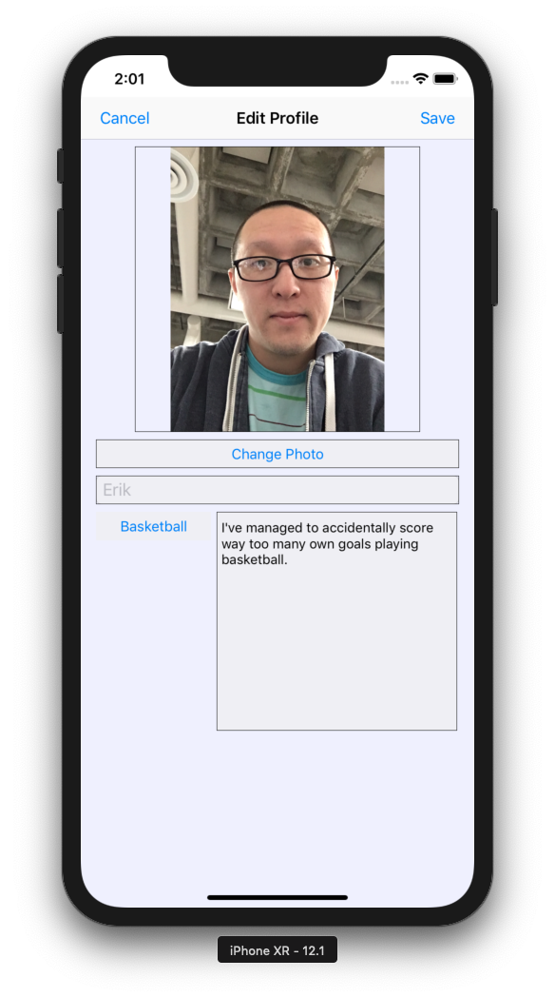
Notable Functional Requirements (continued)
Save Button
When pressed the user input data such as: username, favorite sport, about me, and profile picture will be sent to the Firebase Storage.
A segue is performed that takes the user to the Settings Tab.
Profile Picture Button
When pressed the user will be taken to their camera roll so they can select a photo.
Once selected this photo will be uploaded to Firebase and saved to their account.

Slide 13
Non-Functional Requirements
Operating System
The application will be designed on macOS 10.13.6/10.14.3 and will be written to run on iOS 12.1.4
Programming Language
The application will be written in Swift Version 4.2.3
Developmental Tools
The project will be designed, written, and tested using Xcode Version 10.1/10.2
Database
Firebase SDK Version 5.20.1

Slide 14
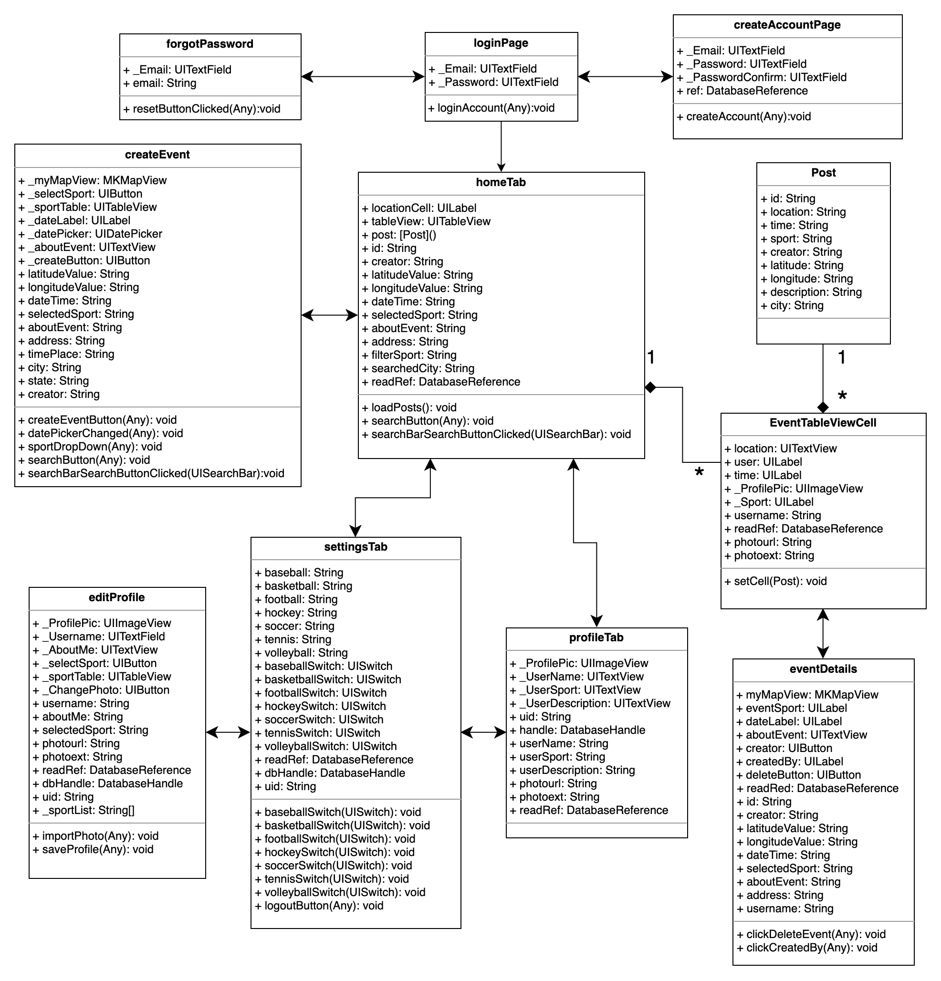
Class Diagram

Slide 15
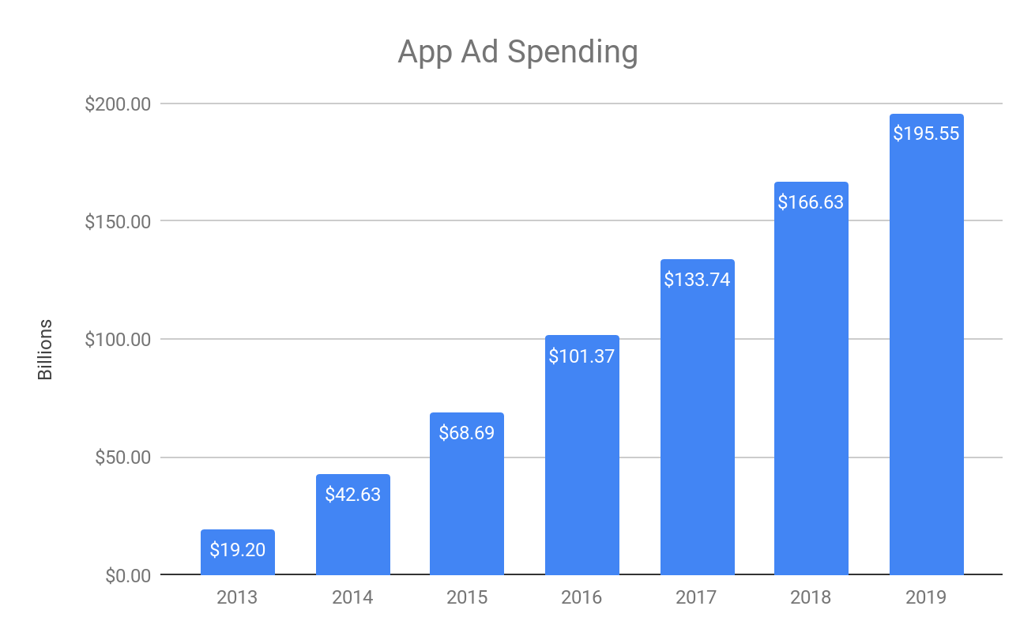
Potential Profit Through Advertisements
According to Business Insider “Display and video will be the fastest-growing mobile ad formats as digital ad dollars quickly shift from desktop to mobile, and ad products improve. US mobile display and mobile video ad revenues will grow at an astonishing CAGR [compound annual growth rate] of 96% and 73% respectively, between 2013 and 2018.” (Hoezel, 2014)
https://www.businessinsider.com/mobile-video-is-the-growth-area-2014-10
(Business of Apps, 2018)
http://www.businessofapps.com/ads/research/mobile-app-advertising-cpm-rates/

Slide 16
User Input
One of the largest complaints users had was accessing their own events and deleting them. That has been addressed in the newest version of the app.
Another complaint was about not being able to save events or RSVP to them.
Adding a messaging system that allows users to communicate with each other.
Users can view their own created events which we added in the final product.

Slide 17
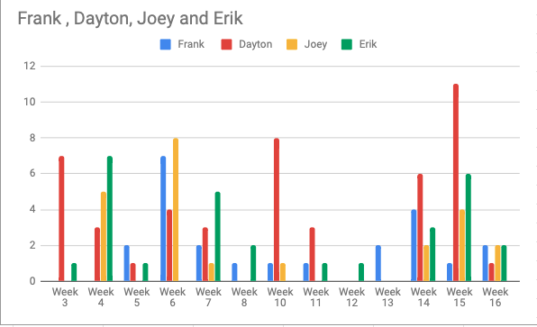
Commit History

Slide 18
Roles
Dayton - Event details, settings tab, home tab event feed filters
Joey - Create event page, home tab event feed pulling, creator profile page
Erik - Profile page, database set up, event feed
Frank - Login page, create account page, keyboard tasks, logo

