Slide 1
Quantum Tunneling
By: Dayton Flores
University of Nevada-Las Vegas

Slide 2
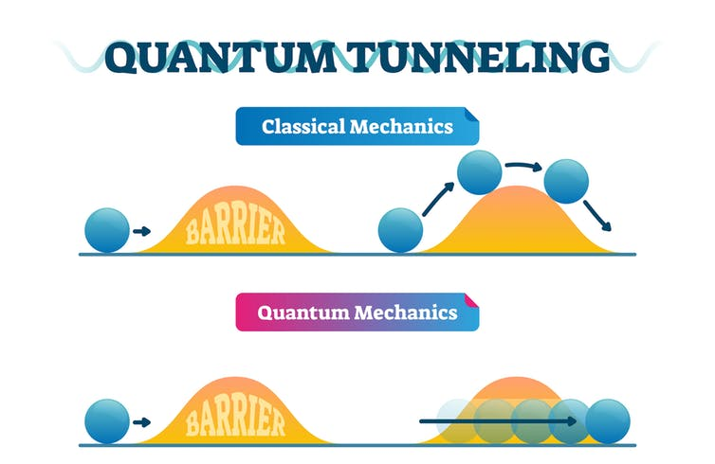
What Is Quantum Tunneling?
Occurs when a subatomic particle passes through a potential barrier whose energy is greater than the particle’s energy
Barrier cannot be overcome under classical mechanics conditions

Slide 3
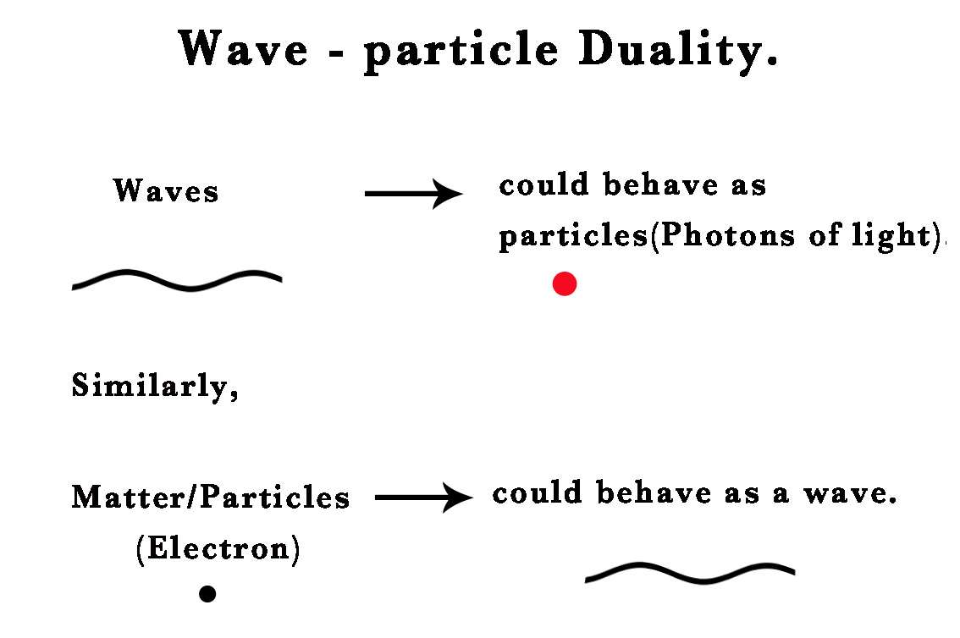
Why Does Tunneling Happen?
Direct consequence of wave-particle duality
Everything in the universe has particle properties as well as wave properties
Non-subatomic objects are dominated by their particle properties, as macroscopic objects’ wave-lengths are too short
Tunneling is impossible in classical mechanics
Whereas subatomic particles are described by their wave functions

Slide 4
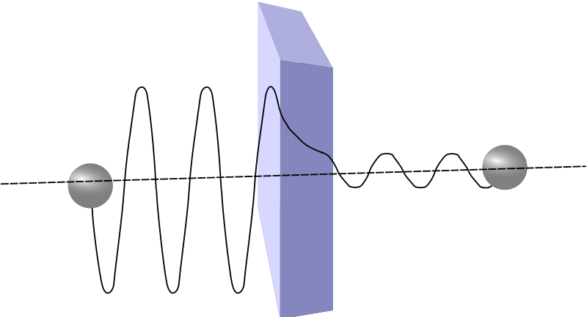
Properties of Wave Function During Tunneling
Electron’s wave function is sinusoidal
Wave function decreases exponentially inside potential barrier
Width of barrier is inversely proportional to likelihood of quantum tunneling

Slide 5
History of Quantum Tunneling
First theorized in 1927 by German physicist Friedrich Hund whilst studying the ground state energy of a double-well potential
In 1928, was first applied in a mathematical explanation for alpha decay
A type of radioactive decay which involves an emission of alpha particles (comprised of protons and neutrons) from nuclei
Wasn’t until 1957 (due to semiconductor physics) that the possibility of electrons tunneling into solids was accepted
Leo Esaki (tunnel diodes), Ivar Giaever, and Brian Josephson (Josephson junctions) received Nobel Prize in Physics for their studies on tunneling in superconducting Cooper pairs
In 2016, quantum tunneling in water was discovered

Slide 6
Fundamental in Nature
Nuclear fusion of hydrogen into helium gives stars their power and produces every element on the periodic table (except hydrogen)
Nuclear fusion is the process by which multiple nuclei join together to form heavier nuclei, releasing large amounts of energy
Since nuclei are of like charges, they strongly repel
The kinetic energy required to overcome this repulsion and fuse is approximately 6 times hotter than the sun’s core
Yet, fusion consistently happens and stars remain stable for millions of years
Proportion of hydrogen nuclei which can undergo fusion is dramatically increased with quantum tunneling taken into account

Slide 7
Quantum Tunneling & Wave Packets (PhET)
Allows simulation of quantum tunneling at modifiable energy levels within four different potential configurations
Constant, step, single well, double well
Modifiable parameters
Average total energy, barrier energies/widths, direction of wave, initial width/position of wave
Observable values
Interactive graph of potential barrier, potential values, graph of wave function (real, imaginary, magnitude, phase), graph of probability density, transmission/reflection probabilities

Slide 8
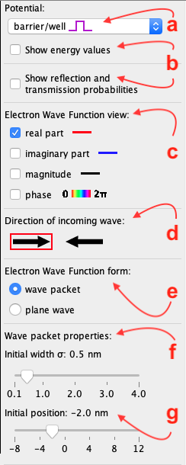
Modifiable Parameters
Select Potential (constant, step, single well, double well)
Show Energy Values or Reflection & Transmission Probabilities
Choose which parts of the Wave Function to view (in Wave Function Graph)
Direction the electron will be traveling
Wave Packet (individual particle) or Plane Wave (continuous stream of particles)
Initial width of the Wave Packet (nm)
Initial position of the Wave Packet relative to the graph (nm)

Slide 9
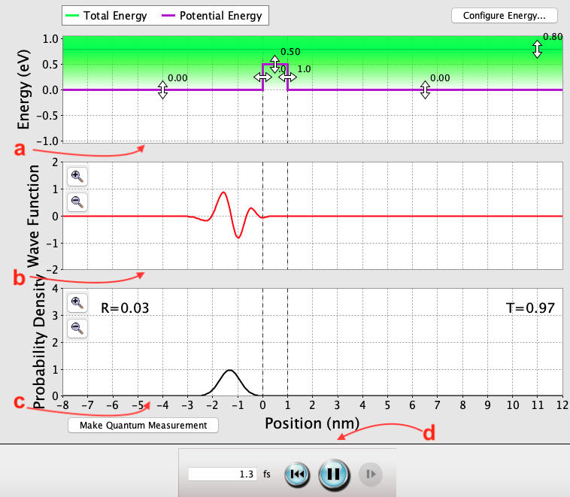
Observable Values
Energy visualization
Wave Function visualization of the electron (ψ) interacting with the Potential from a)
Probability Density visualization of the electron (|ψ²|) interacting with the Potential from a)
Restart or Pause graphs for observation

Slide 10
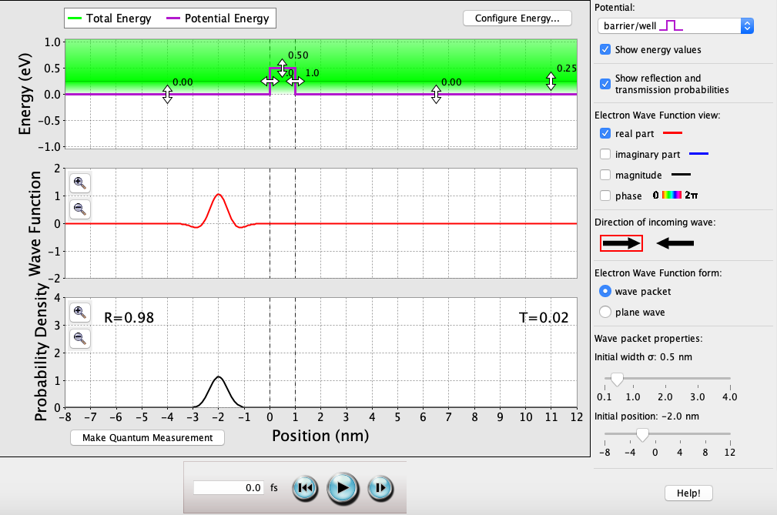
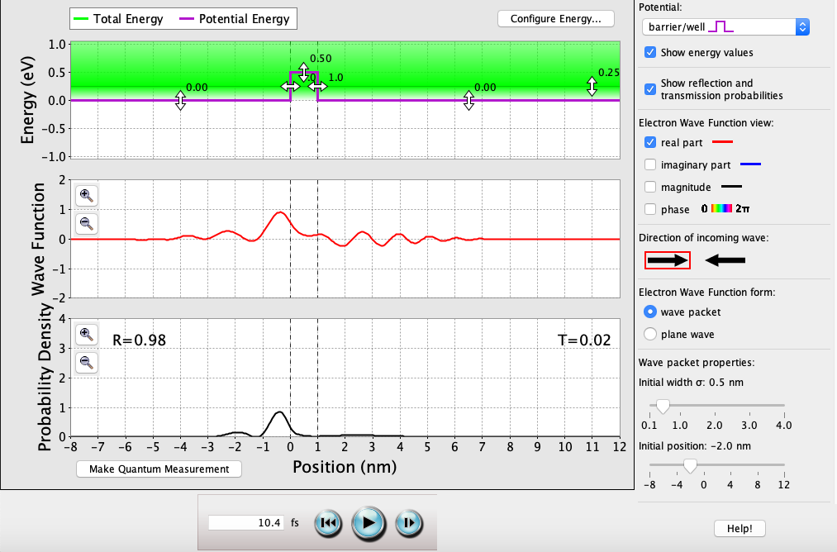
Single Well Example (E < V₂)
After 10 fs, majority of the wave function will be reflected off V₂
Majority of what’s left of that will be reflected off V₃
The 0.02 probability that makes it through the well is the result of quantum tunneling.

Slide 11
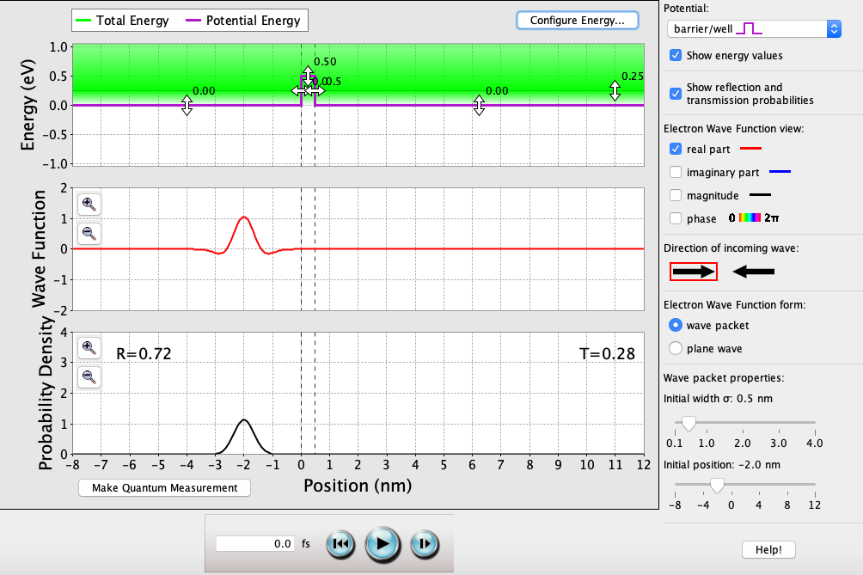

Single Well Example (E < V₂) [cont.]
Since E < V₂, then T = (1 + [V₂² sinh²(k_{0.5}a)]/[4E(V₂ - E)])⁻¹
k_{0.5} = √[2m_{e}[V₂ - E] / ħ²])
NOTE: This means transmission is still possible when E < V₂ (quantum tunneling)
The transmission probability is inversely proportional to the width of the barrier

Slide 12


Single Well Example (E < V₂) [cont.]
The transmission probability (due to quantum tunneling) is also inversely proportional to the height of the barrier

Slide 13
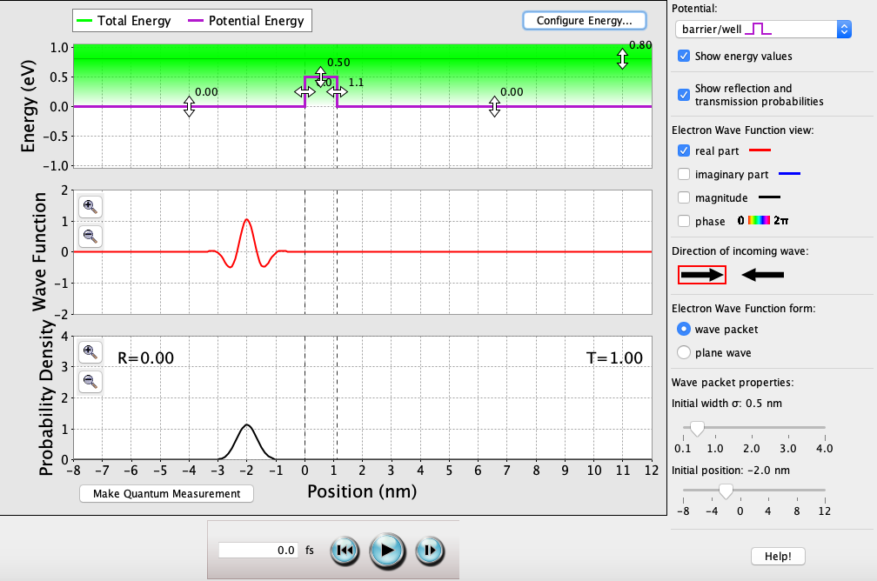
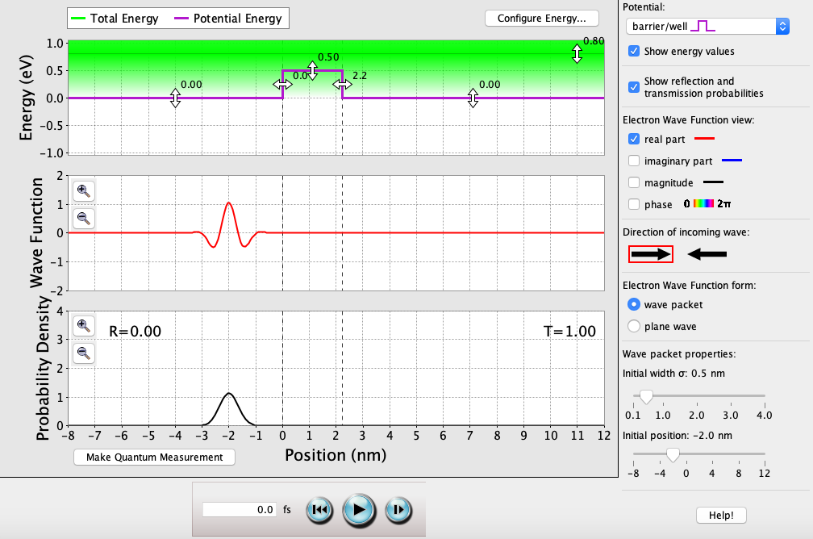
Single Well Example (E > V₂)
As long as E > V₂, the perfect transmission probability oscillates with each solution of k_{0.5}a = nπ → n = k_{0.5}a/π
k_{0.5} = √[2m_{e}[E – V₂] / ħ²])
NOTE: This means reflection is still possible when E > V₂

Slide 14
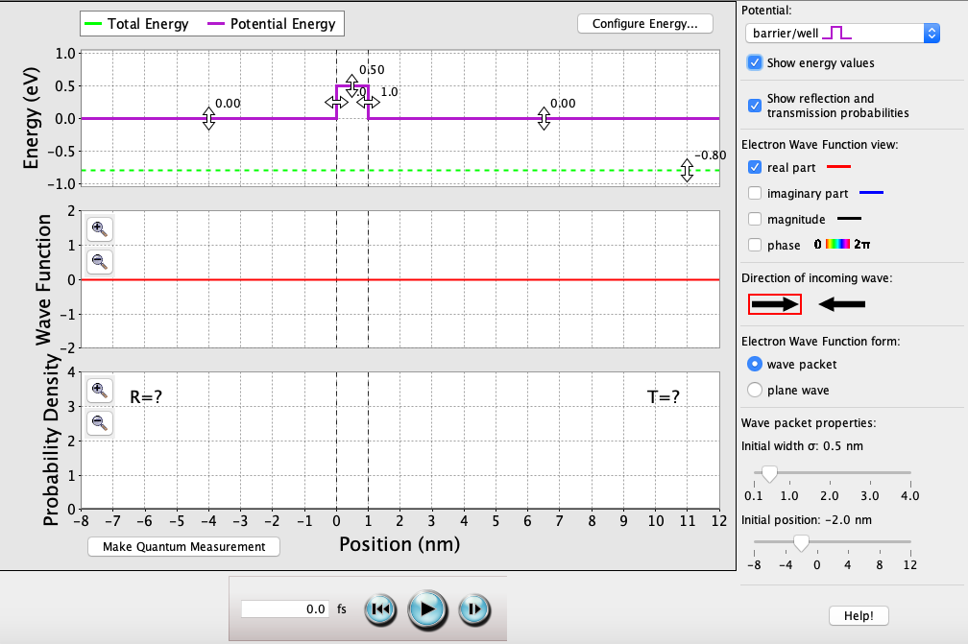
Single Well Example (E < V₁, V₂, V₃)
As long as E is less than all of V₁, V₂, & V₃, the electron will never exist within these bounds
This is because the barrier width approaches ∞ nm (the maximum width to realistically quantum tunnel is around 3nm >)

Slide 15
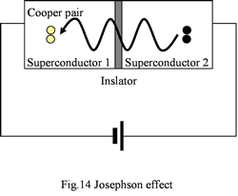
Applications of Tunneling
Josephson junctions, which consist of a very thin insulation barrier sandwiched between two superconductors
Used in superconducting quantum interference devices (SQuIDs, used in precision magnetic measurements)
Also used in superconducting qubits (used in quantum computing)

Slide 16
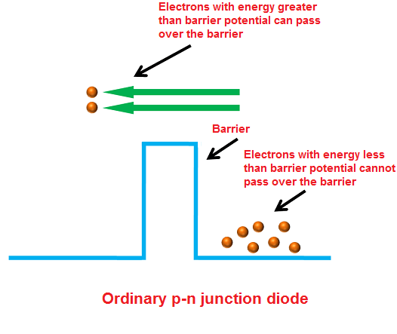
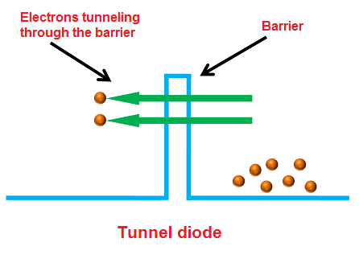
Applications of Tunneling (cont.)
Tunnel diodes, which consist of a heavily doped p-n junction and thus, has a negative resistance
Heavy doping produces a narrow depletion region (which is a potential barrier that, if narrow enough, electrons can tunnel through)
High speed of operation, can withstand high nuclear radiations/magnetic fields, low temperature use, low cost to produce, long life, low noise
Can be function at microwave frequencies, used in military sonars/radars, memory storage, satellite communication

Slide 17
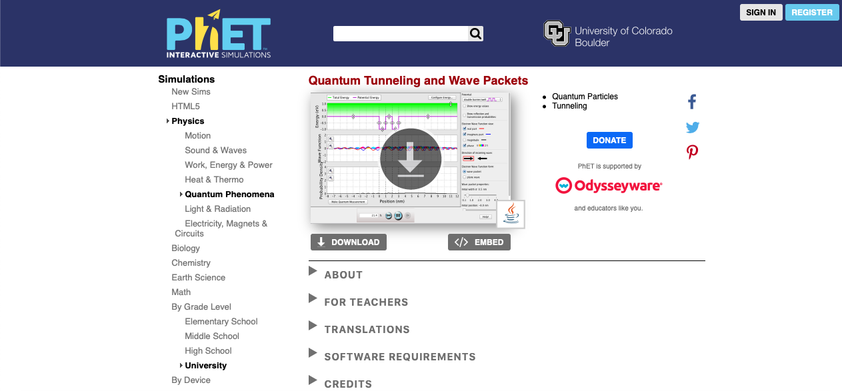
Conclusions
Quantum tunneling is an important, fundamental concept in the study of quantum mechanics, semiconductor physics, quantum biology, astrophysics, etc.
Though a complex concept, can be understood with the help of visualization testing software (Quantum Tunneling & Wave Packets by PhET)

