Slide 1
Hypothesis Testing

Slide 2
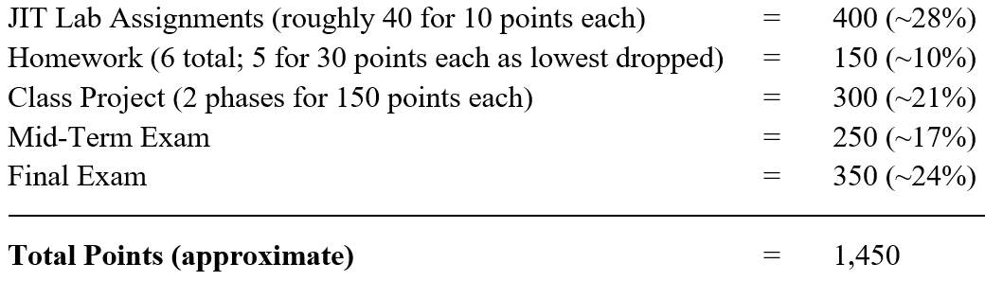
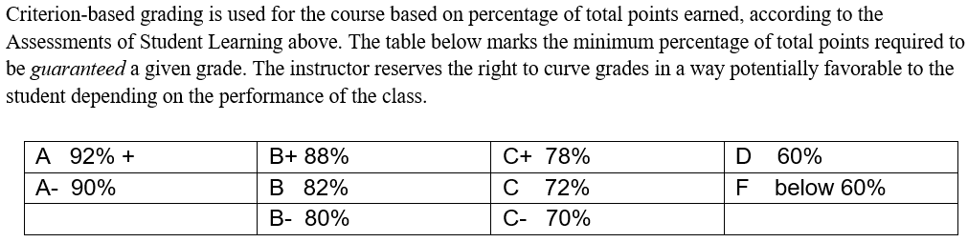
Course Points & Grading (from Syllabus)

Slide 3
Midterm checkpoint
Midterm scores
Midterm grade distribution
Measure | Points | %
Minimum | 20 | 8.0%
Q1 | 130 | 52.0%
Median | 170 | 68.0%
Q3 | 200 | 80.0%
Max | 250 | 100.0%
Current Canvas % Total Points - Bottom | Current Canvas % Total Points - Top | Current Grade
88.94% | 100.00% | A
87.12% | 88.79% | A-
84.09% | 86.36% | B+
74.24% | 83.79% | B
72.73% | 72.73% | B-
61.21% | 62.88% | C
Improving your grade requires:
Staying on top of in-class labs, homework, and group project.
These can really pull up a bad test score!
Doing well on the Final Exam
Reflect on your study habits and consider what could have improved. Examples include: practicing on all labs/homeworks, treating the practice exam as the real exam, etc.
If you did poorly on the Midterm Exam, figure out why and how you can improve

Slide 4
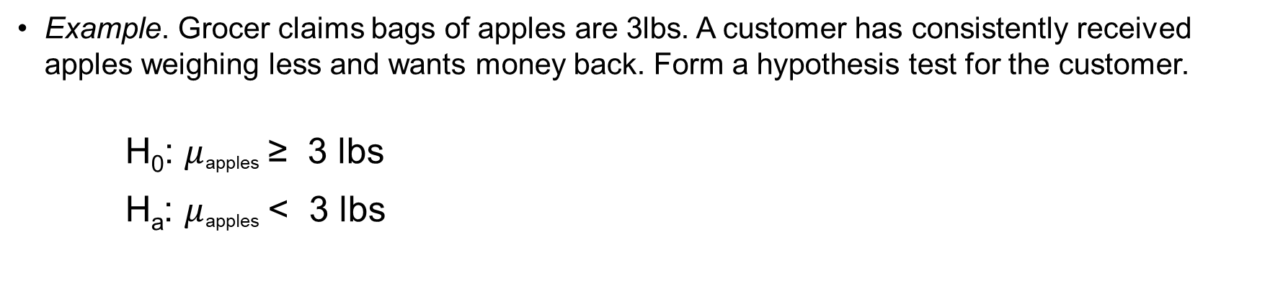
Hypothesis testing - basics
Another way to consider: as a “researcher” you only have a job if show something “interesting” in Ha, which is “alternative” to the “status quo” of H₀
Research (alternative) hypothesis (denoted H_{a})
What the researcher wants to gather evidence to support about the population parameter
Recommend specifying this first
Null hypothesis (denoted H₀)
The “status quo” before the researcher’s test
The opposite of what the researcher wants to show (not believed and why called “null”)
Example. Grocer claims bags of apples are 3lbs. A customer has consistently received apples weighing less and wants money back. Form a hypothesis test for the customer.
H₀: $μ$_{apples} ≥ 3 lbs
H_{a}: $μ$_{apples} < 3 lbs
Write as opposite of H_{a}
Always written in terms of population parameter
Write first based on what trying to show

Slide 5
Key Principles in Hypothesis Testing
Straw man approach – the researcher thinks the null hypothesis is wrong (why it is called “null”), so poses H₀ as a “strawman” to reject in favor of H_{a} based on data
Rare event approach – the researcher shows the null hypothesis is wrong by showing it is statistically unlikely with the data (data observed is “rare”)
We use a p-value to determine the probability such extreme data could have occurred under the null hypothesis (in R, use pnorm for z and pt for t)
To determine whether the p-value is “rare”, we compare to a threshold of rarity
α is a “significance level” chosen before seeing data as the threshold of rarity
α describes the benchmark area in the tail(s) – e.g., .05 or .01
p-value describes the area in the tails, but based on the data
If p-value < α reject H₀
If p-value ≥ α fail to reject H₀
If probability of data occurring is “rarer” than threshold, reject the null

Slide 6
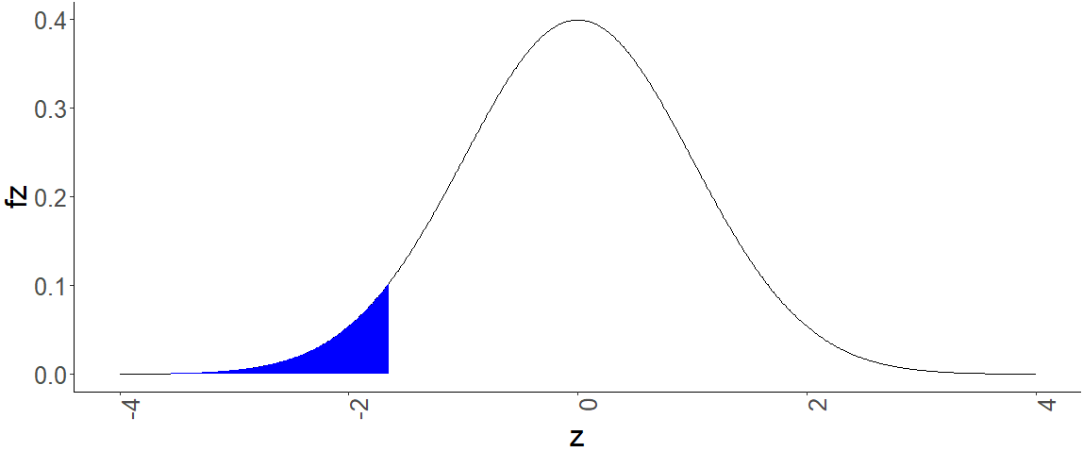

Rejection Region
Consider the example hypothesis before:
H₀: $μ$_{apples} ≥ 3 lbs
H_{a}: $μ$_{apples} < 3 lbs
Using an α = .05 significance level, how do we decide which hypothesis is right?
Set a rejection region from z_{α}
If the observed test statistic z_{obs} falls in that area then the researcher can reject the status quo of H₀ and conclude H_{a}
Observed test
statistic z_{obs}
In p-value language:
Shaded area of z_{obs} < shaded area of z_{α} → reject (rare)
Shaded area of z_{obs} > shaded area of z_{α} then fail to reject (not rare)
Reject H₀
(p-value < α)
Fail to Reject H₀ (p-value ≥ α )
z_{α}

Slide 7
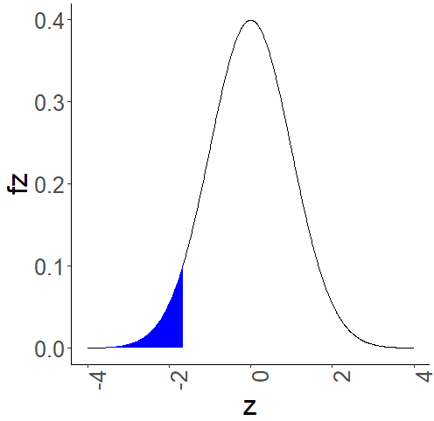
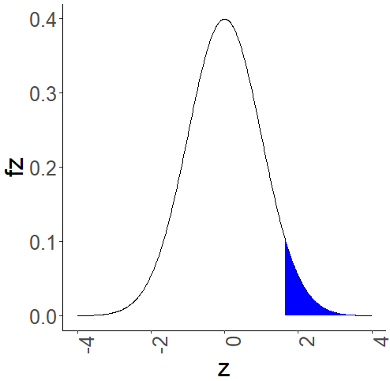
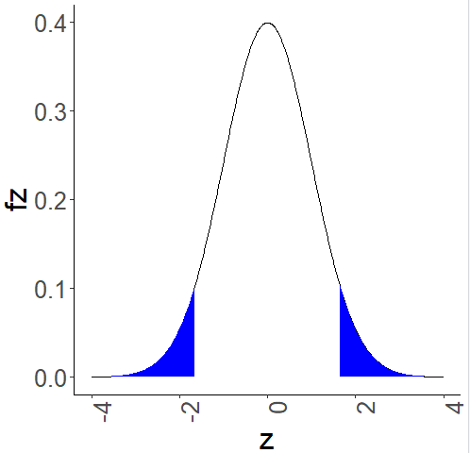
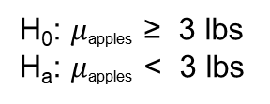
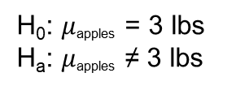
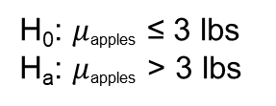
Three types of Hypothesis tests
One-tail, lower tail
(Rejection region in left tail)
One-tail, upper tail
(Rejection region in right tail)
Two-tail
(Rejection region in both tails)
H₀: $μ$_{apples} ≥ 3 lbs
H_{a}: $μ$_{apples} < 3 lbs
H₀: $μ$_{apples} ≤ 3 lbs
H_{a}: $μ$_{apples} > 3 lbs
H₀: $μ$_{apples} = 3 lbs
H_{a}: $μ$_{apples} ≠ 3 lbs
One way to remember: the arrow of H_{a} “points” to the rejection region
Technical note: Hypothesis tests can also be written with only equality in H₀. Either equality only or inequalities in H₀ are ok for this class.

Slide 8
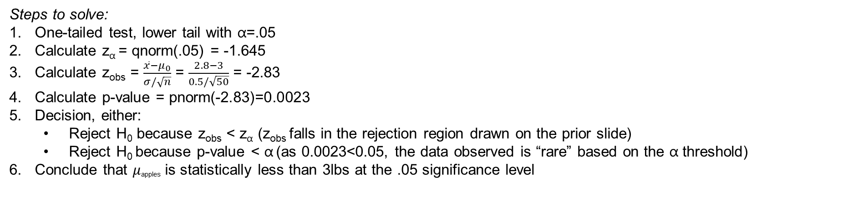

Applying Hypothesis Testing
Example. Grocer claims bags of apples are 3lbs. A customer has consistently received apples weighing less and wants money back. Form a hypothesis test for the customer.
H₀: $μ$_{apples} ≥ 3 lbs
H_{a}: $μ$_{apples} < 3 lbs
Now, suppose the customer has a sample of 50 trips to the grocery store and observes a sample mean of 2.8lbs per bag and a sample standard deviation of 0.5lbs per bag. Does she have ample evidence to sue the grocer at a 0.05 significance level?
Steps to solve:
One-tailed test, lower tail with α=.05
Calculate z_{α} = qnorm(.05) = -1.645
Calculate z_{obs} = $\frac{\overline{x}−μ_{0}}{σ/\sqrt{n}}$ = $\frac{2.8−3}{0.5/\sqrt{50}}$ = -2.83
Calculate p-value = pnorm(-2.83)=0.0023
Decision, either:
Reject H₀ because z_{obs} < z_{α} (z_{obs} falls in the rejection region drawn on the prior slide)
Reject H₀ because p-value < α (as 0.0023<0.05, the data observed is “rare” based on the α threshold)
Conclude that $μ$_{apples} is statistically less than 3lbs at the .05 significance level
Recommend p-value approach to avoid step 2

Slide 9
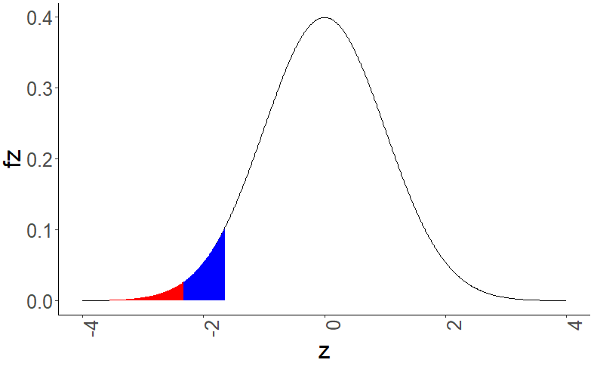

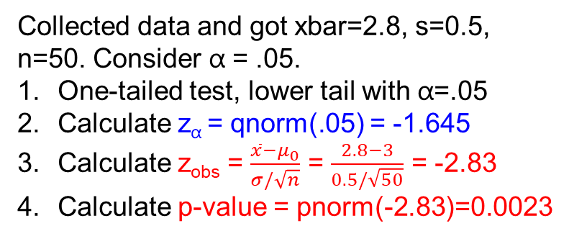
Graphically, z_{α} vs. z_{obs} vs. p-value
Consider the example hypothesis before:
H₀: $μ$_{apples} ≥ 3 lbs
H_{a}: $μ$_{apples} < 3 lbs
Collected data and got xbar=2.8, s=0.5, n=50. Consider α = .05.
One-tailed test, lower tail with α=.05
Calculate z_{α} = qnorm(.05) = -1.645
Calculate z_{obs} = $\frac{\overline{x}−μ_{0}}{σ/\sqrt{n}}$ = $\frac{2.8−3}{0.5/\sqrt{50}}$ = -2.83
Calculate p-value = pnorm(-2.83)=0.0023
Reject H₀
(p-value < α or
z_{obs}<z_{α})
Red area:
p-value=.0023
Blue area:
α=.05
Observed test
statistic
z_{obs}=-2.83
z_{α}=-1.645
Critical value for α rejection region

Slide 10
Statistical vs. Practical Significance
Statistical significance is based on the results of the hypothesis test according to α (black and white)
Example: the bag of apples statistically weighed less than the grocer claimed at .05 significance
Statistical significance = the likelihood of a Type I error (more next slide)
Practical significance is based on the application (less black and white)
Example: is it worth suing over a bag of apples? How much money could you realistically ask for if there is a 0.2lbs difference?
Business managers consider both types of significance

Slide 11
Type I vs. Type II Error
Type I error is the probability of rejecting the null hypothesis but H₀ is true
Small levels of α such as .01 and .05 to ensure that we are confident in making conclusions
Type II error is the probability of not rejecting the null hypothesis when H_{a} is true
Measured by β, typically set at 0.20
Most common way of reducing Type II error is increasing the sample size
In US court system, “innocent until proven guilty,” so H₀ is innocent and H_{a} is guilty
Type I error would be the equivalent of convicting an innocent person in court (less ok, lower α)
Type II error would be equivalent to the jury finding a guilty person as innocent (more ok, higher β)
Decision
 | Reject H₀ | Do not reject H₀
H₀ is true | X Type I Error | ✓ Correct Decision
H₀ is false | ✓ Correct Decision | X Type II error
True state

Slide 12
General Approach
Formulate the null and alternative hypotheses
Is this a one-tailed or two-tailed? Lower-tail or upper-tail?
Calculate the observed statistic based on the data (t_{obs} or z_{obs})
Choose p-value approach or critical value approach
P-value approach
Calculate the area in the appropriate tail(s) based on H_{a}, using pnorm(zobs) or pt(tobs,df=n-1)
If p-value < α reject H₀; if p-value ≥ α fail to reject H₀
Critical value approach:
Calculate the critical value(s) for the rejection region based on H_{a}, using qnorm for z_{α} or qt for t_{α}
If z_{obs} or t_{obs} is in the rejection region, reject H₀; otherwise fail to reject H₀
Make a conclusion based on rejecting/failing to reject H₀

Slide 13
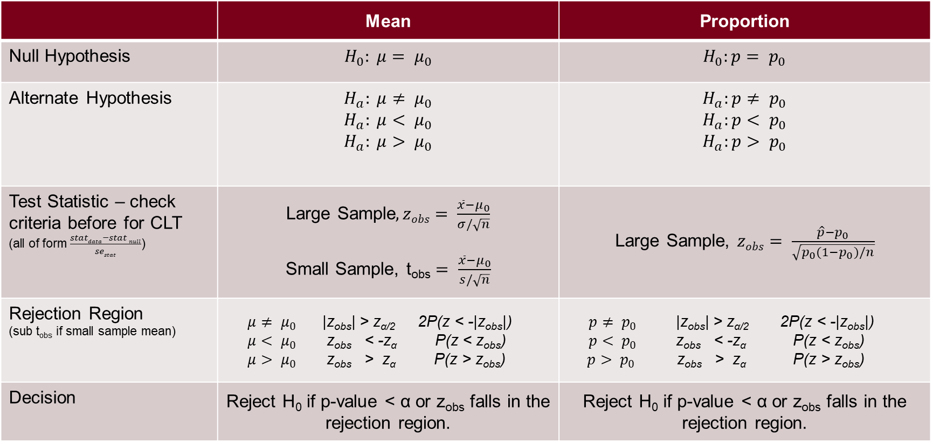
Hypothesis Testing Overview
 | Mean | Proportion
Null Hypothesis | $$H_{0}: μ= μ_{0}$$ | $$H_{0}:p= p_{0}$$
Alternate Hypothesis | $$H_{a}: μ≠ μ_{0}$$ $$H_{a}: μ< μ_{0}$$ $$H_{a}: μ> μ_{0}$$ | $$H_{a}:p≠ p_{0}$$ $$H_{a}:p< p_{0}$$ $$H_{a}:p> p_{0}$$
Test Statistic – check criteria before for CLT (all of form $\frac{statdata−stat null}{sestat}$) | Large Sample$,zobs= \frac{\overline{x}−μ_{0}}{σ/\sqrt{n}}$ Small Sample, t_{obs} $= \frac{\overline{x}−μ_{0}}{s/\sqrt{n}}$ | Large Sample, $zobs= \frac{\hat{p}−p_{0}}{\sqrt{p_{0}(1−p_{0})/n}}$
Rejection Region (sub t_{obs} if small sample mean) | $μ≠ μ_{0}$ |z_{obs}| > z_{α/2} 2P(z < -|z_{obs}|) $μ< μ_{0}$ z_{obs} < -z_{α} P(z < z_{obs}) $μ> μ_{0}$ z_{obs} > z_{α} P(z > z_{obs}) | $p≠ p_{0}$ |z_{obs}| > z_{α/2} 2P(z < -|z_{obs}|) $p< p_{0}$ z_{obs} < -z_{α} P(z < z_{obs}) $p> p_{0 }$ z_{obs} > z_{α} P(z > z_{obs})
Decision | Reject H₀ if p-value < α or z_{obs} falls in the rejection region. | Reject H₀ if p-value < α or z_{obs} falls in the rejection region.

Slide 14
Calculating p-values in R (after calculating the test statistic)
z statistic
###One-tail, lower tail
pnorm( zobs )
###One-tail, upper tail
1-pnorm( zobs )
###Two-tailed
2*pnorm( -abs(zobs) )
t statistic
###One-tail, lower tail
pt( tobs, df=n-1 )
###One-tail, upper tail
1-pt( tobs, df=n-1 )
###Two-tailed
2*pt( -abs(tobs), df=n-1 )

Slide 15
Hypothesis Test for Mean Large Sample

Slide 16
Hypothesis Testing Overview – Large Sample
 | Mean | Proportion
Null Hypothesis | $$H_{0}: μ= μ_{0}$$ | $$H_{0}:p= p_{0}$$
Alternate Hypothesis | $$H_{a}: μ≠ μ_{0}$$ $$H_{a}: μ< μ_{0}$$ $$H_{a}: μ> μ_{0}$$ | $$H_{a}:p≠ p_{0}$$ $$H_{a}:p< p_{0}$$ $$H_{a}:p> p_{0}$$
Test Statistic – check criteria before for CLT (all of form $\frac{statdata−stat null}{sestat}$) | Large Sample$,zobs= \frac{\overline{x}−μ_{0}}{σ/\sqrt{n}}$ Small Sample, t_{obs} $= \frac{\overline{x}−μ_{0}}{s/\sqrt{n}}$ | Large Sample, $zobs= \frac{\hat{p}−p_{0}}{\sqrt{p_{0}(1−p_{0})/n}}$
Rejection Region (sub t_{obs} if small sample mean) | $μ≠ μ_{0}$ |z_{obs}| > z_{α/2} 2P(z < -|z_{obs}|) $μ< μ_{0}$ z_{obs} < -z_{α} P(z < z_{obs}) $μ> μ_{0}$ z_{obs} > z_{α} P(z > z_{obs}) | $p≠ p_{0}$ |z_{obs}| > z_{α/2} 2P(z < -|z_{obs}|) $p< p_{0}$ z_{obs} < -z_{α} P(z < z_{obs}) $p> p_{0 }$ z_{obs} > z_{α} P(z > z_{obs})
Decision | Reject H₀ if p-value < α or z_{obs} falls in the rejection region. | Reject H₀ if p-value < α or z_{obs} falls in the rejection region.

Slide 17
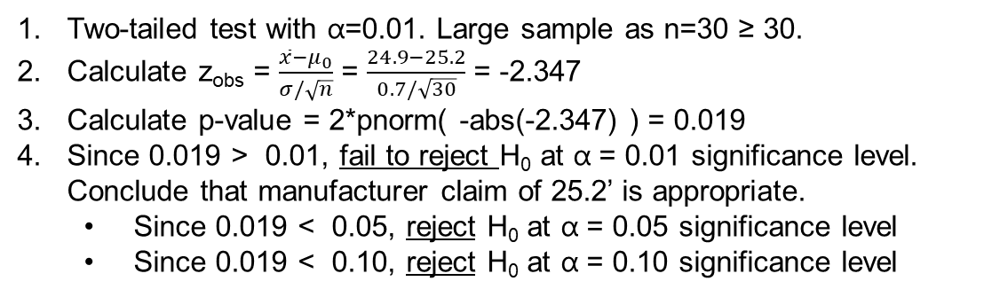

Application – Hypothesis Test for Mean, Large Sample
A plastic wrap manufacturer claims true mean of 25.2’ per roll with population standard deviation of 0.7’. An auditor finds a random sample of n=30 boxes with a sample mean of 24.9’.
Test whether the true mean length of plastic wrap is significantly different than 25.2’ at the 0.01 alpha level.
What about at the 0.05 level? 0.10 level?
H₀: $μ$_{wrap} = 25.2 lbs
H_{a}: $μ$_{wrap} ≠ 25.2 lbs
Two-tailed test with α=0.01. Large sample as n=30 ≥ 30.
Calculate z_{obs} = $\frac{\overline{x}−μ_{0}}{σ/\sqrt{n}}$ = $\frac{24.9−25.2}{0.7/\sqrt{30}}$ = -2.347
Calculate p-value = 2*pnorm( -abs(-2.347) ) = 0.019
Since 0.019 > 0.01, fail to reject H₀ at α = 0.01 significance level. Conclude that manufacturer claim of 25.2’ is appropriate.
Since 0.019 < 0.05, reject H₀ at α = 0.05 significance level
Since 0.019 < 0.10, reject H₀ at α = 0.10 significance level
Reject H₀ α/2=.005
Do Not Reject H₀
Reject H₀ α/2=.005
R Script
#pvalue approach
xbar <- 24.9; mu0 <-25.2; sigma <- 0.7; n <- 30
se <- sigma / sqrt(n)
zobs <- (xbar-mu0)/se
pvalue <- 2*pnorm( - abs( zobs ) )
pvalue
[1] 0.01890584
R Script
#crit value approach
xbar <- 24.9; mu0 <-25.2; sigma <- 0.7; n <- 30
se <- sigma / sqrt(n)
zobs <- (xbar-mu0)/se # -2.35
alpha<- 0.01; zalpha<-qnorm(alpha/2) #-2.58
alpha<-.05; zalpha<-qnorm(alpha/2) # -1.96
alpha<-.10; zalpha<-qnorm(alpha/2) # -1.65

Slide 18
JIT 21 – Hypothesis Test for mean μ, large sample
The true mean stopping distance for an automobile has been 65’. A new brake system has been developed – determine if it is more effective than the old. Take n = 64 observations, x bar is 63.5’. Assume sigma is known and the same as the old at 4.0’.
Set up Ho and Ha in terms of the business application.
Test at the 0.05 level of significance. Show all steps: set up the null and alternative hypothesis and make a determination based on the p-value approach. Show the calculations in R.
Identify Type I and II errors and potential costs. Which is worse? Do you think a small (.01), medium (.05), or large (.10) alpha is more appropriate?
(If you have extra time, try the critical value approach for part b)

Slide 19
Hypothesis Test for Mean Small Sample

Slide 20
Hypothesis Testing Overview – Small Sample
 | Mean | Proportion
Null Hypothesis | $$H_{0}: μ= μ_{0}$$ | $$H_{0}:p= p_{0}$$
Alternate Hypothesis | $$H_{a}: μ≠ μ_{0}$$ $$H_{a}: μ< μ_{0}$$ $$H_{a}: μ> μ_{0}$$ | $$H_{a}:p≠ p_{0}$$ $$H_{a}:p< p_{0}$$ $$H_{a}:p> p_{0}$$
Test Statistic – check criteria before for CLT (all of form $\frac{statdata−stat null}{sestat}$) | Large Sample$,zobs= \frac{\overline{x}−μ_{0}}{σ/\sqrt{n}}$ Small Sample, t_{obs} $= \frac{\overline{x}−μ_{0}}{s/\sqrt{n}}$ | Large Sample, $zobs= \frac{\hat{p}−p_{0}}{\sqrt{p_{0}(1−p_{0})/n}}$
Rejection Region (sub t_{obs} if small sample mean) | $μ≠ μ_{0}$ |z_{obs}| > z_{α/2} 2P(z < -|z_{obs}|) $μ< μ_{0}$ z_{obs} < -z_{α} P(z < z_{obs}) $μ> μ_{0}$ z_{obs} > z_{α} P(z > z_{obs}) | $p≠ p_{0}$ |z_{obs}| > z_{α/2} 2P(z < -|z_{obs}|) $p< p_{0}$ z_{obs} < -z_{α} P(z < z_{obs}) $p> p_{0 }$ z_{obs} > z_{α} P(z > z_{obs})
Decision | Reject H₀ if p-value < α or z_{obs} falls in the rejection region. | Reject H₀ if p-value < α or z_{obs} falls in the rejection region.

Slide 21
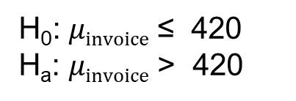
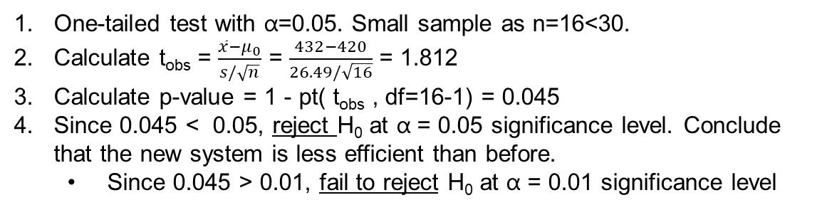
Application – Hypothesis Test for Mean, Small Sample
Accounts payable measures time it takes to pay an invoice has historically taken seven minutes (420 seconds). Assume the population is approximately normal. A financial analyst measures recent data from a new system of n=16 observations, x bar = 432, s = 26.49 seconds. Test at the 0.05 level whether a new financial system makes the process less efficient. What about the 0.01 level?
H₀: $μinvoice$ ≤ 420
H_{a}: $μinvoice$ > 420
One-tailed test with α=0.05. Small sample as n=16<30.
Calculate t_{obs} = $\frac{\overline{x}−μ_{0}}{s/\sqrt{n}}$ = $\frac{432−420}{26.49/\sqrt{16}}$ = 1.812
Calculate p-value = 1 - pt( t_{obs} , df=16-1) = 0.045
Since 0.045 < 0.05, reject H₀ at α = 0.05 significance level. Conclude that the new system is less efficient than before.
Since 0.045 > 0.01, fail to reject H₀ at α = 0.01 significance level
R Script
#pvalue approach
xbar <- 432; mu0 <-420; s <- 26.49; n <- 16
se <- s / sqrt(n)
tobs <- (xbar-mu0)/se
pvalue <- 1-pt( tobs , df=n-1) # 0.045
R Script
#critical value approach
xbar <- 432; mu0 <-420; s <- 26.49; n <- 16
se <- s / sqrt(n)
tobs <- (xbar-mu0)/se
alpha<-.05; talpha<-qt(1-alpha,n-1) #1.753
alpha<-.01; talpha<-qt(1-alpha,n-1) #2.602
Do Not Reject H₀
Reject H₀ α=.05
Same conclusion under either approach.

Slide 22
JIT 22 – Hypothesis Test for mean µ, small sample
Gas mileage for a Toyota Camry has averaged 30 mpg in the past. A new gasoline additive claims to significantly improve gas mileage. To test, there are n = 20 trials, x bar = 34.6 mpg, s = 18 mpg. Assume the population of mpg is approximately normal.
Test at the 0.10 level of significance. Show all steps: set up the null and alternative hypothesis and make a determination based on the p-value approach. Show the calculations in R.
(If you have extra time, try the critical value approach)

Slide 23
Hypothesis Test for Proportion (Large Sample Only – Check CLT)

Slide 24
Hypothesis Testing Overview - Proportion
 | Mean | Proportion
Null Hypothesis | $$H_{0}: μ= μ_{0}$$ | $$H_{0}:p= p_{0}$$
Alternate Hypothesis | $$H_{a}: μ≠ μ_{0}$$ $$H_{a}: μ< μ_{0}$$ $$H_{a}: μ> μ_{0}$$ | $$H_{a}:p≠ p_{0}$$ $$H_{a}:p< p_{0}$$ $$H_{a}:p> p_{0}$$
Test Statistic – check criteria before for CLT (all of form $\frac{statdata−stat null}{sestat}$) | Large Sample$,zobs= \frac{\overline{x}−μ_{0}}{σ/\sqrt{n}}$ Small Sample, t_{obs} $= \frac{\overline{x}−μ_{0}}{s/\sqrt{n}}$ | Large Sample, $zobs= \frac{\hat{p}−p_{0}}{\sqrt{p_{0}(1−p_{0})/n}}$
Rejection Region (sub t_{obs} if small sample mean) | $μ≠ μ_{0}$ |z_{obs}| > z_{α/2} 2P(z < -|z_{obs}|) $μ< μ_{0}$ z_{obs} < -z_{α} P(z < z_{obs}) $μ> μ_{0}$ z_{obs} > z_{α} P(z > z_{obs}) | $p≠ p_{0}$ |z_{obs}| > z_{α/2} 2P(z < -|z_{obs}|) $p< p_{0}$ z_{obs} < -z_{α} P(z < z_{obs}) $p> p_{0 }$ z_{obs} > z_{α} P(z > z_{obs})
Decision | Reject H₀ if p-value < α or z_{obs} falls in the rejection region. | Reject H₀ if p-value < α or z_{obs} falls in the rejection region.

Slide 25
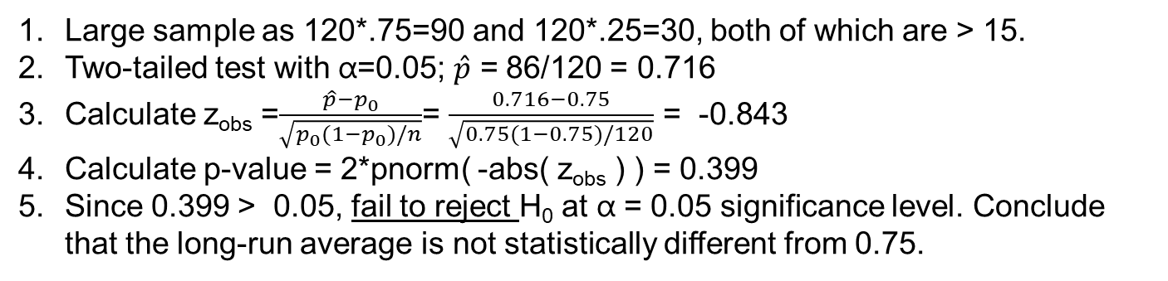
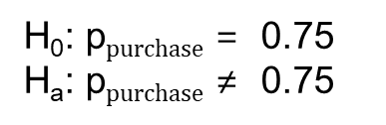
Application – Hypothesis Test for Proportion, Large Sample
Customer delight is defined as responses on a 7 point likert scale that are ‘likely’ (6) or ‘highly likely’ (7) to purchase again. A sample of n = 120 customers is taken and x = 86 customers are likely or highly likely to purchase again.
Is this significantly different than the long-run proportion of 0.75? Test at the 0.05 level of significance.
H₀: p$purchase$ = 0.75
H_{a}: p$purchase$ ≠ 0.75
Large sample as 120*.75=90 and 120*.25=30, both of which are > 15.
Two-tailed test with α=0.05; $\hat{p}$ = 86/120 = 0.716
Calculate z_{obs} =$\frac{\hat{p}−p_{0}}{\sqrt{p_{0}(1−p_{0})/n}}$= $\frac{0.716−0.75}{\sqrt{0.75(1−0.75)/120}}$ = -0.843
Calculate p-value = 2*pnorm( -abs( z_{obs} ) ) = 0.399
Since 0.399 > 0.05, fail to reject H₀ at α = 0.05 significance level. Conclude that the long-run average is not statistically different from 0.75.
Reject H₀ α/2=.025
Do Not Reject H₀
Reject H₀ α/2=.025
R Script
p0 <- 0.75; phat <- 86/120; n <- 120 #inputs same line with ;
se <- sqrt( p0 * (1-p0) / n)
zobs <- (phat-p0)/se
pvalue <- 2*pnorm( -abs(zobs) )
print(pvalue)
[1] 0.3990752

Slide 26
JIT 23 – Hypothesis Testing for p
The CEO at a cell phone carrier is pushing an initiative to offer Voice-Over-Internet-Protocol (VOIP) to consumers, but the CFO will only approve purchase of the technology if enough consumers are willing to enroll in an upgraded VOIP service plan to justify the cost of the technology. If the true proportion of consumers that enroll in VOIP is greater than 1/3, then the CFO will approve the CEO’s initiative.
The CEO tasks the marketing department to form a consumer focus group, resulting in a sample of n=60 customers where 31 stated they would enroll in VOIP. Based on this sample, test at the .01 level whether enough customers will be willing to enroll. Show the calculations in R.
Assess both the statistical significance and practical significance of the hypothesis test.

