Slide 1

Determining
IMDb Movie Ratings using Machine Learning
Dayton Wu and Upama Ferdousi

Slide 2

Why did you choose this topic?
We are interested to learn how IMDb movie ratings are impacted by various features.
In this project we will be working with IMDb dataset from Kaggle. We will focus on IMDb movie ratings as the target.

Slide 3
What are the sources of data?
We extracted movie data from Kaggle and also performed web scraping on the Reelgood movie site. We pulled movie listings dating between 1902 to 2020. It includes:
Movie Titles
Genres
Age Group
Directors
Runtime
IMDb ratings
Platforms
Year
Country of Release
And more…

Slide 4
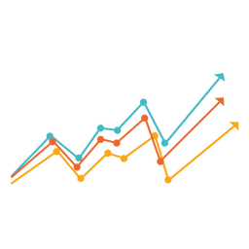
Questions the team hopes to answer...
Through our analysis, we want to answer which feature had the most significant impact on IMDb ratings.

Slide 5

Our Hypothesis...
Based on the observed data, our initial hypothesis was that ‘Runtime’ will have a significant impact on the IMDb score.

Slide 6

Steps to Data Analysis...
Data Acquisition and Cleaning
Features and models
Testing and training
The Results

Slide 7
Method of Data Analysis
Data extraction
Web scraping (Splinter, HTML, Beautiful Soup)
EDA (pandas, numpy, sqlalchemy)
Data Models (sklearn.RandomForestClassifier, sklearn.LinearRegression)
Data visualization (seaborn, matplotlib)

Slide 8
Challenges...
During our analysis, we came to learn that the dataset pulled from Kaggle had many null values.
Solution: To avoid any setbacks we first performed web scraping from the Reelgood movie site to fill in some of the missing values and we also used placeholders to improve our accuracy results.

Slide 9
Results
https://daytwu.github.io/Movies_Analysis/

Slide 10
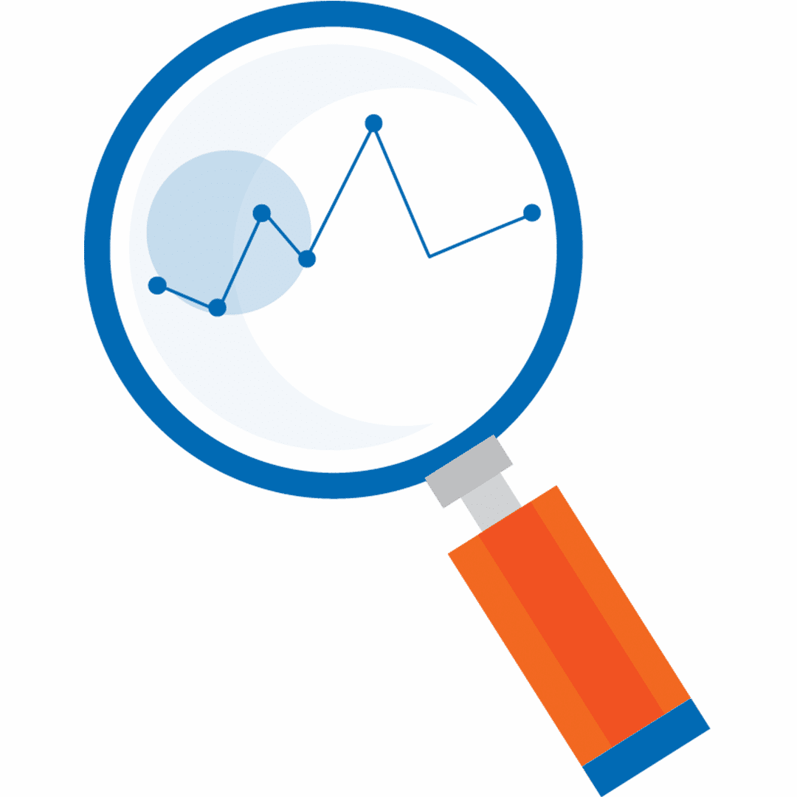
Recommendation For Future Analysis
For future analysis, it would be interesting to find out the significance of the features filtered by country as this dataset focused on movies around the world. We are interested to learn about movies released in the U.S.

Slide 11

Something we could have done differently…
If we had the opportunity to redo this project, we would have used additional dataset from various other reliable sources for a more effective analysis.

Slide 12

Technology, languages, and tools…
Data Cleaning and Analysis
Pandas is used to cleanup and perform the data analysis
Language Python
SQL
HTML
JavaScript
CSS
Tools
Jupyter Notebook
PostgreSQL
Quick DBD

