Slide 1
Mini Project 2
Daria Zahaleanu

Slide 2
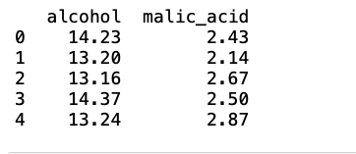
Data Preprocessing
Shrink data to 2 columns: alcohol and malic acid
No missing data
(178, 2) matrix

Slide 3
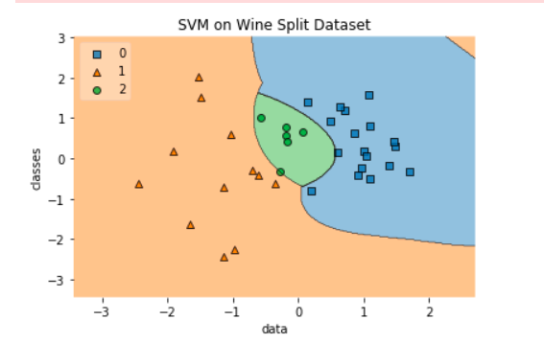
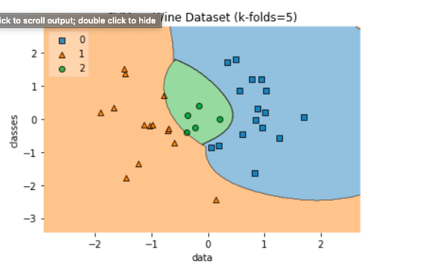
Training Method: Split Data vs Cross Validation

Slide 4
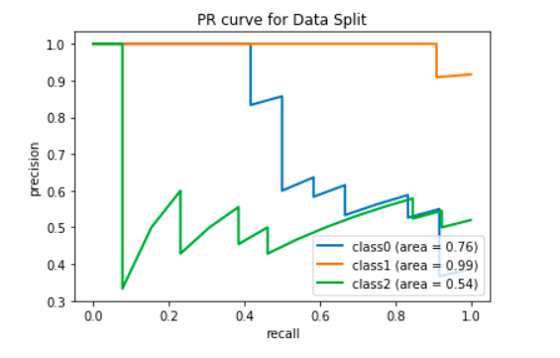
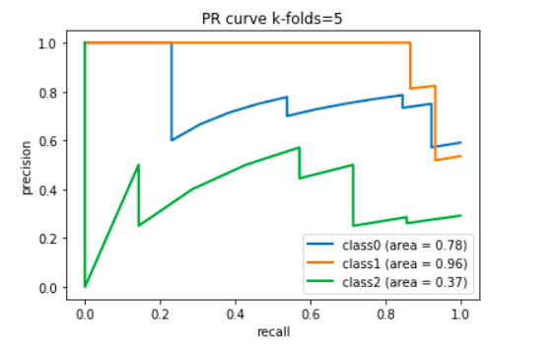
Training Method: Cross Validation

Slide 5
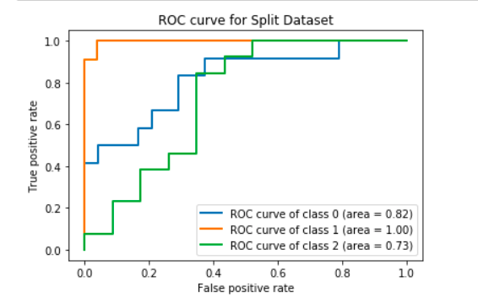
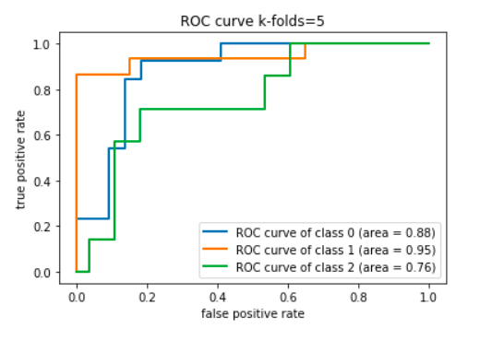
Training Method: Cross Validation

Slide 6
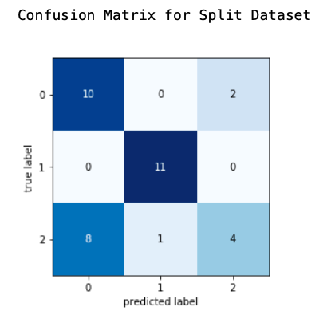
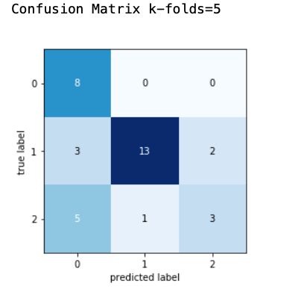
Training Method: Cross Validation

Slide 7
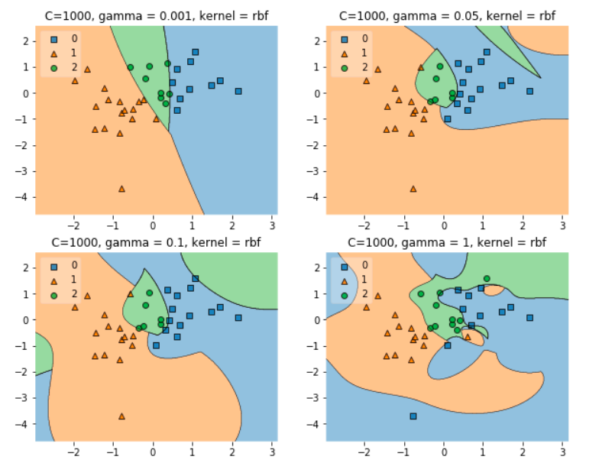
SVM Optimization for Cross-Validation

Slide 8
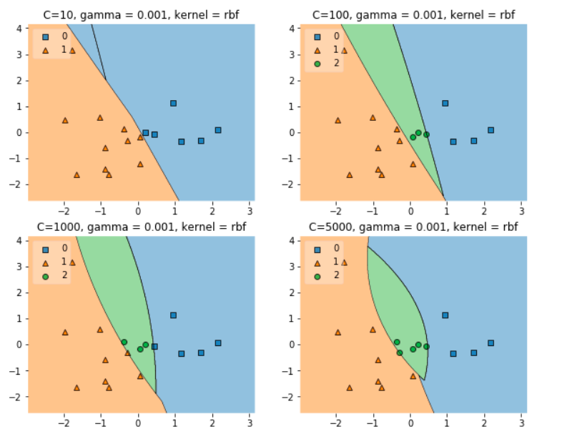
SVM Optimization for Cross-Validation

Slide 9
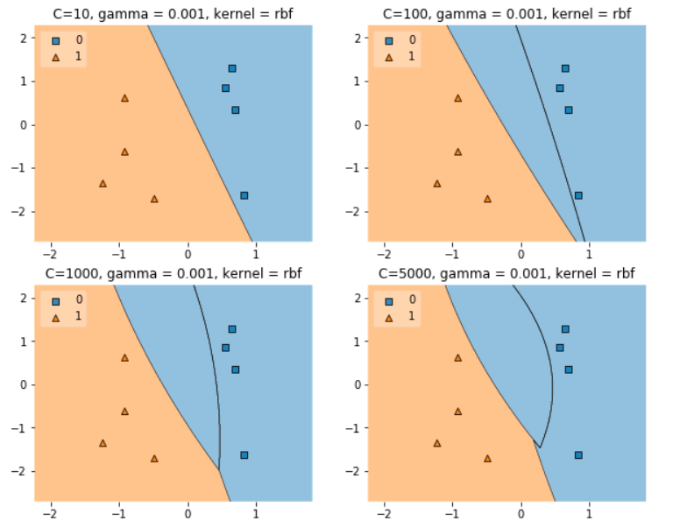
SVM Optimization for Cross-Validation

Slide 10
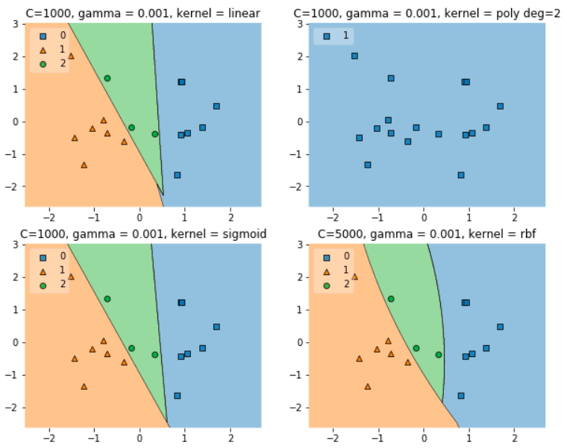
SVM Optimization for Cross-Validation

Slide 11
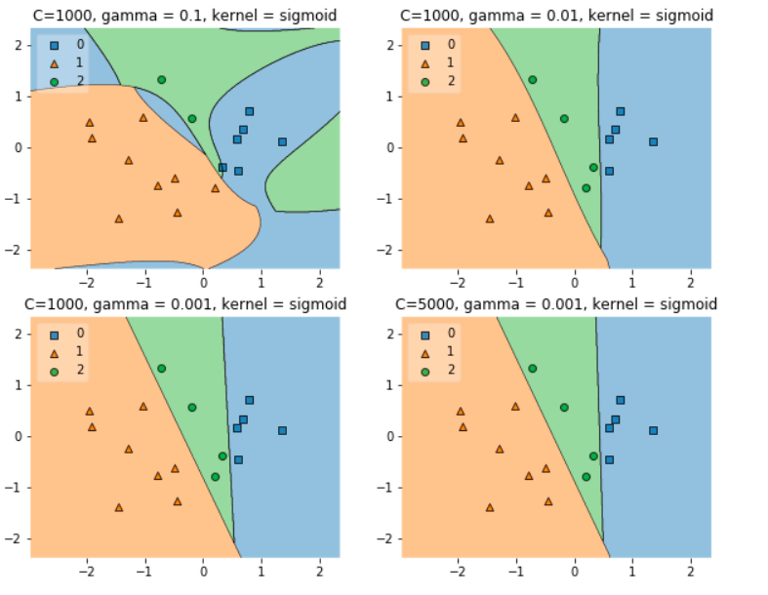
SVM Optimization for Cross-Validation

Slide 12
Best Candidates
C=1000, gamma = 0.001, kernel = SVC linear
C = 5000, gamma = 0.001, kernel = rbf, 10 k-folds

Slide 13
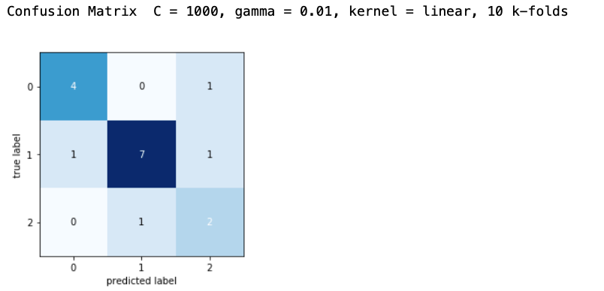
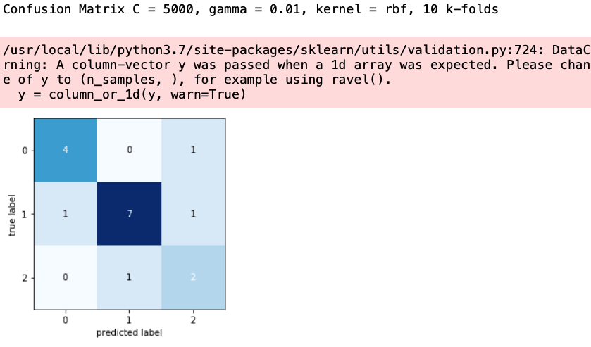
Best Candidates

Slide 14
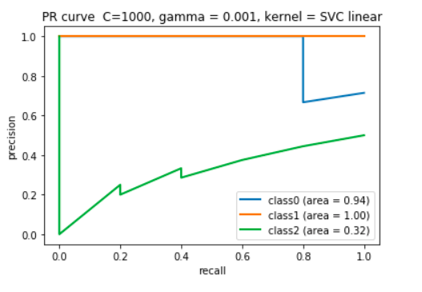
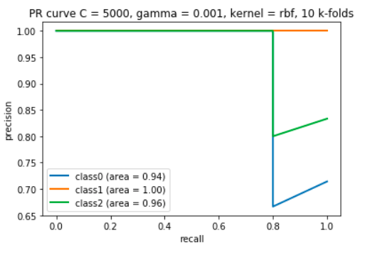
Best Candidates

Slide 15
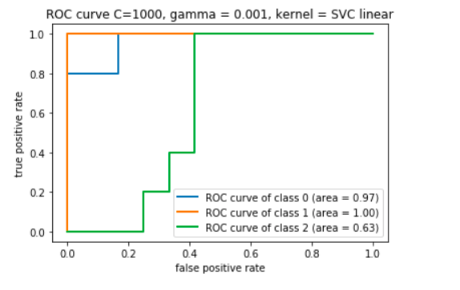
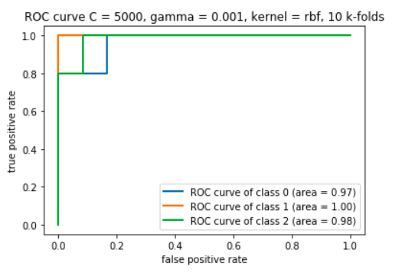
Best Candidates

