Slide 1

C Programming Basic – week 13
http://www.4shared.com/file/59509076/7652409/week13.html
String Pattern Matching
Lecturers :
Cao Tuan Dung
Le Duc Trung
Dept of Software Engineering
Hanoi University of Technology

Slide 2
Topics of this week
String pattern matching algorithms
  Naive algorithm
  Knuth-Morris-Pratt algorithm
  Boyer-Moore algorithm
Exercises
a
b
a
c
a
a
b
1
a
b
a
c
a
b
4
3
2
a
b
a
c
a
b

Slide 3
String matching problem
Let P be a string of size m
  A substring P[i .. j] of P is the subsequence of P consisting of the characters with ranks between i and j
  A prefix of P is a substring of the type P[0 .. i]
  A suffix of P is a substring of the type P[i ..m − 1]
Given strings T (text) and P (pattern), the pattern matching problem consists of finding a substring of T equal to P
Applications:
  Text editors, Search engines, Biological research

Slide 4
Brute Force Matching
The brute-force pattern matching algorithm compares the pattern P with the text T for each possible shift of P relative to T, until either
  a match is found, or
  all placements of the pattern have been tried
Brute-force pattern matching runs in time O(nm)
Example of worst case:
  T = aaa … ah
  P = aaah
  may occur in images and DNA sequences
  unlikely in English text

Slide 5
Algorithm
Algorithm BruteForceMatch(T, P)
// Input text T of size n and pattern P of size m
// Output starting index of a substring of T equal to P or −1
if no such substring exists
for i ← 0 to n − m {
test shift i of the pattern
}
j ← 0
while j < m ∧ T[i + j] = P[j]
j ← j + 1
if j = m
return i {match at i}
else
break while loop {mismatch}
return -1 {no match anywhere}

Slide 6
Exercise 13.1
Make a random string that has about 2000 characters consisting of a set of characters..
For example:
  set of characters: abcdef
  string: abcadacaeeeffaadbfacddedcedfbeccae…
Write the program that searches the pattern, for example “aadbf”, from the string.
Note: use Simple searching string Algorithm

Slide 7
Boyer-Moore Heuristics
The Boyer-Moore’s pattern matching algorithm is based on two heuristics
Looking-glass heuristic: Compare P with a subsequence of T
moving backwards
Character-jump heuristic: When a mismatch occurs at T[i] = c
  If P contains c, shift P to align the last occurrence of c in P with T[i]
  Else, shift P to align P[0] with T[i + 1]

Slide 8
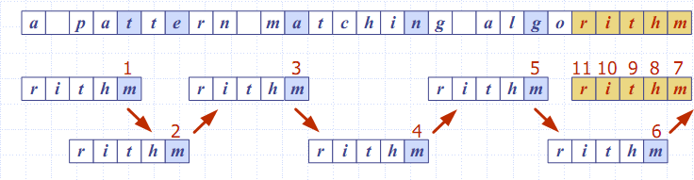
Example

Slide 9
Last-Occurrence Function
Boyer-Moore’s algorithm preprocesses the pattern P and the alphabet Σ to build the last-occurrence function L mapping Σ to integers, where L(c) is defined as
  the largest index i such that P[i] = c or
  −1 if no such index exists
Example:
  Σ = {a, b, c, d}
  P = abacab
The last-occurrence function can be represented by an array indexed by the numeric codes of the characters
The last-occurrence function can be computed in time O(m + s), where m is the size of P and s is the size of Σ
c | a | b | c | d
L(c) | 4 | 5 | 3 | -1

Slide 10
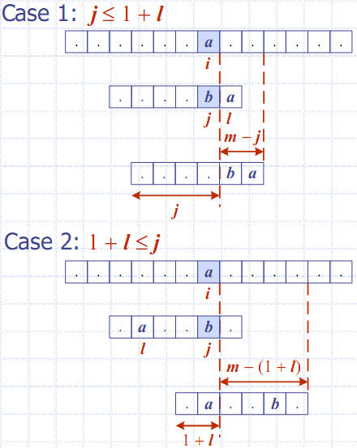
Algorithm Boyer Moore
Algorithm BoyerMooreMatch(T, P, Σ)
L ← lastOccurenceFunction(P, Σ )
i ← m − 1
j ← m − 1
repeat
if T[i] = P[j]
if j = 0
return i { match at i }
else
i ← i − 1
j ← j − 1
else
{ character-jump }
l ← L[T[i]]
i ← i + m – min(j, 1 + l)
j ← m − 1
until i > n − 1
return −1 { no match }

Slide 11
Exercise 13.2: Searching string by Boyer-Moore
Make a random string that has about 2000 characters consisting of a set of characters.
set of characters: abcdef
string: abcadacaeeeffaadbfacddedcedfbeccae…
Write the program that search the pattern, for example “aadbf”, from the string.
Note: use Boyer-Moore Algorithm

Slide 12
KMP string matching
Knuth-Morris-Pratt’s algorithm compares the pattern to the text in left-to-right, but shifts the pattern more intelligently than the brute-force algorithm.
When a mismatch occurs, what is the most we can shift the pattern so as to avoid redundant comparisons?
Answer: the largest prefix of P[0..j] that is a suffix of P[1..j]

Slide 13
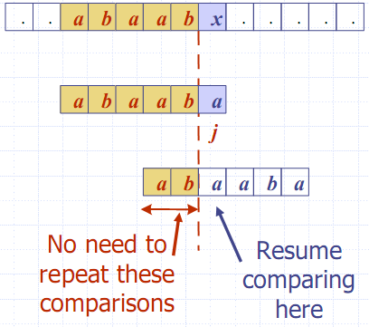
Example

Slide 14
KMP Failure Function
Knuth-Morris-Pratt’s algorithm preprocesses the pattern to find matches of prefixes of the pattern with the pattern itself
The failure function F(j) is defined as the size of the largest prefix of P[0..j] that is also a suffix of P[1..j]
Knuth-Morris-Pratt’s algorithm modifies the brute-force algorithm so that if a mismatch occurs at P[j] ≠ T[i] we set
j ← F(j − 1)

Slide 15
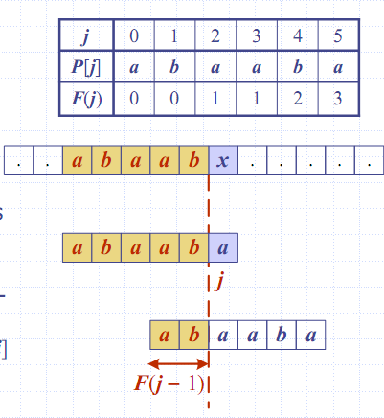
Example

Slide 16
Algorithm failureFunction(P)
F[0] ← 0
i ← 1
j ← 0
while i < m
if P[i] = P[j]
{we have matched j + 1 chars}
F[i] ← j + 1
i ← i + 1
j ← j + 1
else if j > 0 then
{use failure function to shift P}
j ← F[j − 1]
else
F[i] ← 0 { no match }
i ← i + 1

Slide 17
Exercise 13.3
Repeat the exercise 13.2 using the KMP algorithm.
Calculate the number of comparisons.

Slide 18
The KMP algorithm
The failure function can be represented by an array and can be computed in O(m) time
At each iteration of the while-loop, either
  i increases by one, or
  the shift amount i − j increases by at least one (observe that F(j − 1) < j)
Hence, there are no more than 2n iterations of the while-loop
Thus, KMP’s algorithm runs in optimal time O(m + n)

Slide 19
Algorithm KMPMatch(T, P)
F ← failureFunction(P)
i ← 0
j ← 0
while i < n
if T[i] = P[j]
if j = m − 1
return i − j { match }
else
i ← i + 1
j ← j + 1
else
if j > 0
j ← F[j − 1]
else
i ← i + 1
return −1 { no match }

Slide 20
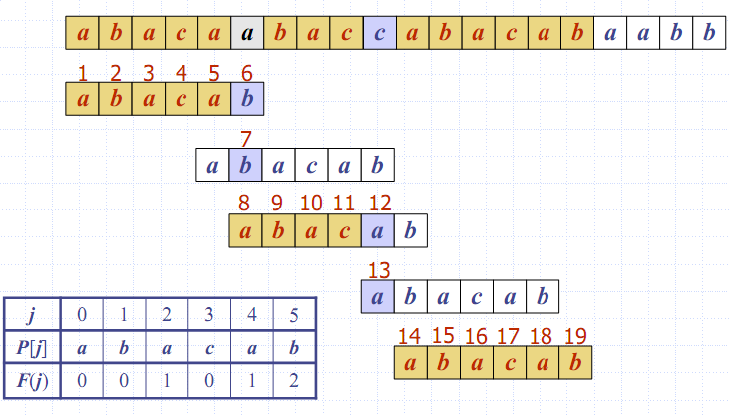
Example

