Slide 1
%
∑
STEM INSTITUTE · MODULE 1
Data Analysis &
Machine Learning
Week 2 · Make data talk — with pandas, charts and a first ML model.
Day 6 — June 16, 2026

Slide 2
TODAY'S PLAN
From Numbers to Answers
One dataset all day: the Titanic passenger list — 891 real people, real facts.
?
▲
⚙
PART 1
PART 2
PART 3
Ask the data
Draw charts
Teach the computer
Load it with pandas and ask questions: who? how many? what average?
Turn answers into pictures everyone understands in 3 seconds.
Train a small machine-learning model that makes predictions.
As always: you describe what you want — Cursor writes the Python. Your job is to ask good questions.
Vibe Coding · June 16, 2026

Slide 3
PART 1 · DATA
What Is Data Analysis?
Four steps — the same loop every data detective runs, on every case.
?
≡
∑
!
Ask a question
Get the data
Look for patterns
Tell the answer
"Did ticket class
change survival?"
A table: one row per
passenger, facts in columns.
Group, count, compare,
average.
Numbers, charts and
a short story.
Data analysis is detective work: the data holds the clues, the chart shows the evidence, and you tell the story. The computer does the counting — you do the thinking.
Vibe Coding · June 16, 2026

Slide 4
PART 1 · DATA
Meet the Dataset: Titanic
Every row is a real passenger. Every column is one fact about them.
Name | Sex | Age | Class | Fare | Survived
Braund, Owen | male | 22 | 3rd | $7 | no
Cumings, Florence | female | 38 | 1st | $71 | yes
Heikkinen, Laina | female | 26 | 3rd | $8 | yes
Allen, William | male | 35 | 3rd | $8 | no
Why this dataset?
A true story from 1912 — every row was a real person.
Small enough to understand, big enough to find patterns.
... 891 rows in total
The classic first dataset for every data scientist on Earth.
Big question of the day: what decided who survived — luck, money, age, or sex?
Vibe Coding · June 16, 2026

Slide 5
PART 1 · DATA
The Helper: pandas
explore.py
pandas = Excel for Python
import pandas as pd # load the table from a file df = pd.read_csv("titanic.csv") df.head() # peek: first 5 rows df.shape # (891, 12) rows, cols df.describe() # min, max, average... # one question, one line: df["Age"].mean() # average age: 29.7
read_csv opens a data file into a table called a DataFrame.
head / shape always peek first — know what you are working with.
describe() instant statistics for every number column.
df["Age"].mean() pick a column, ask it a question.
Rule #1 of data work: always look at the data before you analyze it.
Vibe Coding · June 16, 2026

Slide 6
PART 1 · DATA
Ask the Data a Question
questions.py
groupby = "split into teams"
# Did ticket class change survival? df.groupby("Class")["Survived"].mean() Class 1st 0.63 <- 63% survived 2nd 0.47 3rd 0.24 <- only 24% # And by sex? df.groupby("Sex")["Survived"].mean() female 0.74 male 0.19
groupby("Class") splits passengers into 1st / 2nd / 3rd teams.
["Survived"] looks at one column for each team.
.mean() averages it — for 0/1 data that IS the survival rate.
One line of code answered a question historians wrote books about.
The vibe way: just ask Cursor — "what % survived in each class?" — and it writes this for you.
Vibe Coding · June 16, 2026

Slide 7
PART 1 · DATA
Clean Before You Analyze
Real data is messy. Garbage in → garbage out.
?
Missing values
Aa
Wrong types
177 passengers have no age! Drop them, or fill with the average — your choice, but decide.
"22" as text can’t be averaged. Numbers must be numbers, dates must be dates.
≠
Weird values
=
Duplicates
An age of 230? A fare of -5? Find outliers and check if they are typos.
The same row twice counts twice. Find and remove repeats.
Prompt: "Check titanic.csv for missing values, weird numbers and duplicates — fix them and explain what you did."
Vibe Coding · June 16, 2026

Slide 8
PART 2 · CHARTS
Which Chart for Which Question?
Bar
Line
Scatter
Pie
Compare groups
Change over time
Are two things linked?
Parts of a whole
"Which class survived most?"
"How did the temperature change this week?"
"Do taller students have bigger feet?"
"What share of passengers was in 3rd class?"
Tell Cursor the question, not the chart: it will usually pick the right one — but now you can check it.
Vibe Coding · June 16, 2026

Slide 9
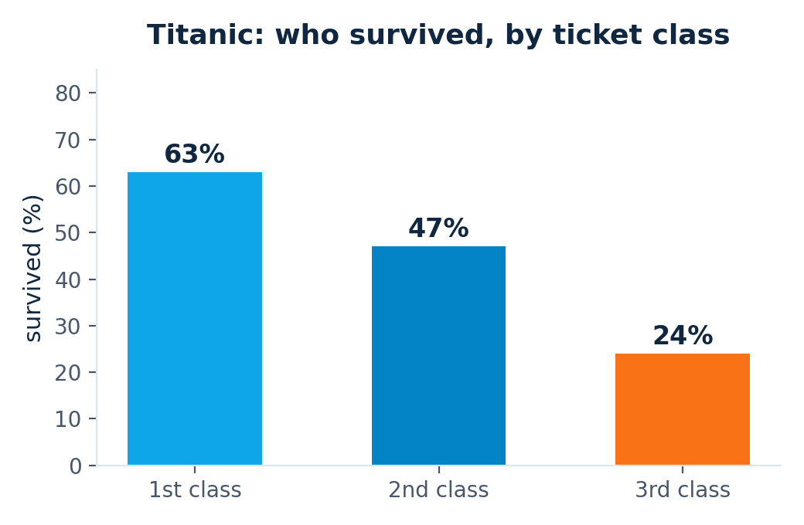
PART 2 · CHARTS
From Code to Chart
chart.py
import matplotlib.pyplot as plt rate = df.groupby("Class") ["Survived"].mean() * 100 rate.plot(kind="bar", color=["#0EA5E9", "#0284C7","#F97316"]) plt.ylabel("survived (%)") plt.savefig("by_class.png")
by_class.png — made by the code on the left
savefig writes a real image file — drop it into your report, slides or website.
Vibe Coding · June 16, 2026

Slide 10
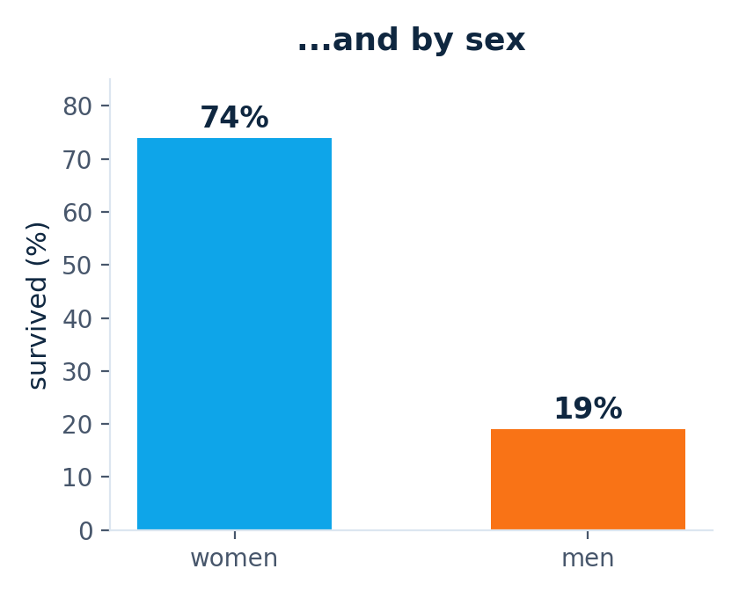
PART 2 · CHARTS
A Chart Answers in 3 Seconds
The story the data tells: "women and children first" was real — and so was the unfair gap between ticket classes.
Vibe Coding · June 16, 2026

Slide 11
PART 3 · MACHINE LEARNING
What Is Machine Learning?
Normal programming
Rules (written by you)
+ Data
→ Answers
Machine learning — flipped!
Data
+ Answers (examples)
→ Rules (found by the computer)
In our case: show the computer 891 passengers and who survived — it finds the pattern by itself.
Vibe Coding · June 16, 2026

Slide 12
PART 3 · MACHINE LEARNING
Train on Some, Test on the Rest
TRAIN — 80% of passengers
TEST — 20%
the model learns from these
kept hidden until the exam
Why hide some data? Imagine practicing a quiz, then being graded on the exact same quiz — of course you ace it! A model must be tested on questions it has never seen to prove it really learned the pattern, not just memorized the answers.
Vibe Coding · June 16, 2026

Slide 13
PART 3 · MACHINE LEARNING
Train Your First Model
train.py
What just happened
from sklearn.tree import DecisionTreeClassifier from sklearn.model_selection import train_test_split # (Sex was converted to 0/1 first) X = df[["Class", "Sex", "Age", "Fare"]] y = df["Survived"] X_tr, X_te, y_tr, y_te = train_test_split( X, y, test_size=0.2) model = DecisionTreeClassifier(max_depth=3) model.fit(X_tr, y_tr) # learn! model.score(X_te, y_te) # 0.80
X = the clues class, sex, age, fare — what the model may look at.
y = the answer survived or not — what it must predict.
fit() the model studies the training passengers.
score() = 0.80 it predicts 80% of unseen passengers correctly!
A decision tree is just a flowchart of yes/no questions the computer invented — ask Cursor to draw it!
Vibe Coding · June 16, 2026

Slide 14
PART 3 · MACHINE LEARNING
How Good Is the Model?
Always ask these questions
80%
?
Better than guessing? Always saying "died" is already 62% right. 80% beats it — good.
accuracy on the test set
What does it get wrong? Which passengers fool the model? Look at the mistakes.
?
It guessed right for 8 of every 10 passengers it had never seen.
?
Would it work on new data? A model that memorizes will fail on a different ship.
Never trust a number alone: a high score can still hide silly mistakes. Stay the detective.
Vibe Coding · June 16, 2026

Slide 15
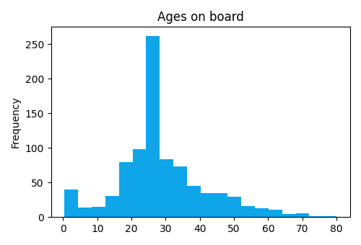
CASE STUDY · WE REALLY RAN IT
Real Run: 891 Passengers, One Script
real output
$ python analyze_titanic.py shape: (891, 12) survival by class (%): 1 63.0 2 47.3 3 24.2 survival by sex (%): female 74.2 male 18.9 missing ages: 177 charts saved: by_class.png, by_sex.png, ... test accuracy: 0.80 (baseline 0.59)
ages.png — made by the same run
Every number on today's slides came from this run — 63/47/24, 74/19, 177 missing ages, 80%.
Try it yourself: examples/june-16-data-analysis-ml/ — titanic.csv and the script are in the class repo.
Vibe Coding · June 16, 2026

Slide 16
PUT IT ALL TOGETHER
The Kickoff Prompt
Explore
PROMPT TO CURSOR
1
"Analyze titanic.csv step by step:
1. Load it and describe what’s inside.
2. Clean it — handle missing ages, explain your choices.
3. Make 3 charts: survival by class, by sex, and an age
histogram. Save them as PNG files.
4. Train a decision tree to predict survival,
test on 20% held-out data, report the accuracy.
5. Write report.md with the charts and what we learned.
Commit after each step."
Clean
2
Chart
3
Model
4
Report
5
Numbered steps = better results. The AI follows your plan instead of inventing its own.
Vibe Coding · June 16, 2026

Slide 17
TIPS
Data Detective Rules
1
Look first
2
Clean first
3
Chart everything
head(), shape, describe() — before any analysis.
Missing and weird values poison every result downstream.
Your eyes find patterns that numbers hide.
4
Start simple
5
Test on unseen data
6
Commit each step
A small decision tree before any fancy model.
Never grade the model on its own practice questions.
Explore → clean → chart → model: one commit each.
Golden loop: question → data → chart → answer → next question.
Vibe Coding · June 16, 2026

Slide 18
Data has stories.
Now you can read them.
%
Practice: find a dataset you care about — games, sports, music — and interview it.
Vibe Coding · Day 6 · June 16, 2026

