Slide 1
</>
STEM INSTITUTE · MODULE 1
Build Windows Software:
A Real PDF Editor
Design it like an engineer — then let the AI build PageMark.
Day 7 — June 22, 2026
Vibe Coding · June 22, 2026

Slide 2
ROADMAP
Today's Plan
Part 1 · Think like a product team
Part 2 · Build PageMark
• Study the giant (Adobe)
• Choose an honest MVP
• Pick the stack
• Write task-22.md
• Core engine first, tests first
• Wire the window (Qt)
• Edge cases that bite
• Ship a Windows .exe
Vibe Coding · June 22, 2026

Slide 3
THE GOAL
One App, Two Jobs
📖
🖍
✏️
💾
Read
Annotate
Edit
Save
Open any PDF, scroll,
zoom, thumbnails, search.
Highlight passages and
stick notes on the page.
Double-click a word —
change the text itself.
A real PDF other apps
open — not a copy format.
Reading is a weekend project. Editing is the boss fight — that's why we design first.
Vibe Coding · June 22, 2026

Slide 4
STEP 0 · STUDY THE GIANT
Map Adobe's Features — Then Choose
Adobe Acrobat feature
Our MVP
Later / roadmap
Open · render · zoom · thumbnails
✅ build it
—
Search with hit highlights
✅ build it
—
Highlight / underline / strikeout
✅ highlight
underline, strikeout
Sticky notes / free text
✅ free-text note
popup threads
Edit page text
✅ replace in place
font matching, reflow
Pages: rotate / reorder / delete
—
✅ same pattern
Forms · signatures · OCR · export
—
✅ each its own project
Engineering is choosing. List the whole feature space first — then scope an MVP you can finish.
Vibe Coding · June 22, 2026

Slide 5
THE HARD TRUTH
Why “Edit a PDF” Is Hard
% inside a real PDF page
BT
/F1 12 Tf
72 706 Td
(The quick brown fox) Tj
ET
% no paragraphs. no words.
% just glyphs at coordinates.
A PDF is a printout, not a document
• Text = positioned glyphs — there is no “paragraph” to edit
• So we do what Acrobat does for small edits:
1. redact the old glyphs (cover + remove)
2. insert new text at the same baseline & size
• Reflowing a whole paragraph? Even Adobe struggles.
We scope it out — and say so in the design doc.
Knowing what's hard before coding is the difference between a plan and a wish.
Vibe Coding · June 22, 2026

Slide 6
STEP 1 · PICK THE STACK
Four Tools, One Language
🖥
🧰
🧪
📦
PySide6 (Qt 6)
PyMuPDF
pytest
PyInstaller
Real native windows —
Windows, macOS, Linux
from the same code.
Renders pages AND
rewrites content.
One library, both jobs.
The whole engine tests
without opening a
single window.
One command turns
main.py into
PageMark.exe.
Python everywhere — UI, engine, and tests in one language a beginner can read.
Vibe Coding · June 22, 2026

Slide 7
STEP 2 · THE DESIGN FILE
Inside task-22.md
# task-22.md
## Feature map (Adobe vs MVP)
## Tech stack — why each piece
## Architecture
pdf_document.py # the core
app_window.py # Qt shell
## Core API (the contract)
doc.search(text) -> rects
doc.replace_text(rect, new)
## Tasks 1-10 (tests first)
## Testing plan + edge cases
What's inside
✓
Overview & honest goals
✓
Adobe feature map → MVP
✓
Module split (who imports Qt)
✓
The core API contract
✓
10 tasks, one test each
✓
Ship: PyInstaller recipe
The doc is the contract: every status code, limit, and trick lives here — graders and AIs read the same truth.
Vibe Coding · June 22, 2026

Slide 8
THE KEY DECISION
Qt Only Displays
UI layer (imports Qt)
Core layer (never imports Qt)
main.py — start the app
app_window.py — toolbar, sidebar, statusbar
page_view.py — zoom, selection, clicks
search_bar.py — the find strip
Displays things. Decides nothing.
pdf_document.py — open, render, search,
highlight, note, replace_text, save
Every feature lives here…
…so every feature is testable
without opening a window.
The split is the design. 18 tests run headless in CI — the window is just a thin skin.
Vibe Coding · June 22, 2026

Slide 9
STEP 3 · BREAK IT DOWN
Ten Tasks, One Failing Test Each
Core: open + render a page to pixels
Wire viewing: open, pages, zoom, thumbs
1
6
Core: read text + search across pages
Wire search: type → hits → Enter jumps
2
7
Core: highlight + sticky note (survive save!)
Wire editing: select, double-click, note
3
8
Core: replace text — redact + insert
Save / Save As + unsaved-changes guard
4
9
Window shell (offscreen-testable)
Package: PyInstaller → PageMark.exe
5
10
Order matters: the core (1–4) is done and tested before a single window exists.
Vibe Coding · June 22, 2026

Slide 10
STEP 4 · TDD IN ACTION
Red → Green, For Real
def test_replace_text_swaps_words(...):
doc = PdfDocument.open(sample_pdf)
[(page, rect)] = doc.search("lazy")
doc.replace_text(page, rect, "sleepy")
saved = reopen_after_save(doc)
assert "sleepy" in saved.page_text(page)
assert "lazy" not in saved.page_text(page)
The honest pattern:
do it → save → reopen → assert
If it only looks right on screen but
doesn't survive the file, it's not real.
Written before the code existed — it failed, then the engine made it pass. 18/18 green.
Vibe Coding · June 22, 2026

Slide 11
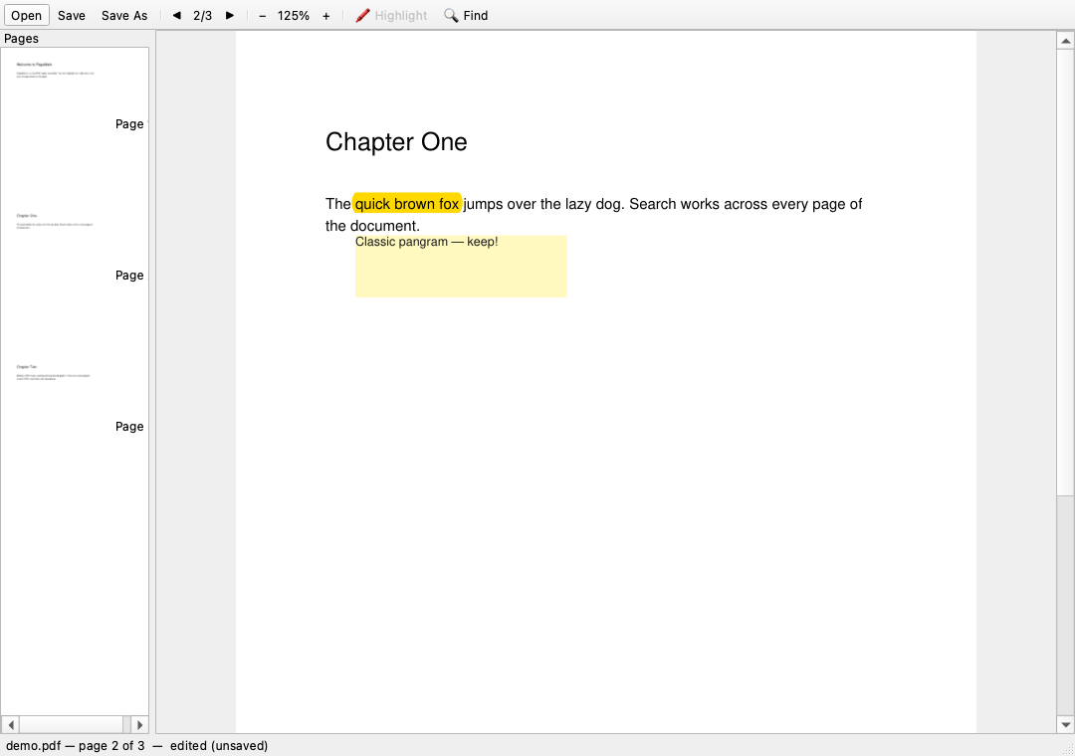
THE RESULT
PageMark, Running
✓
Highlight + note
drag-select → Highlight;
right-click → sticky note
✓
Edit text
double-click a word,
type the replacement
✓
Honest statusbar
“edited (unsaved)” —
Ctrl+S makes it true
Every pixel here is the code you just saw — running offscreen on the test rig.
Vibe Coding · June 22, 2026

Slide 12
EDGE CASES WE TESTED
The Bugs That Didn't Ship
Open a missing file → clean error, not a crash
Replace with empty text → the words just vanish
🗂
✏️
Search miss → empty list (and 0 hits in the UI)
Every edit: save → reopen → still there
🔍
💾
Highlight across two lines → one annotation, two rects
Cloud-synced folders break Qt plugins — README warns
🖍
☁️
That last one cost us 20 minutes of debugging — so students get it for free.
Vibe Coding · June 22, 2026

Slide 13
STEP 5 · SHIP IT
From main.py to PageMark.exe
1
2
3
4
Install the packer
→
One command
→
Test it cold
→
Hand it over
pip install pyinstaller
(on the Windows machine)
pyinstaller --noconsole
--onedir --name PageMark
main.py
Run dist/PageMark.exe on a
PC without Python installed.
Zip the folder — that's
your Windows software.
“Works on my machine” isn't shipping. Shipping is the cold-start test on someone else's PC.
Vibe Coding · June 22, 2026

Slide 14
THE EXAMPLE
The Kickoff Prompt
What you type to start the whole build:
✍
“Build a desktop PDF reader/editor with PySide6 + PyMuPDF. First study Adobe Acrobat's feature set and write the design to task-22.md: an honest MVP feature map (view, search, highlight, notes, replace-text, save), the architecture rule “core never imports Qt”, and 10 tasks. Then build task by task — write the failing test first, make it pass, commit. Every edit must survive save → reopen. Finish with a PyInstaller recipe for a Windows .exe.”
Then answer its questions and approve each step — the design doc does the steering.
Vibe Coding · June 22, 2026

Slide 15
</>
🚀
Let's build PageMark.
Plan it. Test it. Ship it.
Vibe Coding · Day 7 · June 22, 2026

