Slide 1
{ }
STEM INSTITUTE · MODULE 1
Make a 3D Game:
Battle Royale in Godot
Real models, real bots, real multiplayer — Last Circle, a PUBG-style slice.
Day 8 — June 23, 2026
Vibe Coding · June 23, 2026

Slide 2
ROADMAP
Today's Plan
Part 1 · Design the game
Part 2 · Build Last Circle
• Scope like a studio (PUBG → slice)
• Where game art comes from
• Scenes, scripts & the referee
• Write task-23.md
• Arena, movement, shooting
• A real 3D character + bots
• The shrinking zone + multiplayer
• Playtest, then ship an .exe
Vibe Coding · June 23, 2026

Slide 3
THE GOAL
Last Circle, in One Slide
🗺
🤖
⭕
🏆
One arena
Bots + friends
The circle
Last one standing
120×120 m, cover boxes,
spawn ring — built
by code, same for all.
Bots hunt with a tiny
brain; friends join
your match by IP.
The safe zone shrinks
60→35→18→6 m.
Outside? 5 HP/s.
HP 100, hitscan rifle,
no respawns —
winner takes the slide.
PUBG is content at scale. The mechanics fit in a classroom.
Vibe Coding · June 23, 2026

Slide 4
STEP 0 · SCOPE LIKE A STUDIO
PUBG vs Our Slice
PUBG has
Our slice has
Why that's enough
100 players + matchmaking
host + joiners + bots
the mechanic is identical
a huge island
one 120 m arena
level design ≠ engine work
dozens of guns
one hitscan rifle
one gun done well teaches all
the blue zone
✅ the same shrinking circle
the signature, kept whole
loot, armor, heals
— (roadmap)
purely additive content
squads, voice, vehicles
—
out of scope, said out loud
Cutting scope isn't cheating — naming what you cut is the most professional line in the doc.
Vibe Coding · June 23, 2026

Slide 5
GAME ART 101
Where Models Come From
🎁
CC0 packs ← we use this
🕺
Mixamo
🛠
Blender
kenney.nl · kaylousberg.com ·
quaternius.com
Rigged GLB characters, free for
anything, no account needed.
Ours: KayKit Knight & Rogue —
76 animations included.
Upload any humanoid model →
auto-rig → pick from 2,000+
animations → export FBX.
Free with an Adobe login.
Great for custom characters.
Model, rig, and animate your
own — the studio pipeline.
Export GLB → drag into Godot.
The skill ceiling, not the
starting line.
License check is part of engineering: CC0 = use anywhere; always keep the LICENSE file next to the asset.
Vibe Coding · June 23, 2026

Slide 6
STEP 1 · PICK THE STACK
The Whole Stack Is Free
🎮
🐍
📡
🧍
Godot 4
GDScript
ENet built-in
CC0 characters
A real game engine,
100 MB, no license fees,
runs on anything.
Python-like language —
if you wrote the blog,
you can read this.
Host/join multiplayer
ships with the engine.
No extra services.
KayKit GLB models with
Idle/Run/Shoot/Death
animations bundled.
Total cost of the toolchain: $0.
Vibe Coding · June 23, 2026

Slide 7
STEP 2 · THE DESIGN FILE
Inside task-23.md
# task-23.md
## PUBG map -> our slice
## Asset pipeline (CC0/Mixamo/Blender)
## Scenes & scripts
player.tscn bot.tscn zone …
## Multiplayer: host = referee
## Game rules (the contract)
rifle 25 dmg · 0.15s · 30 mag
zone 60→35→18→6 · 5 HP/s
## Tasks 1-8 · ## Testing plan
What's inside
✓
Feature map with cuts named
✓
Asset sources + licenses
✓
One scene per concept
✓
Numbers, not adjectives
✓
8 tasks, run after each
✓
Tests a game can actually run
“Balanced gun” is a wish. “25 dmg every 0.15 s” is a spec a test can check.
Vibe Coding · June 23, 2026

Slide 8
THE ARCHITECTURE
A Bot Is a Player With a Different Brain
base_character.gd (the shared body)
player.gd
bot.gd
capsule body + the KayKit model
Health (HP, die once, broadcast)
animations: Idle / Run / Shoot / Death
position sync to every screen
+ mouse & WASD
+ camera rig
+ trigger finger
= the human
+ a 3-state brain
+ imperfect aim
+ no camera
= the bot
Share the body, swap the brain — one fix fixes everyone; bots and humans are equals to the rules.
Vibe Coding · June 23, 2026

Slide 9
THE MULTIPLAYER MODEL
The Host Is the Referee
HOST (peer 1)
owns the truth: damage, zone, deaths, the winner
“I hit him!” →
← “He has 75 HP.”
CLIENT A
CLIENT B
BOTS (live on the host)
sends input, asks to hit
sends input, asks to hit
think only where truth lives
Never trust the shooter. Clients ask; the host decides; everyone hears the same answer. That's anti-cheat 101.
Vibe Coding · June 23, 2026

Slide 10
STEP 3 · BREAK IT DOWN
Eight Tasks — Run the Game After Each
Arena + a capsule that walks, sprints, jumps
The zone: shrink steps + tick damage
1
5
Shooting: camera ray, ammo, reload
Multiplayer: host / join, spawn, sync
2
6
The real model: GLB import + animations
Match flow: alive count, spectate, winner
3
7
Bots: wander → chase → shoot
Playtest, then export the .exe
4
8
The game must boot after every task — a game that only runs on Friday is eight broken days.
Vibe Coding · June 23, 2026

Slide 11
THE BOT BRAIN
Three States Are Plenty
1
2
3
WANDER
→
CHASE
→
SHOOT
stroll to random points
inside the safe zone
an enemy within 25 m?
sprint at them
within 18 m + line of
sight? stop and fire —
45% accuracy, on purpose
Imperfect aim is a design choice: perfect bots aren't hard, they're just unfun.
Vibe Coding · June 23, 2026

Slide 12
HOW GAMES GET TESTED
Three Layers of Proof
🧪
Rule tests (headless)
⚡
Boot smoke
🤖
The bot match
Weapon: 30 shots, cooldown,
reload. Health: clamp at 0,
die once. Zone: 60→35→18→6.
Runs in CI, no window.
godot --headless --smoke:
the scene loads, 6 characters
spawn, 8 seconds, zero errors.
Catches the “won't even open”.
5 bots, no humans, full match.
Must end with exactly one
survivor.
Ours: 1 survivor in 36 s ✅
You can't unit-test “fun” — but everything below fun, you can.
Vibe Coding · June 23, 2026

Slide 13
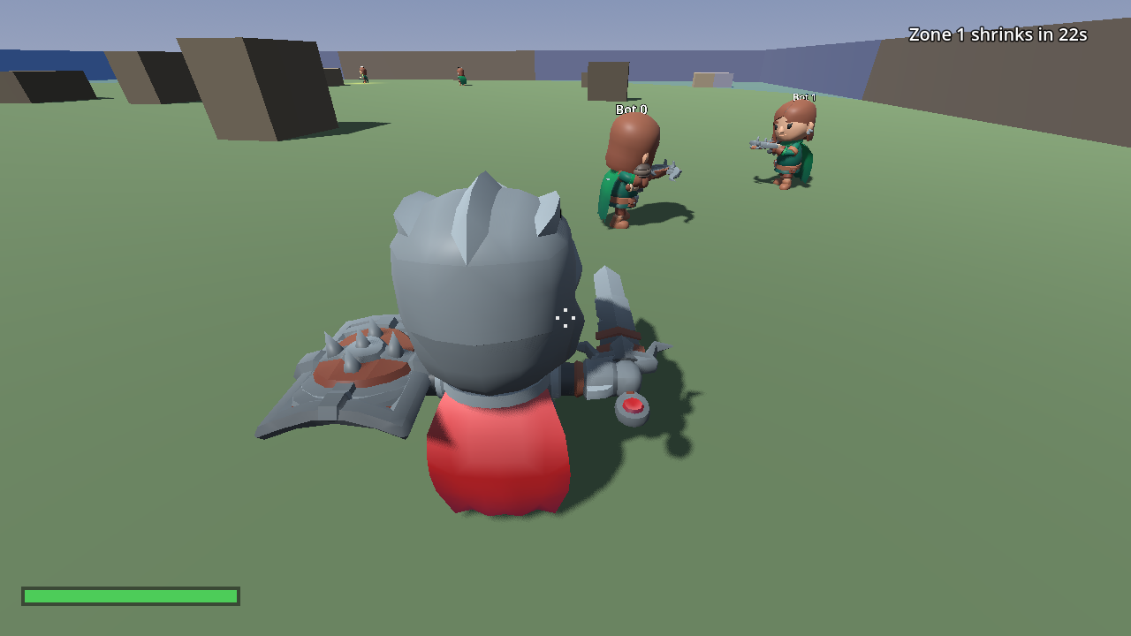
THE RESULT
Last Circle, Running
✓
Real 3D characters
KayKit Knight (you) and
Rogues (bots), animated
✓
The HUD tells the story
zone timer, health bar,
crosshair, alive count
✓
Bots that hunt
these two are mid-CHASE —
they saw the player
Shot by the game itself — a --shot flag is automation, too.
Vibe Coding · June 23, 2026

Slide 14
THE EXAMPLE
The Kickoff Prompt
What you type to start the whole build:
✍
“Build a battle-royale slice in Godot 4 called Last Circle. First write task-23.md: a PUBG-vs-slice feature map with the cuts named, the asset plan (CC0 GLB characters from KayKit), one-scene-per-concept architecture, host-as-referee multiplayer, and exact numbers for the rifle and the shrinking zone. Then build in 8 tasks — the game must boot after every task. Test headless: rule tests, a boot smoke, and a bot-only match that must end with one survivor.”
Then playtest every task — you are the test suite for fun.
Vibe Coding · June 23, 2026

Slide 15
{ }
🚀
Let's drop in.
Plan it. Test it. Ship it.
Vibe Coding · Day 8 · June 23, 2026

