Slide 1
Aa
¶
STEM INSTITUTE · MODULE 1
Word, Excel & LaTeX
with AI
Week 2 · AI for everyday work — let AI do your paperwork.
Day 5 — June 15, 2026

Slide 2
TODAY'S PLAN
Three Paper Superpowers
Today you never click a menu. You tell the AI what you want — it writes the file for you.
¶
∑
π
PART 1
PART 2
PART 3
Word
Excel
LaTeX
Reports, letters, certificates — written and formatted for you.
Clean data, formulas, summaries and charts — in seconds.
The scientists' way to make beautiful PDFs — with perfect math.
Goal: finish class with a report, a gradebook and a math homework — all made by prompts.
Vibe Coding · June 15, 2026

Slide 3
THE BIG IDEA
Files Are Made of Code Too
1
2
3
4
You ask
AI writes a tiny program
The program runs
You open & check
"Make a Word report
about our pet survey."
A few lines of Python
that build the file.
It creates report.docx
on your computer.
Like it? Done.
Not yet? Ask for changes.
Why this works: a .docx or .xlsx file is just structured data. Python libraries can write that data — so anything you can describe, AI can build. You describe, AI builds, you check.
Vibe Coding · June 15, 2026

Slide 4
PART 1 · WORD
What AI Can Do with Word
¶
Write reports
Aa
Format everything
⇆
Find & replace at scale
Title, headings, paragraphs — full documents from one prompt.
Fonts, colors, spacing, page numbers — applied in one go.
Fix a name or date across 50 documents at once.
#
Build tables
+
Merge documents
✓
Pull text out
Turn lists or data into clean Word tables.
Combine many .docx files into one, in order.
Extract all text from documents to summarize or reuse.
The boring parts of homework and office work — gone.
Vibe Coding · June 15, 2026

Slide 5
PART 1 · WORD
The Helper: python-docx
make_report.py
What each line does
# AI writes this for you — just read along from docx import Document doc = Document() doc.add_heading("Pet Survey Report", 0) doc.add_paragraph("We asked 24 students.") table = doc.add_table(rows=1, cols=2) table.rows[0].cells[0].text = "Pet" table.rows[0].cells[1].text = "Votes" doc.save("report.docx")
● Document() starts a new empty Word file.
● add_heading / add_paragraph adds titles and text.
● add_table builds tables row by row.
● save(...) writes the real .docx — open it in Word!
You never memorize this. You just need to recognize what the AI wrote before you run it.
Vibe Coding · June 15, 2026

Slide 6
PART 1 · WORD · DEMO
20 Certificates in One Go
PROMPT TO CURSOR
1
names.xlsx
"Here is names.xlsx with 20 student names.
For each student, make a Word certificate that says
‘Awarded to NAME for finishing Week 1’ —
big title, centered, with today’s date.
Save them in a folder called certificates."
20 names in one column
2
loop: for each name ...
AI writes one small loop
3
certificates/ (20 files)
amy.docx, ben.docx, ...
This is the real superpower: doing it once is easy — doing it 20 times by hand takes an hour. A loop does it in one second. The bigger the boring job, the bigger the win.
Vibe Coding · June 15, 2026

Slide 7
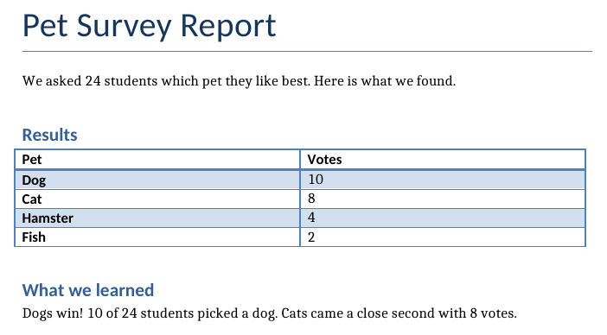
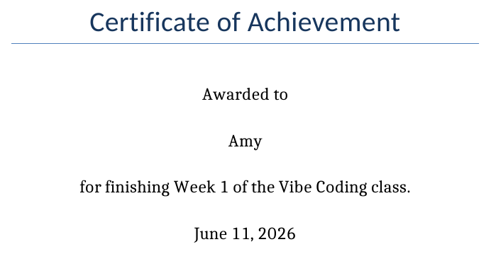
CASE STUDY · WE REALLY RAN IT
Real Run: Report & Certificates
real output
$ python make_report.py report.docx created — open it in Word! $ python make_certificates.py done — 20 certificates in certificates/
report.docx — heading, table, paragraphs
certificates/amy.docx — one of the 20
Vibe Coding · June 15, 2026

Slide 8
PART 2 · EXCEL
What AI Can Do with Excel
✓
Clean messy data
ƒ
Write formulas
∑
Summarize
Fix dates, remove duplicates, fill blanks — automatically.
SUM, AVERAGE, IF, VLOOKUP — AI writes them correctly.
Totals per class, per month, per student — instantly.
▲
Make charts
+
Merge sheets
!
Spot mistakes
Bar, line and pie charts straight from your table.
Combine 12 monthly files into one yearly sheet.
Find weird numbers: a grade of 250? a negative age?
Tomorrow (Day 6) we go further: real data analysis and machine learning.
Vibe Coding · June 15, 2026

Slide 9
PART 2 · EXCEL
The Helper: openpyxl
make_grades.py
What each line does
from openpyxl import Workbook wb = Workbook() ws = wb.active ws.append(["Name", "Quiz 1", "Quiz 2"]) ws.append(["Amy", 9, 10]) ws.append(["Ben", 7, 8]) # a real Excel formula in a cell ws["D1"] = "Average" ws["D2"] = "=AVERAGE(B2:C2)" wb.save("grades.xlsx")
● Workbook() starts a new empty spreadsheet.
● append([...]) adds one row — header or data.
● ws["D2"] = "=AVERAGE..." puts a live formula in a cell, just like typing it in Excel.
● save(...) writes the real .xlsx file.
Formulas stay live: change a quiz score in Excel and the average updates itself.
Vibe Coding · June 15, 2026

Slide 10
PART 2 · EXCEL · DEMO
Demo: The Class Gradebook
PROMPT TO CURSOR
What you get back
"Make grades.xlsx for 10 students with 3 quiz
columns of example scores. Add:
• an Average column (real formula)
• a class-average row at the bottom
• bold header with a blue background
• highlight any average above 9 in green."
✓ A working .xlsx — open it in Excel and it just works.
✓ Live formulas, not pasted numbers.
✓ Colors and bold headers already set.
✓ Want a chart too? Just add one more sentence.
Notice the prompt pattern: say the file, the columns, and exactly how it should look. Specific prompt → perfect file.
Vibe Coding · June 15, 2026

Slide 11
PART 3 · LATEX
What Is LaTeX?
LaTeX ("LAY-tek") is how scientists write papers and books: you write text-code, it builds a beautiful PDF.
Word
LaTeX
● You click buttons to style things
● You write code that describes the page
● Great for letters and reports
● Perfect, beautiful math — its superpower
● Math formulas are clumsy
● Numbering, references: all automatic
● Layout can jump around as you edit
● Same source always builds the same PDF
Sound familiar? LaTeX is "vibe coding for documents" — and your textbook for this class was written in it.
Vibe Coding · June 15, 2026

Slide 12
PART 3 · LATEX
A Tiny LaTeX Document
hello.tex
THE PDF IT BUILDS
\documentclass{article} \begin{document} \section{My First Page} Hello! LaTeX makes clean pages. Math is easy: \[ E = mc^2 \] \end{document}
1 My First Page
Hello! LaTeX makes clean pages.
Math is easy:
E = mc²
\section, \begin, \end — commands start with a backslash. Everything else is just your text.
Vibe Coding · June 15, 2026

Slide 13
PART 3 · LATEX
The Math Superpower
Type the code on the left — get perfect math on the right.
x^2 + y^2 = r^2
x² + y² = r²
\frac{1}{2}
1
— one number stacked over the other
2
\sqrt{16} = 4
√16 = 4
\pi \approx 3.14159
π ≈ 3.14159
This is why scientists love it: no equation editor, no clicking — math is just typed.
Vibe Coding · June 15, 2026

Slide 14
PART 3 · LATEX
Where Do You Run LaTeX?
BEST FOR CLASS
LATER
OUR WAY
Overleaf
On your PC
Ask AI in Cursor
overleaf.com
TeX Live / MiKTeX
your project folder
Free website — type on the left, see the PDF on the right. Nothing to install.
Install once, build PDFs offline. More setup, more power.
Tell Cursor what you need — it writes the .tex file. Paste it into Overleaf to build.
Today: Cursor writes the LaTeX, Overleaf turns it into a PDF. Two tabs, zero installs.
Vibe Coding · June 15, 2026

Slide 15
PART 3 · LATEX · DEMO
Demo: Homework, but Beautiful
Cursor writes homework.tex
PROMPT TO CURSOR
1
"Write a LaTeX file for my math homework:
title ‘Week 2 Homework’, my name, today’s date.
Three numbered problems about areas of circles,
each with the formula and the worked answer.
Use a clean article style."
Paste into overleaf.com
2
Press Recompile → PDF appears
3
Looks like a real math book
4
Math formulas in the prompt? Just describe them in words — AI knows the LaTeX for them.
Vibe Coding · June 15, 2026

Slide 16
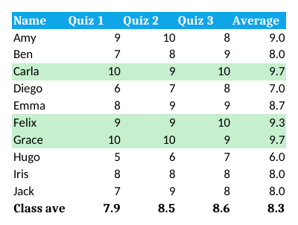
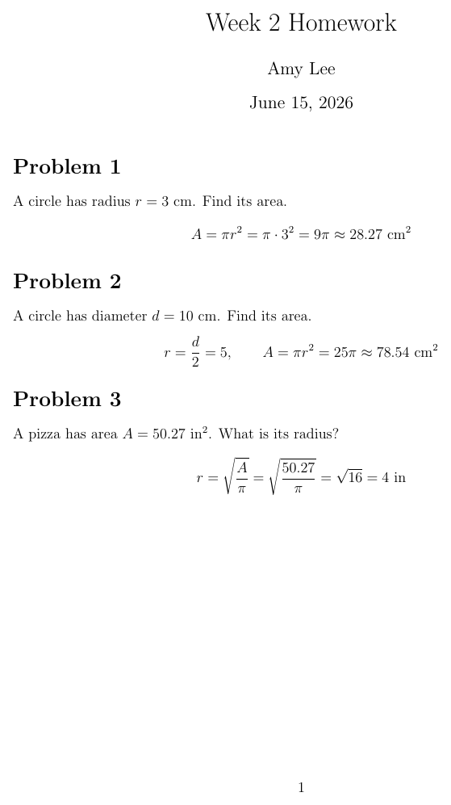
CASE STUDY · WE REALLY RAN IT
Real Run: Gradebook & Homework
What to notice
Live formulas — cell E2 really holds =AVERAGE(B2:D2) — edit a quiz score and it updates.
Real highlights — Carla, Felix and Grace passed the >9 test and turned green.
One command — pdflatex homework.tex built the PDF — perfect math, zero clicking.
grades.xlsx — top scores really turned green
homework.pdf
Try it yourself: everything on this slide lives in examples/june-15-word-excel-latex/ in the class repo.
Vibe Coding · June 15, 2026

Slide 17
TIPS
Tips for Paperwork Prompts
1
Be specific
2
Give sample data
3
Open and check
Name the file, the columns, the colors. Vague in → vague out.
Paste 3 example rows so AI matches your real format.
Always open the file AI made. Trust, but verify.
4
One step at a time
5
Commit & push
6
Errors? Paste them
First the table, then the formulas, then the styling.
Your scripts are code — save a version when they work.
If the script fails, give AI the error message — it will fix the code.
Golden loop: describe → AI builds → open & check → improve → commit.
Vibe Coding · June 15, 2026

Slide 18
Paperwork is now
a one-line prompt.
Aa
Practice: build a certificate generator for your class — Excel list in, Word files out.
Vibe Coding · Day 5 · June 15, 2026

