Slide 1
@
</>
STEM INSTITUTE · MODULE 1
Web Scraping
with AI
Week 2 · Collect data from the web — politely — then turn it into a report.
Day 7 — June 18, 2026

Slide 2
TODAY'S PLAN
From Web Pages to a Report
?
←
@
▲
PART 1
PART 2
PART 3
PART 4
What & why
A little history
AI scrapers
The project
What scraping is — and the rules of doing it politely.
The classic tools, from wget to Playwright.
Meet the new tools — and deploy Crawl4AI on your PC.
Scrape a bookstore → analyze → chart → report.
End of class: a full data pipeline you built with prompts — scrape → clean → analyze → chart → report.
Vibe Coding · June 18, 2026

Slide 3
PART 1 · WHAT & WHY
What Is Web Scraping?
A scraper is a program that visits web pages and collects information — like a super-fast reader taking notes.
People use it for
The Scraper's Code of Honor
Price tracking — "tell me when this drops below $20"
✓
Check robots.txt — every site lists what bots may visit — respect it.
Research — collect 1,000 articles to study
✓
Be gentle — add delays; never hammer a site with fast requests.
News and weather dashboards
✓
Public data only — no logins you shouldn’t have, no personal data.
Feeding data to AI models
✓
Give credit — say where your data came from in your report.
Rule zero: if a website offers an API or a download button, use that instead of scraping.
Vibe Coding · June 18, 2026

Slide 4
PART 2 · HISTORY
The Classic Scraping Tools
1996
2004
2004
2008
2020
wget / curl
BeautifulSoup
Selenium
Scrapy
Playwright
Download a page from the terminal. One page at a time, raw HTML.
Python library that picks data out of messy HTML "soup".
Drives a real browser — can click, type and see JavaScript pages.
A full crawling framework — thousands of pages, fast and organized.
Modern browser control — fast, reliable, built for today’s web.
The common pain: with all of these, a human had to study the page and hand-write the extraction rules.
Vibe Coding · June 18, 2026

Slide 5
PART 2 · HISTORY
Why Scraping Was Hard
</>
Messy HTML
!
Sites change
Real pages are tangled. Finding "the price" meant hunting through hundreds of tags.
The site updates its design → your selectors break → your scraper dies overnight.
JS
JavaScript pages
#
Output was raw
Many pages are empty until scripts run — old tools saw nothing at all.
You got HTML tags, not clean data. Cleaning took longer than scraping.
Then came the idea: what if an AI read the page like a human — and pulled out the data itself?
Vibe Coding · June 18, 2026

Slide 6
PART 3 · AI SCRAPERS
The New Generation (2026)
AI-era scrapers return clean, readable text (Markdown) that both humans and AI models understand.
Cloud service
Instant & simple
Open source · free
Firecrawl
Jina Reader
Crawl4AI
firecrawl.dev
jina.ai
crawl4ai.com
Send a URL, get clean Markdown back. Maps whole websites. Paid plans.
Put r.jina.ai/ in front of any URL — the page comes back as clean text.
A Python library that runs on YOUR computer. Full control, no fees. Our pick!
Why we pick Crawl4AI: free, open source, runs locally — and it was built for the AI era from day one.
Vibe Coding · June 18, 2026

Slide 7
PART 3 · DEPLOY
Deploy Crawl4AI on Your PC
Anaconda Prompt
What each step does
# 1. install the library (Anaconda Prompt) pip install crawl4ai # 2. set it up (downloads a mini browser) crawl4ai-setup # 3. check everything works crawl4ai-doctor [OK] All checks passed!
pip install gets the Crawl4AI Python library (we installed Miniconda on Day 2 — this is why!).
crawl4ai-setup downloads a small hidden Chromium browser the crawler will drive.
crawl4ai-doctor runs a health check and tells you how to fix any problem it finds.
This IS deployment: the crawler now runs on your machine — no cloud account, no fees.
Vibe Coding · June 18, 2026

Slide 8
PART 3 · FIRST CRAWL
Your First Crawl — 8 Lines
first_crawl.py
What happens
import asyncio from crawl4ai import AsyncWebCrawler async def main(): async with AsyncWebCrawler() as crawler: result = await crawler.arun( "https://books.toscrape.com") print(result.markdown[:300]) asyncio.run(main())
A hidden browser opens and loads the page — JavaScript and all.
The page becomes Markdown clean readable text instead of HTML tags.
result.markdown is yours: print it, save it, or hand it to an AI.
async just means "don't wait around" — it lets the crawler handle many pages at once. AI writes it for you.
Vibe Coding · June 18, 2026

Slide 9
PART 3 · EXTRACT
From Pages to a Clean Table
extract.py
Two ways to extract
# describe WHAT you want, by CSS selector schema = { "baseSelector": "article.product_pod", "fields": [ {"name": "title", "selector": "h3 a", "type": "text"}, {"name": "price", "selector": ".price_color", "type": "text"} ] } # -> [{"title": "...", "price": "£51.77"}, ...]
CSS schema (shown) — fast and free. Tell it where things live on the page; it returns JSON rows. Ask the AI to write the schema for you.
LLM extraction — for messy pages: an AI model reads the page and fills your fields. Slower, costs tokens, but survives redesigns.
Start with CSS, switch to LLM only when the page is too messy. Cheap first, smart second.
Vibe Coding · June 18, 2026

Slide 10
CASE STUDY · WE REALLY RAN IT
Real Run: 60 Books Scraped
real output
A real lesson from this run
$ python make_site.py site/ built: 3 pages (60 books) $ python scrape_books.py .../index.html -> 20 books .../page-2.html -> 20 books .../page-3.html -> 20 books saved 60 books to books.csv $ head -3 books.csv title,category,rating,price The Iron Island,History,..,£44.64 The Lost Garden,Fiction,..,£48.20
The crawl worked first try — Crawl4AI + the CSS schema pulled all 60 books, with a 1-second polite delay per page.
But the data came back messy — the rating arrived as ["star-rating", "Two"] — not a number!
We told the AI, it fixed it — one line of cleaning code later, ratings became 1–5. Scraped data is ALWAYS messy — plan to clean it.
We ran it offline on a local practice copy (examples/june-18-web-scraping/) — in class, you point it at books.toscrape.com.
Vibe Coding · June 18, 2026

Slide 11
PART 4 · THE PROJECT
The Whole Pipeline
Six steps — and you already know four of them from Day 6.
1
2
3
4
5
6
Scrape
Save
Clean
Analyze
Chart
Report
Crawl4AI visits
the bookstore
books.csv —
raw data, kept safe
fix prices, ratings
(pandas)
averages, counts,
group by category
bar charts, histograms
(matplotlib)
report.md with
charts + findings
Look familiar? Steps 3–6 are exactly what we did on Day 6 — the only new piece is where the data comes from. Skills stack!
Vibe Coding · June 18, 2026

Slide 12
PART 4 · THE PROJECT
Our Target: books.toscrape.com
books.toscrape.com
Why this site?
✓
Built for practice — a fake bookstore made just for learning to scrape — 100% legal and welcome.
Books to Scrape
We love being scraped!
✓
1,000 books — with prices, star ratings, categories and stock info.
✓
50 pages — perfect for learning to crawl page 1, 2, 3, ...
A Light in...
£51.77 ★★★
Tipping the...
£53.74 ★
Soumission
£50.10 ★
Sharp Objects
£47.82 ★★★★
Questions we will ask it: What does a book cost on average? Are higher-rated books pricier? Which category is biggest?
Vibe Coding · June 18, 2026

Slide 13
PART 4 · THE PROJECT
The Kickoff Prompt
1
Scrape politely
PROMPT TO CURSOR
"Build a scraping project for books.toscrape.com:
1. Use Crawl4AI to scrape all books — title, price,
rating, category. Add a 1-second delay per page.
2. Save the raw data to books.csv.
3. Clean it: prices to numbers, ratings to 1–5.
4. Analyze: average price per category, price vs rating.
5. Make 3 charts and save them as PNGs.
6. Write report.md: the question, the method, the charts,
and 3 findings in plain words. Commit each step."
2
Save raw data
3
Clean
4
Analyze
5
Chart
6
Report & commit
Notice the delay in step 1 — politeness is written into the prompt, not added later.
Vibe Coding · June 18, 2026

Slide 14
PART 4 · THE PROJECT
The Prize: report.md
REPORT.MD
A good report has
# Bookstore Price Study
The question — what you wanted to know.
Data: 1,000 books from books.toscrape.com
Method: Crawl4AI + pandas + matplotlib
The method — where the data came from, what you did.
The evidence — charts beat tables, tables beat sentences.
## Findings
1. Average price: £35.07
2. Rating does NOT raise the price
3. Biggest category: Fiction
Plain-words findings — what a friend should remember.
Bonus: ask AI to turn report.md into a Word doc or slides — you learned that on Day 5!
Vibe Coding · June 18, 2026

Slide 15
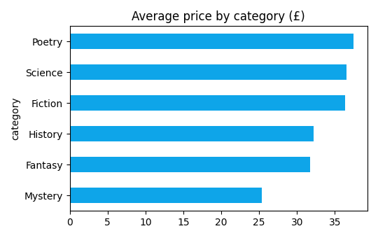
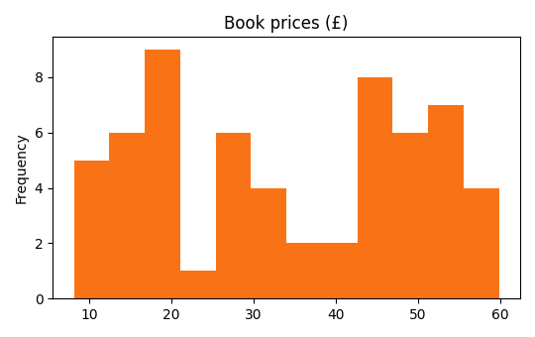
CASE STUDY · WE REALLY RAN IT
Real Run: Charts & Findings
price_by_category.png — from the scraped data
price_hist.png — most books cost £20–50
report.md findings (real): the average book costs £34.02 · price-vs-rating correlation is 0.01 — better stars do NOT mean higher prices · the biggest category is Science (14 books).
Vibe Coding · June 18, 2026

Slide 16
TIPS
Scraper Survival Rules
1
Test on one page first
2
Always add delays
3
Save the raw data
Make page 1 work perfectly before crawling all 50.
1 second between pages. Fast scrapers get blocked.
Keep books.csv untouched; clean a copy. You only scrape once.
4
Expect breakage
5
Check robots.txt
6
Commit each stage
Sites change. When selectors fail, show AI the new page.
Visit site.com/robots.txt first — a 10-second check that keeps you polite and legal.
scrape → clean → analyze → report: one commit per stage.
Golden loop: scrape a little → check the data → scrape more → analyze → report.
Vibe Coding · June 18, 2026

Slide 17
The web is the
world's biggest dataset.
@
Scrape it politely, study it honestly, and tell good stories with it.
Vibe Coding · Day 7 · June 18, 2026

