Slide 1
</>
STEM INSTITUTE · MODULE 1
Vibe Coding
Talk to the computer. It writes the code.
Day 1 — June 8, 2026

Slide 2
ROADMAP
Today's Plan
What is vibe coding?
What can it do?
1
2
The goal of this class
From LLM to Agent
3
4
AI models today
Vibe coding tools
5
6
Our tool: Cursor
Git + build a blog
7
8
Vibe Coding · June 8, 2026

Slide 3




THE BIG IDEA
What Is Vibe Coding?
STEP 1
STEP 2
STEP 3
You say it
AI builds it
You check it
Tell the AI what you want
in plain words.
The AI writes the
code for you.
You read, test,
and fix it.
Bottom line: You lead. The AI types.
Vibe Coding · June 8, 2026

Slide 4



USES
What Can It Do?
Daily Work
Research
Build Apps
Stats, charts,
and documents.
Read papers, get ideas,
run tests, and write.
Web, mobile, games,
and desktop.
Vibe Coding · June 8, 2026

Slide 5

WHY WE'RE HERE
The Goal of This Class
Describe an idea to AI clearly.
Build a small app that works.
By the end,
you can:
Save and share your project.
Make real things — even before you're an expert.
Vibe Coding · June 8, 2026

Slide 6
THE 4-WEEK PLAN
Course Schedule
1
2
3
4
WEEK 1
WEEK 2
WEEK 3
WEEK 4
Jun 8 – 12
Jun 15 – 18
Jun 22 – 26
Jun 29 – Jul 2
Meet the AI Tools
AI for Everyday Work
Apps & Games
Your Own Project
Learn rules, skills, MCP & subagents
Set up the software we need
Build a website & put it online (Cloudflare)
Use AI for daily tasks
Sort, study & chart data
Collect & save web data
Make a Windows app
Build a game with Godot
Plan & build your own idea
Show it to the class
Vibe Coding · June 8, 2026

Slide 7



HOW AI GREW UP
From LLM to Agent
LLM
Agent
Text in → text out.
It uses what it already learned. It answers, but it cannot act on its own.
It can search, look, and use tools.
It takes many steps on its own to finish a job.
An agent is an LLM that can act.
Vibe Coding · June 8, 2026

Slide 8

THE LANDSCAPE
AI Models Today
OpenAI
Anthropic
Microsoft
Alibaba
Zhipu
GPT
Claude
Copilot
Qwen
GLM
GPT-5.5
Claude Opus 4.8
MAI-Thinking-1
Qwen3.7-Max
GLM-5.1
GPT-5.5 Instant
Claude Sonnet 4.6
MAI-Code-1
Qwen3.7-Plus
GLM-5
GPT-5.3-Codex
Claude Haiku 4.5
MAI-Image-2.5
Qwen3.6
New models arrive fast — these are some big names in 2026.
Vibe Coding · June 8, 2026

Slide 9




WHAT WE TYPE INTO
Vibe Coding Tools
Claude Code
Cursor
Codex
Open Code
Code in the terminal.
A smart code editor.
OpenAI's coder.
Free and open.
Same idea, different tools.
Vibe Coding · June 8, 2026

Slide 10


IN THIS CLASS
Our Tool: claude code+codex
Share accounts
Class logins
We use Cursor in class.
About 4 students share 1 login.
dazelu20@gmail.com
daze.lu23@gmail.com
Ask your teacher which login to use.
Vibe Coding · June 8, 2026

Slide 11




VERSION CONTROL
What Is Git?
Saves every version
Each “commit” is a snapshot you can keep.
Go back anytime
Something broke? Return to a good one.
A time machine
for your code
Try ideas safely
Test on a branch, then merge if it works.
Share online
Push to GitHub so others & AI can see it.
Golden rule: commit early, commit often.
Vibe Coding · June 8, 2026

Slide 12
THE BASICS
Git: Common Commands
Start tracking a folder
Upload to GitHub
git init
git push
Copy a project
Get the latest changes
git clone <url>
git pull
See what changed
See the history
git status
git log
Stage your changes
Make a new line of work
git add .
git branch
Save a version
Create & switch branch
git commit -m "msg"
git checkout -b new
Tip: write a clear message — what you changed and why.
Vibe Coding · June 8, 2026

Slide 13
FROM LOCAL TO REMOTE
Push Your Project to GitHub
1
git init
Start Git in your project folder
2
On GitHub: make an empty repo, copy its link
3
git remote add origin <url>
Link your folder to GitHub
4
git add .
Stage all your changes
5
git commit -m "initial commit"
Save this version
6
git push -u origin main
Upload it to GitHub
After that, every change is just: edit → add → commit → push.
Reference: Vibe Coding book · Chapter 9 (Web Development)
Vibe Coding · June 8, 2026

Slide 14

BEFORE THE BLOG
Install Your Tools
Git
Node.js (LTS)
VS Code / Cursor
Saves versions &
runs Git Bash
Runs your
website code
Where you
write the code
git-scm.com
nodejs.org
code.visualstudio.com
Windows. We install Node.js by unzipping it and adding the folder to PATH.
Reference: Vibe Coding book · Chapter 7 (Environment Setup)
Vibe Coding · June 8, 2026

Slide 15
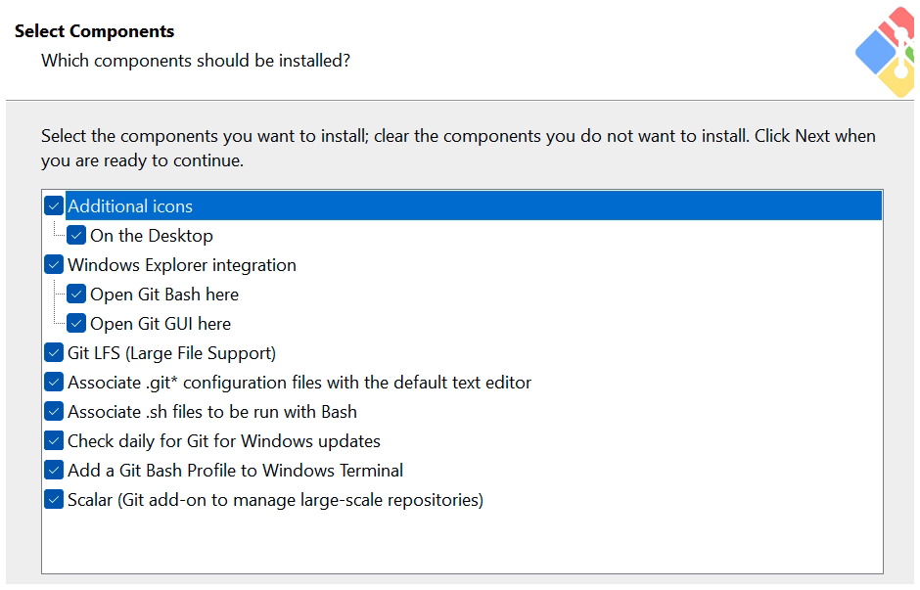
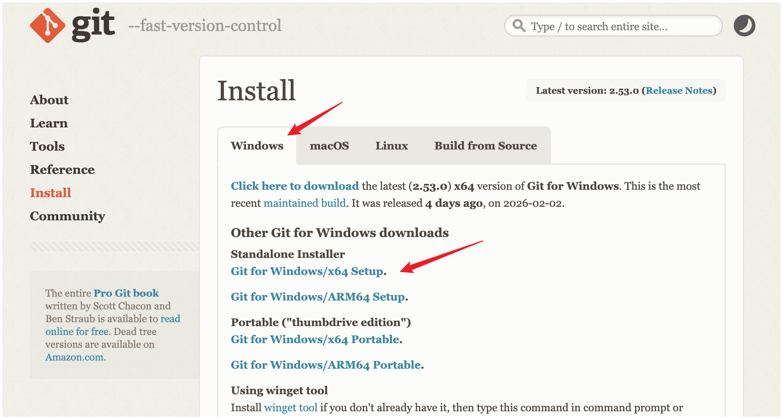
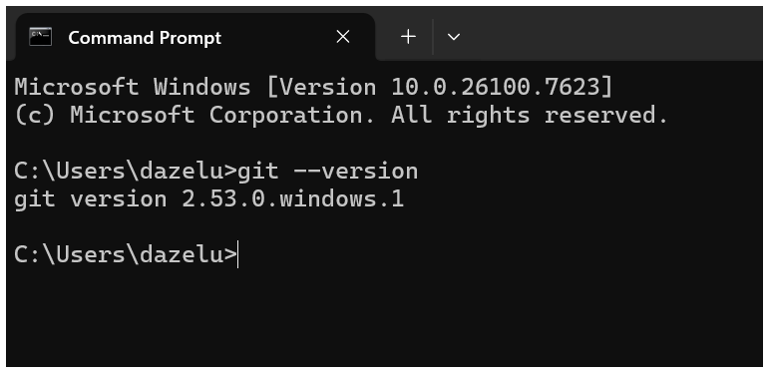
STEP-BY-STEP
Install Git (Windows)
1
Download from git-scm.com
2
Check all parts, click Next
3
Run git --version to check
Reference: Vibe Coding book · Chapter 7 (Environment Setup)
Vibe Coding · June 8, 2026

Slide 16
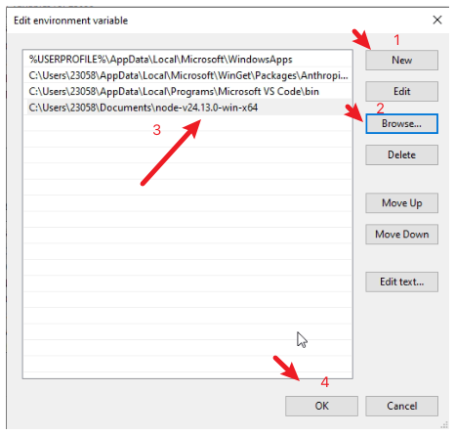
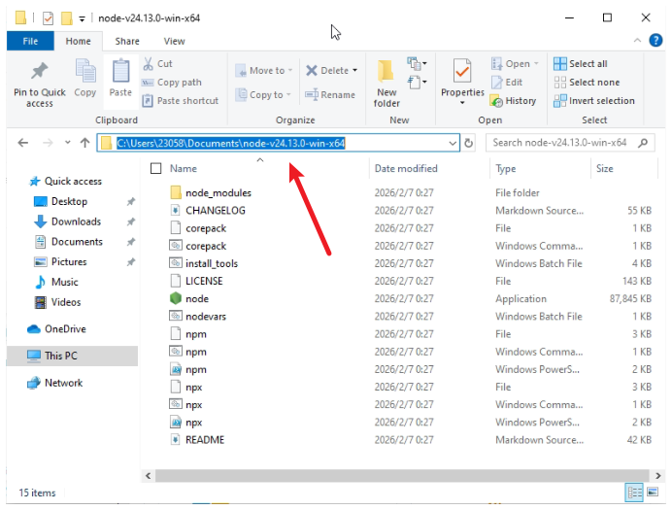
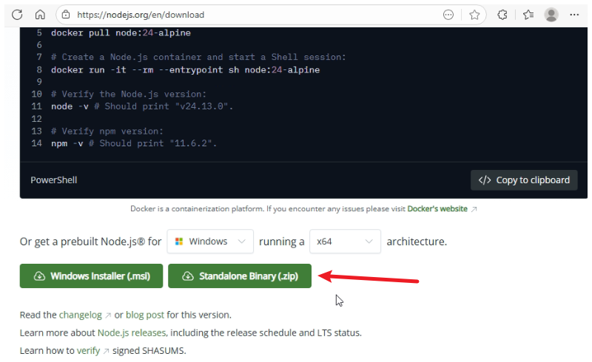
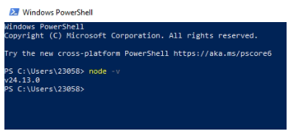
STEP-BY-STEP
Install Node.js (Windows)
1
Download the LTS .zip
2
Unzip to a folder (D:\nodejs)
3
Add the folder to PATH
4
Run node -v and npm -v
Reference: Vibe Coding book · Chapter 7 (Environment Setup)
Vibe Coding · June 8, 2026

Slide 17






WHAT TO BUILD
Plan Your Blog
Sign up & Log in
Log out
Show posts
Make a personal account.
Leave your account safely.
List all posts on the home page.
Write & edit
Light / Dark
Likes & comments
Create, edit, and delete posts.
Switch the page theme.
React, comment, and search.
Reference: Vibe Coding book · Chapter 9 (Web Development)
Vibe Coding · June 8, 2026

Slide 18



WHICH LANGUAGES
Pick Your Tools
RECOMMENDED
FRONTEND
BACKEND
DATABASE
React or Vue
Flask (Python)
SQLite
The look: pages,
buttons, themes.
Login, posts &
the API.
Saves users
and posts.
New to this? Start with Flask + SQLite (one language). Add React or Vue later for a fancier look.
Vibe Coding · June 8, 2026

Slide 19
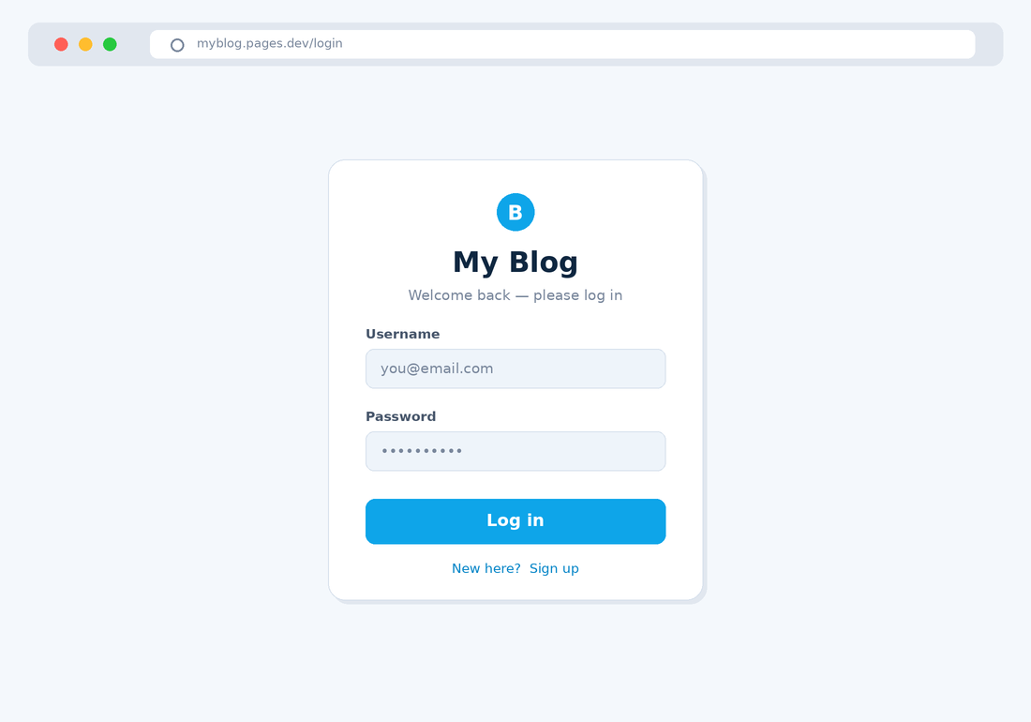
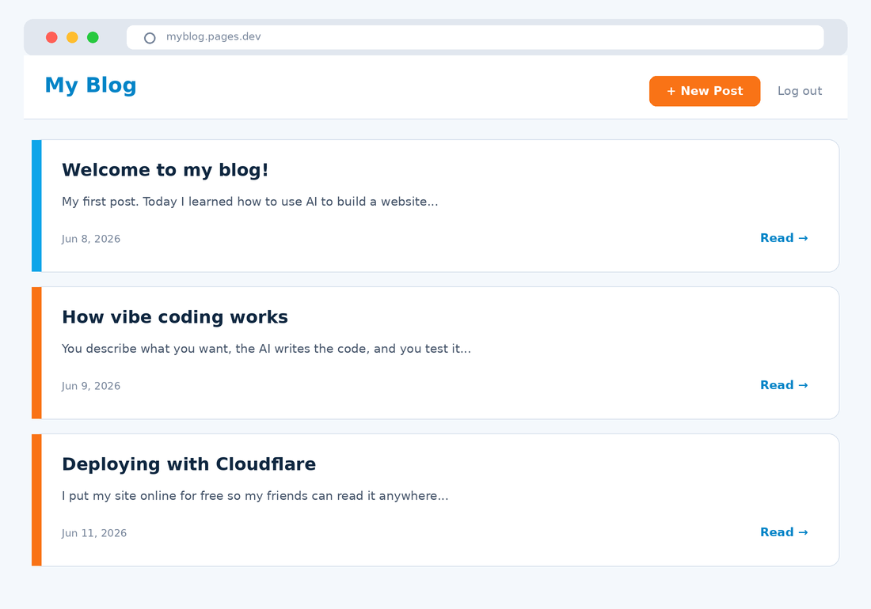
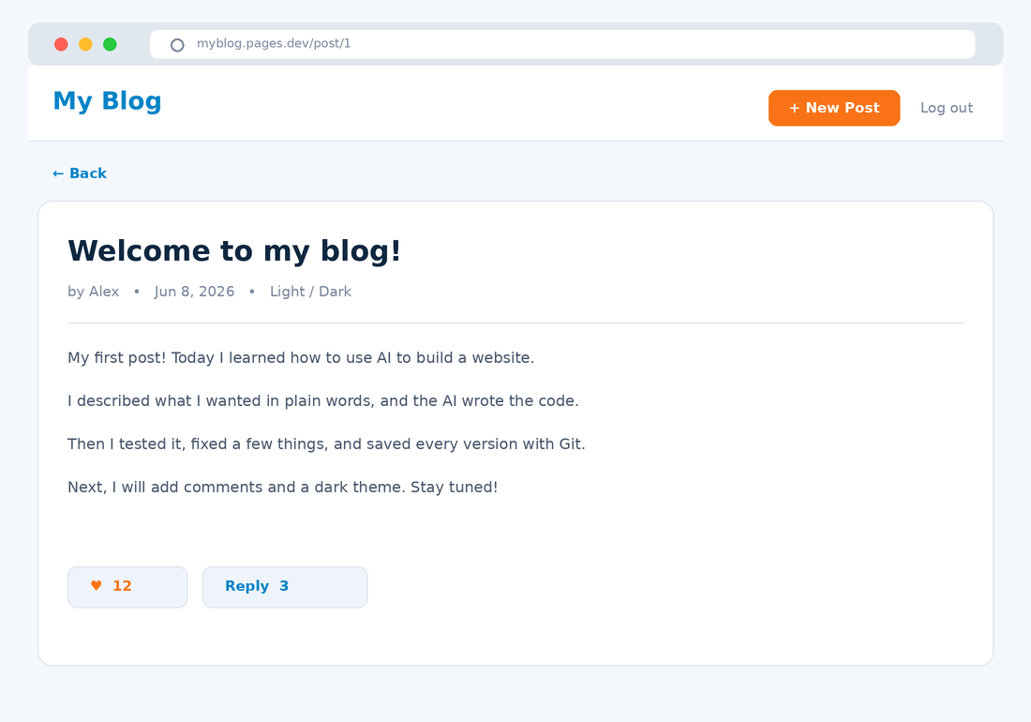
WHAT IT LOOKS LIKE
Page Designs
1
Log in page
2
All posts (home)
3
Read a post
Remember: after every change → git add · git commit · git push
Vibe Coding · June 8, 2026

Slide 20





WORK SMART
Tips for Building Your Blog
Start small
Plan with AI first
One step at a time
Get login + posts working first. Add the rest later.
Make a task.md plan, then follow it step by step.
Ask AI for small pieces, not the whole app at once.
Test as you go
Commit & push often
Stuck? Share the error
Click every button. Fix small problems early.
Save a version every time something works.
Copy the error message and give it to the AI.
Golden loop: build a little → test → commit & push → repeat.
Vibe Coding · June 8, 2026

Slide 21

{ }
Let's start building.
Questions first — then code.
Vibe Coding · Day 1 · June 8, 2026

