Slide 1
</>
STEM INSTITUTE · MODULE 1
MCP, Subagents, Plugins
& Superpowers
Build a blog the engineer's way.
Day 3 — June 11, 2026

Slide 2


ROADMAP
Today's Plan
Part 1 · Power-ups
Part 2 · Build a blog
MCP — plug in tools
Subagents — helper AIs
Plugins — bundles
Meet Superpowers
Install it
Requirements
Break into tasks (task-11.md)
Build with tests (TDD)
Test it
The kickoff prompt
Vibe Coding · June 11, 2026

Slide 3



PLUG IN TOOLS
What Is MCP?
Model Context Protocol
A shared way for AI to reach the outside world.
Talks to “servers”
Each server offers tools or data the AI can use.
One plug for
many tools
One standard
No custom wiring for every tool — it just connects.
Made by Anthropic. Before MCP, every tool needed its own special wiring.
Vibe Coding · June 11, 2026

Slide 4




WHY IT'S USEFUL
What MCP Can Do
Know your code
Use tools
Live data
Read docs
Read the whole
project for context.
Run tests, build,
and deploy.
Read databases
and APIs.
Search guides and
best practices.
Vibe Coding · June 11, 2026

Slide 5




HELPER AIs
What Are Subagents?
A subagent is a helper AI the main agent hands a job to.
Test writer writes the tests
Code reviewer checks the code
Main Agent
Hands out jobs,
collects the results.
Searcher finds things in the project
Each works in its own space, then reports back a short result.
Vibe Coding · June 11, 2026

Slide 6




WHY THEY HELP
Why Use Subagents?
Focused
Clean context
Parallel
Safer
Each has one role
and its own tools.
The main chat sees
only the short report.
Many can work at
the same time.
Fewer tools means
less can go wrong.
Superpowers uses this: subagents build and review each task.
Vibe Coding · June 11, 2026

Slide 7


WHAT'S A PLUGIN?
A Plugin Is a Bundle
One plugin packages many power-ups together — install once, get them all.
Skills
Rules
Subagents
MCP servers
Hooks
Commands
Get them from the Cursor Marketplace — or build and share your own.
Vibe Coding · June 11, 2026

Slide 8


THE STAR PLUGIN
Meet Superpowers
Plans before coding
Shapes the design with you first.
Tests first (TDD)
Writes a failing test, then the code.
A real engineering
workflow for the AI
Reviews its work
Subagents build and check each task.
The most popular plugin (90k+ stars) — and it's in the Marketplace.
Vibe Coding · June 11, 2026

Slide 9

HOW SUPERPOWERS WORKS
Brainstorm → Plan → Build
1. Brainstorm
2. Plan
3. Build & Test
Asks questions and shapes the design with you.
Writes a step-by-step plan — tests first, no extra stuff.
Subagents build each task, test it, and review.
You stay in charge: approve each step before it moves on.
Vibe Coding · June 11, 2026

Slide 10
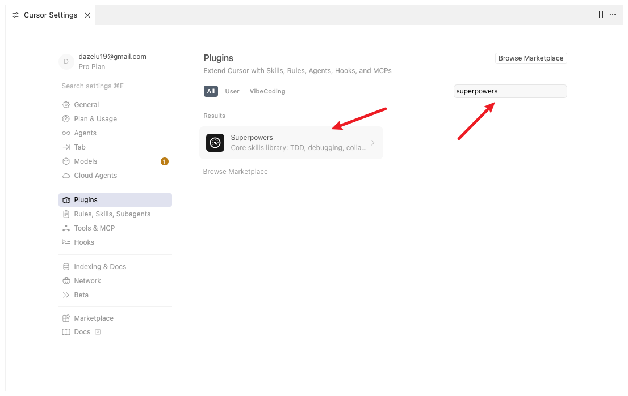
ADD THE PLUGIN
Install Superpowers
Open Cursor Settings → Plugins
1
Type “superpowers” in search
2
Click the plugin → Install
3
It adds the skills to your Agent
4
Reference: Vibe Coding book · Chapter 9 (Web Development)
Vibe Coding · June 11, 2026

Slide 11


THE PLAN
Build a Blog, the Engineer's Way
1. Requirements
2. Break into tasks
3. Build
4. Test
What must it do?
Small steps + a plan.
Code it, one task at a time.
Check every feature.
The same steps real software engineers use.
Vibe Coding · June 11, 2026

Slide 12
STEP 1 · BRAINSTORM
Decide What the Blog Needs
Talk with the AI first. List what the blog must do — before any code.
Sign up / Log in / Log out
Write, edit, delete posts
Home page: list of posts
Post page with comments
Like / dislike a post
Search posts
Light / dark theme
Put it online (Cloudflare)
Tip: write the idea down clearly — a vague plan makes a vague app.
Vibe Coding · June 11, 2026

Slide 13
STEP 2 · BREAK IT DOWN
Make a Plan: task-11.md
1
Setup + database
2
Sign up / log in
3
Posts: add/edit/delete
Split the big idea
into small tasks
4
Comments & likes
5
Search + theme, then deploy
Save the whole design in task-11.md and build one task at a time.
Vibe Coding · June 11, 2026

Slide 14
THE DESIGN FILE
Inside task-11.md
What's inside
# task-11.md
## Requirements
- sign up / log in / log out
- posts: create, edit, delete
- comments, likes, search, theme
## Database
users(id, name, password_hash)
posts(id, author_id, title, body)
comments(id, post_id, user_id, body)
reactions(id, post_id, user_id, kind)
## Tasks (tests first)
1 setup 2 auth 3 posts 4 likes ...
Overview & goals
Requirements
Modules (folders)
Database schema
Routes / API
Task list + tests
Vibe Coding · June 11, 2026

Slide 15

STEP 3 · BUILD IT
Build, One Task at a Time
Test first
Make it pass
Write a failing test for the task.
Write just enough code to work.
Review it
Commit & push
A subagent checks the code.
Save the version, then move on.
Small steps keep the app working the whole time.
Vibe Coding · June 11, 2026

Slide 16
STEP 4 · TEST IT
Red → Green → Repeat
Red
Green
Refactor
Write a test.
It fails (no code yet).
Write code until
the test passes.
Tidy the code,
tests still pass.
Test everything: right pages, login rules, saved data, and edge cases.
Vibe Coding · June 11, 2026

Slide 17
THE EXAMPLE
The Kickoff Prompt
What you type to start the whole build:
“Build a blog with Flask + SQLite. Use the Superpowers workflow: brainstorm the requirements with me, write the design to task-11.md, then build it task by task with tests first. Features: sign up / log in / log out, write/edit/delete posts, a home list, post pages, comments, likes, and a light/dark theme. Commit after each passing test. Ask me questions before you start.”
Then just answer its questions and approve each step.
Vibe Coding · June 11, 2026

Slide 18
{ }
Let's build the blog.
Plan it. Test it. Ship it.
Vibe Coding · Day 3 · June 11, 2026

