Slide 1
</>
STEM INSTITUTE · MODULE 1
Vibe coding
What the course taught, and what we built
The course moved from AI basics to real projects: documents, data, web apps, desktop software, and games.
Vibe Coding · Course Summary
01

Slide 2
COURSE ARC
The course built one delivery loop across many domains
</>
1
Foundation
Vibe coding, agents, Cursor, Git, GitHub.
2
AI workflow
Rules, skills, MCP, subagents, plugins, Superpowers.
Work with data
Word, Excel, pandas, charts, ML.
5
Build apps
Blog system, desktop PDF editor, Godot game.
The same habit repeats every week: describe the goal, make the task small, verify the output.
Vibe Coding · Course Summary
02

Slide 3
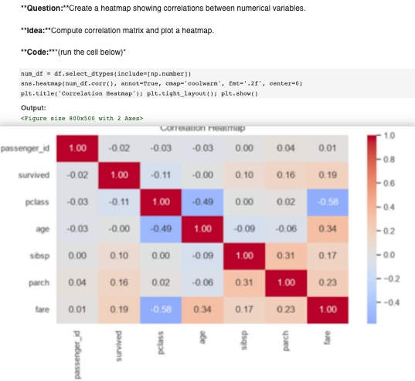
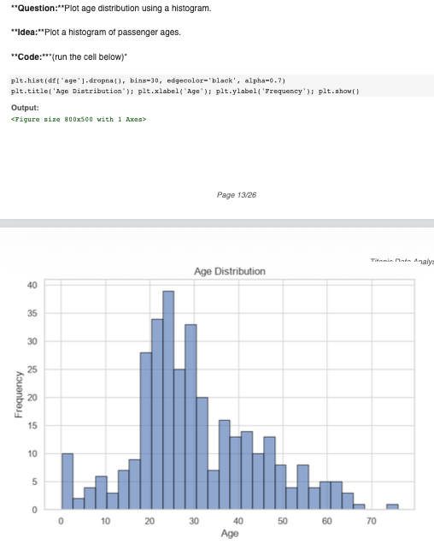
EVERYDAY AUTOMATION
Data-analysis
</>
Vibe Coding · Course Summary
https://github.com/dazelu20-del/titanic-data-analysis-dafne
06

Slide 4
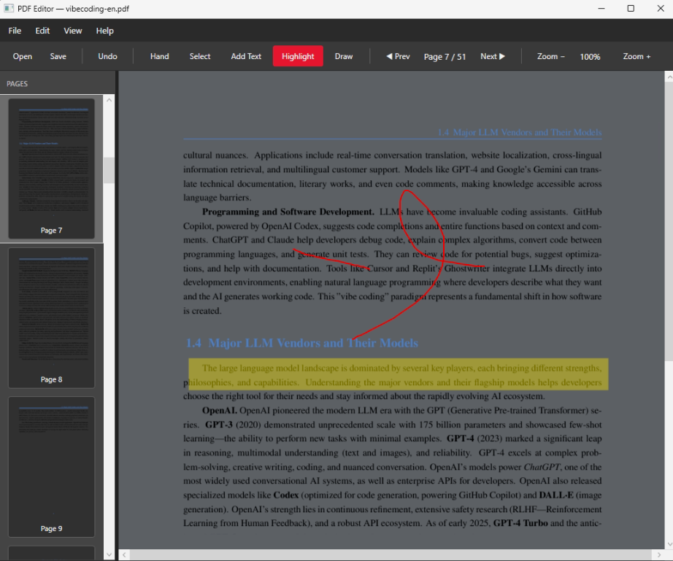
DESKTOP APPLICATION
PageMark
</>
https://github.com/dazelu20-del/Liu-PDF-Editor
Vibe Coding · Course Summary
08

Slide 5
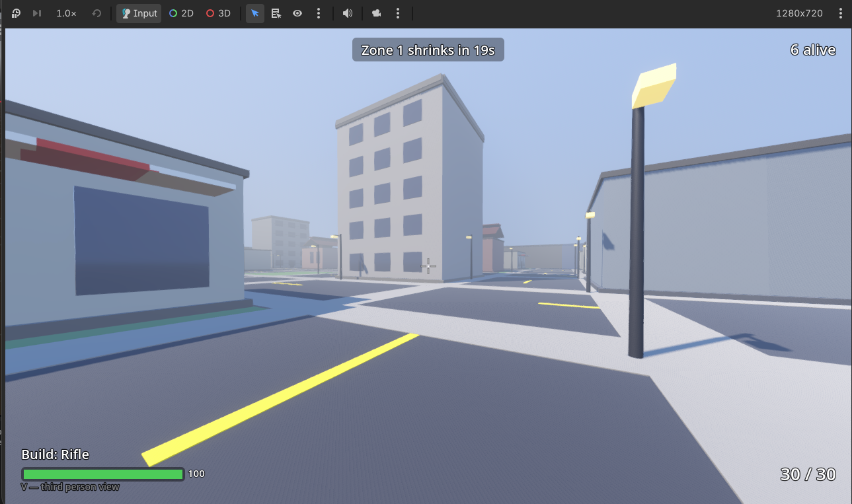
GAME DEVELOPMENT
Last Circle 3d game
</>
https://github.com/dazelu23-droid/fps-game--Aariz
Vibe Coding · Course Summary
09

Slide 6
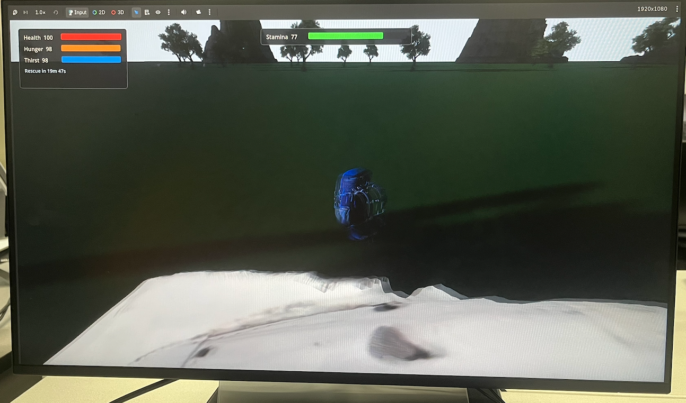
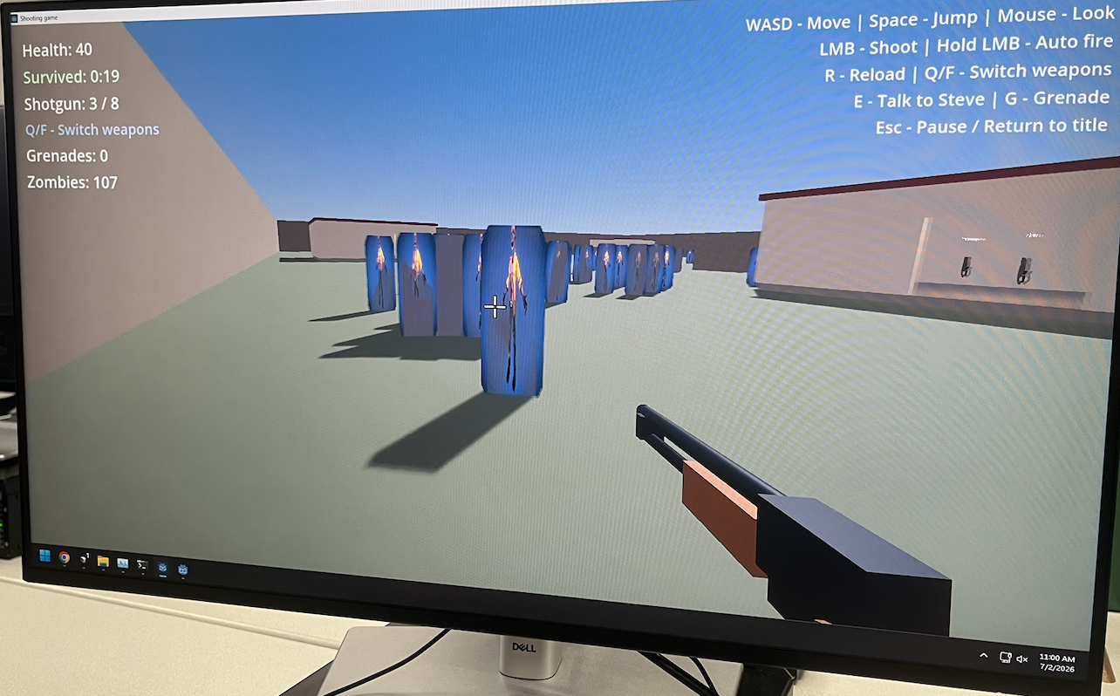
GAME DEVELOPMENT
Final projects
</>
Vibe Coding · Course Summary
09

Slide 7
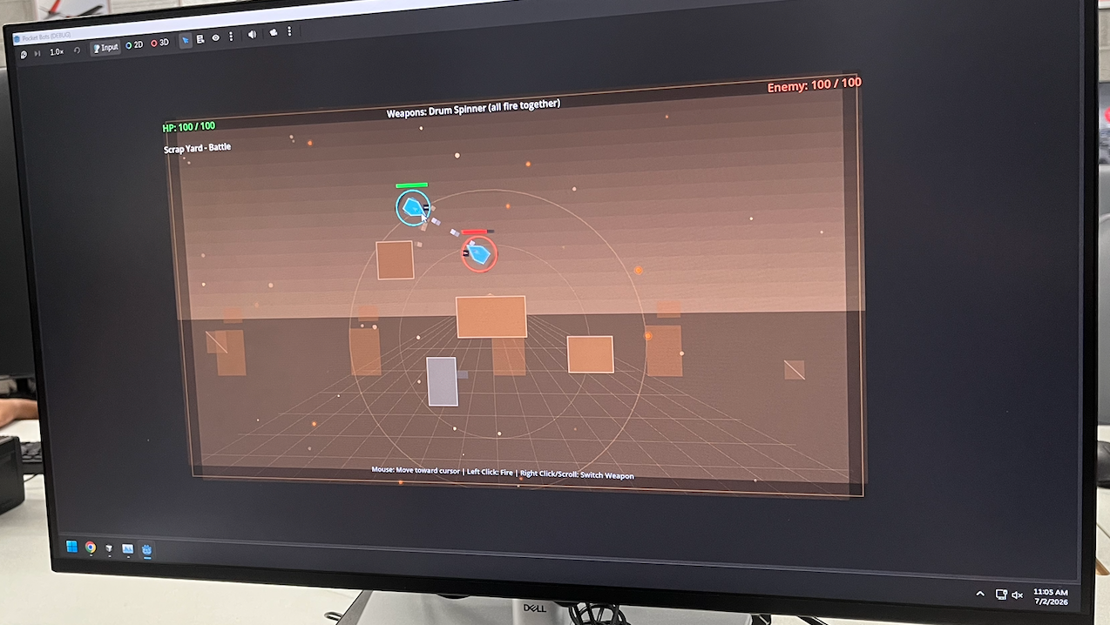
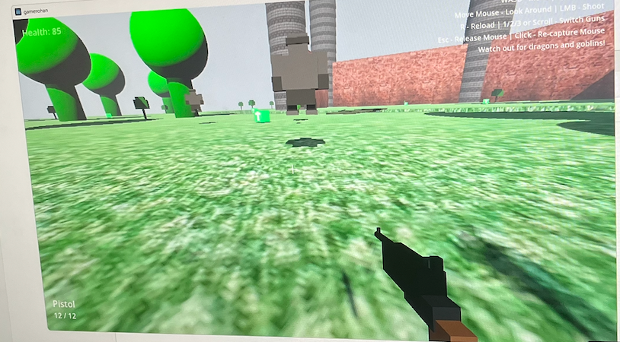
GAME DEVELOPMENT
Final projects
</>
Vibe Coding · Course Summary
09

Slide 8
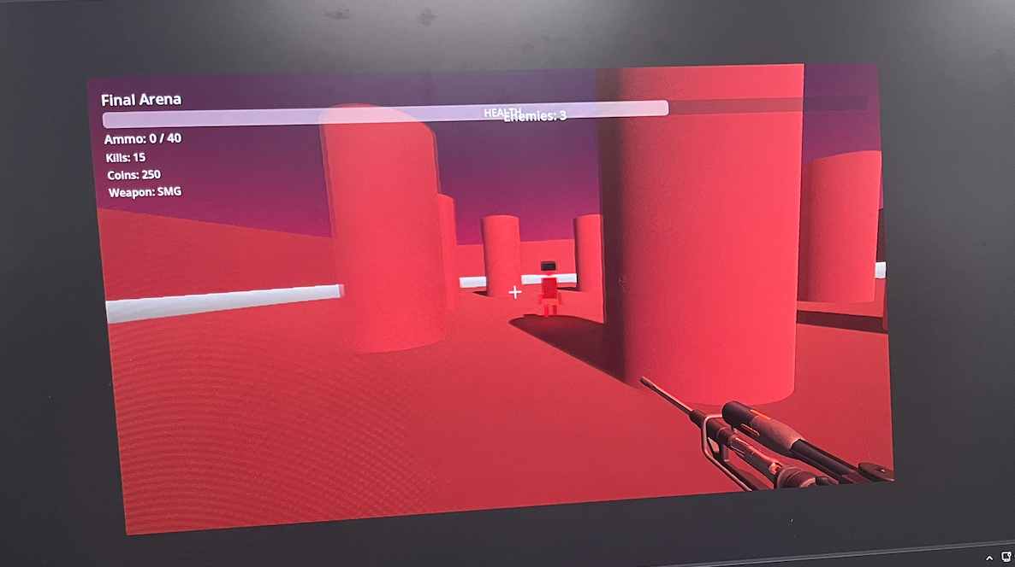
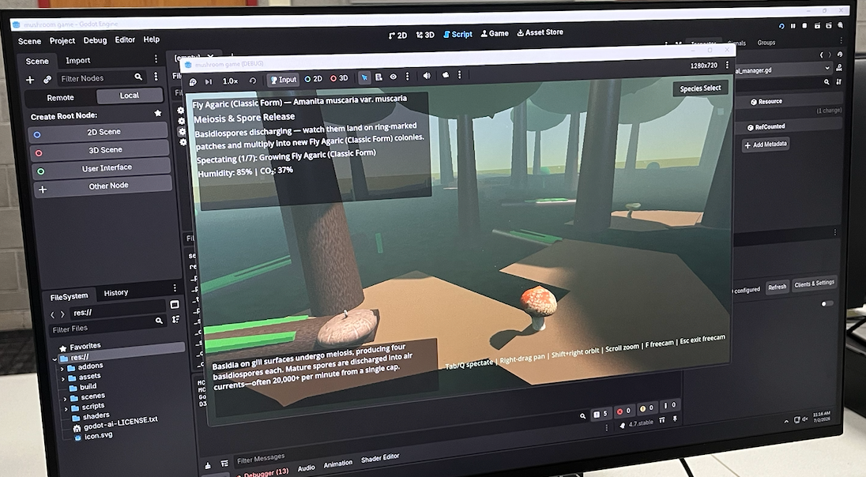
GAME DEVELOPMENT
Final projects
</>
Vibe Coding · Course Summary
09

Slide 9
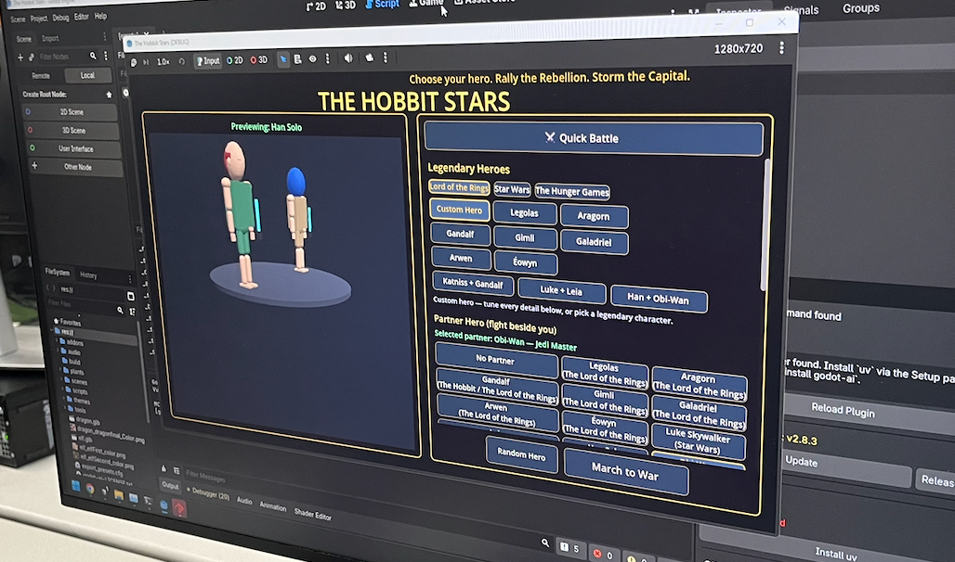
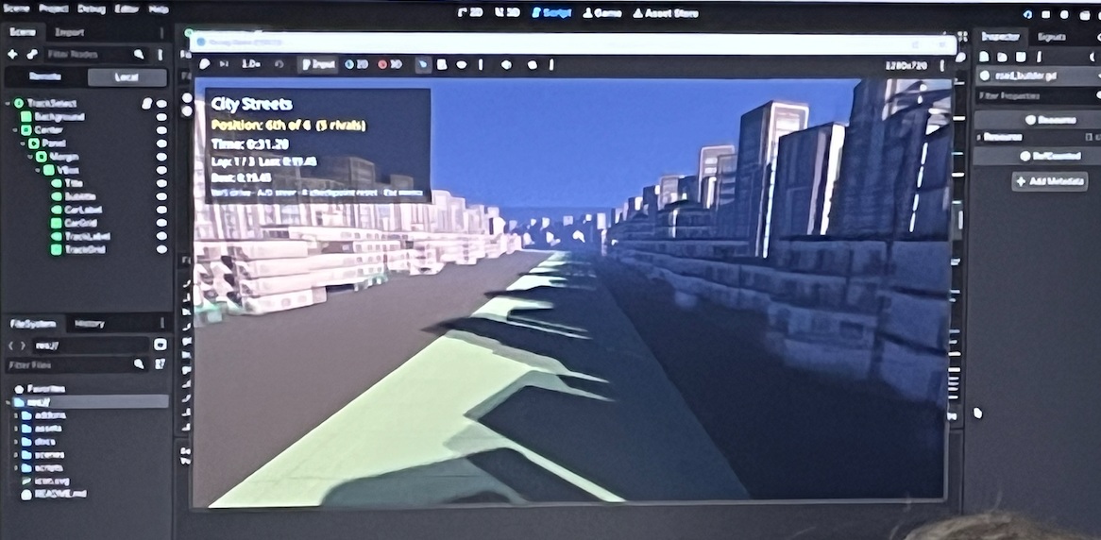
GAME DEVELOPMENT
Final projects
</>
Vibe Coding · Course Summary
09

Slide 10
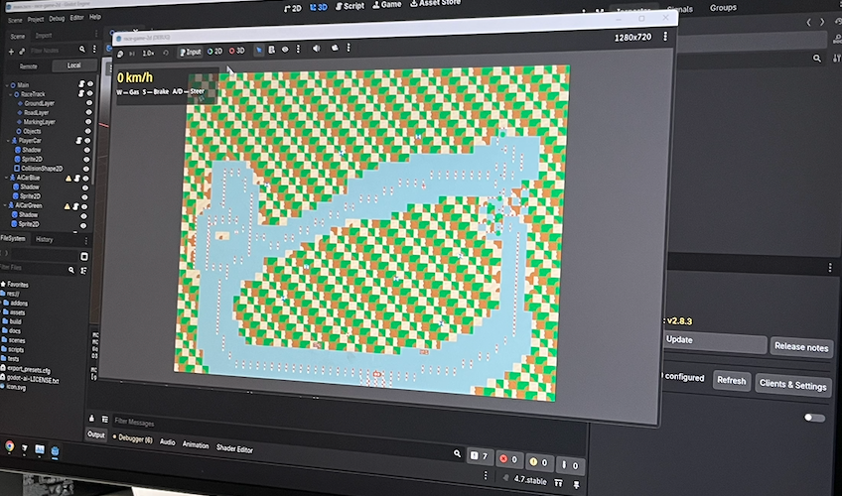
GAME DEVELOPMENT
Final projects
</>
Vibe Coding · Course Summary
09

