Slide 1
Agentic Artificial Intelligence
A Literature Review
Department of Computer Science and Engineering · June 2026
Notes:
Opening: this talk follows an evidence-map structure from the Agentic AI literature review (~15 minutes).

Slide 2
LLMs can reason, but struggle to pursue multi-step goals autonomously
Generative AI: single prompt → single output
Agentic AI: perceive, plan, use tools, iterate toward a goal
2022–2025: rapid rise of ReAct, MCP, and multi-agent frameworks
Industry demand shifts the paradigm from answering to doing
Core shift: from text generation to closed-loop control
2 / 15
Notes:
Frame the timing: LLMs are capable, but lack autonomous multi-step execution and tool orchestration.

Slide 3
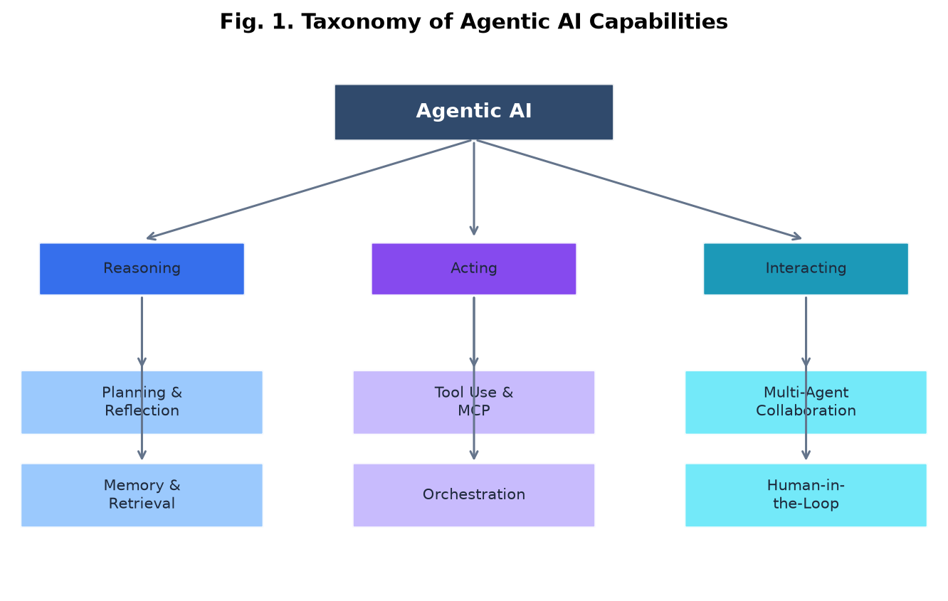
Agentic AI spans reasoning, acting, and interacting
Reasoning (planning/memory), Acting (tools/orchestration), Interacting (multi-agent/HITL)
Adapted from Xi et al., 2025 capability taxonomy
3 / 15
Notes:
Use the taxonomy as the conceptual map for the whole talk; the three axes are facets of one closed loop.

Slide 4
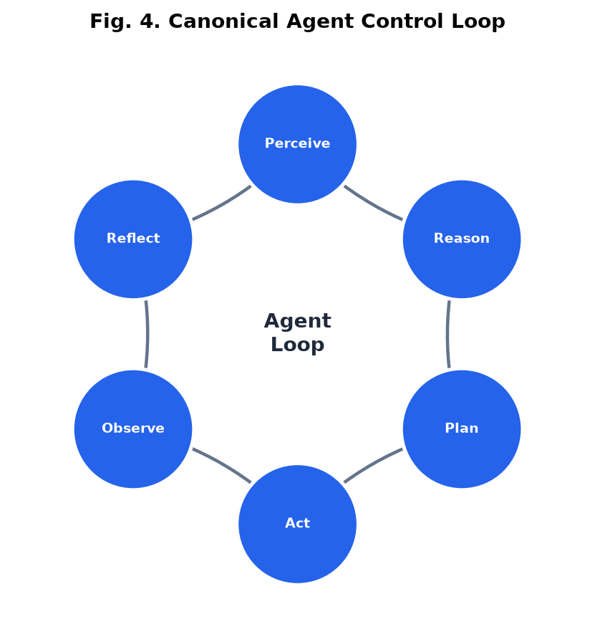
Perceive-plan-act loops are the core of agent control
Key difference from generative AI: observable feedback and plan revision
Perceive → Reason → Plan → Act → Observe → Reflect
Adapted from Guo et al. POMDP agent formalization
4 / 15
Notes:
The control loop underpins ReAct, Reflexion, and later paradigms—closed-loop, not open-loop generation.

Slide 5
Four modules support the Profile-Memory-Planning-Action loop
Core modules
vs. generative AI
Profile — role and constraints
Memory — short-term context + long-term retrieval
Planning — goal decomposition and reflection
Action — tool use and environment interaction
Generative: prompt → single output
Agentic: multi-step loop with feedback
Evaluated on latency, cost, reliability, safety
Formalized as POMDP control (Guo et al.)
5 / 15
Notes:
Engineering view of the same system; complements the conceptual taxonomy on the prior slide.

Slide 6
ReAct established the foundational think-act interleaving paradigm
Paradigm | Year | Key idea | Limitation
ReAct | 2022 | Interleave thought and action | Error propagation
Toolformer | 2023 | Self-supervised tool learning | Training overhead
Reflexion | 2023 | Verbal self-reflection | Higher inference cost
AutoGPT | 2023 | Autonomous goal loops | Stability concerns
6 / 15
Notes:
Paradigm evolution shows different strategies for the same control loop; ReAct remains the most influential baseline.

Slide 7
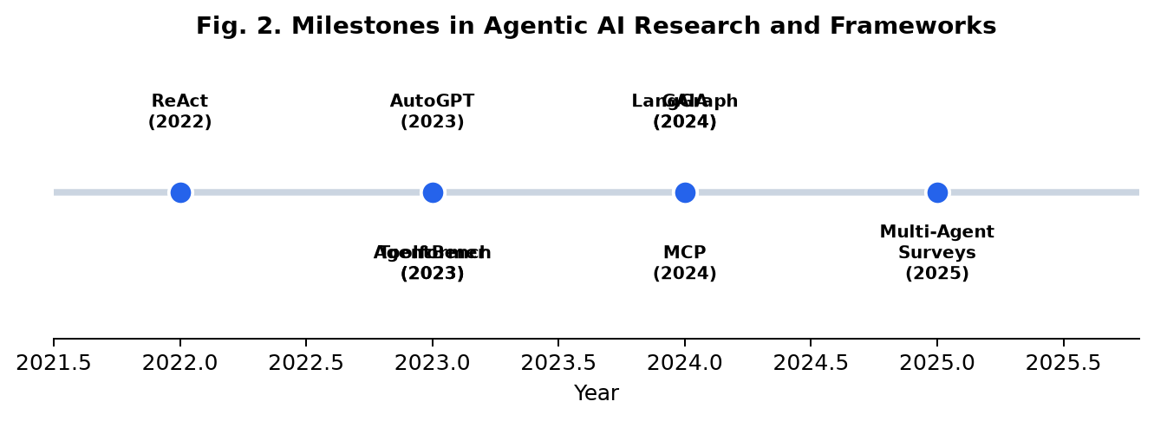
The stack evolved from paradigm innovation to engineering orchestration (2022–2025)
ReAct → Toolformer → AutoGPT → LangGraph → MCP → GAIA
Compiled from review literature timeline
7 / 15
Notes:
Early wins were algorithmic; from 2024 onward frameworks and protocols (LangGraph, MCP) became ecosystem anchors.

Slide 8
Frameworks like LangGraph are moving multi-agent orchestration toward production
Framework | Paradigm | Multi-agent | Production ready
LangGraph | State graph orchestration | Yes | High
AutoGen | Multi-agent conversation | Yes | Medium
CrewAI | Role-based agent teams | Yes | Medium
MetaGPT | Software company simulation | Yes | Medium
CAMEL | Role-playing collaboration | Yes | Emerging
8 / 15
Notes:
Framework choice affects topology, state management, and tool integration; LangGraph is favored for explicit state machines.

Slide 9
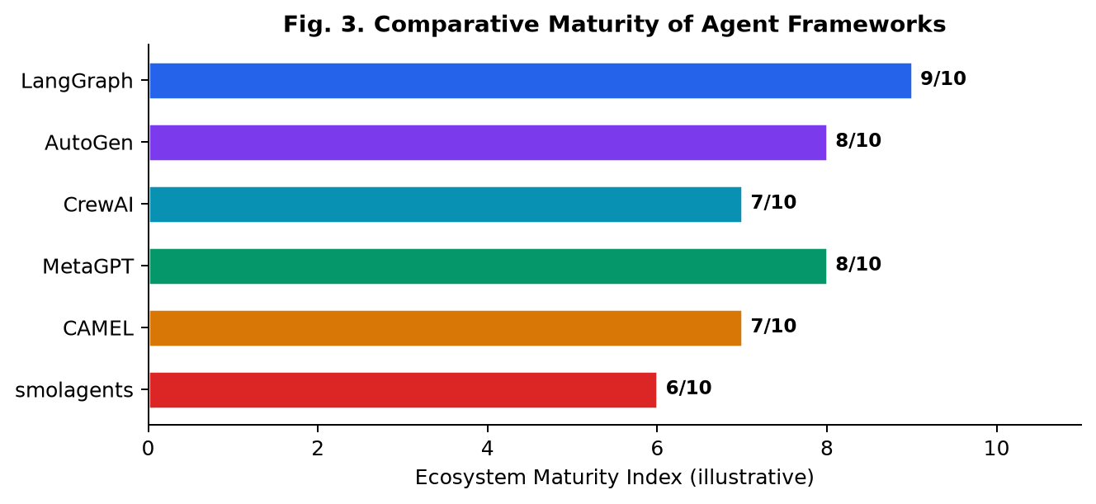
Framework choice can impact performance as much as the base model
Evaluate framework topology as a first-class variable, not only the model
Task success rates vary significantly across frameworks for the same model
Adapted from MASEval, 2026
9 / 15
Notes:
MASEval argues benchmarks are too model-centric; framework and topology matter equally in deployment.

Slide 10
MCP standardizes tool access but introduces new attack surfaces
MCP — unified tool and resource discovery for LLMs
ACP / A2A — cross-agent messaging and collaboration protocols
Benefits: lower integration friction, modular tool ecosystems
Risks: prompt injection, unauthorized tool calls, data exfiltration
10 / 15
Notes:
Protocols are a 2024–2025 hotspot; MCP is widely adopted, but formal security models remain immature.

Slide 11
Most benchmarks are model-centric and miss framework topology effects
Benchmark | Domain | Key metric
AgentBench | 8 environments (OS, DB, web) | Success rate
GAIA | General AI assistants | Level-wise accuracy
SWE-bench | Software engineering | Issue resolution %
τ-bench | Customer service agents | Task completion
Agent-SafetyBench | Agent safety | Harm avoidance score
Gap: no unified system-level benchmark across safety, cost, and coordination
11 / 15
Notes:
Survey major benchmarks and their focus; highlight MASEval's model-centric evaluation blind spot.

Slide 12
Software engineering and scientific discovery lead early deployments
Industry domains
Example capabilities
Software engineering (SWE-Agent)
Scientific discovery and literature synthesis
Healthcare and biomedical research
Finance and enterprise automation
Education and personalized tutoring
Autonomous GitHub issue resolution
Multi-step web deep research
Customer service with tool use
Code generation and DevOps pipelines
Hypothesis generation in materials science
12 / 15
Notes:
Demonstrable pilots exist, but high-stakes domains demand stronger reliability and verifiability.

Slide 13
Hallucinated tool calls and prompt injection remain deployment bottlenecks
Reliability — hallucinated tools, infinite loops, cascading errors
Safety — injection attacks, unauthorized actions, data exfiltration
Cost — each reasoning step adds latency and token overhead
Reproducibility — sampling randomness, API drift, dynamic web environments
13 / 15
Notes:
Group challenges into reliability, safety, economics, and reproducibility—the main barriers to production.

Slide 14
System-level evaluation and protocol security models are the next frontier
Evaluation — unify framework topology, safety, cost, and coordination
Algorithms — RL for dynamic tool selection and long-horizon planning
Protocols — formal security models and standardized interoperability
Integration — neuro-symbolic reasoning for verifiable high-stakes domains
Collaboration — balance autonomy and accountability in human-agent teams
14 / 15
Notes:
Future work addresses the gaps raised earlier: evaluation, protocol security, verifiable reasoning, HITL governance.

Slide 15
Agentic AI is maturing toward engineering—dependable deployment remains open
▸ Agentic AI = LLM reasoning + tool use + multi-step interaction
▸ ReAct established the foundational think-act-observe loop
▸ Framework choice matters as much as model choice
▸ Production requires safety, cost, and reliability engineering
Thank You · Questions?
15 / 15
Notes:
Close with four takeaways; the field is maturing but dependable deployment remains an open problem.

