Slide 1
Cross-variable Summary (n=10000)
CO2 / FiO2 / TEMP vs rSO2 (clinical-step comparable effects)
Run: n10000_overall_mapci_te_boot200 | Model: mapci_te | Scope: overall\nSource: /N/project/waveform_mortality/ZhaoZhang/contour_zhao_all_9_15_2025/result/v5_6_2026_rev2_20260506_co2tempfio2_hemo_adj_boot20_rso2_25_95_full_20260512_152154_overall_mapci_te_n10000_boot200

Slide 2
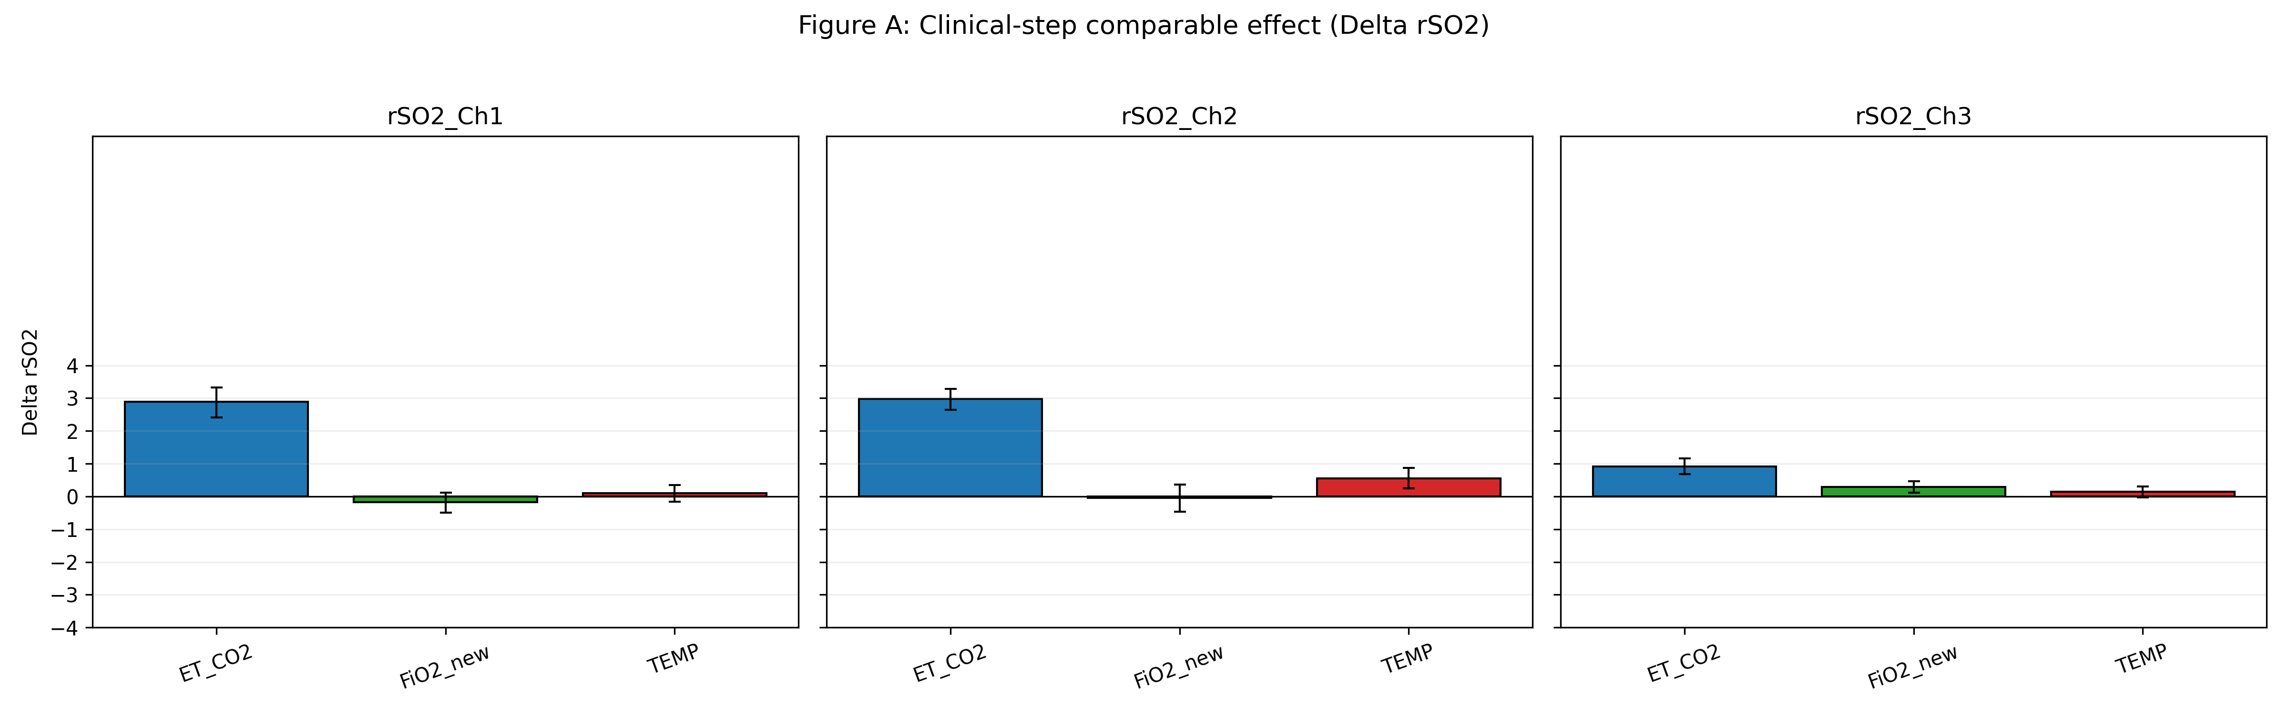
Main effect comparison

Slide 3
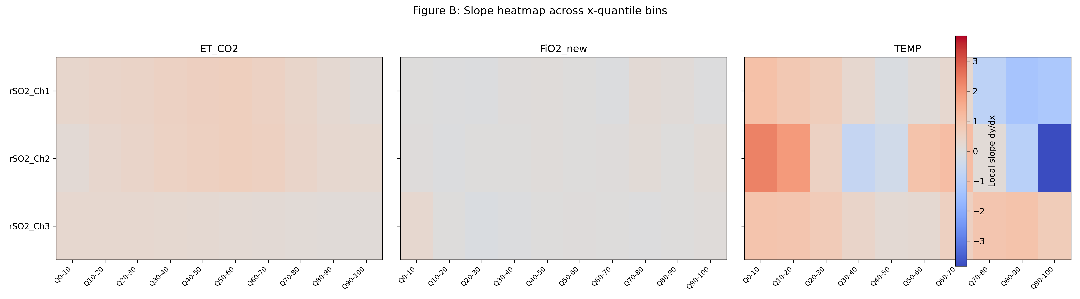
Slope heatmap

Slide 4
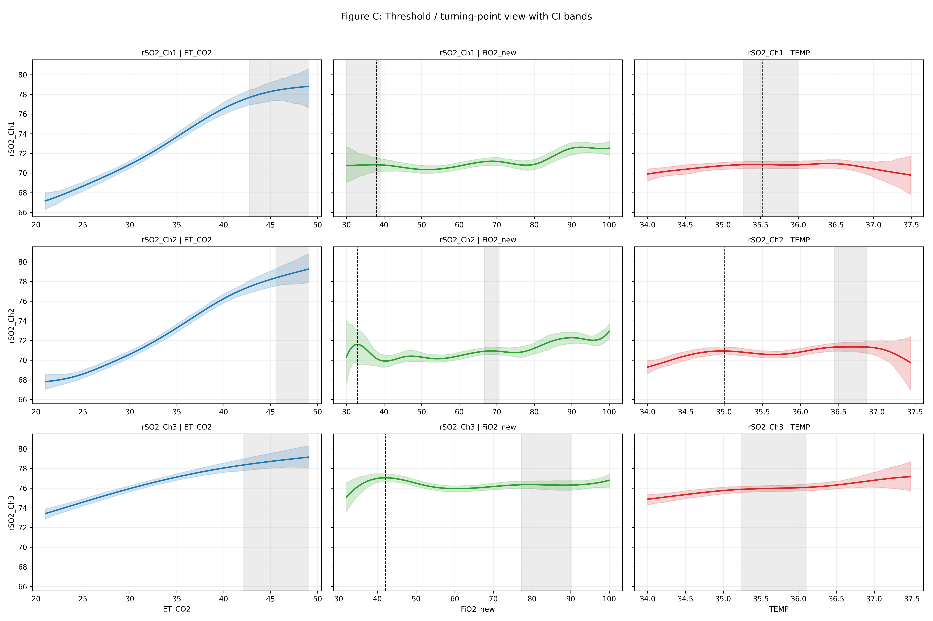
Threshold and turning-point view

Slide 5
Appendix: key numeric summary
rSO2_Ch1 | ET_CO2: Delta=2.889 (95%CI 2.406,3.328), slope@median=0.6221\nrSO2_Ch1 | FiO2_new: Delta=-0.179 (95%CI -0.493,0.121), slope@median=0.0591\nrSO2_Ch1 | TEMP: Delta=0.103 (95%CI -0.156,0.353), slope@median=-0.1548\nrSO2_Ch2 | ET_CO2: Delta=2.977 (95%CI 2.641,3.281), slope@median=0.6043\nrSO2_Ch2 | FiO2_new: Delta=-0.045 (95%CI -0.461,0.365), slope@median=0.0588\nrSO2_Ch2 | TEMP: Delta=0.553 (95%CI 0.253,0.866), slope@median=0.3197\nrSO2_Ch3 | ET_CO2: Delta=0.920 (95%CI 0.679,1.162), slope@median=0.2103\nrSO2_Ch3 | FiO2_new: Delta=0.296 (95%CI 0.113,0.464), slope@median=0.0286\nrSO2_Ch3 | TEMP: Delta=0.147 (95%CI -0.034,0.304), slope@median=0.1644

