Slide 1
Distributed Authentication/Authorization with Page-wise Protected File Access

Slide 2
Outline
Problems
Motivation & Objective
Overview
Login Overview
Protection Overview
Unprotection Overview
Design
Varying keyboard and grouping
Avalanche of states and mapping tables for authentication/authorization
Registration/Login Process
Page-wise Protection/Unprotection
Result
Demo
Security analysis
Conclusion

Slide 3
The Security Problem
Numerous attack vectors exist that are capable of compromising file security systems
No single protective measure can defeat every vector
Possible Vulnerabilities
Key loggers
Device Spoofing
Malware
Password cracking
Data leakage
Memory Scraping
Phishing
Zero day malware

Slide 4
Motivation & Objective
Create a system hardened against numerous attack vectors and impervious to unauthorized access via single-device compromise.
Store protected information in the cloud to provide high reliability and prevent loss of data through physical theft of assets
Minimize the potential loss of sensitive data to in-time memory scraping attacks

Slide 5
Overview

Slide 6
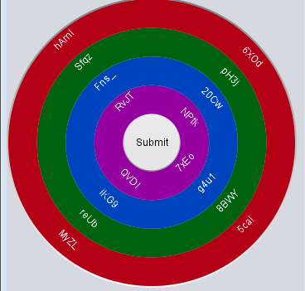





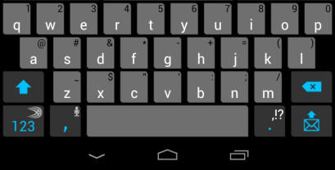
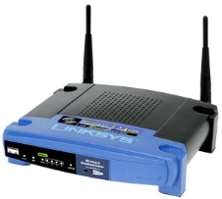

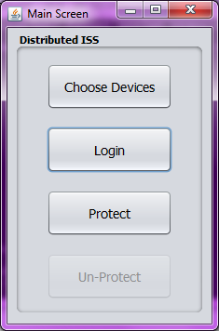


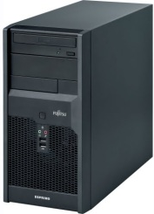
User Login Overview
Master Login
Login
Submit
Master Device
Slave Login
All devices display varying keyboard with varying grouping
User enters password on any combination of devices they chose during registration
User chooses “Submit” on the master device, and is returned to main menu after seeing a ‘pass’/’fail’ notice
If password passed, the “Protect” and “Unprotect” options will become available
Login
Ex. Letters ‘A’B’C’ pressed
Pass?
No
Yes
Distributed ISS
Protect
Un-Protect
Character Stream
‘ABC’
To Server
Notes:
6

Slide 7



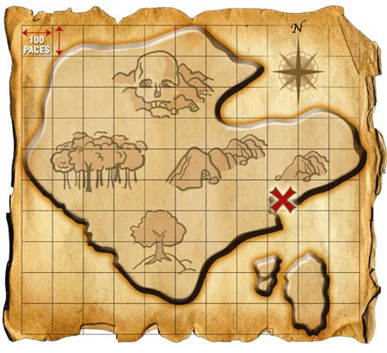
Protection Block Diagram
Mutual Authentication
Feedback System
Output
Password
Synchronous Logon System
Input
seeds
Input
Document Split
AES-GCM File Encyrption
File .bulks
File .pieces
01101110
1/2
Map .bulks
Map .pieces
File Split
1/2
01101110

Slide 8


Unprotection Block Diagram
Feedback System
Mutual Authentication
Password
Synchronous Logon System
Input
Protected File Browser
Input
Map Pieces
File Pieces
01101110
01101110
File Merge
1/2
1/2
Output Part of
Original File
AES-GCM File Decyrption

Slide 9
Design
Secure Channel Communication
Varying keyboard and grouping
Avalanche of states and mapping tables for authentication/authorization
Registration/Login Process
Page-wise Protection/Unprotection

Slide 10
Secure Channel Communication

Slide 11
Encryption Method
Block Cipher
AES-256 GCM will be used to encrypt data and provide data integrity checking.
Encryption Process
Two devices will exchange seeds, XOR the seeds, use the XOR output as a seed into a random number generator, and use that as an initial encryption key.
Next a portion of the key stream will be added with an IV (from a random number generator) to create an IV.
The initial encryption key and IV are used to encrypt a simple file.
The simple file is then encrypted again using the same key and IV. The output of this is the key for the communication line.
The server will attempt to generate the same key. If the server is able to decrypt the file sent then the server has been authenticated.

Slide 12
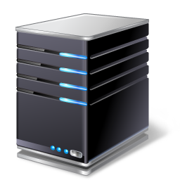




Three way authentication
All three devices (PC, Server, and Android) will need to authenticate each other before the passwords are typed in.
This will be invisible to the user
If authentication fails communication between these devices will be terminated
There will be six different keys for encryption/decryption
K_{PCS} – PC and Server shared key
K_{PCA} – PC and Android shared key
K_{AS} – Android and Server key
EK_{PCS} – Generates K_{PCS} on PC using key stream
EK_{PCA} – Generates K_{PCA} on PC using key stream
EK_{AS} – Generates K_{AS} on Android using key stream
K_{PCS}
K_{AS}
1st Key Pressed
1st Key Pressed
EK_{PCS}
EK_{AS}
2nd Key Pressed
EK_{PCA}
K_{PCA}

Slide 13

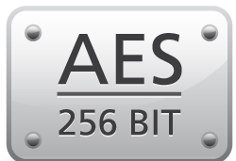
Key Establishment 1
Keys are established between each pair of devices by exchanging two random numbers and “xor”ing the two together to create the seed for the PRNG. The final key is created by encrypting a file of 0s with a portion of the key stream and the IV as the IV.
Send Server random number X
Password
Send PC random number Y
Output of 1 Key press
K_{PCS}
Key
Random seed for key generation:
X
Y
000
GCM
GCM
IV

Slide 14
Key Establishment 2
Master device will first establish keys with each device. Then master device will tell each slave to establish keys with all remaining devices.
Master
Slave 1
Server
Master establishes key with each device
Slave 1 establishes keys with server
Legend:
Key Establishment: Control Message:

Slide 15
Varying Keyboard and Groupings

Slide 16
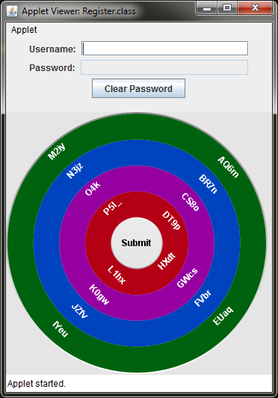
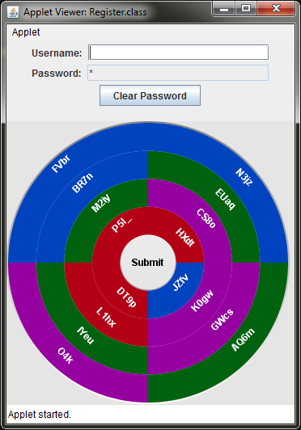
Intra-session Key Scrambling
The position of the buttons is scrambled when either of two cues occur:
The user presses a key
A time interval chosen randomly between four and six seconds elapses.
The time interval changes after each cue.
Interval-based scrambling does not occur until the user presses the first key.

Slide 17
Inter-session Key Value Scrambling
For every login after registration, two buttons have half of their values swapped.
Which half of the values are swapped as well as which buttons have their values swapped is derived from a generated seed.
This seed is derived by computing a hash of the seed used to generate the character mapping table.
1 2 3 4
5 6 7 8
1 2 g h
5 6 7 8
1 2 g h
5 6 3 4
a b c d
e f g h
a b c d
e f 3 4
a b c d
e f 7 8
Registration
1st Login
2nd Login

Slide 18
Password Permutations
Because the password verification stream for the password entered during the Xth login is generated using a value-scrambled version of the keyboard, we cannot guarantee that the two streams will match.
We can, however, enumerate a set of permutations that are permissible.
These permutations are “pre-computed” during the Xth login based on the Xth login mapping seeds and the scrambling that will occur during login X+1.
The assembly of the permuted values is done server side during login X+1.
The password stream entered during login X+1 must match one of the assembled permutations.
1
2
2
1 2
5 6
1 f
5 6
3
3
1
a b
e f
a b
e 2
Registration
1st Login
1
2
1 f
5 6
Example Password: 25a
3
a b
e 2
Alternative input sequence

Slide 19
Avalanche of States & Mapping Tables for Authentication/Authorization

Slide 20
Password setup
USB holds keys and seeds for the PC.
SD card holds keys and seeds for the Android.
Create a password that is at least 9 characters between the PC and Android
Each device must have at least 3 characters of the password.
3 characters of PC password will be used in the feedback code to retrieve the decryption key for the SD card, which will then be sent to the Android.
3 characters of Android password will be used in the feedback code to retrieve the decryption key for the USB device, which will then be sent to the PC.
The combined passwords from both devices will be used for server authentication
Old and new seeds are sent to the device before characters are sent. Old seed is used to create the decryption key for currently stored data. New seed is will be used to encrypt data for next login.
SD key
creation
USB key
creation
Password_{PC}
Password_{A}
Rest of Password
0
2 3
5 6
…
Server Authentication

Slide 21
Character-to-string Mapping
Each input value is mapped to a string of random characters via a session-specific generated table.
Since each button on the keyboard corresponds to four character values, a 32-character stream is generated.
Each client device has its own unique table
Tables are generated via a seed stored on external storage (USB for PC client, SD card for Android client).
“a”
Mapping Function
“1g_B69ap”
R_{x}
Table Generator
Mapping Table

Slide 22
Table Construction via Feedback
Only the first three buttons pressed by the user on each device are mapped according to the initial table.
A new table is generated via a feedback loop that takes into account which buttons the user pressed.
This method of generation ensures that the mapping cannot be cracked merely by acquiring the initial seed.
S_{x} : The initial key mapping table (KMT) used for the Xth login
R_{x} : The metamorphic random number at the Xth login.
SHA-256
S_{x}’
C₀
C₁
SHA-256
First 3 Inputs
Mapping Function
C₂
SHA-256
S_{x}
R_{x}

Slide 23


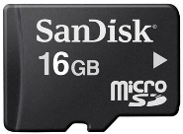
USB/SD feedback code process
Generate new mapping table
Hashed
Key
Hash
SHA-256
Current
Feedback
Output
Password
Pressed Key
Feedback Code
Send Final Output
Seeds
Random #s
The feedback code will be stored on the external device (USB or SD card). Along with the encrypted seeds and keys.
The characters of the password are sent to the feedback code using UDP. The feedback code is started by running the batch file (also stored on the USB/SD).

Slide 24

USB/SD Metamorphic code process
Send
Seeds
Start Batch Command
Send
Step 3
Batch
Start
Step 1
Insert Random Numbers
Start
Step 2
Step 2
Random #s
Step 4
Feedback Code
Metamorphosis code
New Seeds
Step 5
Step 5
Delete Random Numbers
The feedback code will be stored on the external device (USB or SD card). Along with the encrypted seeds and keys.
The characters of the password are sent to the feedback code using UDP. The feedback code is started by running the batch file (also stored on the USB/SD).

Slide 25
Items Stored on External Storage
Items stored on USB
Items stored on SD
Feedback.java – the program for generating the encryption/decryption key for the SD card.
Metamorphosis.java – the program that modifies the stored random number in Feedback.java
FeedbackInt.java – the interface for Feedback.java which is used for java RMI and LipeRMI
MetamorphosisInt.java – the interface for Metamorphosis.java which is used for Java RMI and LipeRMI
run_Feedback.bat – the batch file for running Feedback.java and Metamorphosis.java.
Seed.txt the seed for generating the initial tables.
Seed.txt the seed for generating the initial tables.
The Feedback and Metamorphosis codes aren’t needed on the SD card because the Android uses LipeRMI to remotely invoke the Feedback.java/Metamorphosis.java methods. This is needed because Android doesn’t support compiling/running codes from the SD card or Java RMI.

Slide 26
JavaRMI/LipeRMI with USB/SD contents outlined
Seeds
Runs Java Code Remotely
Feedback Code
w/Feedback Server
(on USB)
Feedback Interface
(on PC, Android and USB)
Runs Java Code Remotely
Metamorphosis code w/Metamorphosis Server (on USB)
Metamorphosis Interface
(on PC and USB)
Batch
Runs Java Code Remotely
Seeds
Legend
Belongs To:
Runs:
Provides Method Details:
LipeRMI:
Java RMI:
Java RMI (Remote Method Invokation) is used to give the PC program access to the code on the USB as if it were part of the PC program
LipeRMI is a lightweight version of Java RMI that is supported by Android

Slide 27
Registration and Login Procedure

Slide 28
Registration
Password
Store Obfuscated/Encrypted Password
Save
Seed1
Seed1
Obfuscate
GCM
Save
Key1
Key1

Slide 29
1st Login
Decrypt Entered Password
Password
Seed1
Key1
GCM
Obfuscate
Password
Decrypt Stored Password
Compare
Key1
Obfuscate
Password
Save
Seed2
Perform file operations
And send response
GCM
Seed2
Save
Key2
Key2

Slide 30

2nd Login
Decrypt Entered Password
Password
Key2
Delete
Key1
on success
Seed2
GCM
Obfuscate
Decrypt Stored Password
Compare
Delete
Seed1
on success
Key2
Obfuscate
Save
Seed3
Perform file operations
And send response
Seed3
GCM
Save
Key3
Key3

Slide 31
Validation flow chart (File operations keys, seeds, and passwords)
Save Seed2 as Seed1 and save Key2 as Key1
Rename Seed1 Seed0 and rename Key1 Key0
Compare
Obfuscated
Passwords
Delete Seed0 and Key0
Delete stored obfuscated password, store entered obfuscated password, and delete keys
yes
Valid
Delete Seed2 and Key2
no
Valid
yes
no
Delete entered obfuscated password
and received keys
Verification Message

Slide 32
Validation flow chart with program suicide
Tries++
Yes
Delete Seeds
Begin Suicide Procedure
Tries <=5
No
Password
Master
Password
Valid
Feedback Code
Send
Verification Message
Continue to protection & unprotection
Suicide procedure involves deleting files necessary for encryption decryption process (seeds, keys, etc.). The attacker will not be notified when the program has committed suicide.

Slide 33
Directory/File Protection

Slide 34


Directory Protection
Begin Protecting Directory
Files
Map Directory Hierarchy
File
Map
FileA.pdf
FileB.pdf
File Protect
File Protect

Slide 35
Multi-Page File Protection (Document Protection)
Splits file by page
File info includes filename, file path, and the number of pages the file contains
Only supports PDF files (uses PDFBox library)
Support for other file types can be added with additional Java libraries
Protect File
File_1.pdf
Protect File
File_2.pdf
File.pdf
Protect File
Add File info to
File_3.pdf
File
Map

Slide 36
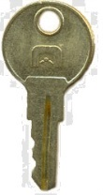

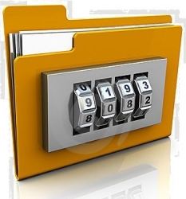
Index File Generation
AES-GCM Encryption
File Splitting
Initial Vector (IV)
File Locations
Random #s for Pieces Extraction
Index File
Encrypted Index File
piece
bulk

Slide 37





File Encryption & Split
Password1
Salt
Enc Key
IV
Salt
Filename and Storage Path
Program Choose
File to Encrypt
Index File
GCM
Split file
Rand. #s
Split Index
1/2
2/2
1/2
2/2
.bulk
.piece
PC
.piece
.bulk
Server

Slide 38



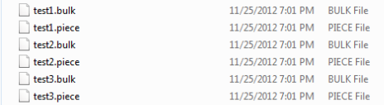
Random File Splitting
Function takes the 1/5 data from the original file based on random location
Random location in a file
Encrypted
Operation in PC
Random # Generator
Split function()
Information like pieces, key, IV saved in index file
4/5 contents
Random # sequence
1/5 contents
Information of pieces saved in Index file
Piece file
Bulk file
.piece to Android
.bulk files and .piece files after splitting in the same directory
Client PC

Slide 39


Random Index File Splitting
Function takes the 1/5 data from the original file based on random location
Random location in a file
EncryptedIndex file
Operation in PC
Random # Generator
Split function()
4/5 contents
Random # sequence
1/5 contents
Random.txt
Random location in a file
Index.piece
Index.bulk
Stores Random.txt
in persistent storage
Index.piece to Server
Server
Client PC

Slide 40
Document Unprotection
Browse Protected Folders/Files
Select Page to View
Unprotect Document X page Y
Display
Page
Map Folder Hierarchy
PDF closed?
yes
File_X.pdf
no
File Merge
Protect current page
File
Map
bulk
piece
Can only view one page at a time, meaning an attacker can only retrieve one page when the document is in the memory decrypted
There is no way to unprotect the entire document or the entire directory
File Split
piece
bulk

Slide 41

File Unprotection
Android
Send piece to PC
Get piece by
filename
Filename from index
index
Piece of file from Android
piece
bulk
Merge using index
information
Decrypt file
*Index file has path for all the pieces
*Merge program looks for the index file
Original files

Slide 42



File Decryption & Merge
1/2
2/2
Choose File to Decrypt
Choose File to Decrypt
(Encrypted file)
Enc Key
Merge file
IV
Rand. #s
Index .bulk File
Orginal file
File Name&Path
GCM
1/2
.bulk
Index file
tell where the pieces are
Index .piece File
GCM
2/2
Server
.piece

Slide 43

Random File Merging
Android
Filename from index
Index File
Operation in PC
Get piece by
filename
Random #s
Send piece to PC
piece
bulk
Piece of file from Android
Get the 1/5th useful data using Random #s
Remove the junk data according to Random #s
Encrypted
Merge function()
*Index file has path for all the pieces
*Merge program looks for the index file

Slide 44
Random Index File Merging
Random.txt
Random.txt
from persistent storage
Server
Operation in PC
Get index.piece
Random file locations
Send piece to PC
Index.piece
piece
bulk
Get the 1/5th useful data using Random # locations
Remove the junk data according to Random # locations
Encrypted Index File
Merge function()

Slide 45
Results

Slide 46
Synchronous Logon System Latency (Unit: seconds)
Group | 1 | 2 | 3 | 4 | 5 | 6 | 7 | 8 | 9 | 10 | Average
Logon Time | 29.1 | 27.1 | 38.6 | 30.1 | 26.4 | 30.8 | 26.0 | 21.5 | 34.4 | 23.8 | 28.78
Detail: Logon Latency = User Input Latency + Network Latency + Verification Latency

Slide 47
PDF Split/Protect Latency (Unit: seconds)
Group File size &number | 1 | 2 | 3 | 4 | 5 | 6 | 7 | 8 | 9 | 10 | Average
File number: 1 File size: 50KB # of Pages: 6 | 0.27 | 0.14 | 0.11 | 0.11 | 0.11 | 0.11 | 0.12 | 0.10 | 0.11 | 0.11 | 0.129
File number: 2 File size: 1100KB # of Pages: 26 | 1.84 | 3.21 | 2.32 | 2.64 | 1.82 | 1.90 | 2.27 | 2.06 | 2.93 | 2.15 | 2.314
File number: 3 File size: 2000KB # of Pages: 103 | 21.6 | 20.3 | 22.5 | 19.0 | 20.8 | 20.5 | 22.9 | 21.5 | 19.5 | 19.7 | 20.83
File number: 5 File size: 3000KB # of Pages: 147 | 35.1 | 31.3 | 30.2 | 33.1 | 31.9 | 32.8 | 32.7 | 36.1 | 32.5 | 31.6 | 32.73
File number: 2 File size: 5600KB # of Pages: 170 | 39.2 | 37.3 | 36.1 | 35.8 | 39.9 | 35.4 | 39.0 | 37.5 | 34.7 | 38.5 | 37.34
Detail: Total unprotection latency = Password Logon System Latency + TPM Identity Attestation Latency + Key Unbinding Latency + File Merging & Decryption Latency

Slide 48
PDF Split Latency (Unit: seconds)
Group File size &number | 1 | 2 | 3 | 4 | 5 | 6 | 7 | 8 | 9 | 10 | Average
File number: 1 File size: 50KB # of Pages: 6 | 0.07 | 0.08 | 0.07 | 0.07 | 0.07 | 0.08 | 0.08 | 0.06 | 0.07 | 0.08 | 0.073
File number: 2 File size: 1100KB # of Pages: 26 | 1.18 | 1.78 | 1.12 | 1.34 | 1.15 | 1.25 | 1.45 | 1.16 | 1.84 | 1.23 | 1.350
File number: 3 File size: 2000KB # of Pages: 103 | 9.49 | 8.76 | 9.70 | 9.20 | 9.17 | 9.82 | 7.90 | 10.1 | 9.35 | 8.85 | 9.230
File number: 5 File size: 3000KB # of Pages: 147 | 15.6 | 14.2 | 15.8 | 15.1 | 15.1 | 16.3 | 16.2 | 16.7 | 16.5 | 15.5 | 15.70
File number: 2 File size: 5600KB # of Pages: 170 | 18.2 | 17.8 | 18.1 | 15.0 | 21.3 | 18.5 | 18.2 | 17.1 | 17.2 | 17.7 | 17.91
Detail: Total unprotection latency = Password Logon System Latency + TPM Identity Attestation Latency + Key Unbinding Latency + File Merging & Decryption Latency

Slide 49
Protection Latency (Unit: miliseconds)
Group File size &number | 1 | 2 | 3 | 4 | 5 | 6 | 7 | 8 | 9 | 10 | Average
File number: 1 File size: 50KB | 15.0 | 12.3 | 11.5 | 7.78 | 12.5 | 9.90 | 9.33 | 7.78 | 7.57 | 8.92 | 10.258
File number: 2 File size: 100KB | 18.7 | 11.8 | 15.6 | 14.4 | 14.3 | 10.5 | 10.5 | 13.7 | 9.23 | 12.6 | 11.703
File number: 3 File size: 200KB | 16.5 | 14.7 | 14.4 | 20.7 | 18.8 | 20.6 | 24.7 | 16.2 | 16.8 | 15.4 | 17.880
File number: 5 File size: 300KB | 29.0 | 25.1 | 23.2 | 22.4 | 25.2 | 17.9 | 20.0 | 21.4 | 28.1 | 17.6 | 22.990
File number: 2 File size: 500KB | 47.1 | 24.3 | 25.5 | 37.3 | 26 | 36.7 | 29.7 | 25.4 | 26.5 | 23.6 | 30.210
Detail: Total protection latency = Password Logon System Latency + File Encryption & Splitting Latency + Key Binding Latency + AIK & File Distribution Latency

Slide 50
Unprotection Latency (Unit: miliseconds)
Group File size &number | 1 | 2 | 3 | 4 | 5 | 6 | 7 | 8 | 9 | 10 | Average
File number: 1 File size: 50KB | 19.2 | 28.0 | 37.9 | 29.2 | 46.7 | 15.0 | 33.6 | 18.8 | 23.6 | 15.4 | 26.74
File number: 2 File size: 100KB | 48.8 | 19.0 | 18.2 | 40.0 | 30.8 | 35.1 | 18.7 | 35.3 | 44.9 | 20.3 | 31.11
File number: 3 File size: 200KB | 44.2 | 25.9 | 46.8 | 27.9 | 44.7 | 26.9 | 25.1 | 43.6 | 26.5 | 28.3 | 33.99
File number: 5 File size: 300KB | 61.2 | 38.9 | 30.2 | 34.4 | 37.7 | 54.4 | 34.5 | 42.7 | 48.6 | 35.4 | 41.8
File number: 2 File size: 500KB | 95.3 | 60.7 | 61.3 | 54.5 | 66.6 | 76.5 | 77.0 | 106 | 48.1 | 70.4 | 71.64
Detail: Total unprotection latency = Password Logon System Latency + TPM Identity Attestation Latency + Key Unbinding Latency + File Merging & Decryption Latency

Slide 51
Demo

Slide 52
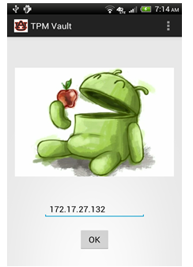
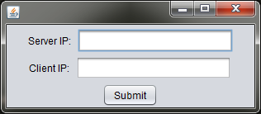
Enter IP information on Client and Android
Client Side
Android Side

Slide 53
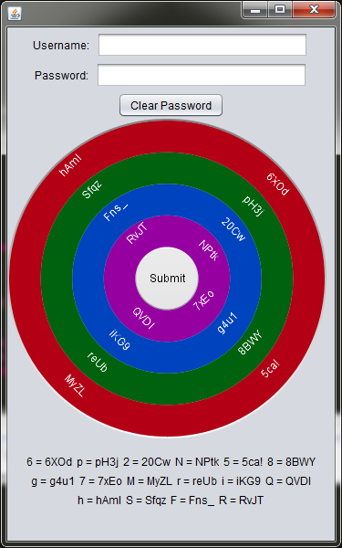
Enter Username and Password
At registration time, the user enters at least three key groupings per device (in any chosen order) to create the initial password.
Android key mappings are displayed below the PC software keyboard
During subsequent logons, the user must re-enter the sequence in the correct order across devices.
Since each key represents a grouping of characters rather than a single input, the user’s “true” plaintext password (e.g. War_Eagle) can never be recovered by an attacker.

Slide 54
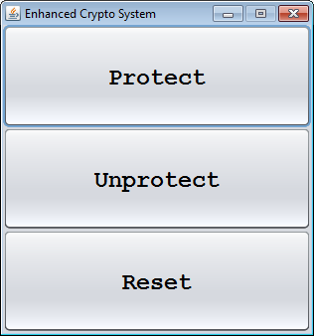
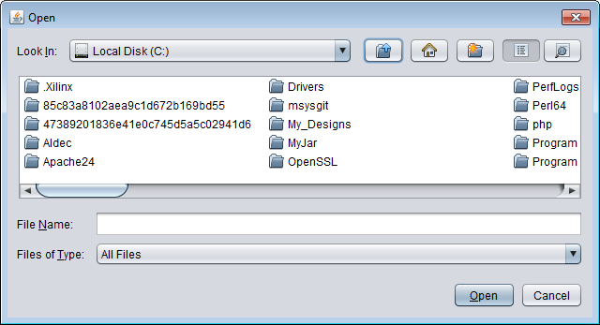
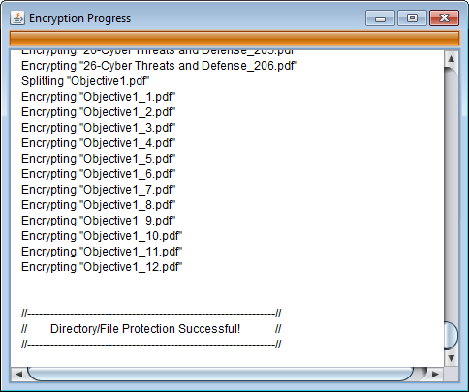
Protect Directory/File
Select PDF file and or directory of PDF files to protect
Files not ending in .pdf will be ignored

Slide 55
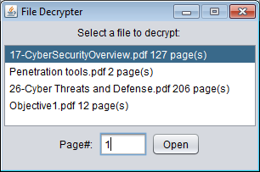
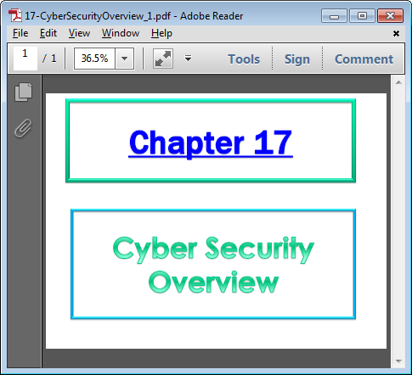
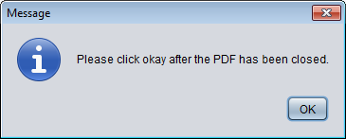
Unprotect Directory/File
Click OK after the PDF file has been closed, otherwise, the unprotected file won’t be deleted

Slide 56
Security Analysis

Slide 57
Security Analysis
Attack Method | Defense
Software/Hardware Keyloggers Screen Capture, HTML injection | Multi-device, distributed password input Random character groupings Intra-session key scrambling Inter-session key value scrambling
Password Guessing (Brute force) Dictionary Attack Device Spoofing | Pre-negotiated information requirement System suicide procedure
Packet Sniffing Middle man attack | GCM-AES-256 authenticated encryption for transmission channels between all devices without PKI
Physical theft of assets loss of all user’s devices | Cloud-based data backup User’s knowledge cannot be captured using any technical method
Malware | Distributed file protection scheme
Spear Phishing | Input device password obfuscation.
In-time memory scraping | Page-wise file access

Slide 58
Conclusion
No security system is perfect; however, our system is hardened against numerous single- and multi-vector attacks
Cloud-based backup of auth information and file pieces mitigates the risk of losing sensitive information due to loss or destruction of physical assets.
The human element remains the weakest link in any secure system – the user controls who has physical access to the system as well as knowledge of the password

