Slide 1

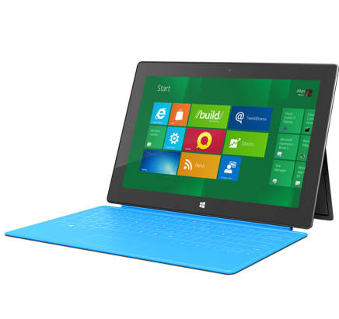
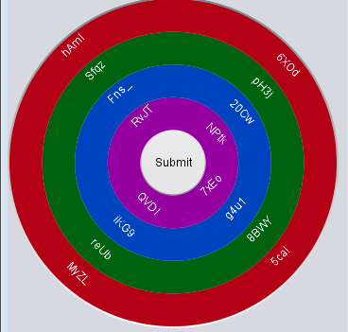


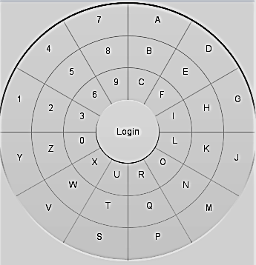


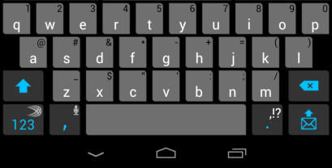
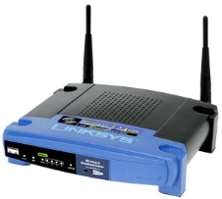

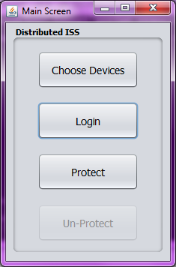


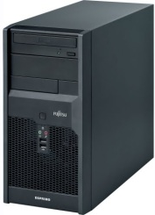






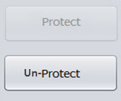



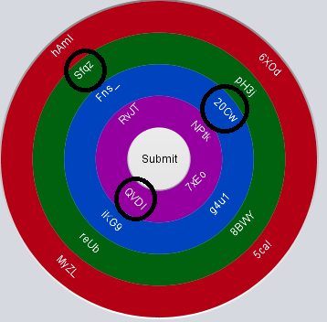









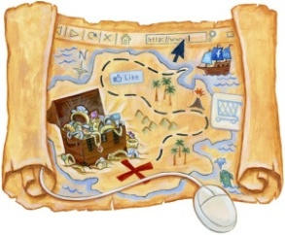
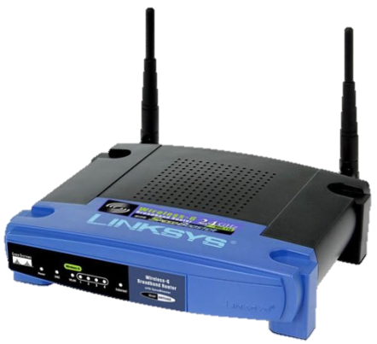

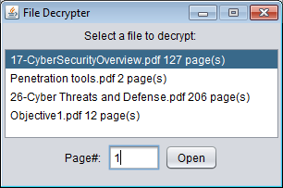

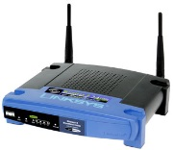



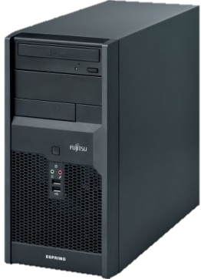
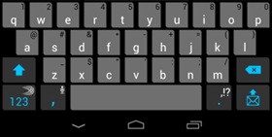
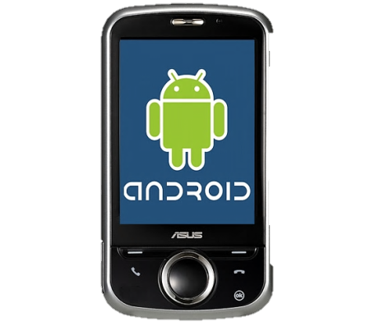
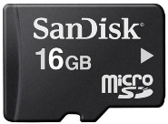

User clicks “Un-Protect”
Distributed Authentication/Authorization
With Page-wise File Access for Mobile Information System
Security Analysis
Overview
Protect Process
Strengths and weaknesses of system in terms of protection against various attack methods:
Strengths
Key-logging:
Passwords entered in and encoded using multiple devices
Password never exists in plain text, ciphertext or encoded form
Device Spoofing:
Attacker device cannot have key information previously negotiated to communicate with devices
Malware:
To access protected files, malware must compromise EVERY device and owner’s knowledge
Password Guessing:
No password hashing
Data leakage prevention
The system initiates a suicide procedure after 5 unsuccessful login attempts
In-time Memory Scraping:
Page-wise encryption/decryption minimizes the risk of memory read attack
Weaknesses
Denial of Service:
Attacker can use some methods of attack to prevent normal operation
Social Engineering:
User controls who can access devices
User responsible for keeping password secret
Objective: Provide a security system of storing private information in clouds with high reliability, and low susceptibility to unauthorized accessing
Problems:
Encryption may help hide information, but encryptions can be broken
Key-loggers can capture entered passwords or keys used for encryption
Zero-day malware attacks
Key idea: The average user has multiple mobile devices that can access the internet e.g. desktop, laptop, smart phone, and/or tablet
Solutions:
Encrypt files on multiple devices then split the data and store the pieces on each device
Utilize on-screen, varying keyboards of multiple devices for password entry
Dynamically obfuscate password entering and file protection
Result: In order to capture password entry or access protected files, the attacker must compromise all devices and owner’s knowledge!
1
A user clicks “Log In”
Master Login
Master Device
Login
Submit
All devices:
1. Display varying keyboards with varying grouping
2. User enters password on any combination of devices they choose.
On Master Device:
1. User chooses “Submit” and is returned to main menu after seeing a ‘pass’/’fail’ notice.
2. If password passed, the “Protect” and “Un-Protect” options will become available.
Slave Login
Ex. Letters ‘Eagl’ pressed
Pass?
No
Yes
Distributed ISS
Protect
Un-Protect
Character Stream
‘War_’ then ‘e’
To Server
Slave Device
2
Slave Device
Master Device
File_1.pdf
Protect File
1/2
Protect File
On all devices:
A piece of encrypted original file is stored on each device
File_2.pdf
Protect File
File.pdf
File_3.pdf
File
Map
Design: Three Basic Security Elements
Unprotect Process
1
Master Login
What You Know
Device-specific passwords and input ordering
What You Own
Devices connected to the system
Accounts with cloud storage services
System States
The parameters used to govern device authentication and user authorization
On all devices:
User enters password
On the Master:
User presses 'submit' to enter password
User chooses file package to un-protect
Master Device
Login
Submit
Slave Login
Ex. Letters ‘Eagl’ pressed
Pass?
No
Yes
Master Keyboard
Master Device
Cloud Storage
Seed used for communication keys stored on each device
Character Stream
‘War_’ then ‘e’
USER
(USB)
Protected File Information:
Slave Device
Use To Un-Protect
Then Open File Viewer
(PC)
2
“Unprotection” Process
Index File
User switches devices multiple times while entering password
On all devices:
Pieces of the unprotected page are shredded, all other pages remain protected
On the Master:
One page is unprotected, and displayed
After the PDF of the page is closed, it is protected again
Master Device
Split-File Info keeps track of parameters for protected file
Stored in index file
Split-File Info keeps track of parameters for index file, which is also split an stored in multiple devices
Protect info keeps track of auth. parameters used to protect and unprotect files
1/2
Slave Device
2/2
Unprotect Document X page Y
Slave Keyboard
Slave Device
1/2
2/2
no
Protect current page
PDF closed?
(Android Device)
(Micro SD)
Java Server
yes
Page Y of Document X

