Slide 1
Making the Internet Sensible
Web Data Processing Systems
GROUP 33
Aneesh Makala, Nader Ahmed Sobhi, Gyan de Haan, Salmane Dazine

Slide 2
Structure
1. WSD
The WHY?
2. Urban Dictionary
3. Methods
4. Results
5. Final DEMO
6. Discussion

Slide 3
Introduction
WSD stated simply is the process of taking a context and a word and giving the meaning of the word in that context
WSD is an open problem that has many general and important use cases, such as
Machine Translation:
Link the sense found in one language to the equivalent sense in another language
Question Answering:
Knowing the meaning of the words in the questions leads to better answers or sometimes the question’s answer is a single
Speech Synthesis:
Knowing the meaning of words helps know what text or words you can formulate

Slide 4
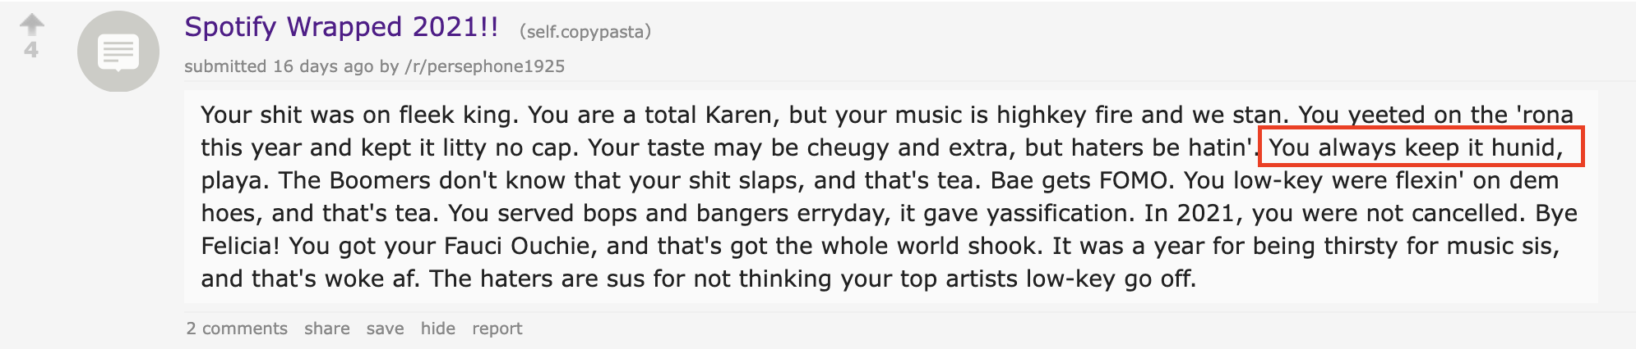
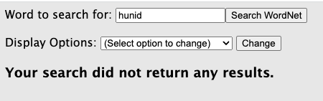
Motivation
Let’s try to disambiguate a reddit post using Wordnet..
Image: https://old.reddit.com/r/copypasta/comments/r7l6zx/spotify_wrapped_2021/, Search: http://wordnetweb.princeton.edu/perl/webwn?
Notes:
References: -

Slide 5
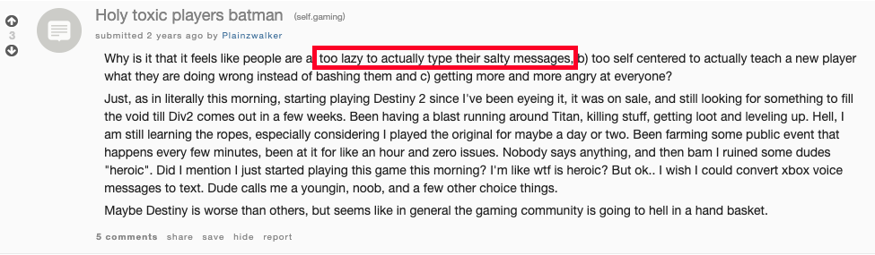
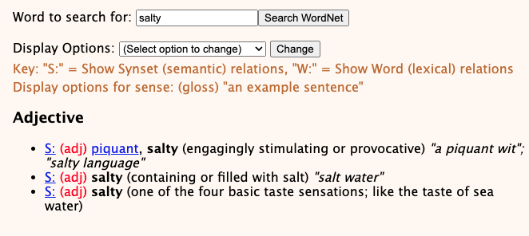
Motivation
Let’s try another one!
Image: https://old.reddit.com/r/gaming/comments/asvflg/holy_toxic_players_batman/, Search: http://wordnetweb.princeton.edu/perl/webwn?
Notes:
WSD disambiguation on text found on the internet doesn’t not always reflect the senses made in the lexical databases of old, e.g. WordNet. This is because language evolves as our modes of communication evolve. For this reason something better or new is needed, enter UrbanDictionary

Slide 6
Motivation
WSD disambiguation on text found on the internet doesn’t not always reflect the senses made in the lexical databases of old, e.g. WordNet
This is because language evolves as our modes of communication evolve.
For this reason something better or new is needed, enter UrbanDictionary

Slide 7
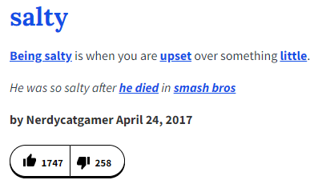
Urban Dictionary
Urban dictionary is an online dictionary that was launched in 1999 by Aaron Peckham to include urban slang words and phrases that are usually not found in other dictionaries.
Using the Urban Dictionary API, we retrieve the data corresponding to each definition:
Word
Example
Number of Upvotes
Number of Downvotes
Author Identifier
Date of posting

Slide 8
Goal
Use Wordnet + Urban Dictionary to disambiguate words

Slide 9
Methods
Simple Lesk
Most popular
Soft Cosine Measure
Average Cosine Similarity

Slide 10
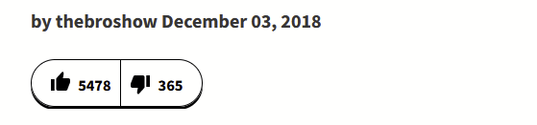
Methods
Simple LESK
Most Popular
Maximum overlap between the context and the sense
Most relative upvotes
or highest sense index
image: https://www.urbandictionary.com/

Slide 11


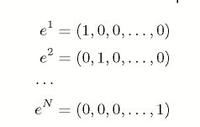


Methods
Soft Cosine Measure
Average Cosine Similarity
TF-IDF on context and senses
Embeddings for every word
Cosine similarity
Average of embeddings for context
Average of embeddings for senses
Cosine similarity
images: http://www.scielo.org.mx/pdf/cys/v18n3/v18n3a7.pdf

Slide 12
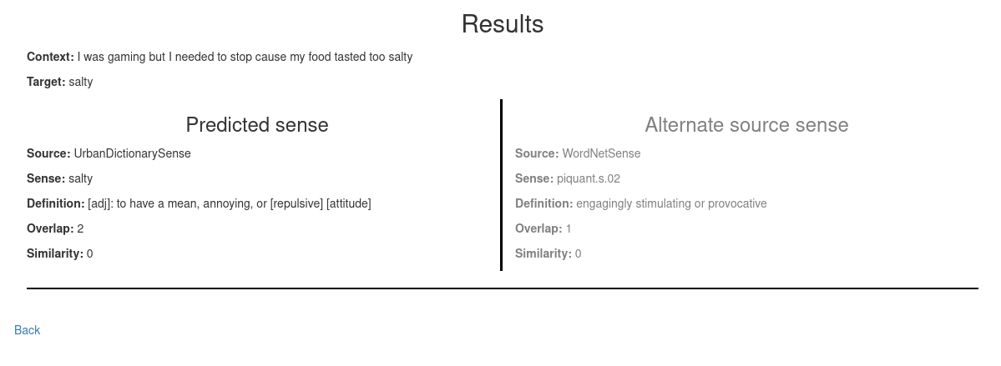
Results
Using Overlaps:

Slide 13
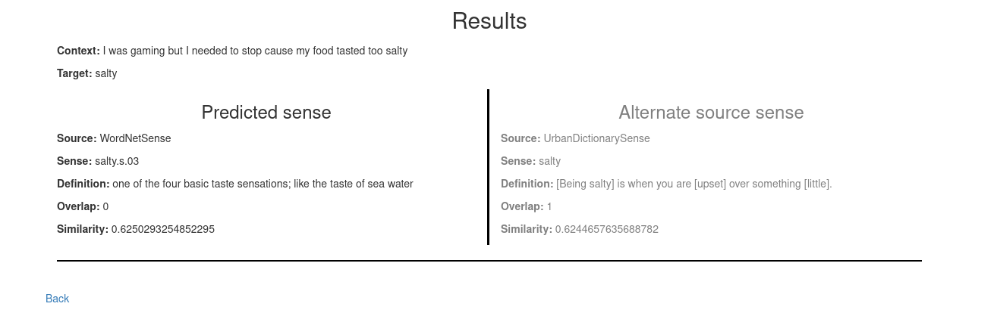
Results
Using Average Cosine Similarity:

Slide 14
DEMO

Slide 15
Discussion
A good step is set into the direction of the goal, but we have yet to reach it
Evaluation can be improved
Learn embeddings for slang together with the “normal” words
De-duplicate Urban Dictionary senses

