Slide 1
U.S. Fuel Economy Data
Darryl Smith

Slide 2
U.S. Fuel Economy Data
The U.S. Environmental Protection Agency publishes miles-per-gallon data following tests of vehicles on the road in the United States.
Data set for vehicles 1984-2017

Slide 3
U.S. Fuel Economy Data
Objectives:
Calculate the miles-per gallon on a selection of vehicles.
Predict the miles per gallon on a selection of vehicles using supervised learning and a linear regression model

Slide 4
U.S. Fuel Economy Data
Exploratory Data Analysis:
Data set contains 38113 cars (rows) and 81 features (columns)
17 of these features contained missing values
12 of these features contained 60% or more of missing values

Slide 5
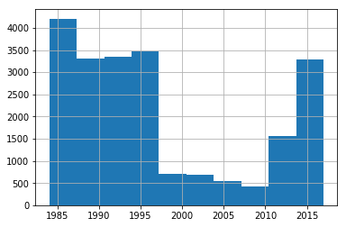
U.S. Fuel Economy Data
Exploratory Data Analysis:
Data set contained significant amount of ‘missing’ vehicles 1997-2011

Slide 6
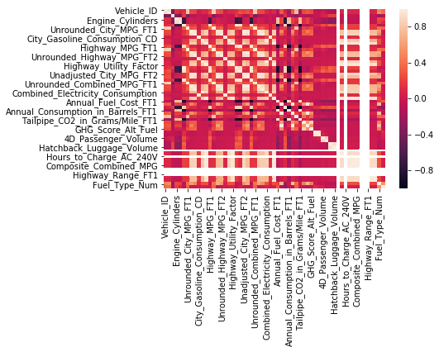
U.S. Fuel Economy Data
Exploratory Data Analysis
No (relevant) direct correlation

Slide 7
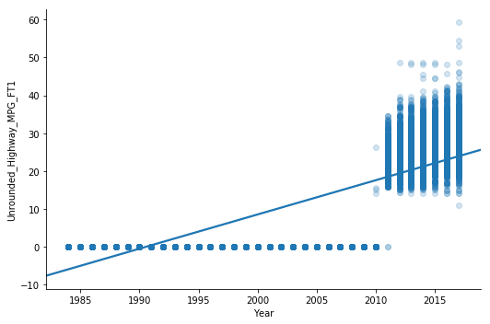
U.S. Fuel Economy Data
Model Training and Testing
Linear Regression:
Unrounded Highway
Miles-per-gallon
in relation to year
(Not Linear)

Slide 8
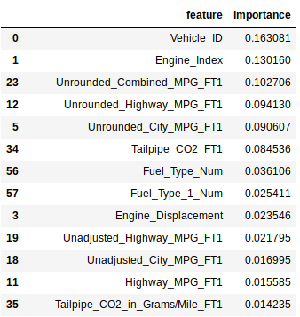
U.S. Fuel Economy Data
Model Training and Testing
Random Forest:
(No correlations)

Slide 9
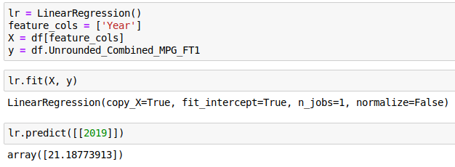
U.S. Fuel Economy Data
Model Training and Testing
Linear Regression
Prediction for any U.S.
vehicle in 2019 is
21.18 Miles-per-Gallon

