Slide 1
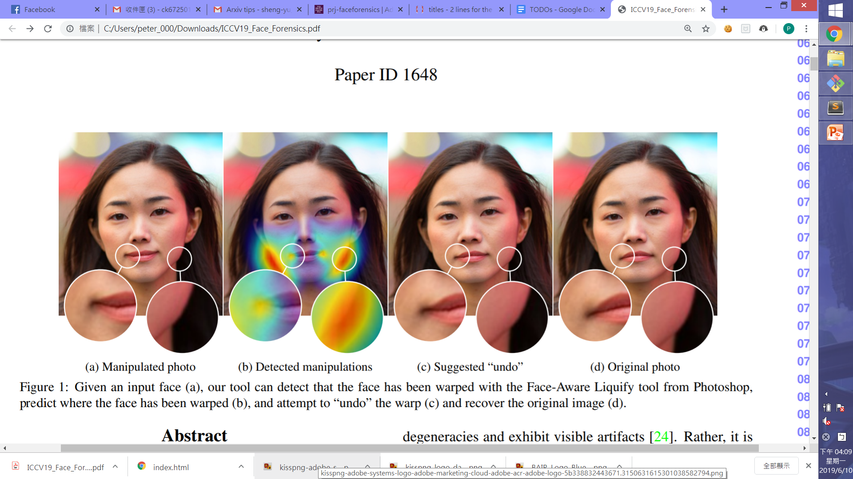
Manipulated photo
Detected manipulations
Suggested “undo”
Original photo

