Slide 1
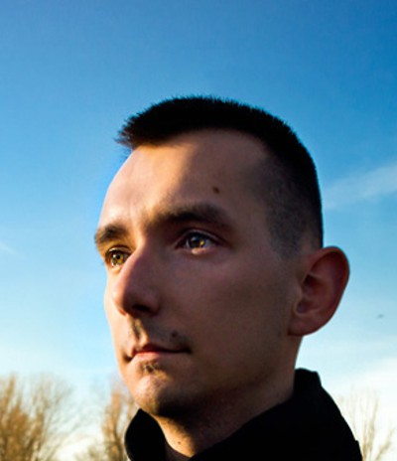
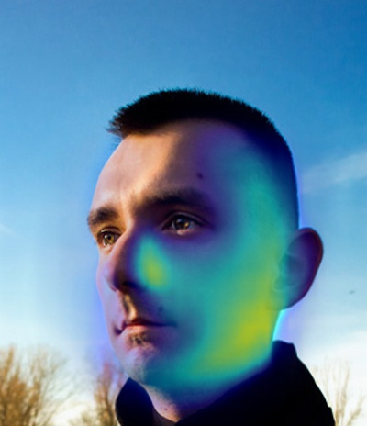
Manipulated?
ResNet-50
Warped Image
Dilated ResNet
Warp Prediction

