Slide 1
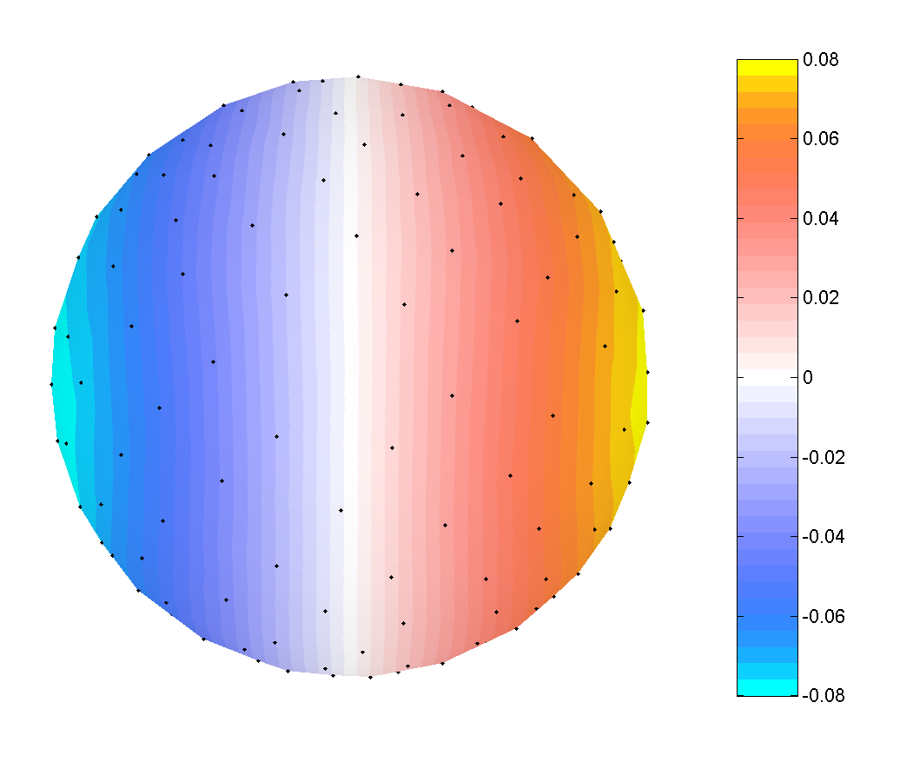

Electrode Potential
Spherical Spline Fit
Spherical Spline SCD
Perrin F, Pernier J, Bertrand O, Echallier JF (1989, 1990). Spherical splines for scalp potential and current density mapping. Electroencephalography and Clinical Neurophysiology, 72: 184-187, corrigenda 76: 565.

