Slide 1
mrFlatMesh
V1.0 02/18/01
A.R. Wade wade@white.stanford.edu
Last updated: 4/3/2001

Slide 2
What does it do?
1: Unfolds meshes generated by mrGray’s 3D visualisation routine
2: Maps gray layers to the unfolded mesh to generate a flat.mat file

Slide 3
How do I run it?
Type
mrFlatMesh
from the matlab prompt.
(mrFlatMesh.m brings up mrFlatMesh.fig)

Slide 4
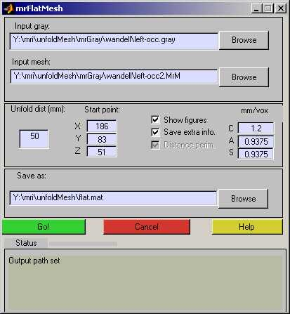
What does it look like?
Name of the .gray file
generated by mrGray
Name of the .MrM file
generated by mrGray
Coords of start point
(found in mrGray)
Mm per voxel in mrGray – default setting.
Minimum radius of the unfold
Output file path : “flat.mat” file
HTML help
Status indicator
Status messages

Slide 5
What does it want?
Three things:
A mesh file: This is generated when you run mrGray’s 3D visualisation routine.
A gray file: These are the gray nodes that will be mapped to the mesh. Save this out from mrGray.
An output filename: mrFlatMesh will save a “flat.mat” file. You can call it anything you like.

Slide 6
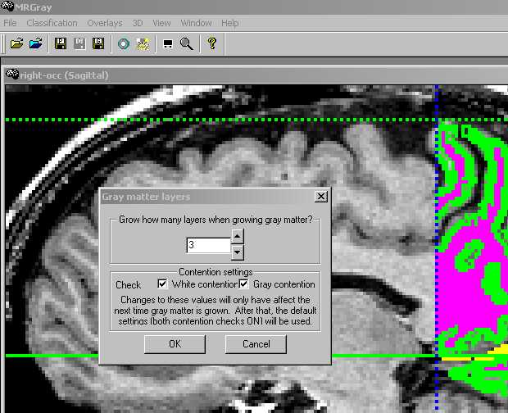
How do I make a mesh? 1
1: Once you’ve segmented your white matter in mrGray, grow 4 (or fewer) layers of gray matter. Save the gray matter in a file with a .gray suffix.

Slide 7
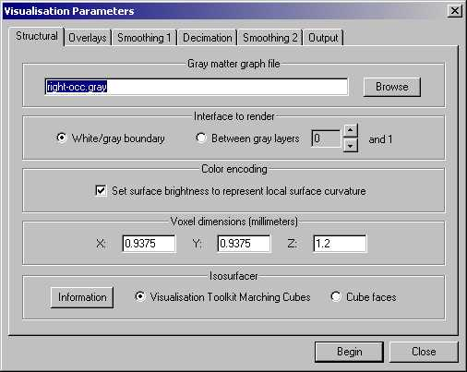
How do I make a mesh? 2
2: Then open the 3D visualisation menu. You will see a series of tabbed option screens….
Render the white/ gray boundary.
Use ‘marching cubes’.
Make a note of the voxel dimensions.

Slide 8
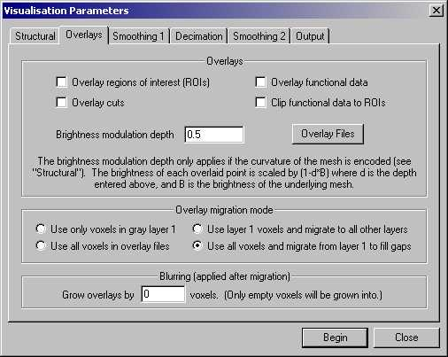
How do I make a mesh? 3
3: Don’t overlay any functional data.

Slide 9
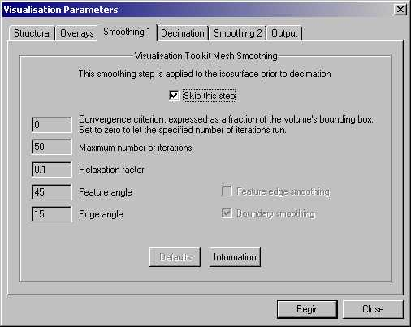
How do I make a mesh? 4
4: Don’t smooth

Slide 10
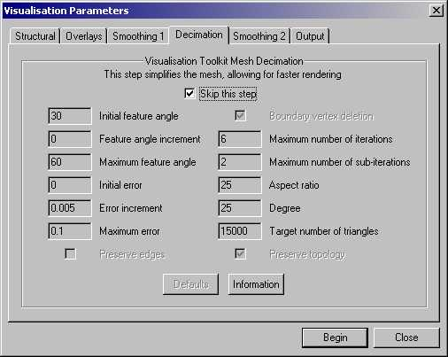
How do I make a mesh? 5
5: Don’t decimate

Slide 11

How do I make a mesh? 6
6: Don’t smooth here either

Slide 12
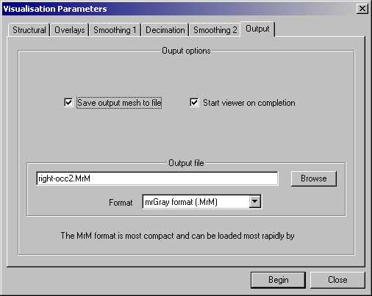
How do I make a mesh? 7
7: Make sure you save the mesh.
Use .MrM format
Then Begin…

Slide 13
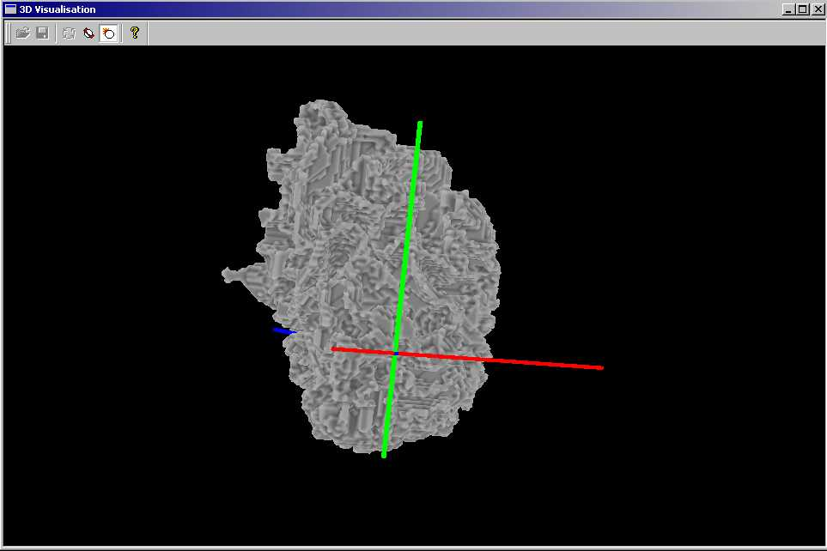
How do I make a mesh? 8
8: This is the sort of thing you’ll end up with.

Slide 14
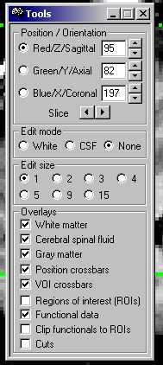
What now?
After making the mesh, pick a start point in mrGray.
Note the order of the coordinates: Z,Y,X

Slide 15
Now run mrFlatMesh
GO!

Slide 16
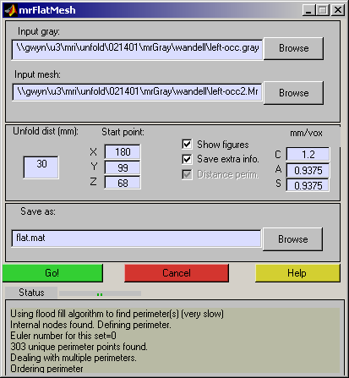
As it runs…
The status bar and status window will keep you informed about what’s going on.

Slide 17
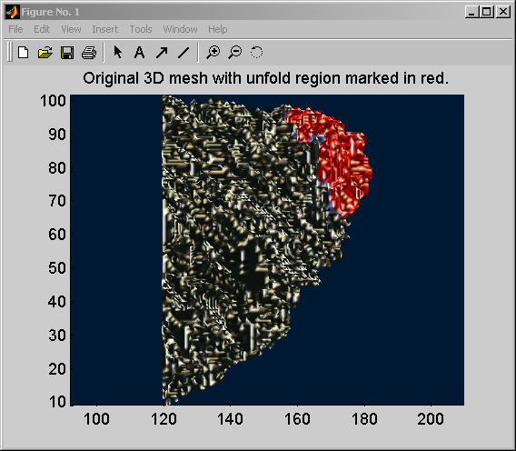
As it runs…
If you select the ‘show images’ option it will generate some pictures. The first one renders the mesh in 3D and illustrates the extent of the unfold. You can rotate this figure in 3D using this button:

Slide 18
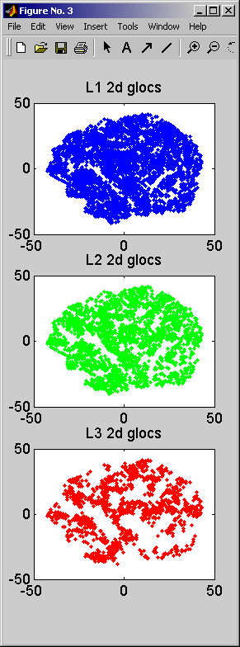
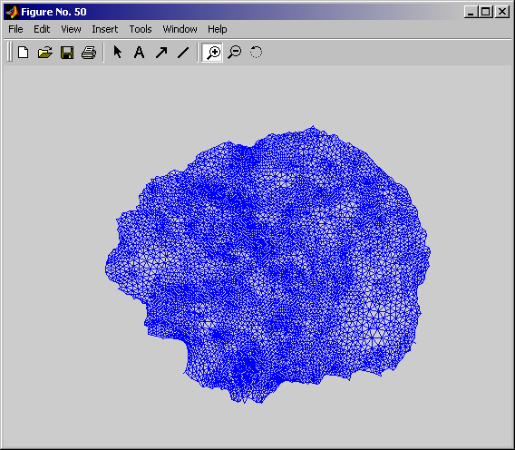
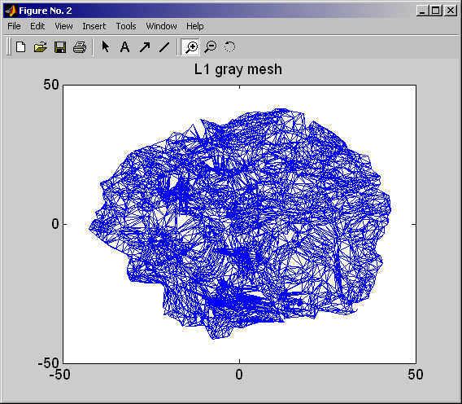
As it runs…
You also get to see the unfolded mesh, the layer 1 gNodes (with their interconnections) and the 2D locations of all the gNodes.

Slide 19
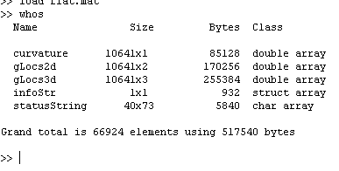
What’s in flat.mat?
Curvature map from mrGray – used to make flat anatomy
2d locations of flattened gray nodes
3d locations of gray nodes
Useful unfold params:
infoStr =
startTime: '20-Feb-2001 11:38:42'
endTime: '20-Feb-2001 11:44:51'
perimType: 1
meshFile: [1x56 char]
grayFile: [1x56 char]
Everything that was printed in the status window during the unfold

Slide 20
Example data sets
Are in
/usr/local/matlab/toolbox/mri/mrFlatMesh/exampleData/

Slide 21
Csource code and mex files
Are in
/usr/local/matlab/toolbox/mri/mrFlatMesh/Csource/
There are two mex files required for mrFlatMesh
mrManDist: (Everyone’s favourite manifold distance routine)
assignToNearest: Takes two sets of 3D coords and for each point in the first set, returns the index of the nearest point in the second set.
>> a=rand(10,3);
>> b=rand(5,3);
>> c=assignToNearest(a,b);
‘c’ is now a 5x1 vector containing and index into ‘a’ for each member of ‘b’

Slide 22
Help files
An online help system is provided
For those interested, the callback is
web1 = 'web([''file:///'' which(''unfoldMeshHelp.html'')],''browser'')';
web2 = 'web([''file:///'' which(''unfoldMeshHelp.html'')])';
eval(web1,web2);

Slide 23
Other questions 1:
Q:I don’t like GUIs
A:Try (and look at and copy and edit)
>>consoleUnfold
Q: Does it work?
A: It is much faster and it generates sane-looking retinotopies. I have no numbers on the relative distortions between mrUnfold and mrFlatMesh.

Slide 24
Other questions 2:
Q:It’s all gone wrong
A: Make sure you’ve made the mesh properly and that the voxel sizes in mrFlatMesh and mrGray match. Also, note that you must use the >new< version of mrGray (the one that saves out mesh voxel sizes). You can get this from
//red/u2/pc/dist/mrGray.exe if it’s not already in your path.
If you’re still stuck, email wade@white.stanford.edu

Slide 25
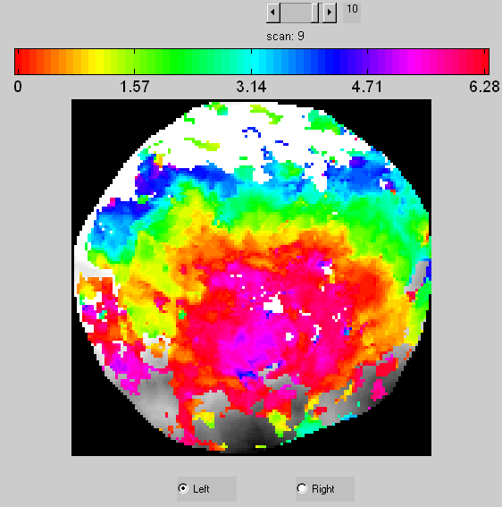
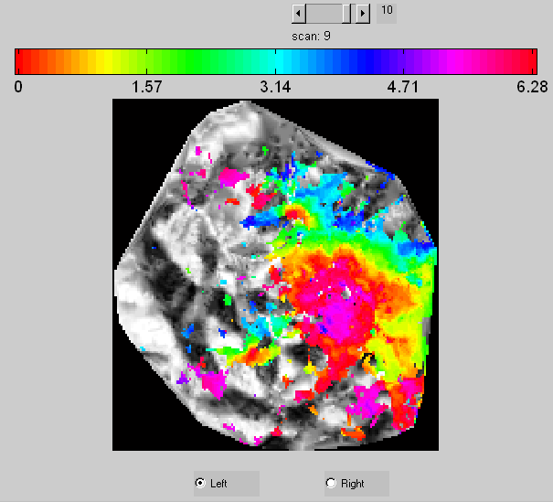
Comparison with mrUnfold

