Slide 1
UX Scenario Document File Version 4.3
Zaplist
Submission Date | 2026 / 10 / 10
App Ver. | 1.0.0
App Developer | Name: Zaplist E-mail address: nomoredazzling@gmail.com

Slide 2
Table of Contents
1. Basic Information
2. Document History
3. Remote Control Keys
4. Detailed Login Information
5. Main Page Description
6. Sub Page Description
7. Paid Content (not applicable)
8. In-App Ad (not applicable)

Slide 3
1. Basic Information
Category | Items | Input (By Developer) | Example
App Information | App Title | Zaplist
 | Category | Entertainment | Entertainment / Game / Life
 | File Type | Web (packaged IPK) | Web / Adobe Flash / Native App
 | Optimized Resolution | 1920*1080 | 1280*720 / 1910*1080
 | Service Area Information | Global | Global / KR, US
 | App Service Language | English | English, Spanish
 | Geo-IP Block | No | Yes / No
 | SDK Version | webOS (webOS TV 4.0 and later) | NetCast (XX. XX. XXX) / webOS (X. X. X)
 | In-App Ad | Not Applicable | Banner AD / AVOD / Not Applicable
 | Paid Content | Not Applicable | Transaction / Subscription / Not Applicable
 | Sound (For Game Type) | Not applicable (not a game; no BGM or sound effects) | BGM (Yes / No), Sound Effect (Yes / No)
Test Information | Service URL (For Web Type) | Not applicable (packaged app) | URL for LG Smart World/LG Content Store
 | Test URL (For Web Type) | Not applicable (the IPK is attached) | URL only for QA (If necessary, please attach a test .ipk file to Test IPK File or Test URL section at LG Seller Lounge)
 | Service Platform | webOS | NetCast / webOS
Notes 1. Correct and detailed Basic Information required for App QA. 2. If you indicate Geo-IP Blocking as “Yes” you must white list the range of IPs required by the QA Team for testing. Please request the range of IPs to white list through the LG Seller Lounge 1:1 Inquiry. 3. You can use a 3rd party billing system for Paid Content. You shall be aware that you are liable for all claims arising from the use of a 3rd party billing system. 4. You can monetize your application with in-app advertising services with a 3rd party ad platform. Seller shall not violate LG’s content guideline and will be solely responsible for any claims from violation of the content guideline. 5. Game apps: If there is sound, detailed description of the BGM / Sound Effects, etc. is required. 6. Even though there may be no payment process within the app itself, having any related payment process outside the app such as paying on the app’s website, converting to a paid account, etc., will categorize the app as having Paid Content. If this is the case for your app, add detailed guidelines regarding the app’s paid content on the UX Scenario document, and mark the Paid Content option as “Transaction” or “Subscription” on the LG Seller Lounge. You can also mark the both options together.

Slide 4
2. Document History
No. | Sent | Version | File Name | Contents
1 | 10.10.2026 | 1.0.0 | Zaplist_UX_Scenario_1.0.0 | Initial document
Notes:
4

Slide 5
3. Remote Control Keys
1. Keys used in the app
Key | What it does
Arrow keys | Move the focus. In the player: Up/Down change the channel, Left/Right show the info bar.
OK | Select, or play the focused channel. In the player: open the channel list.
OK (hold) | Channel menu: add to or remove from Favorites; in Favorites also move the channel.
Back | Close the open bar, menu or list, or go back one screen. On Home: leave the app through the system (exit popup or Home screen).
CH + / CH - | Page up/down in lists. In the player: next/previous channel.
0-9 | In the player: go to a channel number.
Red | Add or remove the focused or playing channel from Favorites.
Yellow | In the player: change the picture mode. In Favorites: move the channel.
Info | In the player: show or hide the info bar.
Play / Pause / Stop | In the player: resume, pause, or return to the previous screen.
Magic Remote | Point and click any item; hold OK on a channel for its menu; the wheel scrolls lists and the TV guide.
Detailed Information
- Everything also works with the arrows and OK alone: the Magic Remote has no color or media keys, so each color-key and media-key action also has an on-screen button.
- Home, Exit, volume and input keys are handled by the TV.

Slide 6
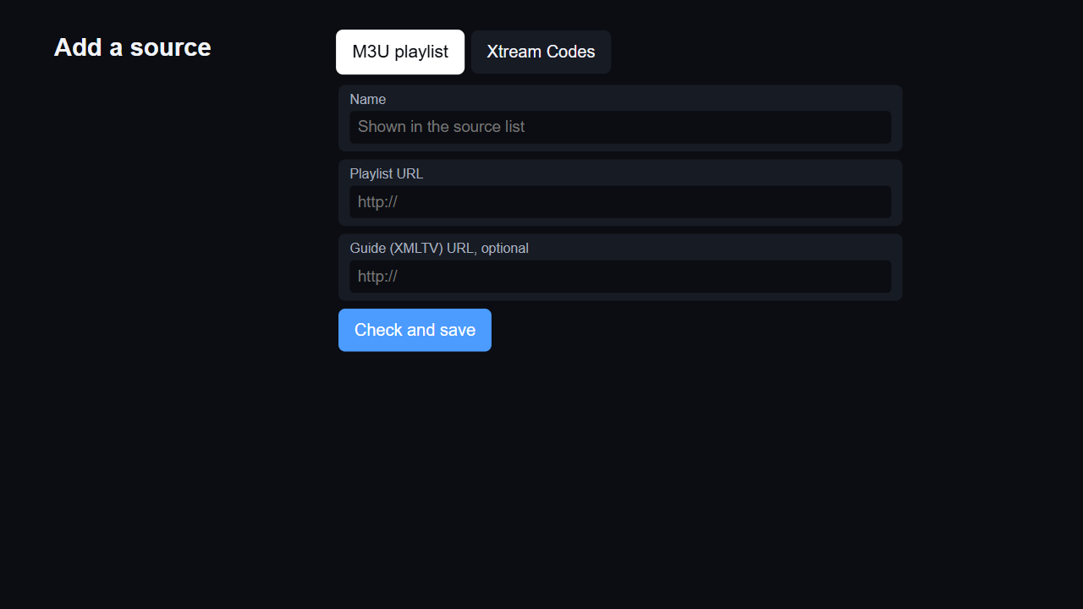
4. Detailed Login Information
1. Adding a playlist (the app has no user accounts)
Description
1 | Source type: M3U playlist or Xtream Codes login
2 | Name shown in the source list
3 | Playlist URL (M3U/M3U8)
4 | TV guide (XMLTV) URL, optional
5 | Check and save: downloads the playlist and saves it
Test playlist (no account needed)
1 | https://raw.githubusercontent.com/dazzling-no-more/zaplist/main/store/test-playlist.m3u
Xtream Codes test account
1 | Server address: https://zaplist-test.zaplist.workers.dev
2 | Username: zaplist
3 | Password: review
Activation codes
- | Not applicable
1
2
3
4
5
Detailed Information
- Zaplist has no sign-in, account or activation, and it includes no channels: users add a playlist from their TV provider.
- To test: on the start page press OK on "Add a playlist", enter any name and the test playlist URL from the table, then press "Check and save". Home opens with 5 channels in 2 categories; the TV guide fills in moments later.
- To test Xtream Codes: choose the Xtream Codes tab and enter the test server, username and password from the table. It serves the same test channels and guide.

Slide 7
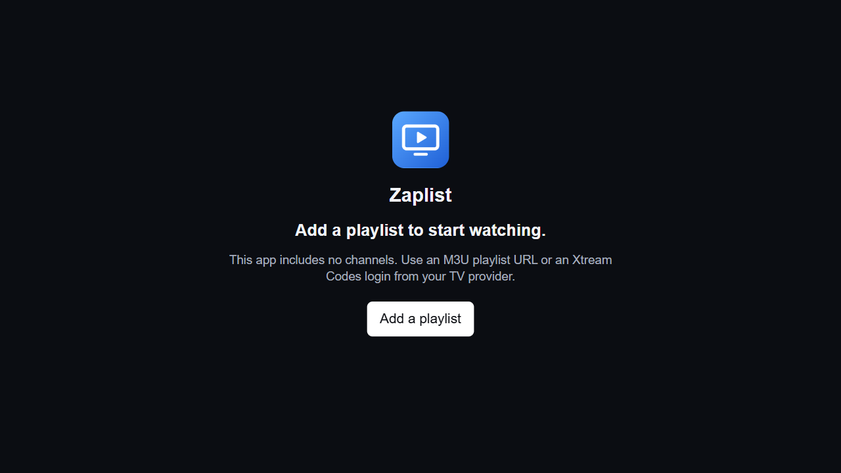
5. Main Page Description
1. Start page (first launch)
Description
1 | App icon and title
2 | Notice: the app includes no channels
3 | Add a playlist: opens the playlist form (see 4)
1
2
3
Detailed Information
- Shown while no playlist has been added. After the playlist is saved, Home opens.
- Back leaves the app through the system (exit popup or Home screen, depending on the webOS version).

Slide 8
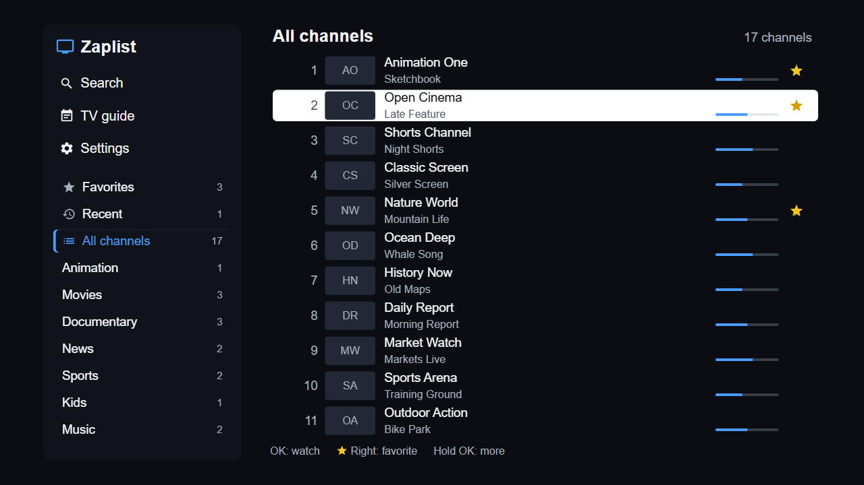
5. Main Page Description
2. Home
Description
1 | Search: find channels by name
2 | TV guide: programme grid
3 | Settings
4 | Favorites, Recent and All channels, with channel counts
5 | Playlist categories; the list on the right follows the focus
6 | Channel: number, logo, name and programme on now. OK plays it
7 | Favorite star: Right, then OK (or click)
8 | Number of channels in the category
9 | Key hints
8
1
2
6
7
3
4
5
9
Detailed Information
- Up/Down move through the sidebar or the channel list; Right/Left move between them; CH +/- page through the list.
- Hold OK on a channel for its menu (see 6-5). The red key adds or removes a favorite.
- Back on Home leaves the app through the system.

Slide 9
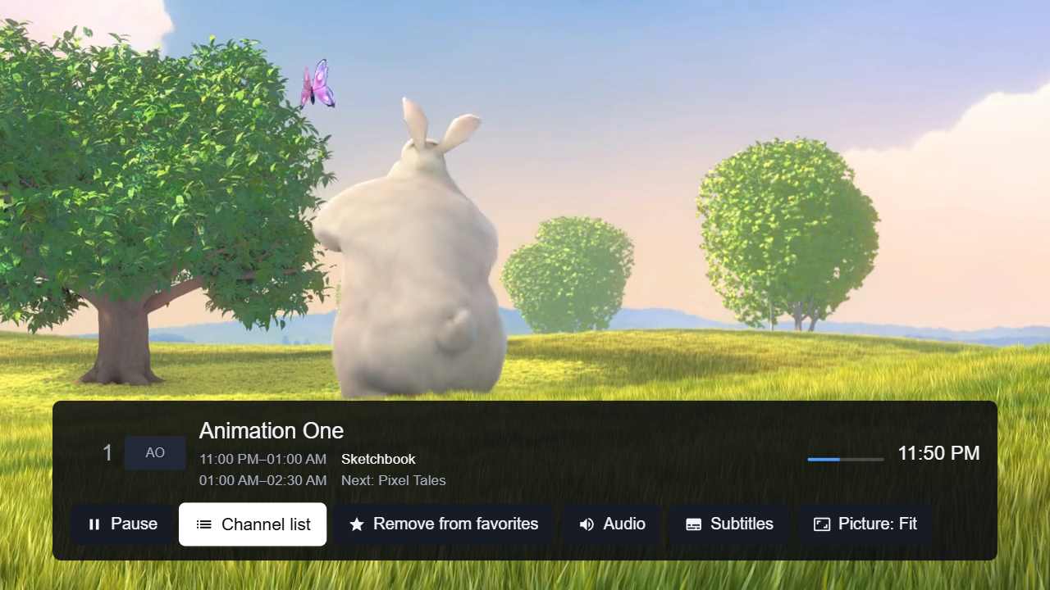
6. Sub Page Description
1. Player
Description
1 | Channel number, logo, name, programme now and next
2 | Programme progress and clock
3 | Play / Pause
4 | Channel list (see 6-2)
5 | Add to / remove from Favorites
6 | Audio track
7 | Subtitles
8 | Picture mode: Fit, Zoom, Fill, 16:9, 4:3
1
2
3
4
5
6
7
8
Detailed Information
- The info bar shows when the channel changes and hides after 5 seconds; Left/Right or Info show it with its buttons.
- Up/Down or CH +/- change the channel; number keys go to a channel; OK opens the channel list.
- Back hides the bar, then returns to Home. If the network drops, a message shows and playback resumes by itself.

Slide 10
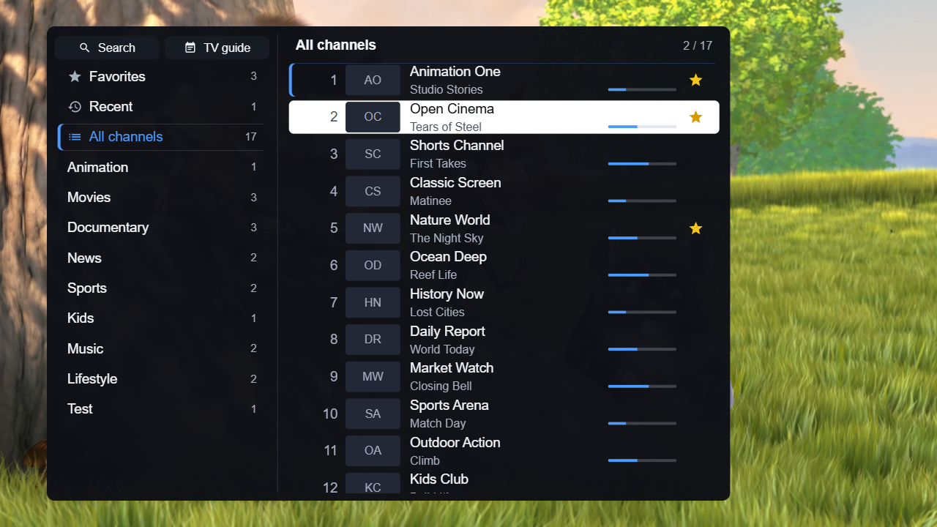
6. Sub Page Description
2. Channel list (OK in the player)
Description
1 | Search
2 | TV guide
3 | Categories with channel counts
4 | Category and position in the list
5 | Channels; the blue mark shows the channel playing now
6 | Favorite star: Right, then OK
1
2
4
3
5
6
Detailed Information
- Opens over the video on the current channel. Left/Right move between categories and channels.
- OK on a channel switches to it and closes the list. Back closes the list.

Slide 11
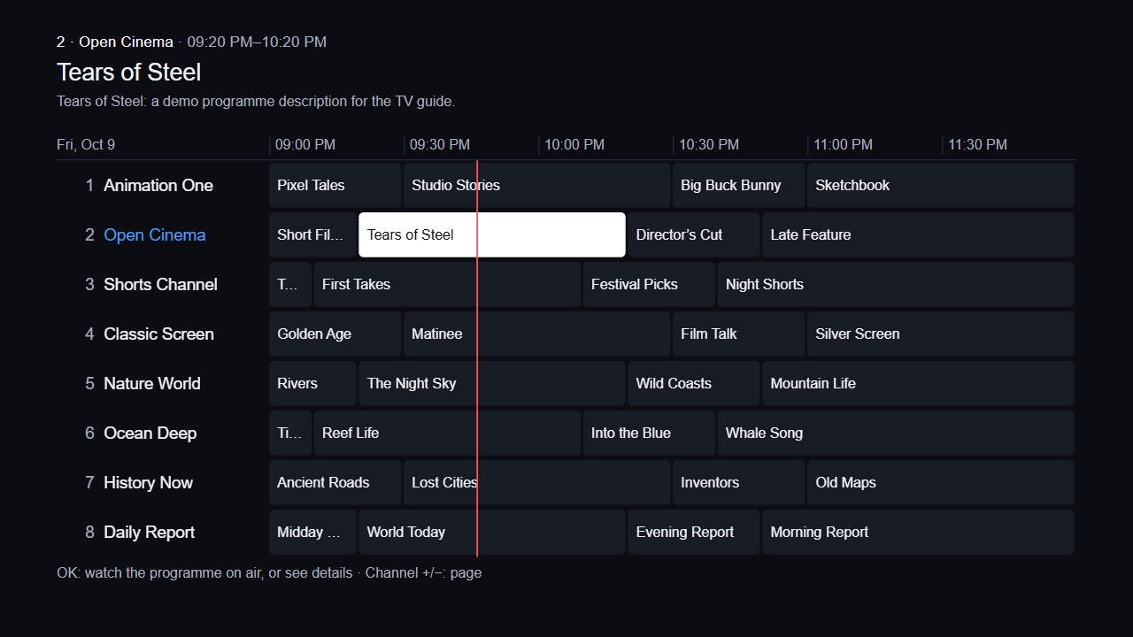
6. Sub Page Description
3. TV guide
Description
1 | Focused programme: channel, time, title, description
2 | Date and time scale
3 | Channels
4 | Programmes; the red line marks the current time
5 | Focused programme
6 | Key hints
1
2
3
4
5
6
Detailed Information
- Arrow keys move through programmes and channels; CH +/- page; the wheel scrolls. OK on a programme on air plays its channel.
- Guide data comes from XMLTV named in the playlist, in Settings, or by the Xtream server.
- The test playlist comes with guide data, so every test channel shows programmes.

Slide 12
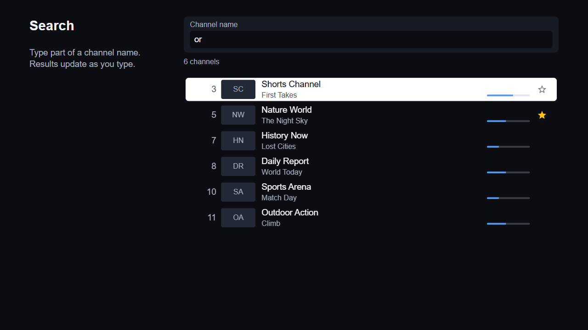
6. Sub Page Description
4. Search
Description
1 | Search field: OK opens the LG keyboard
2 | Number of results
3 | Results update while typing. OK plays the channel
4 | Favorite star: Right, then OK
1
2
3
4
Detailed Information
- Search ignores case and accents and matches any part of a channel name.
- Down moves from the field to the results. Back closes the keyboard, then the screen.

Slide 13
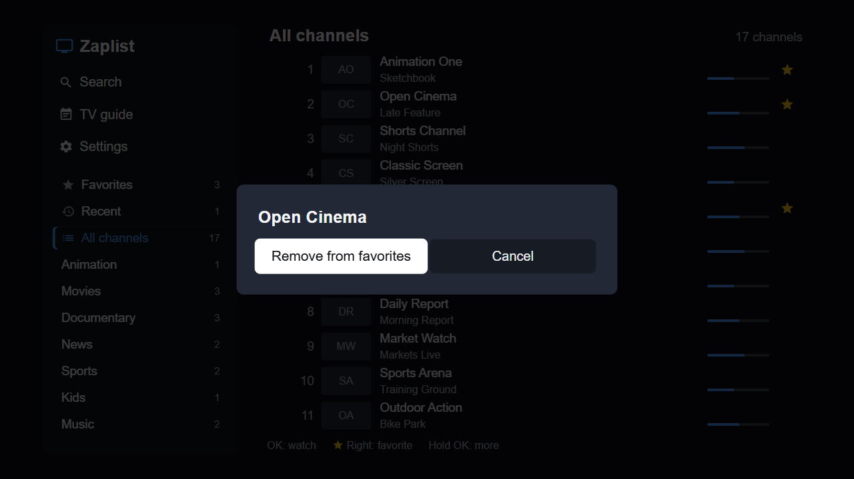
6. Sub Page Description
5. Channel menu (hold OK on a channel)
Description
1 | Channel menu
2 | Add to / remove from Favorites
3 | Cancel
1
2
3
Detailed Information
- In Favorites the menu also offers Move: Up/Down, or the arrows shown on the channel, reorder it; OK finishes.
- Back closes the menu.

Slide 14
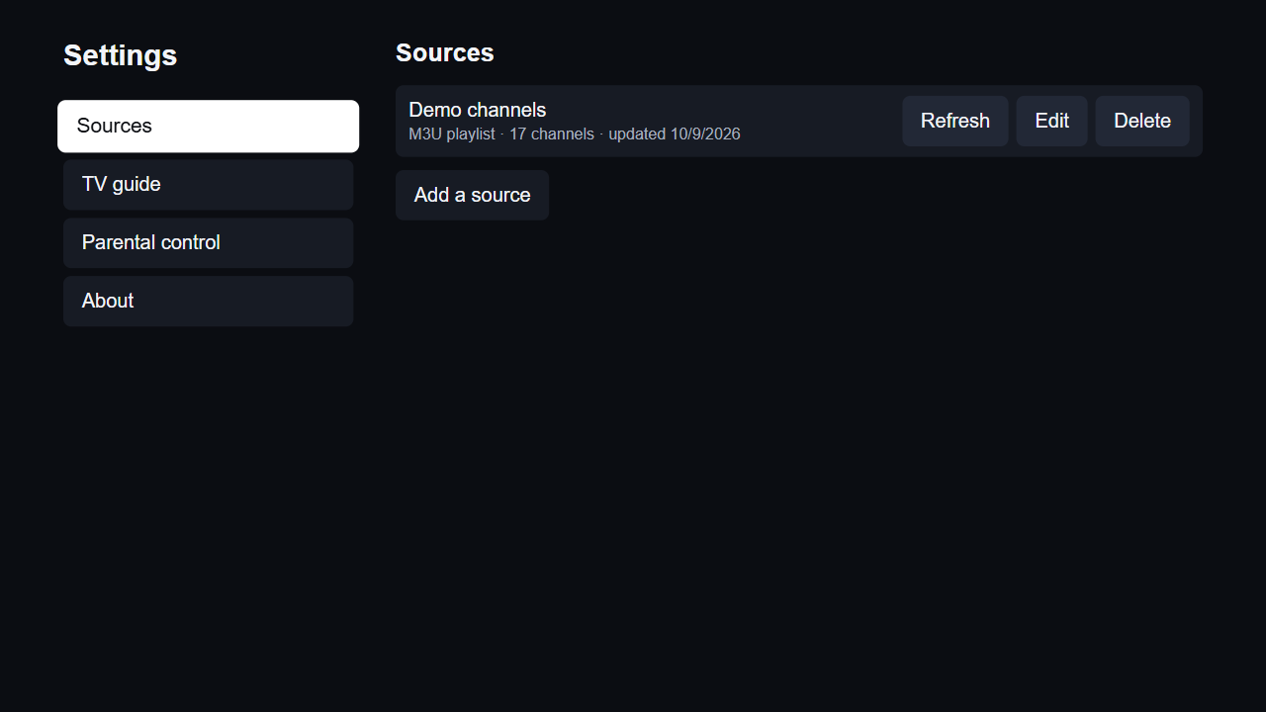
6. Sub Page Description
6. Settings: Sources
Description
1 | Settings sections
2 | Playlist: type, channels, last update
3 | Refresh: download the playlist again
4 | Edit the playlist
5 | Delete (asks for confirmation)
6 | Add another playlist (see 4)
1
2
3
4
5
6
Detailed Information
- Xtream Codes sources also show the account's expiry date and connection limit.

Slide 15
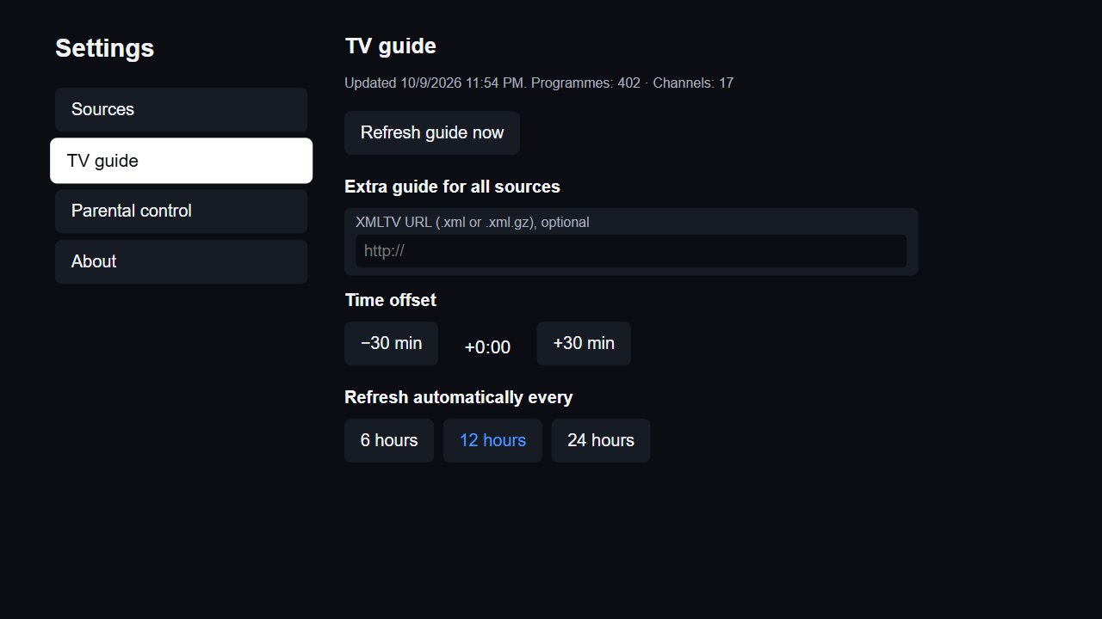
6. Sub Page Description
7. Settings: TV guide
Description
1 | Guide status and Refresh guide now
2 | Extra XMLTV guide address for all sources (optional)
3 | Time offset for guide times
4 | Automatic refresh interval
1
2
3
4
Detailed Information
- The guide also refreshes by itself at the chosen interval.

Slide 16
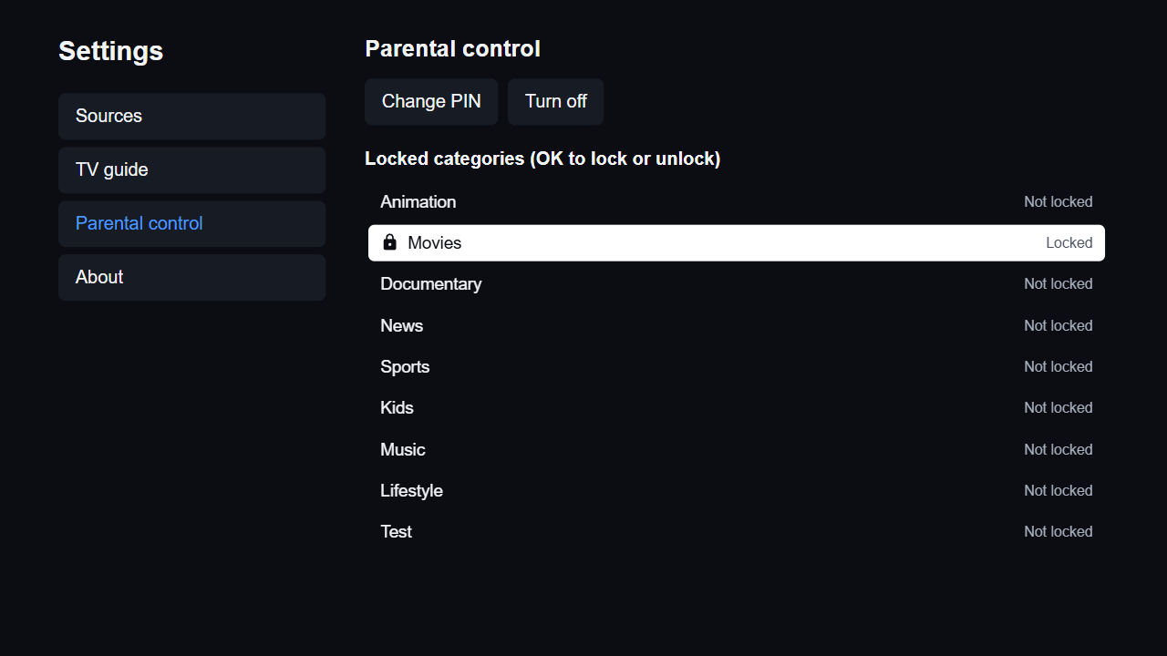
6. Sub Page Description
8. Settings: Parental control
Description
1 | Change PIN / Turn off
2 | Locked categories: OK locks or unlocks
3 | A locked category
1
2
3
Detailed Information
- Setting a 4-digit PIN turns parental control on. The PIN is asked for before these settings can be changed.
- This is how users protect adult content in their own playlists; the app has no content of its own.

Slide 17
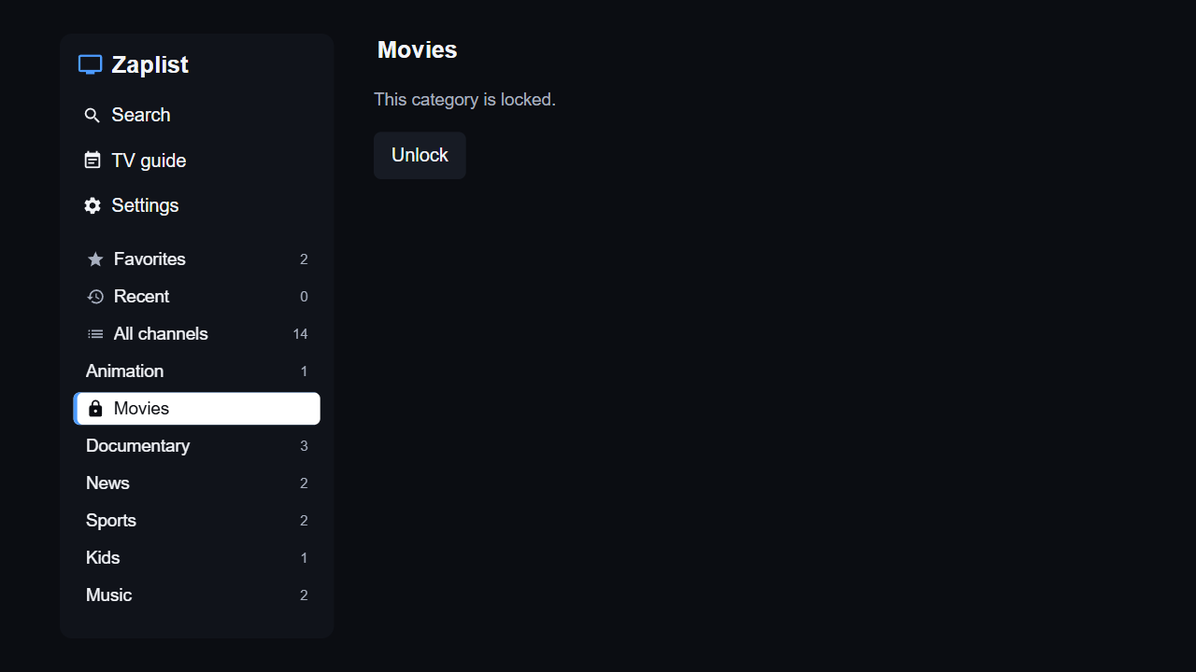
6. Sub Page Description
9. Locked category
Description
1 | Locked category: lock icon, no count
2 | Unlock: asks for the PIN (see 6-10)
2
1
Detailed Information
- Channels of locked categories are hidden everywhere (All channels, Favorites, Recent, Search) until the PIN is entered.
- They lock again when the app restarts.

Slide 18
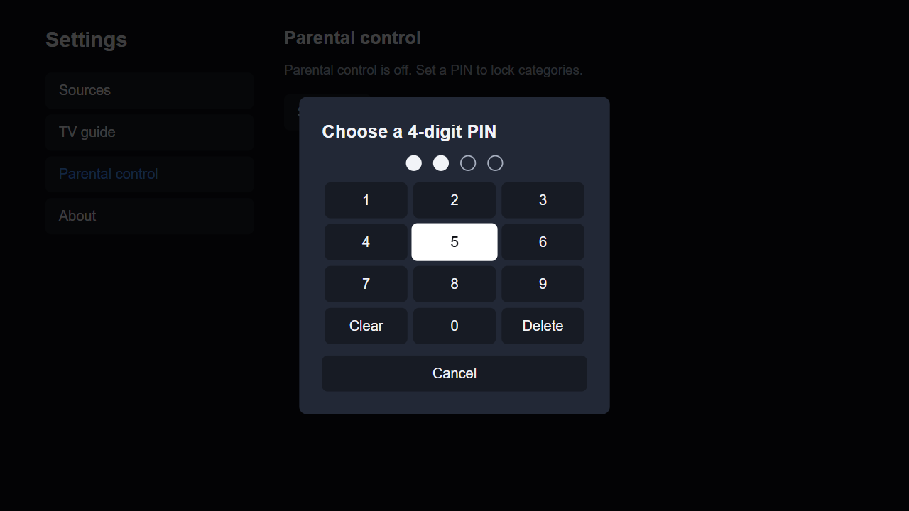
6. Sub Page Description
10. PIN entry
Description
1 | Digits entered
2 | Keypad; the number keys on the remote also work
3 | Cancel
1
2
3
Detailed Information
- A wrong PIN shows "Wrong PIN. Try again." Back cancels.

Slide 19
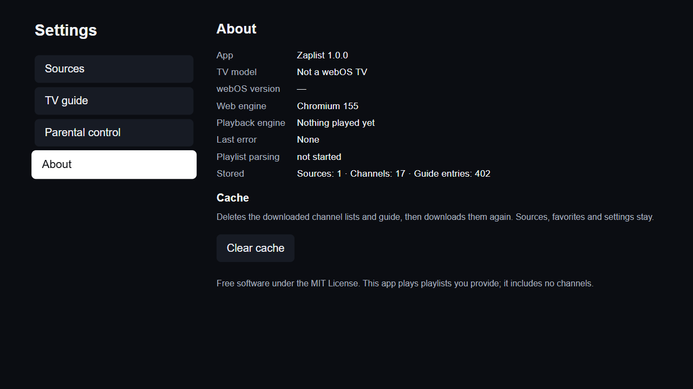
6. Sub Page Description
11. Settings: About
Description
1 | App name and version
2 | TV model and webOS version
3 | Playback diagnostics
4 | Stored data
5 | Clear cache: downloads channel lists and guide again
6 | License and content notice
1
2
3
4
5
6
Detailed Information
- Clear cache keeps playlists, favorites and settings.

Slide 20
7. Paid Content
1. Payment methods
Not applicable
Zaplist is free. There are no purchases, subscriptions or payments of any kind, inside or outside the app.
Detailed Information
- No test credit cards or voucher codes are needed.

Slide 21
8. In-App Ad
1. Ad information
Not applicable
Zaplist shows no advertising of any kind.
Detailed Information
- No ad network or ad content is included.
Notes:
21

Slide 22
[Appendix]
If you have anything to let the LG QA Management know, please comment here. Any detailed references will be welcome.
1. Zaplist includes no channels. Add the test playlist from page 6 to test playback and the TV guide; it uses public test streams (Blender Foundation open movies, Apple and Google test streams) and comes with guide data.
2. To test Xtream Codes, use the test server https://zaplist-test.zaplist.workers.dev with username zaplist and password review (page 6). It serves the same test channels and guide.
3. Back on the first screen calls webOS.platformBack(), so the TV shows its exit popup or Home screen depending on the webOS version.
4. No credentials are hard-coded. The words "password", "credential" and "token" in the package come from the Xtream Codes API parameters, the login form field, the core-js URL polyfill (URL.password) and the XHR/fetch withCredentials options in hls.js and mpegts.js. Playlist URLs, logins, the cached channel lists and guide addresses, and the parental PIN are stored only on the TV, encrypted (AES-GCM, key generated on the TV).
5. Contact: nomoredazzling@gmail.com

