Slide 1
Library AI Agent
IBM HACKATHON PROJECT
Presented By: Simran
Student name : Simran Chaudhary
College Name & Department : University of Calcutta and MCA

Slide 2
OUTLINE
Problem Statement
Technology used
Wow factor
End users
Result
Conclusion
Git-hub Link
Future scope
IBM Certifications

Slide 3
Problem Statement
In educational institutions, students often face difficulty locating the right academic resources from vast library collections. Traditional search tools lack personalization and adaptability to individual needs.
Proposed Solution: A Library AI Agent that autonomously:
Understands student queries using Natural Language Processing (NLP)
Analyzes user profiles, course content, and syllabi
Recommends relevant books and digital material
Checks real-time availability
Supports reservations and waitlists
This agent enhances library engagement and resource utilization by delivering smart, contextual assistance.

Slide 4
Technology used
IBM cloud lite services
Natural Language Processing (NLP)
Retrieval Augmented Generation (RAG)
Prompt-based AI technology for conversational flows
IBM Granite model
Student Profile & Syllabus Matching Engine
Library Database Integration API

Slide 5
IBM cloud services used
IBM Cloud Watsonx AI Studio
IBM Cloud Watsonx AI runtime
IBM Cloud Agent Lab
IBM Granite foundation model

Slide 6
Wow factors
This agent will significantly reduce search time, improve access to relevant study materials, personalize learning, and support academic performance.
Unique features:
Semantic search across library books and academic materials
Personalized book recommendations based on syllabus & interests
Real-time book availability tracking and reservation support
Prioritizes high-demand titles and alternatives
Supports voice/text queries for quick access
Syllabus-mapped smart study kits
Feedback-based learning for refined suggestions

Slide 7
End users
College and University Students
Teachers and Faculty Members
Academic Librarians
Online Education Platforms

Slide 8
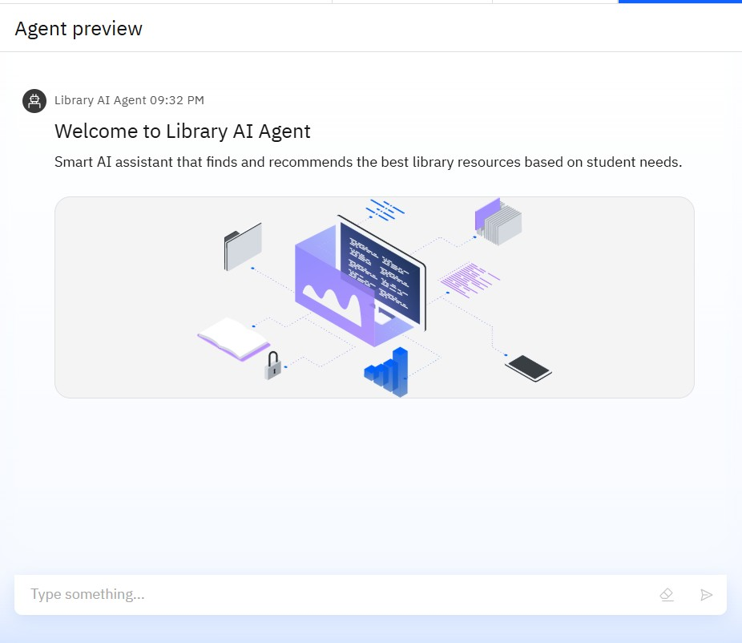
Results

Slide 9
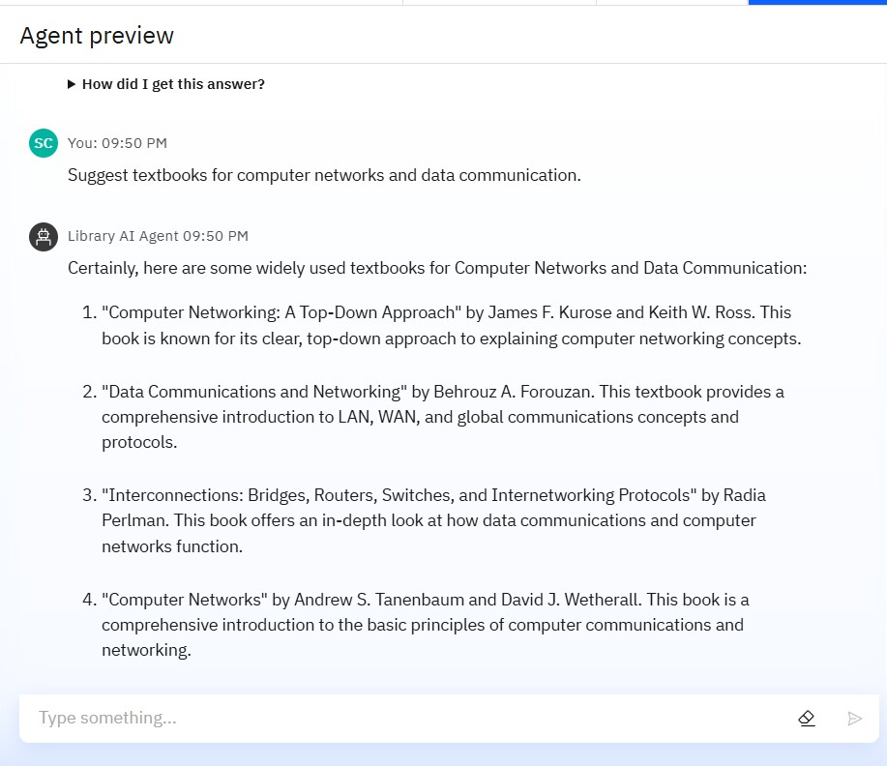
Results

Slide 10
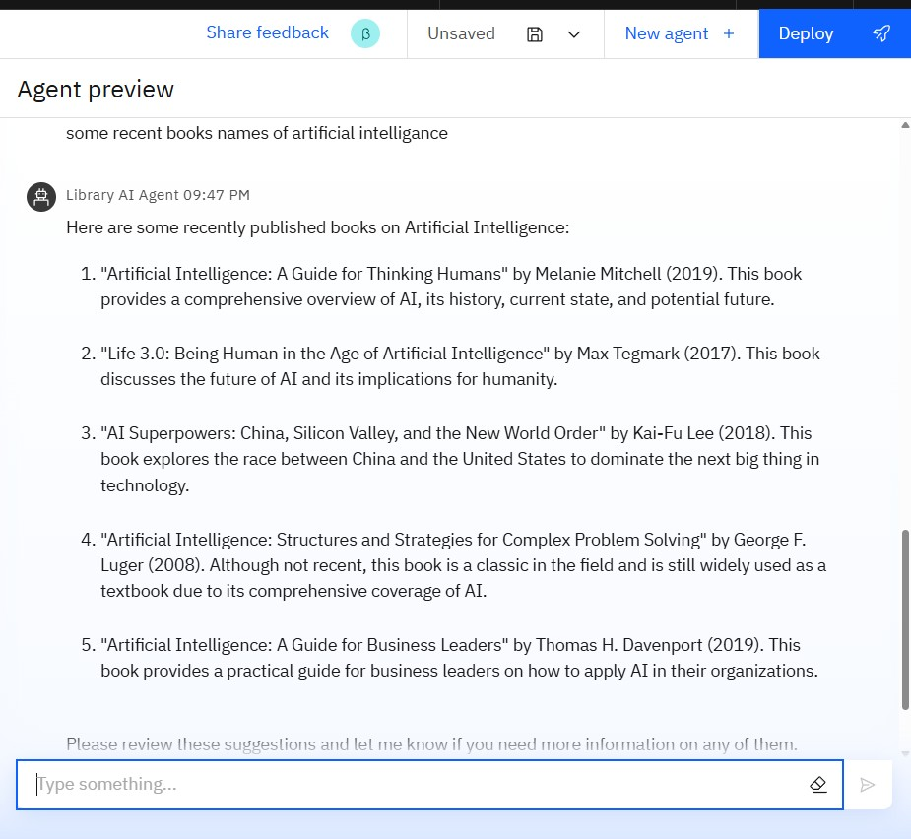
Results

Slide 11
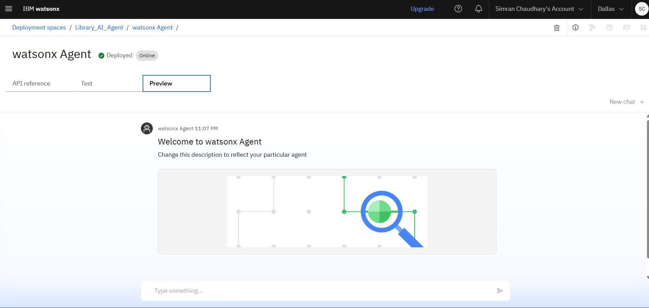
Results
Deployed AI Agent

Slide 12
Conclusion
The Library AI Agent improves the educational experience by giving students direct access to the right materials at the right time.It enhances efficiency in academic libraries, bridges the access gap, and provides intelligent, user-specific guidance.

Slide 13
GitHub Link
Make sure that there should be readme file
https://github.com/dazzlingSimmi123/Library_AI_Agentss/upload/main

Slide 14
Future scope
Integration with university LMS and digital libraries
Multilingual support for diverse users
Voice assistant integration
Analytics dashboard for librarians
Recommendations based on peer usage & reviews

Slide 15
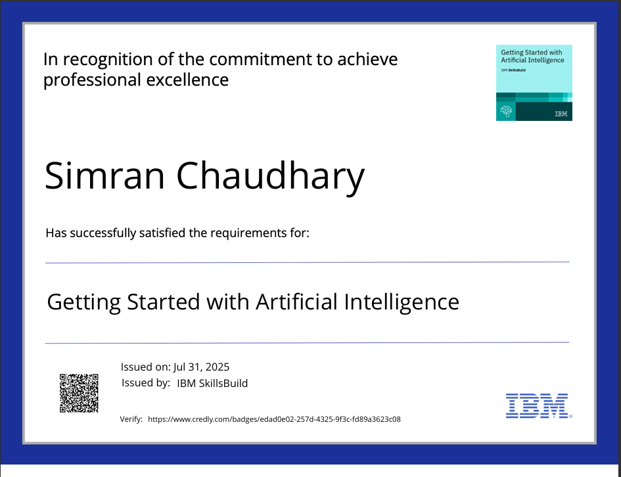
IBM Certifications

Slide 16
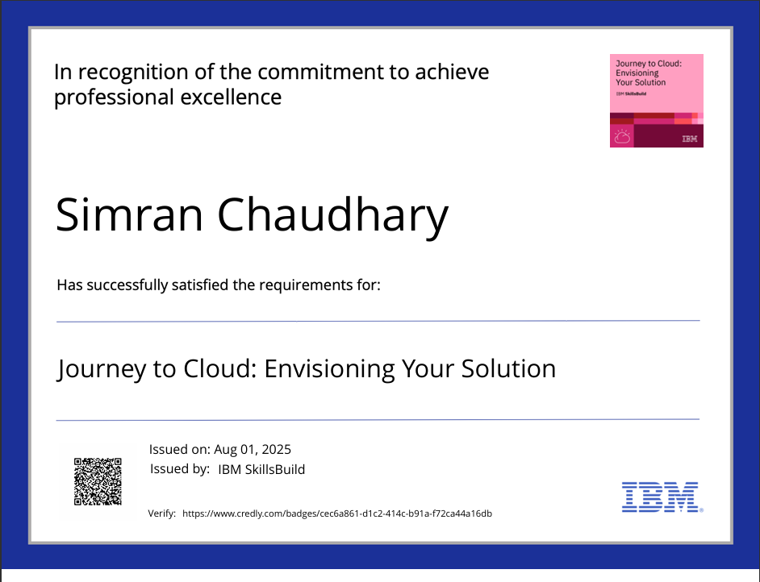

Slide 17
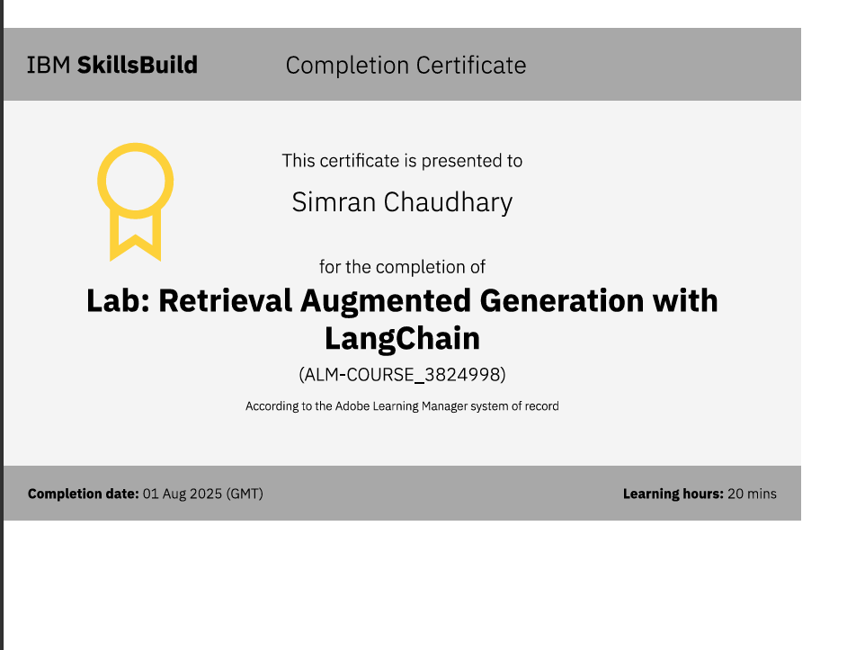
Attach your RAG LAB certificate here

Slide 18
THANK YOU

