Slide 1



AI-DRIVEN INTERACTIVE INTERVIEW SIMULATOR WITH RESUME-BASED QUESTIONING AND CODE EVALUATION
Guided By,
Mrs.S.Gayathri, M.E.,
DEEPAK MADHU KUMAR N(811721104026)
HARIHARAN (811722104048)
FADHEELUDDEEN K (811721104040)
SIVA SARAVANAN KKV (811721104307)
DD/MM/YYYY

Slide 2
ABSTRACT
Our platform uses AI to analyze resumes and generate personalized questions, simulate realistic interviews, and offer coding challenges with instant feedback. It highlights your strengths, pinpoints areas to improve, and delivers a smooth, interactive experience for confident interview prep.
DD/MM/YYYY

Slide 3
OBJECTIVE
Resume-Based Questioning : Automatically generate technical & behavioural questions based on a candidate’s skills and experience.
AI-Powered Interactive Interviewing: Conduct realistic text-based interviews with an AI-driven interviewer.
Automated Code Evaluation: Assess logic, syntax, and efficiency of the candidate’s code in real-time.
Performance Analytics: Provide detailed insights, feedback, and suggestions for improvement.
Scalability & Accessibility: Make the system available globally for job seekers to practice anytime.
DD/MM/YYYY

Slide 4
LITERATURE SURVEY
S.No. | Paper Title | Year | Remark
1 | AI-driven mock interview assessment leveraging generative language models for automated evaluation | 2025 | This study presents a valuable contribution to AI-driven educational
2 | AI-Driven Technical Interview Simulator | 2014 | It provides real-time feedback and helps candidates improve confidence
3 | AI-enhanced interview simulation in the metaverse | 2025 | This open-source metaverse platform combines LLMs and VR to simulate interviews.
DD/MM/YYYY

Slide 5
LITERATURE SURVEY
S.No. | Paper Title | Year | Remark
4 | AI Interviewer Chatbot for Technical and HR Brilliance | 2019 | The chatbot conducts mock interviews and provides real-time feedback for improvement.
5 | AI Based Interview Simulation for Smart Hiring | 2024 | An NLP and ML-based system that evaluates candidates objectively during interviews.
6 | AI Interview Simulator and Course Generator | 2025 | Uses AI, CV, and deep learning for both interview simulation and educational feedback.
DD/MM/YYYY

Slide 6
LITERATURE SURVEY
S.No. | Paper Title | Year | Remark
7 | An AI Driven Mock Interview Platform | 2024 | Provides real-time analysis of body language, tone, and communication via AI.
8 | AI-Driven Technical Interview Simulator | 2023 | This updated version evaluates verbalresponses.
9 | AI Mock Interview | 2023 | Simulates realistic interviews using LLMs and speech analysis for instant feedback.
DD/MM/YYYY

Slide 7
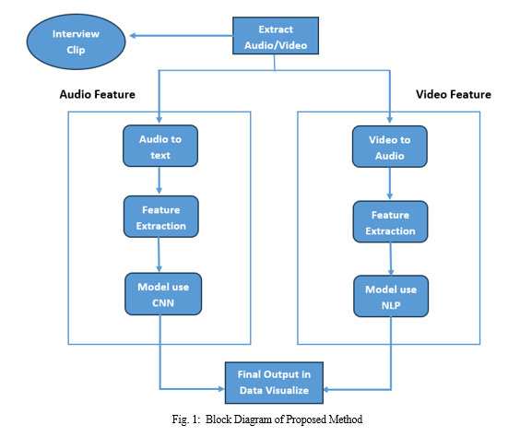
EXISTING SYSTEM
DD/MM/YYYY

Slide 8
PROPOSED SYSTEM
Resume Parser: Extracts skills, education, and experience.
AI Question Generator: Creates customized interview questions.
AI Interview Bot: Conducts real-time interviews.
Code Evaluation Engine: Assesses coding responses automatically.
Performance Analytics Module: Provides feedback & improvement suggestions.
DD/MM/YYYY

Slide 9
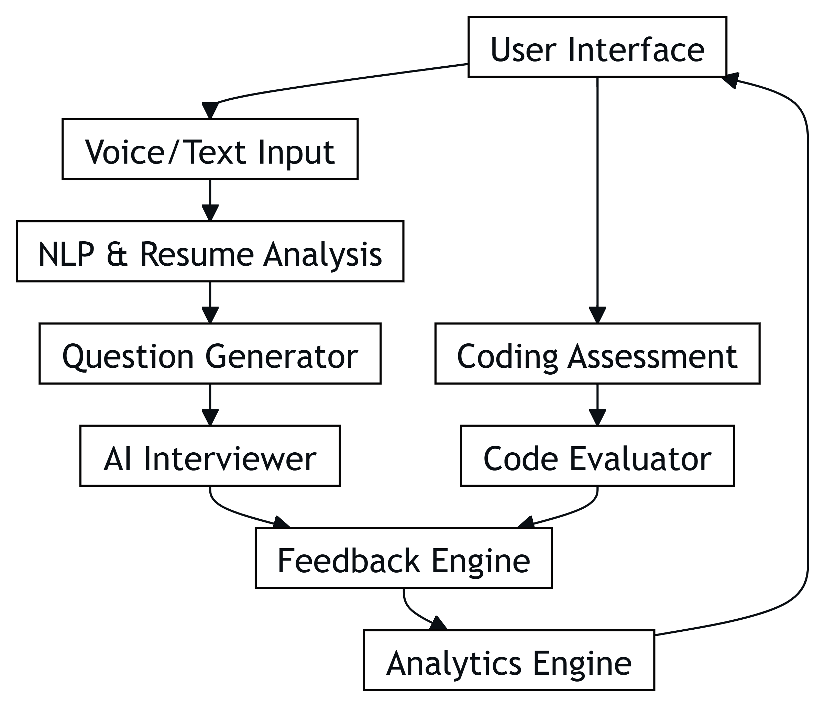
SYSTEM ARCHITECTURE
DD/MM/YYYY

Slide 10
MODULE 1 : RESUME PARSER MODULE
Generates customized interview questions based on candidate expertise and job role. By analyzing the extracted data, it ensures relevant and targeted questioning, improving the accuracy of interview assessments.
Extracts key details such as skills, work experience, education, and certifications. It efficiently processes various resume formats like PDF.
DD/MM/YYYY

Slide 11
MODULE 2 : AI-BASED QUESTION GENERATOR
Dynamically generates interview questions by analysing the candidate’s resume, skills, and job role. It ensures personalized and role-specific questioning using Machine Learning (ML).
Adjusts question difficulty based on the candidate’s responses and experience level. The AI continuously learns from interactions to create adaptive and intelligent interview scenarios.
DD/MM/YYYY

Slide 12
MODULE 3 : CODE EVALUATION MODULE
Automatically assesses coding solutions by evaluating syntax, logic, efficiency, and correctness. It uses code execution engines like Postsql to run test cases in real-time.
Provides instant feedback and scoring based on execution time, memory usage, and edge case handling. The AI also suggests optimizations and improvements to enhance coding proficiency.
DD/MM/YYYY

Slide 13
MODULE 4 : PERFORMANCE ANALYTICS & FEEDBACK
Generates detailed reports on candidate performance by analysing interview responses, coding accuracy, and behavioural traits. It provides AI-driven insights to highlight strengths and weaknesses.
Offers personalized improvement suggestions based on resume analysis, coding efficiency, and communication skills. Candidates receive actionable feedback to enhance their technical and soft skills.
DD/MM/YYYY

Slide 14
MODULE 5 : User Interface
.
DD/MM/YYYY

Slide 15
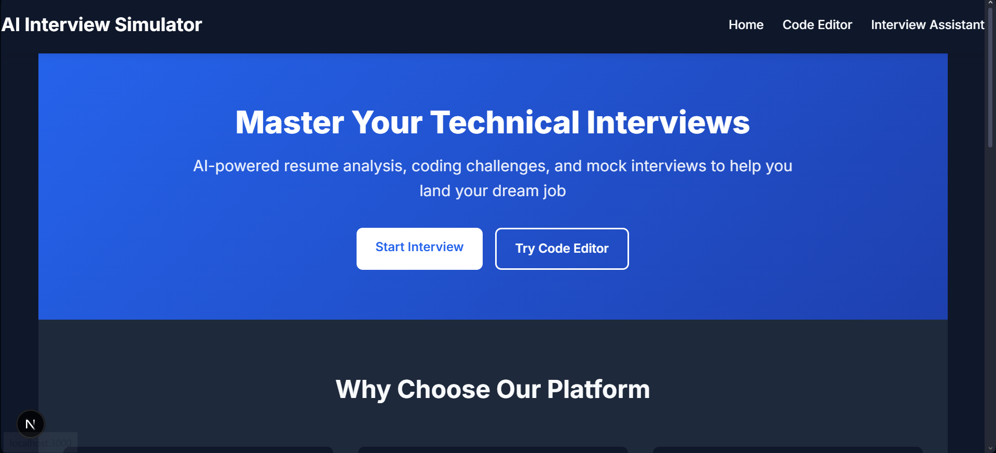
OUTPUT
DD/MM/YYYY

Slide 16
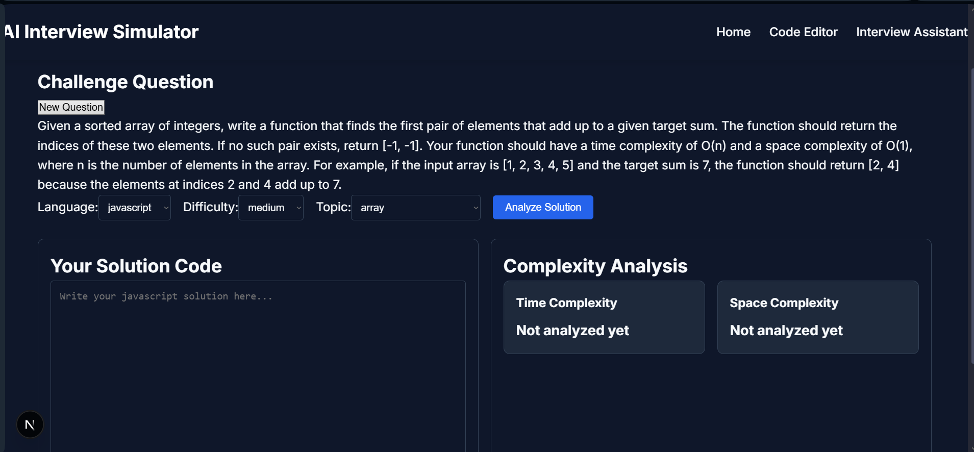
OUTPUT
DD/MM/YYYY

Slide 17
CONCLUSION & FUTURE ENHANCEMENT
Advanced Voice Recognition: Improve speech-to-text accuracy and natural language understanding for voice interviews.
Integration with Job Portals: Allow users to apply directly to jobs based on their performance.
Adaptive Questioning: Implement AI that adjusts difficulty based on real-time candidate responses.
Gamification: Introduce badges, leaderboards, and rewards to boost engagement.
Mobile App Version: Expand accessibility through a cross-platform mobile application.
DD/MM/YYYY

Slide 18
REFERENCES
Next.js Documentation Next.js – The React Framework for the Web. Retrieved from https://nextjs.org/docs
React Documentation Meta. (n.d.). React – A JavaScript Library for Building User Interfaces. Retrieved from https://reactjs.org/docs/getting-started.html
OpenAI API Documentation OpenAI. (n.d.). OpenAI API Reference. Retrieved from https://platform.openai.com/docs
MDN Web Docs Mozilla. (n.d.). MDN Web Docs – Resources for Developers, by Developers. Retrieved from https://developer.mozilla.org
DD/MM/YYYY

Slide 19

DD/MM/YYYY

